Slide 1
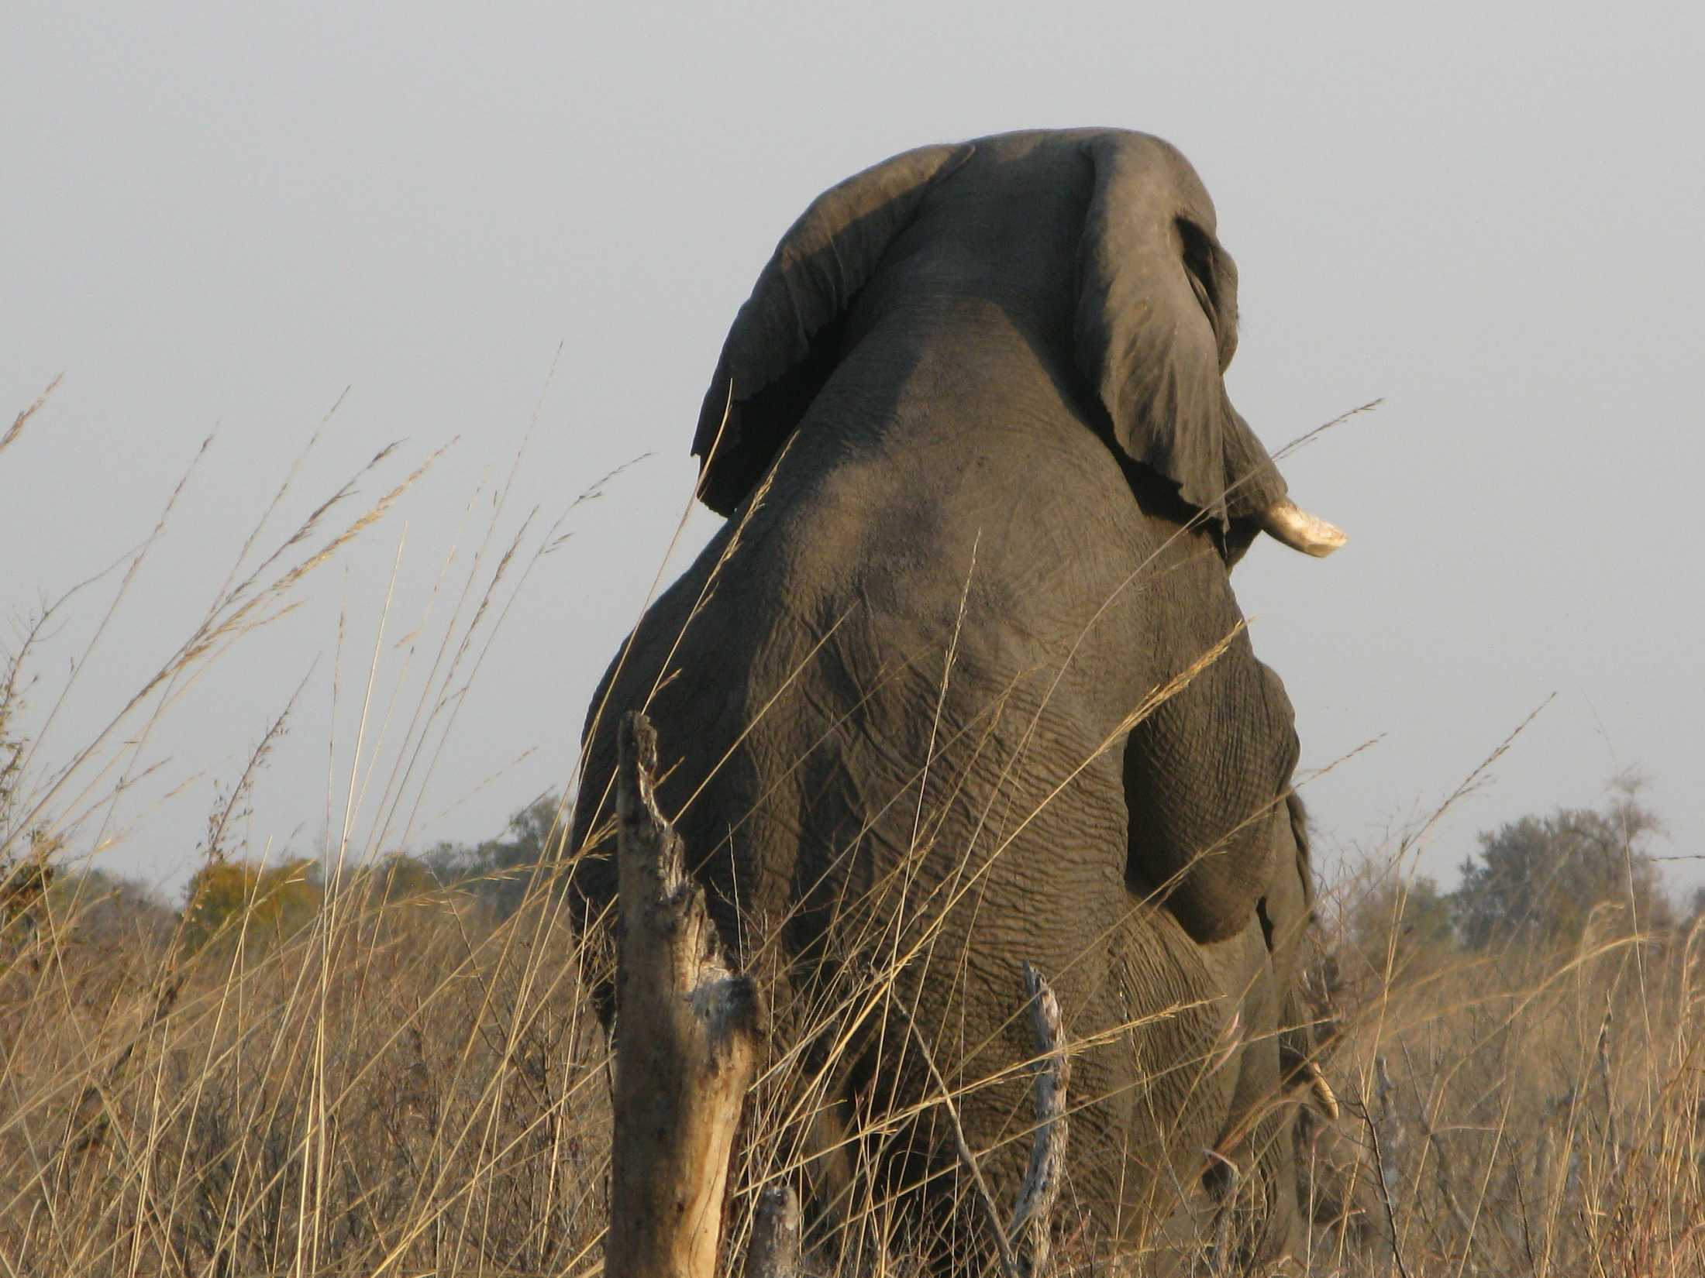
Moderate
GOP
Sissy
Tea Party Stud
Hwange National Park
August 2009

