Slide 1
2025 Legislative Session Insurance Update
H. French Brown, IV
Jones Walker

Slide 2
PCS HB 947 – Civil Actions
Requires a court to award prevailing party attorney fees in specified insurance lawsuits and provides that, where such fees are awardable, the offer of judgment statute does not apply (HB 1551);
Amends s. 376.308, F.S., and creates a defense from strict liability for lawsuits brought under the Water Quality Assurance Act if the lawsuit is related to pollution caused by a former phosphate mine and certain requirements are met;
Amends s. 768.0427, F.S., clarifying certain types of evidence that shall be admissible to calculate medical damages in a personal injury or wrongful death action. The PCS allows parties to present certain evidence related to what the plaintiff’s private health insurance would be obligated to pay for past unpaid or future medical damages, the reasonable and customary rates for such rendered or future medical services, and other evidence.
https://www.flhouse.gov/Sections/Documents/loaddoc.aspx?PublicationType=Committees&CommitteeId=3298&Session=2025&DocumentType=Proposed%20Committee%20Substitutes%20(PCSs)&FileName=PCS%20for%20CSHB%20947.pdf
https://www.flhouse.gov/Sections/Documents/loaddoc.aspx?PublicationType=Committees&CommitteeId=3298&Session=2025&DocumentType=Proposed%20Committee%20Substitute%20Amendments&FileName=PCS%20for%20CSHB%20947%20a1.pdf

Slide 3
PCS HB 947 – Civil Actions

Slide 4
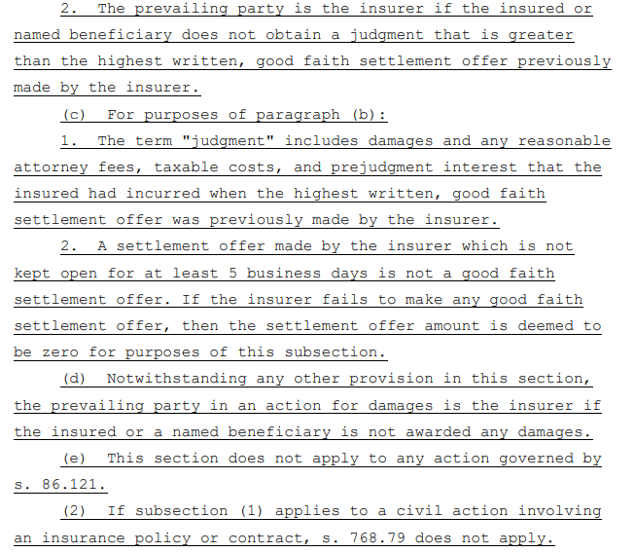
PCS HB 947 – Civil Actions

Slide 5
SB 1520 / SB 426

Slide 6
HB 1097 & SB 114 Insurance Research
Creates the Florida Center for Excellence in Insurance and Risk Management at the Florida State University College of Business, Department of Risk Management.
The Center will conduct research into all lines of insurance offered in Florida and catastrophic risk management generally, with a focus on property insurance issues.
Purpose:
Develop, conduct, evaluate, promote, and disseminate accurate and timely research on issues related to the state’s insurance market and risk management.
Assist the Legislature in developing and evaluating evidence-based policy options and making recommendations related to insurance and risk management in this state.
Identify emerging issues in the insurance market.
Provide insight regarding the accessibility and affordability of insurance products.
Assist in identifying and developing education and research grant funding opportunities among higher education institutions in this state and the private sector.

Slide 7
SB 1076 & HB 715 Roofing Services
Expands the scope of work for licensed roofing contractors to include evaluation and enhancement of roof-to-wall connections for structures with wood roof decking provided that any enhancement was properly installed and inspected in accordance with certain requirements.
The bill provides that a resident may cancel a roofing contract without penalty within 180 days of an event causing a state of emergency. The option to cancel a roofing contract entered into because of a state of emergency only applies to owners whose property is in the geographic area covered by the state of emergency.

Slide 8
https://www.flsenate.gov/ https://www.flhouse.gov/

Slide 9
Questions?
H. French Brown, IV
Partner
Jones Walker
fbrown@joneswalker.com
850.459.0992

