Slide 1


F. Hale Stewart, JD. LL.M.
The Law Office of Hale Stewart
Co-Author of U.S. Captive Insurance Law
www.uscaptiveinsurancelaw.com
www.halestewartlaw.com
Halestewart@halestewartlaw.com
832.330.4101
Alexis Campestre
Captive Consulting Group, LLC, President
Retirement Planning & Wealth Management, LLC Wealth Advisor/Financial Planner
www.rpwmadvisors.com
Alexis.campestre@rpwmadvisors.com
979-285-0023

Slide 2
An introduction to Captive Insurance

Slide 3
Outline
What is Insurance?
What is an Insurance Company?
How Did We Get Here? Or, A Brief History of Captive Insurance
A Brief Case Law History of the IRS’ unsuccessful attempt to challenge captives
The Road to 831(b)
Forming, Running and Shutting Down the Captive

Slide 4
What is Insurance?

Slide 5
What is Insurance?
A Definite Risk
We must be able to clearly define a “triggering event” – a specific occurrence that allows the insured to file a claim
Fortuity
The possibility of it happening must be so random that we can’t prepare for its eventuality
An Insurable Interest
The person buying the policy must be hurt if the triggering event occurs
Risk Shifting
If the event happens to party A, the risk of loss is shifted to party B.
Risk Distribution
Every insurance company must be a pool of risk

Slide 6
Risk Shifting
There must be a valid contract between the insured and the insurer
Contract formation elements Must be Met
Offer
Acceptance
Consideration
Detriment

Slide 7
Risk Distribution
What is a reserve?
An insurance company can’t be a reserve; instead it must pool risk from a variety of companies to achieve “risk distribution.”

Slide 8
Risk Distribution Model 1: The Fronting Model
Insured 1
Insured 1 CIC
Insured 2
Insured 2 CIC
Fronting Carrier
Insured 3
Insured 3 CIC
Insured 4
Insured 4 CIC
Each insured pays its premium to the fronting carrier. The carrier pools the funds, creating risk distribution. The fronting carrier typically holds the funds for a certain amount of time, usually up to 18 months. Then, the carrier sends the premiums to each individual insured’s captive

Slide 9
Risk Distribution Model 2: the Retrocessional Model
Clearing Account
Captive 1
Captive 2
Captive 3
Captive 4
Captive 5
Captive 6
Here, the insureds pay a specific amount of their premium into a central account, which pools the premium. The account then cedes premium out to the other captives. Each captive signs a retrocessional reinsurance agreement with the pool to cover claims.

Slide 10
Outline
What is Insurance?
What is an Insurance Company?
How Did We Get Here? Or, A Brief History of Captive Insurance
A Brief Case Law History of the IRS’ unsuccessful attempt to challenge captives
The Road to 831(b)
Forming, Running and Shutting Down the Captive

Slide 11
From the Regulations
The term insurance company means a company whose primary and predominant business activity during the taxable year is the issuing of insurance or annuity contracts or the reinsuring of risks underwritten by insurance companies. Thus, though its name, charter powers, and subjection to State insurance laws are significant in determining the business which a company is authorized and intends to carry on, it is the character of the business actually done in the taxable year which determines whether a company is taxable as an insurance company under the Internal Revenue Code.
There are 4 key points
Primary: “first in order of time or development” (Merriam-Webster)
Predominant: “more important, powerful, successful, or noticeable than other people or things” (Merriam-Webster)
The name, charter powers, and subjection to State insurance laws are significant
“it is the character of the business actually done in the taxable year:” how did the business make its money?
26 CFR 1.801-3 Definitions. (Code of Federal Regulations (2016 Edition))

Slide 12
The Harper Test
Whether the arrangement involves the existence of an “insurance risk”;
Whether there was both risk-shifting and risk- distribution; and
Whether the arrangement was for “insurance” in its commonly accepted sense.
Harper Grp. & Includible Subsidiaries v. Comm'r of Internal Revenue, 96 T.C. 45, 96 T.C. No. 4 (U.S.T.C., 1991)

Slide 13
What is an Insurance Company?
Rampart
was both organized and operated as an insurance company.
It was regulated by the Insurance Registry of Hong Kong.
The adequacy of Rampart's capitalization is not in dispute.
The premiums charged by Rampart to its affiliates, as well as to its shippers, were the result of arm's-length transactions.
The policies issued by Rampart were valid and binding.
In sum, such policies were insurance policies, and the arrangements between the Harper domestic subsidiaries and Rampart constituted insurance, in the commonly accepted sense.
Harper Grp. & Includible Subsidiaries v. Comm'r of Internal Revenue, 96 T.C. 45, 96 T.C. No. 4 (U.S.T.C., 1991)

Slide 14
What is An Insurance Company?
Eastland
was both organized and operated as a valid insurance company and was not a sham corporation.
It was regulated by the authorities of Bermuda, and
its capitalization was adequate under Bermuda law.
The insurance agreements between Malone & Hyde and Northwestern and the reinsurance agreements between Northwestern and Eastland were the result of arm's-length negotiations and
were properly evidenced by written policies and endorsements.
The reinsurance policies issued by Eastland were valid and binding.
Eastland operated as a separate and viable entity, financially capable of meeting its obligations.
(Malone & Hyde, Inc. v. Commissioner, 66 T.C.M. 1551 (U.S.T.C., 1993)

Slide 15
Outline
What is Insurance?
What is an Insurance Company?
How Did We Get Here? Or, A Brief History of Captive Insurance
A Brief Case Law History of the IRS’ unsuccessful attempt to challenge captives
The Road to 831(b)
Forming, Running and Shutting Down the Captive

Slide 16
A Brief History of Insurance Coverage
These cases were very expensive leading to some bankruptcies and major payouts.
Starting in the late 1970s, the insurance industry started to greatly limit their actual exposure, slowly eliminating expensive insurance coverage.
Starting in the 1950s, certain businesses either couldn’t find insurance, or could only find very expensive insurance.
Flood Plain Cases
Oil and Gas (Mobil Oil, Offshore)
Large Contractors (Stearns Rogers)
Hospitals (Humana)
In the 1970s, the US insurance industry was sued under four causes of action
Asbestos
Professional Liability (Med Mal)
Environmental Claims
Products Liability

Slide 17
Outline
What is Insurance?
What is an Insurance Company?
How Did We Get Here? Or, A Brief History of Captive Insurance
A Brief Case Law History of the IRS’ unsuccessful attempt to challenge captives
The Road to 831(b)
Forming, Running and Shutting Down the Captive

Slide 18
The Two Earliest Cases Foreshadow the Path the Future Litigation Would Take
The Flood Plain Cases:
Consumers Oil: a New Jersey oil company formed a trust that had no other insureds
Weber Paper: a group of Kansas and Missouri Businesses formed a single captive

Slide 19
The Captive Insurance Story Arc
The IRS won the first 5 captive cases: Carnation, Clougherty, Beech Aircraft, Stearns Rogers and Mobil. Why?
Three of these parent companies (Carnation, Clougherty and Beech) had insufficient risk distribution, insuring only the parent company
The other two were caught up
The IRS was far better prepared
The taxpayers weren’t well prepared
The law didn’t have a definition of insurance company.

Slide 20
The First Big IRS Loss: Crawford
Crawford was a national company divided into three different subdivision:
The first set was Crawford, Nupro, Whitey and Cajon, all of which manufactured “valves and fittings … used in numerous applications.”
The second set of companies was the regional warehouses that purchased the manufacturers’ products. The warehouses were broken down regionally, with one warehouse each for the eastern, southern, central and western U.S.
Each of these warehouses sold to a group of independent and exclusive Crawford distributors.
Each of these companies purchased insurance from the captive, creating sufficient risk distribution.

Slide 21
Humana
This was the captive insurance litigation turning point for the taxpayer.
Representation was far more sophisticated
The Human captive solid insurance to Humana’s parent company and each Humana subsidiary
The court ruled that insurance purchased by each subsidiary was insurance

Slide 22
The IRS Losses (Post-Humana)
Sears
UPS
Harper
Amerco
Kidde
Malone and Hide

Slide 23
Safe Harbors
Revenue Ruling 2002-89: at least 50% of the captive’s revenue and risk must come from 3rd party risk
Harper lowers this amount to 30%
Revenue Ruling 2002-90: if there are at least 12 subsidiaries, and no 1 subsidiary accounts for less than 5% nor more than 15% of the captives risk and revenue, there is sufficient risk distribution.

Slide 24
Outline
What is Insurance?
What is an Insurance Company?
How Did We Get Here? Or, A Brief History of Captive Insurance
A Brief Case Law History of the IRS’ unsuccessful attempt to challenge captives
The Road to 831(b)
Forming, Running and Shutting Down the Captive

Slide 25
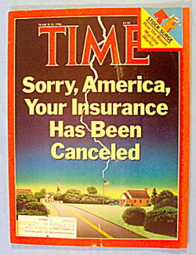
The Insurance Crisis of the 1980s

Slide 26
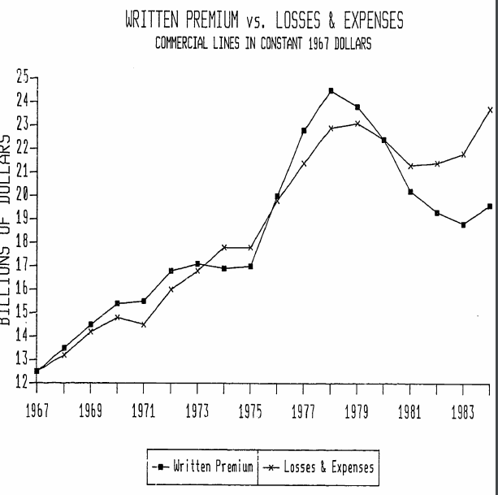
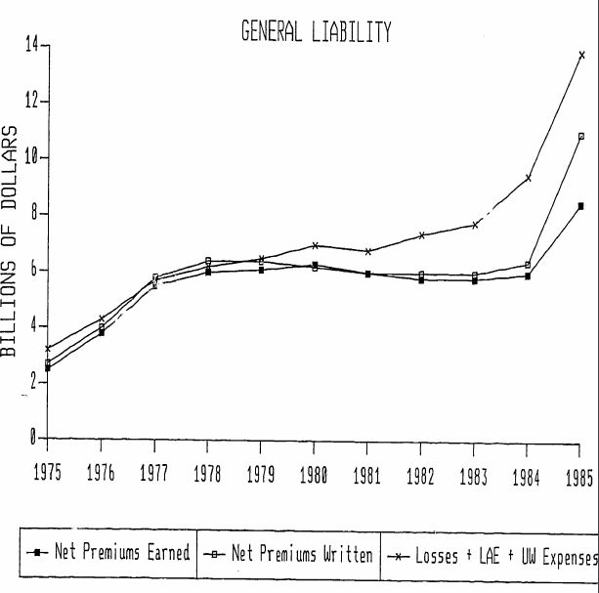
The Insurance Crisis of the 1980s
Report of the Tort Policy Working Group on the Causes, Extent and Policy Implications of the Current Crisis in Insurance Availability and Affordability DOJ, 2/86

Slide 27
831(b) Part 1
(1) In general
In lieu of the tax otherwise applicable under subsection (a), there is hereby imposed for each taxable year on the income of every insurance company to which this subsection applies a tax computed by multiplying the taxable investment income of such company for such taxable year by the rates provided in section 11(b).
(2) Companies to which this subsection applies
(A) In general This subsection shall apply to every insurance company other than life (including interinsurers and reciprocal underwriters) if—
(i) the net written premiums (or, if greater, direct written premiums) for the taxable year do not exceed $2,200,000, and
(ii) such company elects the application of this subsection for such taxable year.
The election under clause (ii) shall apply to the taxable year for which made and for all subsequent taxable years for which the requirements of clause (i) are met. Such an election, once made, may be revoked only with the consent of the Secretary.

Slide 28
831(b), Part 2; the Mirror Image Rule
EITHER:
OR:
The captive gets no more than 20% of its risk and revenue from a single source,
Family members must hold the same percentage of the captive that they do of the parent company. This includes direct and indirect ownership.

Slide 29
Where Should We Form It?
Offshore
Generally seen as a more relaxed regulatory environment
Most offshore captives make the 953(d) election (to be treated as an onshore company)
Onshore
Over 30 U.S. Jurisdictions have captive enabling legislation

Slide 30
Which U.S. Jurisdiction?
There’s a large amount of statutory overlap between the jurisdictions.
What you need to look for are the following:
How long has a jurisdiction been licensing captives?
What is the industry depth?
How many service providers are there?
Is there a professional trade group?
Is this a jurisdiction you want to visit?
How long has the manager been in that state?

Slide 31
What Policies Does a Captive Write?
CGL Exclusions
Property Exclusions
Employment Claims
Employee Fidelity (employee theft)
Cyber-Risk
Products Liability
Products Recall
Loss of key contract/loss of key person
Pollution
Mold Remediation
Flooding
Windstorm Deductible

Slide 32
Other Captive Coverages Include:
Statutory Change
Administrative Actions
Legal Liability
Accounts Receivable Coverage

Slide 33
What Are the Steps to Forming a Captive?
The jurisdiction where the captive is being formed must determine if forming the captive is in the jurisdiction’s best interest. To do that, they will consider:
The character, reputation, financial standing and purposes of the incorporators;
The character, reputation, financial responsibility, insurance experience and business qualifications of the officers and directors; and
Such other aspects as the commissioner shall deem advisable.

Slide 34
What Are the Steps in Forming a Captive (con’t)
Next, the applicant must make a formal application to open an insurance company. The application must typically contain the following information
The amount and description of its assets relative to the risks to be assumed;
The adequacy of the expertise, experience, and character of the person or persons who will manage it;
The overall soundness of its plan of operation;
The adequacy of the loss-prevention programs of its parent, member organizations, or industrial insureds, as applicable; and
Other factors considered relevant by the commissioner in ascertaining whether the proposed captive insurance company will be able to meet its policy obligations
Finally, there is the issue of original capital and surplus.

Slide 35
Running the Captive
Domicile manager
Legal counsel
Audit
Actuarial Services
Investment manager

Slide 36
Reporting Requirement
Every year, the captive must file an annual report with the state’s Department of Insurance. This document includes:
Audited financial statements
A statement of actuarial opinion regarding the captive’s reserves
A list of all claims paid
The captive must also file the following information with the IRS:
A list of all loans made between the captive and parent
A list of all claims paid
All actuarial information related to the policies

Slide 37
Shutting Down the Captive
In most states, one of the following seven reasons will allow a state regulator to shut down a captive:
Insolvency or impairment of capital and surplus.
Refusal or failure to submit an annual report … or any other report or statement required by law or by lawful order of the director.
Failure to comply with the provisions of its own articles of incorporation, bylaws or other organizational document.
Failure to submit to an examination or any legal obligation related to the examination.
Refusal or failure to pay the cost of an examination.
Use of methods that, although not otherwise specifically prohibited by law, render its operation hazardous or its condition unsound with respect to the public or to its policyholders.
Failure otherwise to comply with the captive statute.

Slide 38
Disclosures
This material is for general information only and is not intended to provide specific advice or recommendations for any individual. To determine what is appropriate for you, consult a qualified professional. CWM, LLC is not a law firm and does not provide tax or legal advice. Investors should consult with a tax or legal advisor before making any investment decision.
No strategy assures success or protects against loss.
Investment advisory services offered through CWM, LLC, an SEC Registered Investment Advisor. Carson Group Partners, a division of CWM, LLC, is a nationwide partnership of advisors.
This content cannot be copied without express written consent of CWM, LLC. Wealth Designed. Life Defined.® is a registered trademark of CWM, LLC and may not be duplicated.

Slide 39
What Are the Steps to Forming a Captive?
After a company decides to form a captive, the next step is to perform a feasibility study, which has three objectives.
It provides a blueprint for the entire captive program.
Second, it aids in compliance.
Third, the study can aid in selling important decision-makers within the organization on the plan.

Slide 40
Outline
What is Insurance?
What is an Insurance Company?
How Did We Get Here? Or, A Brief History of Captive Insurance
A Brief Case Law History of the IRS’ unsuccessful attempt to challenge captives
The Road to 831(b)
Forming, Running and Shutting Down the Captive

