Slide 1
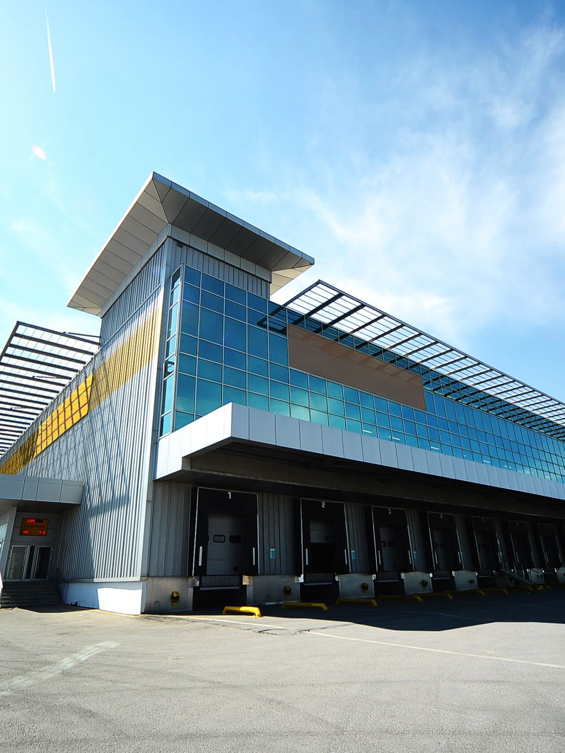
Property Insurance Issues in Lease Agreements
Charles E. Comiskey
CPCU, CIC, CPIA, CRM, PWCA, CRIS, CCM, CMIP
April 23, 2021

Slide 2
Hard Market Conditions
Causes
Combined loss ratios are up, many exceeding 100%
Return on equity is down
Sustained and significant rate increases
Increased reinsurance costs
Diminished capacity (within and overall)
Effects
Conservative underwriting
Stringent coverage restrictions
New exclusions
Increased deductibles/retentions
Growing attention on alternative risk financing

Slide 3
Hard Market Specifics
Most recent quarter was 14th consecutive with increased prices (The Council of Insurance Agents and Brokers).
Umbrella/excess recorded the highest premium increase.
Followed by D&O, Professional Liability, Property, Auto, EPLI, GL – in that order
Insureds incur increased administrative burden as carriers demand far more information than usual.

Slide 4
Drivers of Current Hard Market Conditions
Most storm events have been small-medium, meaning more loss absorbed by primary carriers as opposed to reinsurers.
Global natural catastrophes $76B in 2020, up 40% from 2019.
Through Q3 2020 insurance industry’s net underwriting gains fell from $5.4B in 2019 to $300M (Verisk Analytics).
Winter Storm Uri expected to cost at least $18-20B (Insurance Council of Texas).
Insurance issues have global reach – same reinsurers.

Slide 5
Property Insurance Industry Issues
Rate increases have been steep – even for “best in class”
More property going into E&S (non-admitted) market due to vacancies – at all time high.
Freedom of rate and form
Deductibles/retentions
Adding “convective storm” (especially Texas, Oklahoma and Colorado)
Adding separate water damage deductible (faulty construction issues)
Adding sublimits in certain locations
Civil riot and commotion

Slide 6
Property Insurance Industry Issues
Focus on valuation adequacy.
Increasing reconstruction costs – wood, steel & labor.
Restrictions/moratoriums
Habitational
Type of property
Locations
Scheduled limits and margin clauses are more commonly applied.
COVID-related vacancies – vacancy clauses.

Slide 7
Property Actions to Take
Complete a risk assessment.
Consider a third-party engineering report. This may be necessary to fill capacity with as few carriers as possible. Cost goes up dramatically when syndication of small portions of capacity is required.
Put proactive, scheduled regular maintenance plan in place and document it.
Carriers are adverse to properties that use their coverage as a maintenance plan.
Have a water damage mitigation plan in place and document it.
Include both fire protection and domestic water systems. Identify and map shut-off values. Consider leak detection devices.

Slide 8
Property Actions to Take
Update building systems.
Know their life expectancy & plan accordingly. Keep accurate replacement and maintenance records. Research retrofit options ahead of equipment failure.
Have an accurate valuation.
Underwriters are more likely than ever to pass on quoting when a schedule of properties are undervalued.
Be prepared to tell your story and document it. Prove that you are Best in Class and act early!

Slide 9
Property Actions to Take
Speak early with Mortgage Company.
Important to understand flexibility, if any.
Coverage changes
Deductible minimums
Catastrophe limits
Permits greater range of potential insurance companies to work with.
Don’t wait until insurance program is renewing.

Slide 10
Insurance Lease Issues
“Clients typically disfavor overly detailed insurance provisions, preferring instead to coordinate with their insurance agents and/or risk management departments in order to police the actual insurance coverages and endorsement forms used.”
Coverage is provided “Where Required By Written Contract”
Recent N.Y. Federal District Court decision functioned to incorporate the contract into the policy and Upstream Party could not enjoy greater insurance than what was agreed in the contract.
Precision is paramount.
Lack of care in any respect is only likely to invite questions over the parties’ true goals, debate over ambiguity, and potentially lead to uncertainty of result.

Slide 11
Tenant’s Insurance
“Tenant’s casualty insurance shall be maintained against all hazards covered by fire and extended coverage”.
Casualty insurance = liability insurance, not property insurance.
“Extended Coverage” is named peril and means:
“windstorm, hail, explosion (except steam boilers), riot, civil commotion, aircraft, vehicles, and smoke”;
Ceased to be used in the insurance industry in 1986; and
Does not include water damage (e.g., winter storm Uri)
ISO Causes of Loss Forms
Basic
Broad
Special

Slide 12
ISO Special Causes of Loss Does Not Provide All-Risk Coverage
Earth Movement
Earth movement includes earthquake, landslide, mine subsidence, earth sinking (other than sinkhole collapse), and volcanic eruption, explosion or effusion.
Equipment Breakdown
Sudden and accidental, mechanical or electrical
Flood
Terrorism
Volcanic Action
and more

Slide 13
Tenant’s Improvements and Betterments (“I&B”) Requirement
“All Tenant Improvements, regardless of which party constructed or paid for them, shall become the property of Landlord and shall remain upon and be surrendered with the Premises upon the expiration or earlier termination of this Lease …”
Tenant owns that property until Lease expiration.
Does “expiration” include lease extensions? See definition of “Lease Term” on page 2 which makes no reference to extensions.
How to insure TI?

Slide 14
Coverage for Tenant-Owned I&B
Building and Personal Property Coverage Form (CP 00 10 10 12) defines Business Personal Property as including:
Your use interest as tenant in improvements and betterments. Improvements and betterments are fixtures, alterations, installations or additions:
Made a part of the building or structure you occupy but do not own; and
You acquired or made at your expense but cannot legally remove.

Slide 15
Use Interest as Tenant in Improvements and Betterments
Who owns the I&B?
Are they part of the building the Tenant occupies but does not own?
Were they acquired or made at the Tenant’s expense but cannot be legally removed?
Can Tenant be required to insure both standard and above-standard improvements if Tenant paid for only above-standard improvements?
Can Tenant be required to insure I&B made by a previous occupant but now being used by Tenant?

Slide 16
New Endorsements for Tenant I&B
Leases often require commercial tenants to insure or be responsible for certain building property, such as HVAC equipment, building fixtures, permanently installed machinery or equipment, and building glass.
Scheduled Building Property Tenant’s Property CP 14 01 09 17 – modifies the tenant’s policy to allow them to include certain landlord-owned building property as insured property, provide the property is specifically scheduled.
Unscheduled Building Property Tenant’s Property CP 14 02 09 17 – modifies the tenant’s policy to allow them to include certain landlord-owned building property as insured property, but unlike CP 14 01 does not require the insured to specifically schedule the property.
CP 14 01 includes building glass in the definition of building property. CP 14 02 requires a separate limit for building glass.
Not that adding either of these forms still does not provide coverage for equipment breakdown.

Slide 17
New Endorsements for Tenant I&B
Ordinance or Law Coverage for Tenant’s Interest in Improvements and Betterments (Tenant’s Policy) CP 04 26 09 17 – similar to ordinance or law endorsement CP 04 05, this covers Tenants I&B when damaged by a covered cause of loss and undamaged portion must be demolished, repaired and/or reconstructed in accordance with current codes.

Slide 18
Valuation of Improvements and Betterments
7. We will determine the value of Covered Property in the event of loss or damage as follows:
e. Tenants’ Improvements and Betterments
A proportion of your original cost if you do not make repairs promptly. We will determine the proportionate value as follows:
Multiply the original cost by the number of days from the loss or damage to the expiration of the lease; and
Divide the amount determined in (a) above by the number of days from the installation of improvements and betterments to the expiration of the lease.
If your lease contains a renewal option, the expiration of the renewal options period will replace the expiration of the lease in this procedure.

Slide 19
Utilities
“Tenant shall not install any supplemental HVAC, space heaters or other utilities in the Premises without Landlord’s prior written consent. In the event that Landlord consents to such installation, Tenant shall be responsible for the installation, maintenance and repair of the Equipment. Tenant agrees that it will maintain and repair such Equipment in first class condition. Tenant shall enter into a regularly schedule preventative maintenance contract.”
Maintain & repair does not mean replacement.
Tenant’s standard property insurance does not cover such equipment for breakdown.

Slide 20
Equipment Breakdown Exclusion
Causes of Loss – Special Form CP 10 30 10 12
We will not pay for loss or damage caused directly or indirectly by:
Artificially generated electrical, magnetic or electromagnetic energy; or
Mechanical breakdown, including rupture or bursting caused by centrifugal force;
Explosion of steam boilers, steam pipes, steam engines or steam turbines
Procurement of Equipment Breakdown (a/k/a boiler and machinery) coverage should be required when such exposures exist.

Slide 21
Tenant Improvements
Recommended:
Tenant is to maintain property insurance on a Causes of Loss-Special Form. This insurance is to be issued for 100% Replacement Cost, on an Agreed Value Basis, and in compliance with all laws, regulations or ordinances affecting such property at any time during the Lease, for the Tenant’s improvements and betterments, including all the items including in Tenant’s Work, and all equipment and other property used in connection therewith, including Tenant’s business personal property, HVAC system supporting the Leased Premises, trade fixtures and signs from time to time in, on adjacent to or upon the Leased Premises, and all alterations, additions, or changes made by or for Tenant pursuant to the terms of this Lease, and shall not be subject to coinsurance.

Slide 22
Tenant Improvements
Recommended:
If the leased premises provide electrical, HVAC, boiler or similar equipment dedicated exclusively to that premises Tenant is to maintain equipment breakdown insurance to be issued on a Comprehensive Form, including Business Income and Extra Expense. If not provided by the same insurance company as the property insurance, a Joint Loss Agreement shall be included. This insurance is to be issued on a Replacement Cost, Agreed Value basis.

Slide 23
Tenant’s Business Income lnsurance
“Business interruption insurance shall be maintained in an amount sufficient to insure payment of Rent for a period of not less than six months.”
“Business interruption in an amount sufficient to cover costs, damages, lost income expense, Base Rent, Additional Rent and all other sums payable under this lease for period of up to 12 months.”
Business Income = Net Income (before taxes) and continuing normal operating expenses.
Coinsurance issue
Add: Landlord shall be named as an additional insured on ISO CP 15 03 06 07.
By not abating, Landlord has given

Slide 24
Landlord’s Business Income Insurance
“If the damage is caused by Tenant’s negligence, rent shall not be abated.”
Landlord has lost its right to make claim against its own Loss of Rents coverage.
Landlord is left with only a breach of contract claim against Tenant.

Slide 25
Tenant’s Business Income
Recommended:
Tenant is to maintain business income and extra expense insurance on a Causes of Loss-Special Form covering all operations at the Leased Premises. Coverage is to be provided in an amount of not less than 80% of Tenant’s gross annual income at the Leased Premises less non-continuing expenses and shall be on an Agreed Value basis.

Slide 26
Maintenance and Repair by Landlord
“Landlord shall maintain the public and common areas of the Building. Landlord shall provide janitor service. All repair costs shall be including in Operating Costs to the extent permitted except for damage occasioned by the act or omission of Tenant or Tenant’s Agents which shall be paid for entirely by Tenant.”
Property insurance issue – endangers ability to make claim against Landlord’s property coverage.
This appears to conflict with most Waiver of Subrogation provisions.

Slide 27
Landlord as Loss Payee
“Property insurance shall name Landlord as loss payee for property in which Landlord has an insurable interest”.
A loss payable provision provides little protection. Claims must be paid jointly. No protection is provided to Landlord against the policy being invalidated by actions of the tenant/insured & no notice of cancellation will be provided. This form is really geared to miscellaneous machinery & equipment.

Slide 28
Landlord as Loss Payee - Alternatives
If Building is being insured by Tenant add Additional Insured – Building Owner on ISO CP 12 19 06 07
This form makes the building owner a named insured for the building only. Loss is adjusted with both the tenant and building owner ATIMA, but no protection is provided against invalidation of the policy by actions of the tenant and no notice of cancellation of cancellation will be provided to the Owner.
A Building Owner Loss Payable clause CP 12 18 establishes that a building claim will be adjusted with building owner only and an improvements & betterments claim will be adjusted with tenant, but no protection is provided to the owner against invalidation of the policy by actions of the tenant and no notice of cancellation will be provided to the owner

Slide 29
Damage or Destruction
“If the Premises are damaged by fire, earthquake or other casualty …”
Recommended: If the Premises are damaged by any cause of loss covered by ISO Causes of Loss-Special Form or flood, earth movement, terrorism, mechanical breakdown or other casualty …

Slide 30
Damage or Destruction
“If Landlord estimates that the damage can be repaired within 120 Business Days after Landlord is notified and if there are sufficient insurance proceeds available to repair such damage …”
= 5.6 months, a very short period of time.
Important reason to require Tenant to have business income coverage.
Tenant should require Landlord to insure for full replacement cost on agreed value basis.

Slide 31
Damage or Destruction
“Landlord may elect to (b) restore the Premises. If Landlord restores the Premises, then (3) Landlord shall not be required to repair or restore Tenant Improvements, Alterations and [other property] not owned by Landlord.”
Take care with regard to Tenant’s obligation to insure.
“Base rent, Additional Rent and any other sum due under this Lease during any reconstruction period shall not be abated.”
Landlord loses all right to make claim against Landlord’s own loss of rental income coverage.
Important reason to require Tenant to have proper business income coverage.

Slide 32
Damage or Destruction
“If there is damage to the Premises or Building and if the insurance proceeds are otherwise inadequate to complete the repair, then Landlord shall have the right to terminate this Lease.”
Tenant should place requirements on Landlord to insure for 100% replacement cost on an agreed value basis or without application of coinsurance.

Slide 33
Damage or Destruction
“If the Premises or the Building are wholly or partially damaged or destroyed within the final six months of the Lease Term, Landlord may elect to terminate this Lease.”
Partially damaged = to any degree, no matter how minimal?
Damaged in any manner?

Slide 34
Carrier Requirement
“All insurance shall be with admitted companies reasonably approved by Landlord and shall provide that it is not subject to cancellation, lapse or reduction in coverage except after 30 days notice, and (a), (c), and (d) shall include Landlord et. al. as additional insureds.”
Admitted excludes E&S marketplace. Use “licensed” instead.
Reasonably approved? Use “rated by Best’s as no less than A-: VII”
No such endorsement as “lapse”
No such endorsement as “reduction” – every claim reduces amount
Scope of desired additional insured coverage?

Slide 35
Additional Insured – Managers or Lessors of Premises
CG 20 11 04 13
“Who Is An Insured is amended to include as an additional insured the person(s) or organization(s) shown in the Schedule, but only with respect to liability arising out of the ownership, maintenance or use of that part of the premises leased to you …”
CG 20 11 12 19
“Who Is An Insured is amended to include as an additional insured the person(s) or organization(s) shown in the Schedule, but only with respect to liability for “bodily injury”, “property damage” or personal and advertising injury” caused, in whole or in part, by you or those acting on your behalf in connection with the ownership, maintenance or use of that part of the premises leased to you …”

Slide 36
The Bottom Line
January 1 reinsurance treaty renewals were not as bad as feared.
Premium increases are continuing but are leveling out in most areas.
It’s important for insureds to act now. Insureds often react post-accident. Demonstration of proactive preparation and preparedness is essential.
Landlord’s should show insurance companies how carefully they are transferring risk through lease agreements.
Do not treat insurance as a commodity. Those that do end up paying the most.
Insureds look at limits, deductibles and premiums.
Focus on coverage.
The end of the hard market: How and when?

Slide 37

Questions
Charles E. Comiskey
713.254.1818
Charles.comiskey@risktechinc.com
Charles.comiskey@bch-insurance.com

Slide 38
Charles E. Comiskey, CPCU, CIC, CPIA, CRM, PWCA, CRIS, CCM, CMIP
Insurance Broker since 1971 and a shareholder/Senior Vice President of Brady Chapman Holland & Associates, one of the largest privately held insurance brokerage firms in the U.S.
Risk Manager since 1988 and President of RiskTech, Inc., Houston’s oldest risk management consulting firm.
National Chairman, Construction Insurance Practice Group of RiskProNet International, the 5th largest insurance brokerage organization in the U.S.
Equally at home in the Court Room or Board Room, Comiskey has served as pre-trial consultant/expert witness in well over 300 cases in State and Federal courts, serving for both plaintiff and defense testifying for and against insurance companies, insurance agencies, insureds and claimants.
Nationally recognized expert and frequent speaker on a variety of risk management and insurance issues to legal, construction, and real estate groups across the country, including the American Bar Association, American College of Real Estate Lawyers, American College of Mortgage Attorneys, American Law Institute, International Council of Shopping Centers Law Conference, State Bars of Florida, Hawaii, New Mexico, Texas and Washington, Construction SuperConference, and numerous local associations.
Published co-author, in United States Library of Congress – COMMERCIAL REAL ESTATE TRANSACTIONS HANDBOOK, Aspen Publishers, and numerous articles in periodicals.
Contributor to the 2017 AIA insurance requirements.

