Slide 1
Keystone Airpark Auth. v. Pipeline Contractors, Inc., 266 So. 3d 1219, 1220 (Fla. 1st DCA 2019)
Filed in Fourth Judicial Circuit, in and for Clay Court, Florida in 2010
First District Court of Appeal—January 25, 2019
Review by Florida Supreme Court Denied on March 27, 2019

Slide 2

The Keystone Airport Project

Slide 3
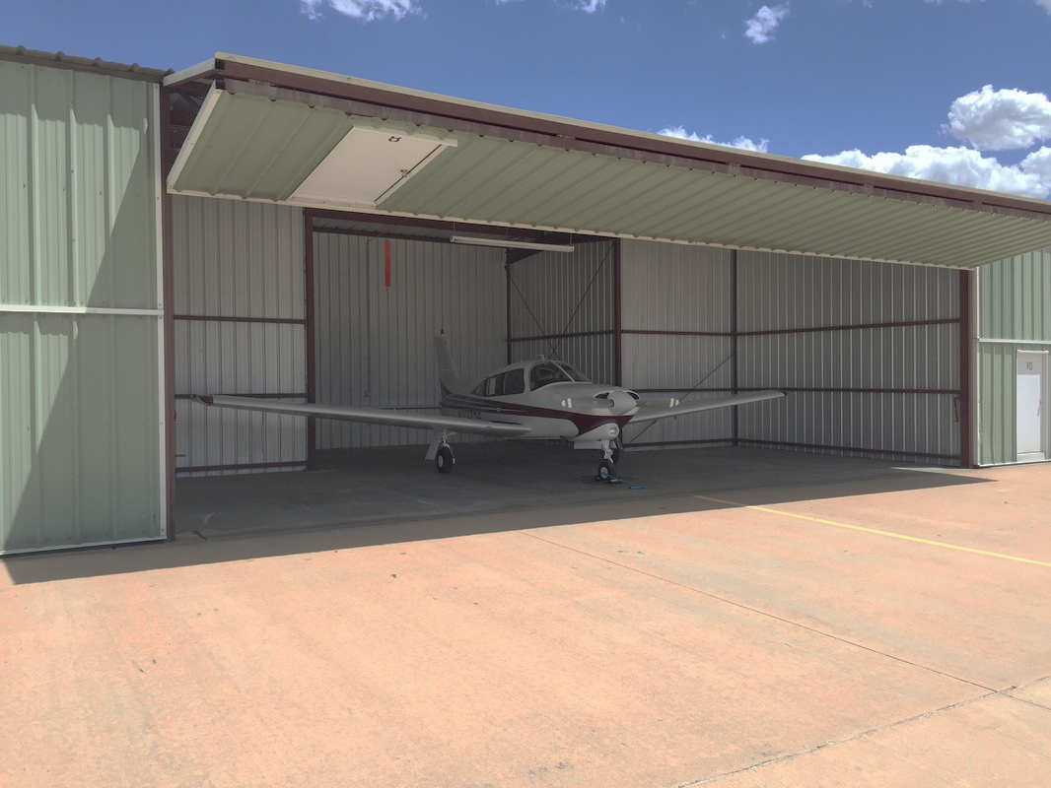
The Project: Construction of 10 unit T-hangar and 4 unit corporate hangar at Keystone Heights Airport. Construction underway from 2008-2009.
https://www.thewashingtondailynews.com/2018/05/02/city-hopes-decrease-attracts-more-planes-to-airports-t-hangars/

Slide 4
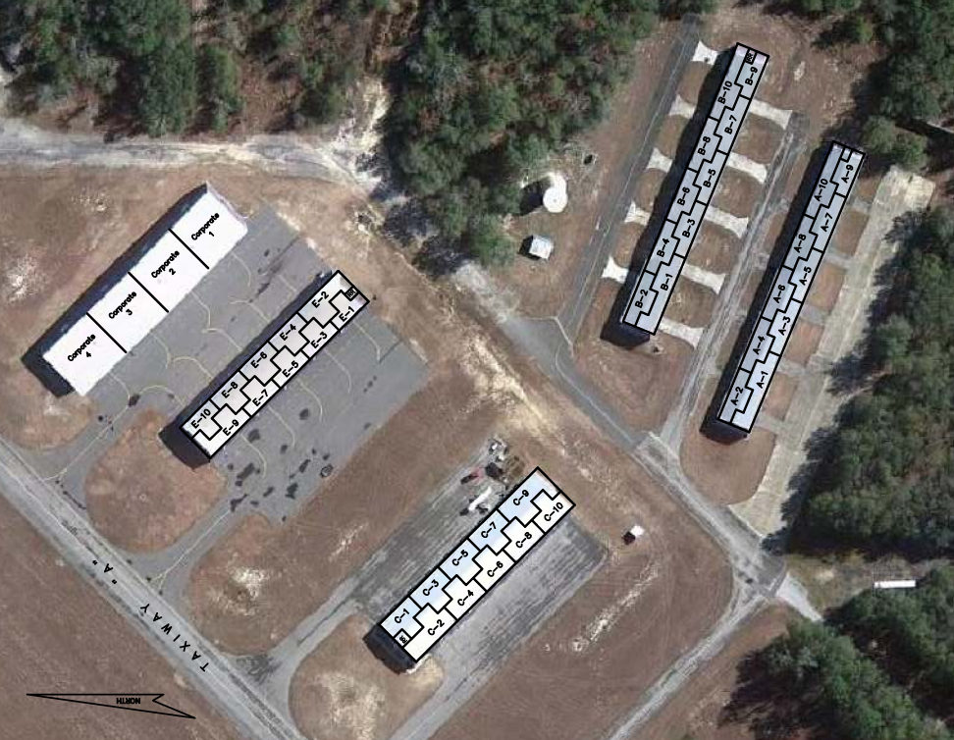
https://keystoneairport.com/wp-content/uploads/T-Hangers-1.pdf

Slide 5
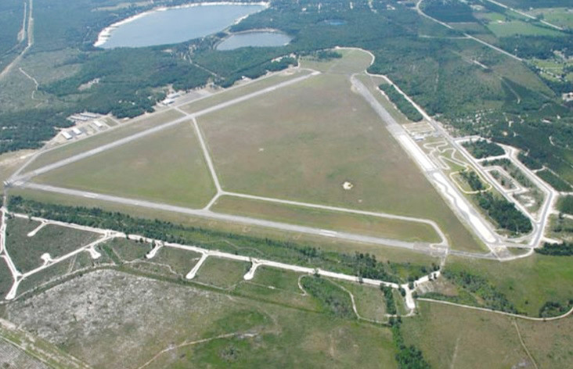
https://www.claytodayonline.com/stories/decade-old-trouble-comes-to-an-end-for-keystone-airpark,11449

Slide 6
Keystone Airpark Authority “Airport”
Contracted with Contractor and Engineer separately
Pipeline Contractors “Contractor”
Used defective product, EZ Base, during the Project
Passero Associates LLC
“Engineer”
Contractually assumed broad inspection responsibilities under contract with Airport

Slide 7
Under The Airport Engineer Contract, The Engineer Must, ON A PART TIME BASIS:
“Observe the work to determine conformance to the contract documents and ascertain the need for correction or rejection of the work” | “Periodically monitor the construction activities on the project.”
“Interpret the contract plans and specifications and monitor the construction activities to maintain compliance with the intent.” | “Determine the suitability of materials on the site, and brought to the site, to be used in construction.”
MOST IMPORTANTLY…. “Passero shall have no liability for indirect, special, incidental, punitive, or consequential damages of any kind.”

Slide 8
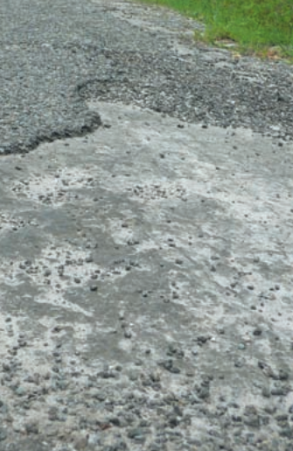

Slide 9
Airport discovers extensive cracking,
begins investigation,
and stops paying Contractor
Airport wanted
GENERAL DAMAGES
claiming costs to repair and replace the pavement and slab
Contractor sues Airport for nonpayment
Engineer says repair and
replacement costs are
CONSEQUENTIAL DAMAGES
barred by the waiver in contract
Airport files Counterclaim Against Contractor and Engineer for breach of contract and professional negligence

Slide 10
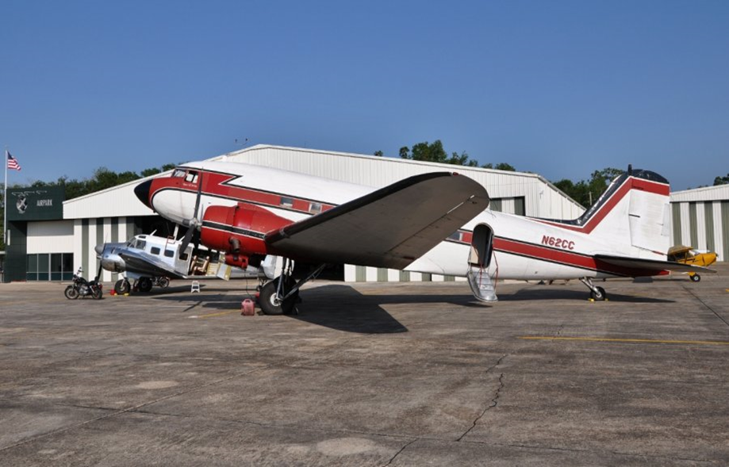
Trial court grants Engineer’s Motion for Summary Judgment Barring Repair and Replacement Costs As
Consequential Damages
Fourth DCA Affirmed
Repair and replacement damages resulting from engineer’s failure to inspect are consequential damages

Slide 11
Repair and replacement costs are not general damages because
they are not direct consequence of Passero’s failure to properly inspect, and
the need for repair didn’t arise within the scope of the immediate transaction between Engineer and Airport.
“Contractor could have completed the job correctly even without Passero failing to perform its inspection duties”

Slide 12
“The consequential nature of loss
is not based on the damages being unforeseeable
by the parties. . .”
Engineer conceded repair damages were a foreseeable result of its failure to perform the work in conformity with the contract.

Slide 13
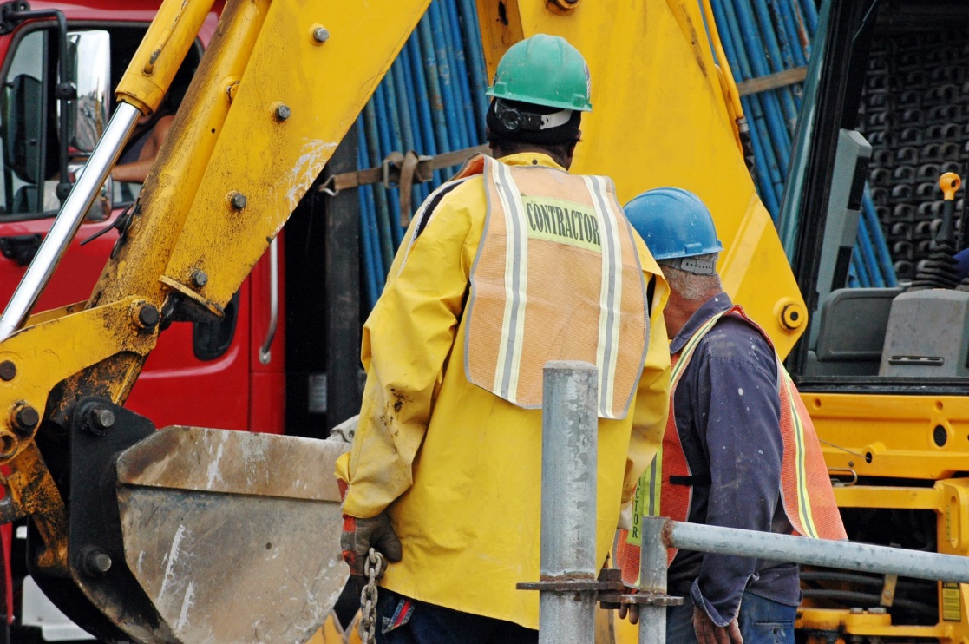
“What makes a loss consequential is that it stems from relationships with third parties, while still reasonably foreseeable at the time of contracting.”
Airport’s damages arise from its dealings with third party, the Contractor

Slide 14
See Urling v. Helms Exterminators, Inc., 468 So.2d 451, 454 (Fla. 1st DCA 1985) (finding the cost to repair extensive termite damage to a home purchased after a termite inspection company erroneously certified that the home was free of damage constituted consequential damages, whereas the cost of the termite inspection constituted actual damages);
Rollins, Inc. v. Heller, 454 So.2d 580, 585 (Fla. 3d DCA 1984) (finding where a home was burglarized following the installation of a deficient security system, the actual damages constituted the cost of the defective system, not the value of the items stolen during the burglary).
Mosteller Mansion, LLC v. Mactec Eng'g & Consulting of Georgia, Inc., 190 N.C.App. 674, 661 S.E.2d 788, n.2 (2008) (finding a builder's claim for damages to repair and recondition soil after an engineering firm erroneously conducted soil testing were consequential and indirect damages because they “do not flow directly and immediately from any action of” the engineering firm);

Slide 15
4th DCA certified the following question to the Florida Supreme Court:
WHERE A CONTRACT EXPRESSLY REQUIRES A PARTY TO INSPECT, MONITOR, AND OBSERVE CONSTRUCTION WORK AND TO DETERMINE THE SUITABILITY OF MATERIALS USED IN THE CONSTRUCTION, BUT THE PARTY FAILS TO DO SO AND INFERIOR MATERIALS ARE USED, ARE THE COSTS TO REPAIR DAMAGE CAUSED BY THE USE OF THE IMPROPER MATERIALS GENERAL, SPECIAL, OR CONSEQUENTIAL DAMAGES?
The court denied review on March 27, 2019

