Slide 1


Slide 2
CONSTRUCTION PLAN READING FOR LAWYERS
2020 Winter Executive Council Meetings & Committee Meetings

Slide 3
AGENDA
Understanding plans
Types of drawings
Putting it all together

Slide 4
Brice R. Miller
Miller Building Group
Dba Hoy & Miller Consulting
20-years experience in construction industry
10-years as Principal of Hoy & Miller
BSBC and MBC from University of Florida School of Building Construction
State of Florida Certified General Contractor and Home Inspector
Provides consulting and expert services for construction defect litigation. Typically consults on multi-million-dollar lawsuits involving single-family, multi-family, and commercial developments in claims brought in accordance with Florida Statute 558. This involves the evaluation of completed construction projects for compliance with drawings and specifications, applicable codes and standards, and accepted construction practices.
For more information on our company, visit www.hoymiller.com

Slide 5
1
Understanding Plans

Slide 6
2017 FBC [A]107.2.1 Information on construction documents
Construction documents shall be of sufficient clarity to indicate the location, nature and extent of the work proposed and show in detail that it will conform to the provisions of this code and relevant laws, ordinances, rules and regulations, as determined by the building official.

Slide 7
Design Team
Civil Engineer, Architect, Structural Engineer, MEP Engineers, and others

Slide 8
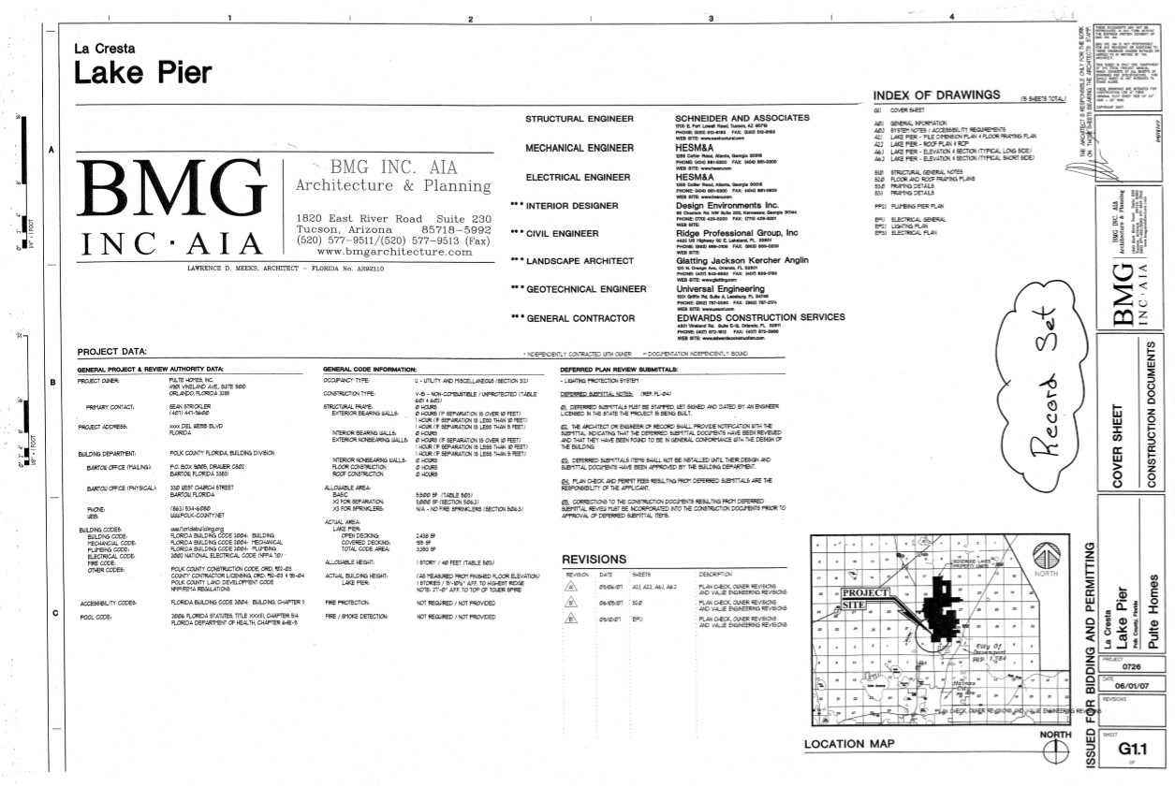

Slide 9
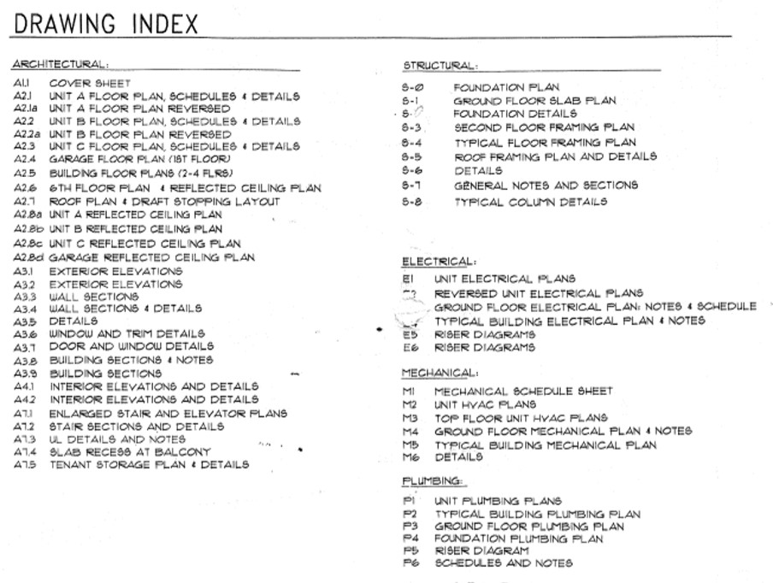

Slide 10
2
Types of drawings

Slide 11
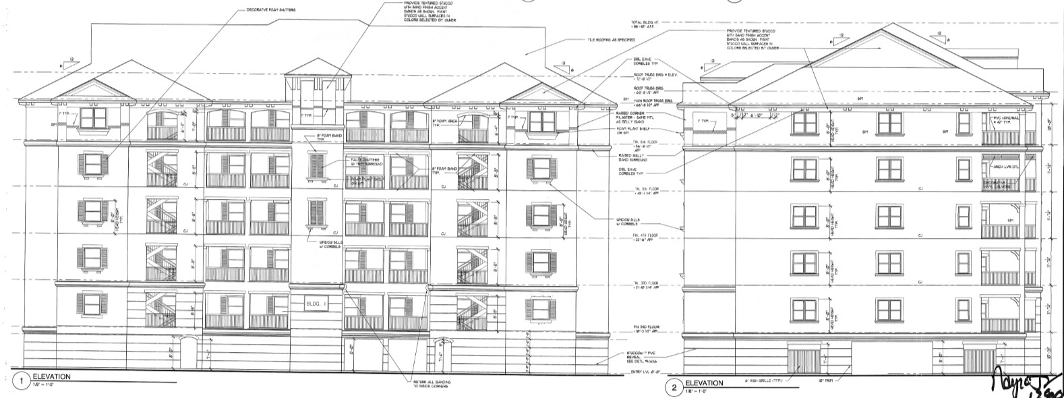
Elevations

Slide 12
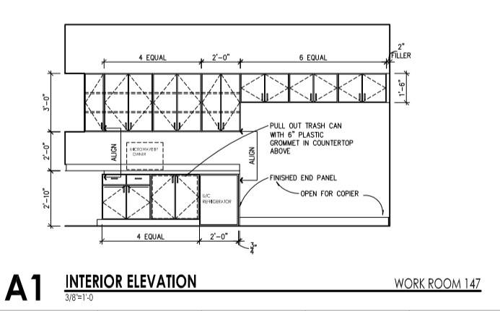
Interior Elevations

Slide 13
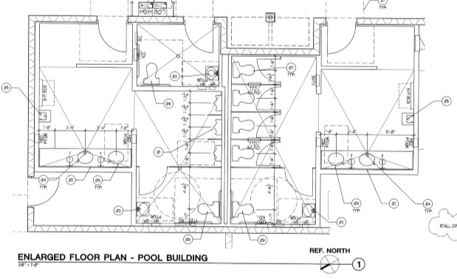
Floor Plans

Slide 14
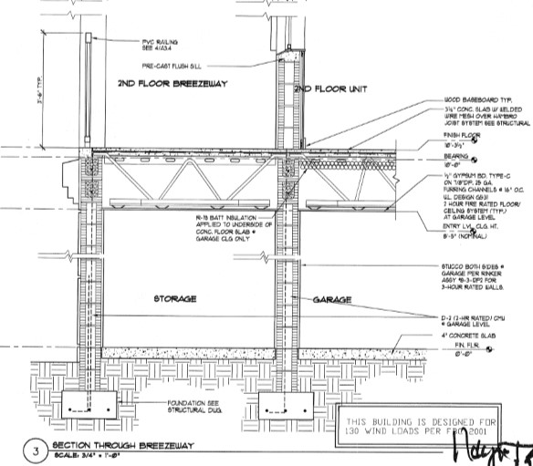
Sections

Slide 15
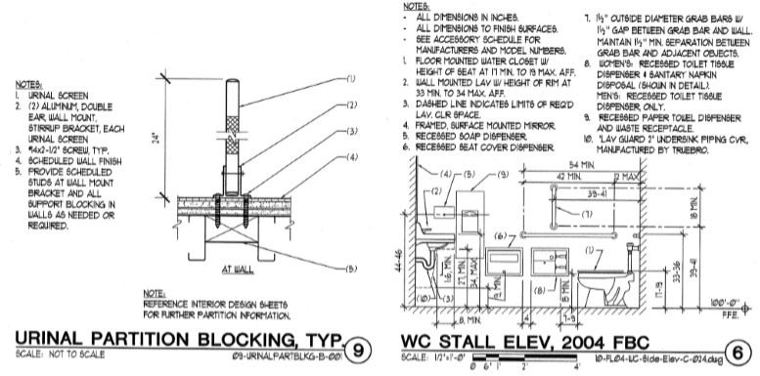
Details

Slide 16
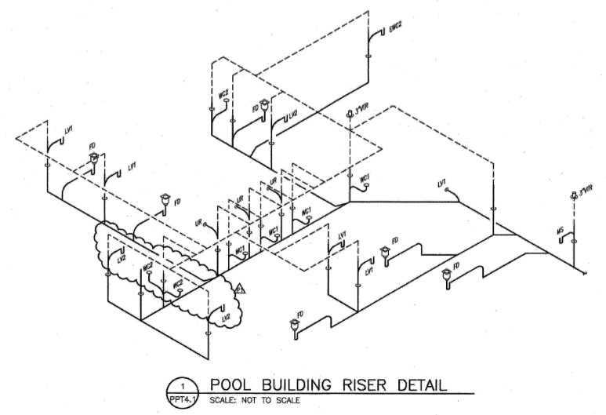
Isometrics

Slide 17
3
Putting it all together

Slide 18
To gain a quick understanding of a building:
Review title sheet and project data.
Review architectural site plan.
Review exterior elevations.
Review floor plans.
Review sections.
Review details as needed.

Slide 19
Thanks!
ANY QUESTIONS?
You can find me at:
brice@hoymiller.com www.hoymiller.com

