Slide 1


The Florida Bar Association Section on Real Property Probate and Trust Law Presents INSURANCE 101 FOR ATTORNEYS.. How the Industry Functions on a Day to Day Basis so You Can Better Serve Your Clients without
©2019 Fisher Consulting Group, Inc.

Slide 2
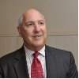

Instructor Name
Frederick J. Fisher, J.D. is President of Fisher Consulting Group, and previously was Founder and Sr. Vice President of E.L.M. Insurance Brokers, a Wholesale & MGA facility specializing in Professional Liability and Specialty Line risks. In 1975, Mr. Fisher began his career as an Independent E&O claims adjuster. In 1982, he ultimately bought the Company, and continued with claims while expanding the firm’s services to include qualitative Claim auditing, risk management., loss control services, and acting as a TPA. His claim auditing techniques and recommendations resulted in substantial client savings (including the SCRTD). Many Insurers and self-insured’s adopted not only the performance standards raised in the audits, but adopted his recommended Attorney Management Guidelines as a base, Guidelines which are still in use today by many major insurers.
In 1994 he formed what is now known as ELM insurance Brokers, a firm that has acted as an MGA and wholesale broker of Professional Liability Insurance and Specialty Lines. He has lectured extensively on professional liability issues since 1978, and authored over 64 articles in trade journals and periodicals. He is the author of BROKER BEWARE, Selling Real Estate within the Law. He designed a program to conduct on site pre-underwriting risk management assessments of a clients' professional liability exposures. In 1993, he was elected to the Professional Liability Underwriting Society (PLUS) Board of Trustees. After serving in all Officer capacities, he was elected President in 1997. He remains a Special Materials Expert for several RPLU courses and as the Senior Technical Advisor for The Professional Liability Manual, first published by the International Risk Management Institute in 1990. In 1990 and 2009, he wrote the definitive articles on the evolution of the Claims Made policy form. The principles and issues raised were used in the IRMI Manuals on Professional Liability, the first RPLU Course Guides, several modules of the revised study materials, and are required reading by many Insurers. Several insurers use the Articles as part of the required Claims Made Insurance training programs in Colorado. Mr. testifies regularly as an expert witness in cases dealing with the duties and obligations of professionals as well as on coverage and claims-made issues.
Mr. Fisher can be reached at 310/426-2105 Email-fjfisher@fishercg.com
© Fisher Consulting Group, Inc.

Slide 3
Hypothetical: Jane Doe Real Estate Broker goes to an insurance broker to secure insurance for her real estate sales business. The [retail broker] gathers information and has her fill out various forms. The retail broker [shops the risk] to the carriers with whom he has a [direct appointment]. The retail broker also takes that risk and shops it to various [wholesale] and [surplus lines] brokers. The retail broker is looking for the best coverage whether it is [admitted or non-admitted]. The [underwriters] review the applications, [supporting material] and 3 - 5 Prior Years [Loss Runs]. After a review, the Underwriter may issue an [indication OR a quote] for coverage. Among the coverage’s that are quoted for Jane Doe Real Estate Broker are [expense outside of limits] general liability and [expense within limits] professional liability. For the workers compensation, the broker obtains a quote from a [Self Insured Group (SIG)]. Based on all of the quotes, Jane Does makes her selection to accept terms from an [A- Rated Insurer] with a [positive loss ratio] and an [internal claims Department]. The retail broker [binds] the applicable coverage’s. Immediately thereafter, Jane Doe Real Estate Broker signs a contract that requires that Jane Doe name her client as an [additional insured]. Jane calls her broker and he sends over a [declaration page] that says that the [certificate holder] is an additional insured. She also wants to [Finance] her premium an signs a [Premium Finance contract].
© Fisher Consulting Group, Inc.

Slide 4

The retail broker
Deals directly with the consumer.. But don’t be fooled by that… it’s a license issue too– coming up soon
Is it a model ?
There are also “Captive Agents” like those working for State Farm, Allstate and Farmers
© Fisher Consulting Group, Inc.

Slide 5
So…what IS an Agent and what are they supposed to do?
An “Agent” is an Organization and/or Natural person appointed to represent an Insurer or Insurers.
An “Agent” may also be a controlled or “Exclusive Agent”
The standard of care for an agent is to diligently follow the requests and guidelines of their principal in selling and servicing their products to customers and to diligently comply with all statutory and regulatory requirements of the State(s) in which they are licensed.
Some States license everyone as a “Producer”, and, absent a “Special Relationship”, there is no duty to advise.
© Fisher Consulting Group, Inc.

Slide 6
What IS a Broker… And what are they supposed to do ?
A Broker is an Organization and /or Natural person that is licensed as a broker, posts any required Bond, and represents the Insured in obtaining and placing coverage on their behalf.
The standard of care for a Broker is to diligently follow the requests and guidelines of their principal in obtaining the coverage(s) requested and to diligently comply with all statutory and regulatory requirements of the State(s) in which they are licensed. Absent a “Special Relationship” there is no duty to advise.
© Fisher Consulting Group, Inc.

Slide 7
In General:
Generally, the agent owes no continuing duty to advise, guide or direct the customer insured to obtain additional coverage; however, when a special relationship develops between the broker and client, the broker may be liable, even in the absence of a specific request, for failing to
advise or direct the client to obtain additional coverage. The appellate court identified three “exceptional situations” that may give rise to such a special relationship:
1. The agent receives compensation for consultation apart from payment of the premiums;
2. There was some interaction regarding a question of coverage, with the insured relying on the expertise of the agent; or
3. There is a course of dealing over an extended period of time that would have put objectively reasonable insurance agents on notice that their advice was being sought and specially relied on.
© Fisher Consulting Group, Inc.

Slide 8
SHOP THE RISK
DIRECT APPOINTMENT- Can go directly to those Insurers willing to accept the submission (whether appointed or not)
INDIRECT- goes to wholesalers who have markets the retail agent cannot access.
© Fisher Consulting Group, Inc.

Slide 9
Wholesale and Surplus Lines Brokers
What is it ?
Why is it …..
What are their Positions ..and excuses for each?
© Fisher Consulting Group, Inc.

Slide 10
And what About the Others?
Insurance Producers – Some States only this license which is a combination of “Agent” & Broker” license in that all admitted Insurers MUST do business with appointed agents, but one is equally licensed to “broker” business to a Wholesaler to access other markets.
Surplus Lines Brokers- are licensed to place business with non-admitted Insurers.
Wholesale Brokers- is a Business Model only- whereby they rarely have contact with the consumer and work only with Retail firms.
Managing General Agents/ Underwriters is also a Business Model using a “Controlled Business Model.
© Fisher Consulting Group, Inc.

Slide 11
And We Have Several Models
We can be Retail
We can be Wholesale
We can believe in “Controlled Business” Models
Each with its own “rules” and behavioral standards
© Fisher Consulting Group, Inc.

Slide 12
Admitted or Non-admitted
So- do you want to be regulated or not..
An Admitted Insurer is one who applies for and receives a “charter” or license from a State to be approved to insure certain applied for hazards. They also agree to seek permission and approval of all forms and pricing guidelines and well as to seek pre-approval of any changes.
A non-admitted does non of the above- and only agrees to maintain at least a minimum of Capital Surplus ……. And abide by Surplus Lines Laws and any Claim regulations
© Fisher Consulting Group, Inc.

Slide 13
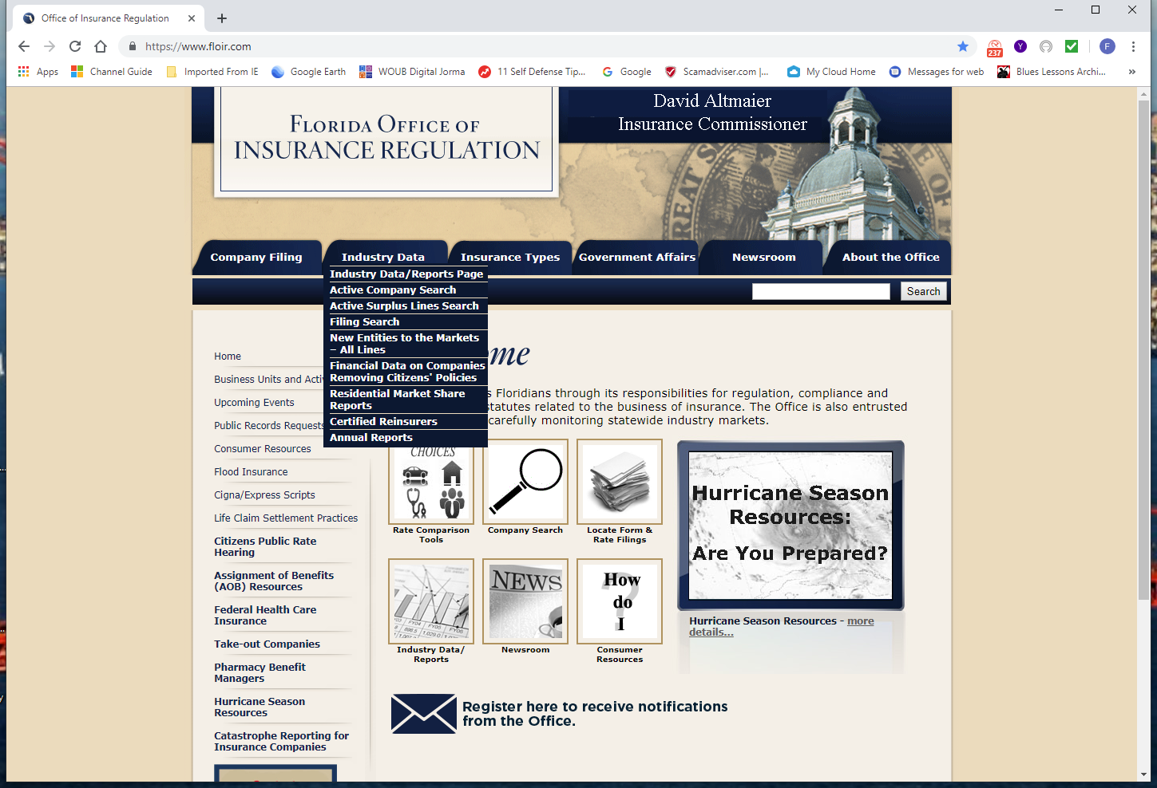

Florida Office of Insurance Regulation
Notes:
Florida Department of Financial Services- Numerous Divisions –including Ins Agent & Agency Services

Slide 14
Underwriters
-Its THEIR call to analyze, quote and bind it a submission-
And is often an ambiguous terms depending on the context used……

Slide 15
Expense Outside of Limits
Lots of defense dollars-
But there are limits…. And dangers….
Should you turn a blind eye?
© Fisher Consulting Group, Inc.

Slide 16
Expense within Limits
Oh oh.. Settle soon….
Communicate – Communicate – Communicate…
What did the Brokers recommend?
© Fisher Consulting Group, Inc.

Slide 17
Self Insured Group (SIG)
Kinda Like Insurance….. And maybe so
© Fisher Consulting Group, Inc.

Slide 18
A- Rating
-What’s a “rating” ?
Why it matters-
Who does it ?

Slide 19
Loss Ratios
By Policy holder
By Book of business
By Line of business
And what does it tell you ????

Slide 20
Claims Department Models
Internal
TPA’s
Monitoring Counsel
Expense to loss ratios and reserve recaptures

Slide 21
The broker binds
Can they ?
Should they ?
Did they ?
© Fisher Consulting Group, Inc.

Slide 22
Certificate Holder is an Additional Insured
Not routine.. And a major source of claims….
Implied versus express Indemnity…
© Fisher Consulting Group, Inc.

Slide 23
The client as an additional insured.
“They messed up…pay me..”
The Insured v Insured dilemma..
Liability assumed from any contract
© Fisher Consulting Group, Inc.

Slide 24
Certificate & Declaration Page
Won’t be viewed in a Museum, but Could be more important .
© Fisher Consulting Group, Inc.

Slide 25
FINANCING THE PREMIUM and The Finance Contract
What is it ?
Who arranges it ?
What are the benefits
Is the policy being canceled for Non payment of premium ?
And there are dangers…..
© Fisher Consulting Group, Inc.

Slide 26
So- What’s the goal?
CLOSE THE FILE…..
-And will everyone be happy
© Fisher Consulting Group, Inc.

Slide 27
Thank you!
Frederick J Fisher, J.D
President, Fisher Consulting Group, Inc.
(310) 426-2105 fjfisher@fjfishercg.com
© Fisher Consulting Group, Inc.

