Slide 1
Rip & Tear and Insurance Law for Defective Construction Claims In Florida
Mark A. Boyle, Esquire
Boyle, Leonard & Anderson, P.A.
2050 McGregor Blvd, Fort Myers, FL
Mboyle@Insurance-Counsel.com

Slide 2
Overview
ISO
Duty to Defend
Occurrence
Property Damage
Additional Insured Coverage

Slide 3
ISO CGL FORM
CG 00 01 12 04

Slide 4
POLICY FORMS

Slide 5
BASELINE CGL FORM

Slide 6
“because of”
The words “because of” indicate that the legal liability must have as its source, or arise from, physical injury to or loss of use of tangible property. Once “property damage” has been established, the CGL then covers economic losses that flow from the “property damage.”

Slide 7
Policy Language of CGL Insuring agreement
Property Damage
When the allegations against the insured are for only defective workmanship that merely diminishes the value of the property without causing physical injury or loss of use, there is no insurance coverage because defective work in and of itself is not “property damage” under the insuring agreement in most states. See, e.g., Lamar Homes, Inc. v. Mid-Continent Cas. Co., 242 S.W.3d 1, 11 (Tex. 2007)

Slide 8
Policy Language of CGL Insuring agreement
To Which This Insurance Applies
The CGL insuring agreement’s language “to which this insurance applies” means that the “property damage” must be covered before the consequential damages flowing from such “property damage” can be covered. See, e.g., Hartford Acc. & Indem. Co. v. Pac. Mut. Life Ins. Co., 861 F.2d 250, 255 (10th Cir. 1988) (“Since the insured’s products and installation are not property damage to which the insurance applies, any consequential damages caused by such products and installation are not covered.”); American Home Assurance Co. v. Libbey-Owens-Ford Co., 786 F.2d 22, 24-25 (1st Cir. 1986)

Slide 9
Policy Language of CGL Insuring agreement
Consequential Damages
The insuring agreement provides insurance coverage for damages “because of” property damage. “In light of [the insuring agreement] wording, all damages flowing as a consequence of bodily injury or property damage would be encompassed by the insurer’s promise, subject to any applicable exclusion or condition. This includes purely economic damages, as long as they result from otherwise covered bodily injury or property damage.” Donald S. Malecki, Commercial General Liability Coverage Guide, 2-3 (11th Ed. 2015)

Slide 10
Policy Language of CGL Insuring agreement
Plain Language Rule: Rip and Tear cannot create coverage
The plain language rule that the majority of courts follow can be summarized as follows “[T]he costs to rip out otherwise non-defective work in order to repair otherwise non-covered defective work is not “property damage,” but the costs to rip out non-defective work in order to repair covered “property damage” is considered damages because of “property damage” and is covered. The rationale of many of these decisions is that the nature of the repairs cannot create coverage if none exists.” Lee H. Shidlofsky, Deconstructing CGL Insurance Coverage Issues in Construction Cases, Journal of the American College of Construction Lawyers, Vol. 9, No. 2 (Summer 2015)

Slide 11
Regional Steel Corp. v. Liberty Surplus Ins., 226 Cal.App.4th 1377, 173 Cal.Rptr.3d 91, 93-94 (2014)
The California Court of Appeals provided a good example of repair expenses for which the insured was liable were not covered because they did not flow from covered “property damage.” 226 Cal.App.4th 1377, 173 Cal.Rptr.3d 91, 93-94 (2014). The California Court of Appeals relied upon the rule that incorporating the wrong product into a structure is not covered “physical injury to tangible property” unless the product causes physical injury to other property. Because there was no covered “property damage,” the cost to get to the tie hooks were not covered either.

Slide 12
Is Defective Construction an “Occurrence”?

Slide 13
“Occurrence”

Slide 14
“Occurrence”
U.S. Fire Ins. Co. v. J.S.U.B., 979 So. 2d 871 (Fla. 2007)
We hold that faulty workmanship that is neither intended or expected from the standpoint of the contractor can constitute an “accident” and thus, an “occurrence” under a post-1986 CGL policy period.
Kvaerner Metals Division of Kvaerner U.S., Inc. v. Commercial Union Ins. Co., 908 A.2d 888 (Pa. 2006)
The definition of “accident” required to establish “occurrence” under the commercial general liability (CGL) insurance policies cannot be satisfied by claims based upon faulty workmanship; such claims simply do not present the degree of fortuity contemplated by the ordinary definition of “accident”.
VS

Slide 15
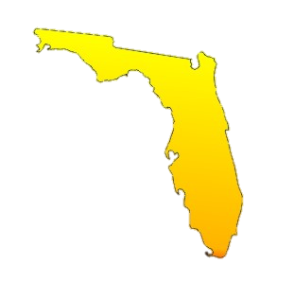
Choice of Law
Florida adheres to the rule of lex loci contractus. State Farm Mut. Auto. Ins. Co. v. Roach, 945 So. 2d 1160, (Fla.2006).
In the context of insurance contracts, that rule provides that the law of the jurisdiction where the contract was executed governs the rights and liabilities of the parties in determining an issue of insurance coverage. Id.

Slide 16
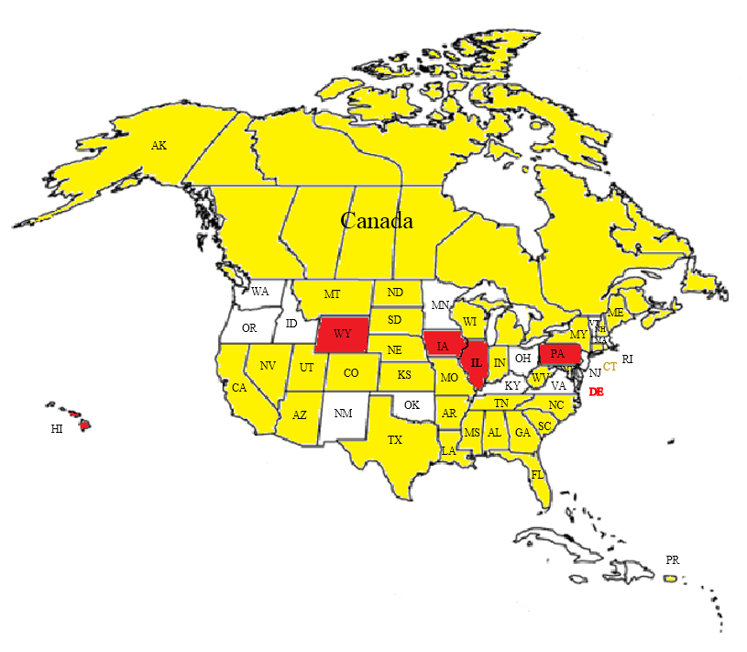
“Occurrence”
= OCCURRENCE
= NO OCCURRENCE
= UNSETTLED*
* Ohio, after many years in flux has affirmatively joined the “No Occurrence” minority of jurisdictions finding no occurrence under a contractor’s CGL policy based on a claim of faulty workmanship of a subcontractor. See Ohio Northern University v. Charles Construction Services, Inc., 2018 WL 4926159(Ohio, Oct. 9, 2018)

Slide 17
What does “Property Damage” really mean in Florida?

Slide 18
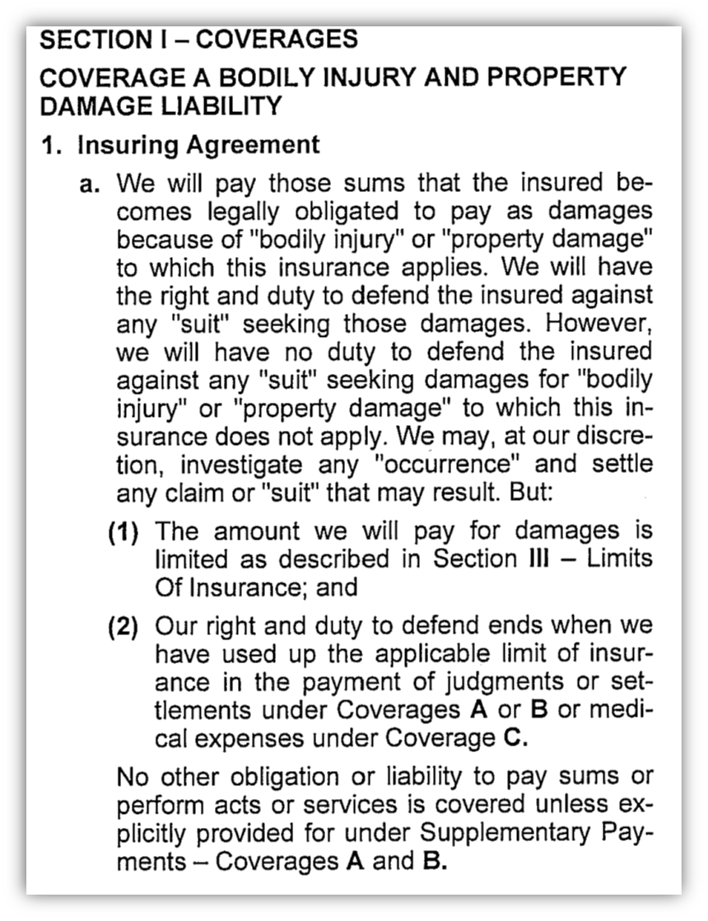
“Property Damage”
Under most policies, “property damage” is defined as:
a. Physical injury to tangible property, including all resulting loss of use of that property. All such loss of use shall be deemed to occur at the time of the physical injury that caused it; or
b. Loss of use of tangible property that is not physically injured. All such loss of use shall be deemed to occur at the time of the “occurrence” that caused it.

Slide 19
What was intended by Insurance Services Office (ISO)?
The insured would have no coverage for damage to his work arising out of his work.
The insured would have coverage for damages to his work arising out of a subcontractor’s work
The insured would have coverage for damage to a subcontractor’s work arising out of the subcontractor’s work
The insured would have coverage for damage to a subcontractor’s work, or if the insured is a subcontractor to a general contractor’s work or another subcontractor’s work, arising out of the insured’s work.
Insurance Services Office Circular, Commercial General Liability Program Instructions Pamphlet, No. GL–86–204 (July 15, 1986).
Insurance Services Office Circular, Broad Form Property Damage Coverage Explained, GL-79-12 (January 19, 1979).

Slide 20
“Property Damage”
FL law is unclear about whether coverage is available when a subcontractor’s defective performance of work damages only the materials of the subcontractor.

Slide 21
Auto-Owners Ins. Co. v. Pozzi Window Co., 984 So. 2d 1241 (Fla. 2008)
Facts: Homeowner bought windows, manufactured by Pozzi, but installed by a subcontractor. Subcontractor incorrectly installed the windows, which caused damage around the windows. The Florida Supreme Court held that the damage was covered.
Construction defects = an “accident” and “occurrence”
Physical injury to tangible property arising out of the defective work = “property damage”

Slide 22

West Orange Lumber Co., Inc. v. Indiana Lumbermans Mut. Ins. Co., 898 So. 2d 1147 (Fla. 5th DCA 2005)
The cost of removing and replacing cedar siding of the wrong grade, installed in breach of contract, was not “property damage.”
Claims solely for “the costs of repairing and replacing the actual defects in ... construction” are not covered under CGL policies.

Slide 23
Amerisure Mut. Ins. Co. v. Auchter Co., 673 F.3d 1294 (11th Cir. 2012)
Limited the definition of covered “property damage” in a standard CGL policy such as the one issued by MCC in this case.
The claim for the costs to repair the defective roof were not claims for “property damage” because the defective installation of the inn's roof did not cause “physical injury to tangible property.
The relevant component for examining the scope of the subcontractor's defective work was not the individually installed roofing tiles, which the Court considered to be the raw materials from which the roof was made, but instead was the entire roof itself.

Slide 24
J.B.D. Const., Inc. v. Mid-Continent Cas. Co., 571 Fed. Appx. 918 (11th Cir. 2014)
Costs to repair the defectively installed roof, doors and windows, these costs were not “property damage” and therefore not covered by the policy under Florida law.
Defective construction qualifies as an occurrence.
Policy’s “your work” exclusion barred coverage of costs to repair damage to fitness center.

Slide 25
Does lose of use alone constitute property damage?
Mid Continent Casualty Co. v Adams Homes
More specifically, Adams initiated construction in locations meant for retainage lakes under the original drainage plan, redirected historical water flow by elevating lots, and used “impervious muck and clay as fill,” thereby “reduc[ing] the natural drainage capacity of the area.” As a result, Homeowners’ “homes, the streets adjacent to their homes, and the common areas they have access to, are now prone to flooding....” The flooding has made “[Homeowners’] ordinary use or occupation of their property physically uncomfortable” and “disturb[ed] the [Homeowners’] free use ... of their property.”
These allegations, fairly read, create a factual issue as to loss of use.
CITING: McCreary v. Florida Residential Property and Casualty Joint Underwriting Association, 758 So.2d 692, 693 (4th Dist. Ct. App. 1999)

Slide 26
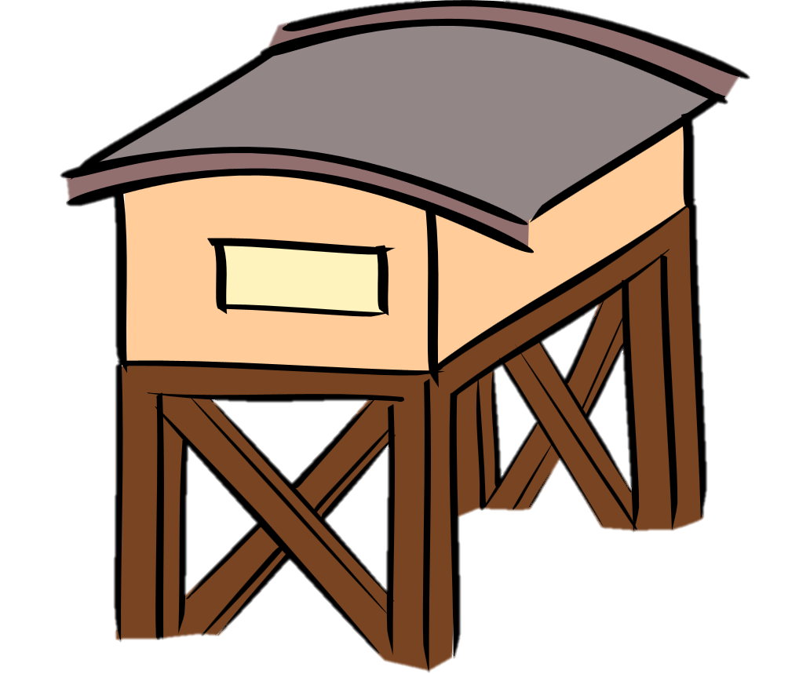
Physical Injury
Threshold for constituting a “physical injury,” a definitional term of “property damage,” is low.
Any physical or material alteration resulting in a detriment constitutes “physical injury” in a CGL policy.
See Zurich Am. Ins. Co. v. Cutrale Citrus Juices USA, Inc., 2002 WL 1433728 (M.D. Fla. 2002)(stating “[t]he accidental introduction of an adulterant is a physical event that causes injury or damage just as surely as the damage resulting from the collision of two automobiles”).
Most courts have rejected the argument that “property damage” must be to property owned by or work performed by a third party.

Slide 27
Does Incorporation of a Defective Component Constitute Property Damage?
Eljer Mfg., Inc. v. Liberty Mut. Ins. Co., 972 F.2d 805 (7th Cir. 1992)
Holding that the incorporation of a defective product into another product constituted property damage, as physical injury to tangible property, at the moment of incorporation.
Travelers Ins. Co. v. Eljer Mfg., Inc., 757 N.E.2d 481 (Ill. 2000)
The court disagreed with the policyholders’ argument, holding that the home owners whose systems did not leak suffered no “physical injury to tangible property.” The court also held that the post-1986 edition CGL insurance policies are not triggered if a home is physically damaged by a home owner replacing a nonleaking system; this does not constitute physical injury to tangible property arising from a covered occurrence under the policies.

Slide 28
Rip and Tear and its impact on Property Damage

Slide 29
Carithers v. Mid-Continent Cas., Co., 782 F. 3d 1240 (11th Cir. 2015)
Impact:
In the Eleventh Circuit, damages for an insured’s defective work are covered if the defective work must be replaced in order to repair covered property damage.

Slide 30
Carithers v. Mid-Continent Cas., Co., 782 F. 3d 1240 (11th Cir. 2015)
Holdings and Reasoning:
Damage to brick caused by defective coating was not covered:
Failure of coating caused to damage to brick. Because the Carithers could not prove that different subcontractors performed the brick work and the coating work, the damage was not covered pursuant to U.S. Fire Ins. Co. v. J.S.U.B., Inc., 979 So.2 d 871 (Fla. 2007).

Slide 31
Carithers v. Mid-Continent Cas., Co., 782 F. 3d 1240 (11th Cir. 2015)
Holdings and Reasoning:
Damage to tile caused by defective mud base was not covered:
Even though the Carithers had purchased the tile that was damaged, the Eleventh Circuit’s narrow interpretation of Pozzi Window in Auchter precluded coverage. Auchter distinguished between a window, which has many components, and a roof tile, which is one component that goes into a roof.
No coverage for a defective installation when there is no damage beyond the defective work of a single subcontractor. Here, mud base and tile were done by the same subcontractor.

Slide 32
Carithers v. Mid-Continent Cas., Co., 782 F. 3d 1240 (11th Cir. 2015)
Holdings and Reasoning:
Carithers were entitled to cost of rebuilding balcony (get-to damage) ($3,325).
Trial court found that balcony was not covered.
But, trial court found as a fact that, in order to repair the garage (which was covered), the balcony had to be rebuilt.
Mid-Continent did not appeal this fact-finding.
“Under Florida law, the Carithers had a right to ‘the costs of repairing damage caused by the defective work …’ J.S.U.B.”
“Since the district determined that repairing the balcony was part of the cost of repairing the garage, which was defective work, the Carithers were entitled to these damages.”

Slide 33
Carithers v. Mid-Continent Cas., Co., 782 F. 3d 1240 (11th Cir. 2015)
Unresolved Questions:
Who has burden of proof regarding necessity of rebuilding insured’s work in order to repair covered property damage?
What is the extent to which work to the insured’s work becomes compensable? Removal? Replacement? With what? (value of what was there vs. what should have been there in the first place)

Slide 34
Pavarini Constr. Co. (Se) Inc. v. Ace Am. Ins. Co., 161 F. Supp. 3d 1227 (S.D. Fla. 2015)
Where defective work causes damage to otherwise non-defective completed product, defendant is entitled to coverage for the repair of that non-defective work. Even if the predominant objection of the repair effort was to fix the instability caused by the defective work repair for the defective work was covered where the same effort was required to put an end to the ongoing damage to otherwise non-defective property.

Slide 35
Pavarini Constr. Co. (Se) Inc. v. Ace Am. Ins. Co., 161 F. Supp. 3d 1227 (S.D. Fla. 2015)
Two footnotes from this Court are telling about the status of “Rip & Tear” coverage in Florida:
Footnote 6: Citing J.S.U.B., Defendant argues somewhat incidentally that mitigation of damages is not covered Nowhere in J.S.U.B. is mitigation of damages mentioned. On the contrary, J.S.U.B. stands for the proposition that claims for repairing structural damage caused by the defective work of subcontractors may be covered. As a natural corollary, coverage may exist for costs to repair defective work in order to prevent further structural damage and covered loss. See, e.g., Carithers v. Mid–Continent Cas. Co., 782 F.3d 1240, 1251 (11th Cir.2015).

Slide 36
Pavarini Constr. Co. (Se) Inc. v. Ace Am. Ins. Co., 161 F. Supp. 3d 1227 (S.D. Fla. 2015)
Two footnotes from this Court are telling about the status of “Rip & Tear” coverage in Florida:
Footnote 5: ACE misunderstands the facts of Carithers when it asserts that the defective work was removed simply to access covered property damage. See DE 140 at 11–12. To the contrary, the District Court held that faulty workmanship that causes damage to non-defective property and that must be repaired in order to repair the damage being caused can constitute covered property damage under the policy. See Memorandum and Order, Carithers v. Mid–Continent Casualty Company, No. 12–00890, 2014 WL 11332308 (M.D.Fla. Mar. 11, 2014), DE 126 at 8.

Slide 37
Beyond Carithers, Florida Court’s continue to affirm coverage for “get-to” or “rip & tear” damages.
See Mid-Continent Casualty Co. v. Treace 186 So.3d 11(Fla. 5th DCA 2015)
Holding unequivocally that “[W]ithout further discussion we affirm that portion of the trial court’s judgment which found the damages awarded for the cost to access and repair the water damage were covered by MCC’s policy.”

Slide 38
Amerisure Insurance Company v. The Auchter Company, 2018 WL 4293149, (M.D. Fla. Mar. 27, 2018)
The Auchter Company reaffirms Carithers “rip and tear” holding. In The Auchter Company, a window system was defectively installed. Water intrusion resulted and damaged walls, ceiling tiles, and carpet. The question was whether the policy covered the repair and replacement of the window system. Citing Carithers, the Middle District Court held “the cost of repairing and replacing the defective [w]indow [s]ystem constitutes “property damage,” resulting in coverage.” Such a rule, makes sense because:
Carithers teaches that the cost [to] repair and/or replacement of the defective work to stop future covered property damage, is subject to indemnification by the insurer of a CGL policy. Such a result makes sense; to find that only the damaged “other” property, such as the garage, was covered by the CGL policy, would mean that the insured, such as the Carithers, would either be forced to repeatedly file claims with the insurer for the continued and renewed property damage caused by defective leaking balcony, or be foreclosed from recovering the full consequences of the defective work.

Slide 39
Amerisure Insurance Company v. The Auchter Company, 2018 WL 4293149, (M.D. Fla. Mar. 27, 2018)
Such a rule, makes sense because:
Carithers teaches that the cost [to] repair and/or replacement of the defective work to stop future covered property damage, is subject to indemnification by the insurer of a CGL policy. Such a result makes sense; to find that only the damaged “other” property, such as the garage, was covered by the CGL policy, would mean that the insured, such as the Carithers, would either be forced to repeatedly file claims with the insurer for the continued and renewed property damage caused by defective leaking balcony, or be foreclosed from recovering the full consequences of the defective work.

Slide 40
Amerisure Insurance Company v. The Auchter Company, 2018 WL 4293149, (M.D. Fla. Mar. 27, 2018)
As such, the court held that because the leaky window system caused water damages to personal property and to otherwise non-defective work of the contractors and that the only work to stop of the ongoing water instruction (and thus, ongoing “property damage”) would be to replace the entire window system, an insurer owed a duty to indemnify for such damages under the standard CGL policies issued.

Slide 41
US Metals, Inc. v Liberty Mutual Group, Inc., 490 S.W. 3d 20 (Tex. 2016)
Court holds that incorporation of defect component does NOT constitute property damage however, costs to “access” defective competent does constitute property damage.

Slide 42
U.S. Metals, Inc. v. Liberty Mut. Grp., Inc., 2015 WL 7792557, (Tex. Dec. 4, 2015)
Rip and Tear coverage resulting from replacement of defective components in a refinery
“[U]nits were physically injured in the process of replacing the faulty flanges. Because the flanges were welded to pipes rather than being screwed on, the faulty flanges had to be cut out, pipe edges resurfaced, and new flanges welded in. The original welds, coating, insulation, and gaskets were destroyed in the process and had to be replaced. The fix necessitated injury to tangible property, and the injury was unquestionably physical.”
“But the insulation and gaskets destroyed in the process were not restored to use; they were replaced. They were therefore not impaired property to which Exclusion M applied, and the cost of replacing them was therefore covered by the policy.”

Slide 43
Examples and Courts’ Analysis

Slide 44
Pool – Colorado Pool Systems, Inc. v. Scottsdale Insurance Company, 317 P.3d 1262 (Colo. App. 2012)
The court there considered two types of property damage:
(1) the cost of demolishing and replacing the defective pool; and
(2) consequential, or “rip and tear,” damage to nondefective third-party work, which occurred during the replacement project.
The court concluded that the “policy does not cover damage incurred in demolishing and replacing the pool itself.... [but the] rip and tear damage to nondefective third-party work (including damage to the deck, sidewalk, retaining wall, and electrical conduits) is covered. Thus, the court determined that “property damage” does not include costs of repair or replacement of defective workmanship, but does include consequential damage to other parts of the property.

Slide 45
Balcony - Carithers v. Mid–Continent Casualty Company, 782 F.3d 1240 (11th Cir. 2015)
The Eleventh Circuit agreed that the cost to remove and replace the defectively installed balconies was covered even though the balcony was originally defective. The court determined that “[s]ince the district court determined that repairing the balcony was part of the cost of repairing the garage, which was defective work, the Carithers were entitled to these damages.”

Slide 46
Soil - Desert Mountain Prop. Ltd. Partnership v. Liberty Mutual Fire Insurance Co., 236 P.3d 421 (Ariz. App. 2010), aff’d, 250 P.3d 196 (Ariz. 2011)
The court stated:
The removal or destruction of non-defective property required to repair poorly compacted soil is not damage caused by the poorly compacted soil. Rather, it is damage caused by the repair of the poorly compacted soil. Therefore, because the cost of repairing the defect is not recoverable under a CGL policy in Arizona, the superior court did not err by ruling that costs incurred in “getting to” the defect were not covered under the policies at issue.

Slide 47
Flanges - U.S. Metals, Inc. v. Liberty Mut. Group, Inc., 490 S.W.3d 20 (Tex. 2016)
The Court determined that Exclusion M did not apply to those items by stating, “But the insulation and gaskets destroyed in the process were not restored to use; they were replaced. They were therefore not impaired property to which Exclusion M applied, and the cost of replacing them was therefore covered by the policy.” Thus, under the Court’s U.S. Metals analysis, the destruction of the insulation and gaskets in order to repair the defective flanges generated new property damage that triggered the CGL policy.

Slide 48
Future Issues

Slide 49
Can Rip and Tear Be an “Occurrence”?
One uncertainty created by the courts is whether rip and tear can be an “occurrence.”

Slide 50
Which Policy is Triggered?
Under the majority rule injury-in-fact trigger, property damage due to faulty workmanship “occurs” occurs when actual physical damage to the property occurred

Slide 51
Applicability of Exclusion A?
Exclusion A may apply to property damage caused by rip and tear. This exclusion precludes coverage for property damage if the property damage is “expected or intended from the standpoint of the insured.”

Slide 52
Carriers Respond with Rip and Tear Endorsements
In light of the uncertainties created by courts around the country, some insurers have created rip and tear exclusions that limit their exposure for rip and tear costs. The following exclusion (Form AGL04250611) is an example of a rip and tear exclusion.

Slide 53
Damages arising out of:
(1) Any expenses incurred in removing concrete or concrete products from any structure or building due to defective concrete or for improperly mixed, manufactured, poured, formed, cured, or installed concrete;
(2) Any expenses for replacing forms, reinforcements, piping and wiring that are destroyed during the course of removing defective concrete products; or
(3) Any expenses for returning the structure or building to the condition that existed prior to the installation of concrete products.

Slide 54
Impaired Property Exclusion
2. Exclusions
This insurance does not apply:
m. Damage To Impaired Property Or Property Not Physically Injured
"Property damage" to "impaired property" or property that has not been physically injured, arising out of:
(1) A defect, deficiency, inadequacy or dangerous condition in "your product" or "your work"; or
(2) A delay or failure by you or anyone acting on your behalf to perform a contract or agreement in accordance with its terms.
This exclusion does not apply to the loss of use of other property arising out of sudden and accidental physical injury to "your product" or "your work" after it has been put to its intended use.
SECTION V – DEFINITIONS
8. "Impaired property" means tangible property, other than "your product" or "your work", that cannot be used or is less useful because:
a. It incorporates "your product" or "your work" that is known or thought to be defective, deficient, inadequate or dangerous; or
b. You have failed to fulfill the terms of a contract or agreement;
if such property can be restored to use by:
a. The repair, replacement, adjustment or removal of "your product" or "your work"; or
b. Your fulfilling the terms of the contract or agreement.

Slide 55
Impaired Property Exclusion
Drafted in 1986 as a revision to the 1973 form exclusion, which generated inconsistent interpretations
The purpose of the revised exclusion is to preclude coverage for loss of use claims arising from faulty work or products when there is no physical injury to the property.
Therefore, the exclusion should not apply where there is physical damage or loss of use to other property into which the insured’s work or product has been incorporated if the insured’s work cannot be repaired or replaced without causing physical injury to the other property.

Slide 56
Impaired Property Exclusion
Seneca Ins. Co., Inc. v. Q Sono II, LLC, 66 Conn. L. Rptr. 421 (Conn. Super. Ct. 2018) (damaged fixtures which could not be restored by repair to the building were not excluded under the impaired property exclusion).
The insured, Q Sono II, under the terms of a lease with its tenant was responsible for maintenance of the premises. Q Sono made repairs and performed work on the building negligently, causing the roof to collapse, and ordering tenant’s restaurant to close
Court found damages to the building were excluded by the impaired property exclusion in the policy because the premises could be restored by Q Sono, while the fixtures and contents of the restaurant damaged by the collapse were not excluded because they could not be restored by the repair of the building.
See also Travelers Property Cas. Co. of America v. Northwest Pipe Co., No. C17-5098 BHS, 2017 WL 2687652 (W.D. Wash. June 22, 2017) (finding that the circumferential welds attaching Northwest Pipe Co’s faulty grout plugs to a large steel pipe liner could not be restored by replacement of the plugs, and the cost of such damages to the welds were not excluded under the impaired property exclusion).

Slide 57
Impaired Property Exclusion
Maryland Cas. Co. v. Mid. Con. Cas. Co., 725 Fed. Appx. 699, 711 (10th Cir. 2018) (Allegations of loss of use of personal property and damage to personal property were sufficient to reject the application of the Impaired Property Exclusion).
Court found that while the complaints alleged loss of use of personal property, which was excluded from coverage under the impaired property exclusion, the complaints also arguably alleged damage to personal property, and “other property” which were not explicitly excluded from coverage under the exclusion.
Therefore, the allegations in the underlying action were potentially covered, and triggered Mid-Continent’s duty to defend.
See also Morette Company v. Southern-Owners Ins. Co., 301 F. Supp. 3d 1175, 1186 (N.D. Fla. 2017) (Where a lawsuit alleges property damage or physical injury to the work product of others resulting from an insured’s own faulty workmanship, it necessarily follows that the impaired property exclusion, on its face, is inapplicable.)

Slide 58
Questions?

