Slide 1
Farming, Liability & More
Specifically for the Florida Bar’s Insurance and Surety Committee, RPPTL Section

Slide 2
What Is A Farm
USDA defines it as “any place from which $1,000 or more of agricultural products were produced and sold, or normally would have been sold, during the year.”

Slide 3
Two Primary Advisory Companies
ISO – Insurance Services Office
AAIS – American Association of Insurance Services

Slide 4
AAIS Definition
“Farming” means the ownership, maintenance, or use of the premises for the production of crops or the raising or care of livestock, including all necessary operations.
“Farming” also includes the operations of roadside stands and farm markets maintained principally for the sale of the “insured’s” own farm products, but it does not include other retail activities.

Slide 5
ISO Definition
“Farming” means the operation of an agricultural or aquacultural enterprise, and includes the operation of roadside stands, on your farm premises, maintained solely for the sale of farm products produced principally by you.
Unless specifically indicated in the Declarations, “farming” does not include:
a. Retail activity other than that described above; or
b. Mechanized processing operations

Slide 6
Our Concerns For Today’s Session
Agritainment/Agritourism
Pollution Coverage

Slide 7
Agritainment
USDA – “Agritourism involves attracting paying visitors to farms by offering farm tours, harvest festivals, hospitality services, petting zoos & other attractions.”

Slide 8
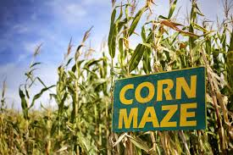
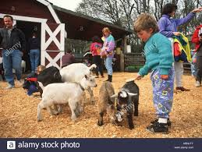
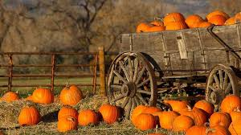
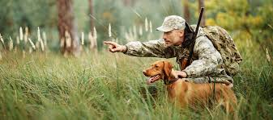

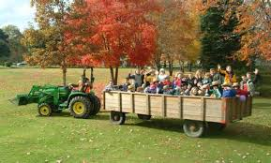
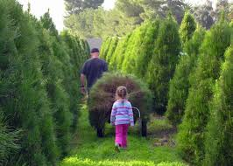

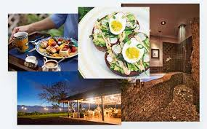
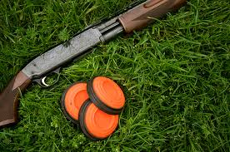
It’s Not Farming

Slide 9
What Can Be Done
Endorsements to the Farm Liability policy (ISO/AAIS)
Agritainment endorsement (ISO)
Commercial General Liability policy (CGL)

Slide 10
Other Concerns
Virtually all policies have some sort of “transmissible disease” exclusion
When an Agritainment operator has a petting zoo or related activity – it is likely that the exposure from the animals that could cause disease transmission is NOT covered

Slide 11
Pollution Exposures
AAIS
A. Any solid, liquid, gaseous, thermal, or radioactive irritant or contaminant, including acids, alkalis, chemicals, fumes, smoke, soot, vapor, and waste. Waste includes materials to be recycled, reclaimed, or reconditioned, as well a disposed of.
B. Electrical or magnetic emissions, whether visible or invisible, and sound emissions.

Slide 12
Pollution Exposures
ISO
“Pollutants” means any solid, liquid, gaseous or thermal irritant or contaminant, including smoke, vapor, soot, fumes, acids, alkalis, chemicals and waste. Waste includes Materials to be recycled, reco0nditioned o0r reclaimed.

Slide 13
NO Coverage Unless… AAIS
BI or PD that results from the heat, smoke, or fumes from a fire on the “insured premises” that:
1) becomes uncontrollable or breaks out from where it was intended to be; or
2) is set by the “insured” for the purpose of burning off crop stubble or other vegetation consistent with normal and usual “farming” practices, and is not in violation of any ordinances or laws.

Slide 14
NO Coverage Unless… ISO
(i) “Bodily injury” if sustained within a building and caused by smoke, fumes, vapor or soot produced by or originating from equipment that is used to heat, cool or dehumidify the building, or equipment that is used to heat water for personal use, by the building’s occupants or their guests; or
(ii) “Bodily injury” or “property damage” arising out of heat, smoke or fumes from a “hostile fire”.

Slide 15
NO Coverage Unless… ISO (continued)
(iii) “Bodily injury” or “property damage” caused by heat, smoke or fumes from a fire, if the fire:
i. is set by the “insured” on the “insured location”; and
ii. Is set for the purpose of burning off crop stubble or other vegetation and is consistent with normal and usual agricultural practice; and
iii. Is not set in violation of the law.

Slide 16
HOWEVER…
Both types of policies add minimal coverage for “chemical drift” from the “insured location” as long as the chemicals are:
Approved for use
Applied in normal and usual agricultural applications
They have NOT been applied or dispersed from an aircraft
Coverage is normally provided for damage or injury to ani8mals or crops – Bodily Injury is often excluded

Slide 17
Thank You
Casey Roberts, ACSR, AFIS, CIC
Laurus Insurance Consulting
(707) 477-0913
casey@laurusinsuranceconsulting.com

