Slide 1
Additional Insured Endorsement Forms and Other Practical Tips When Drafting Insurance Requirements
Insurance and Surety Committee
RPPTL Section of The Florida Bar
June 19, 2017
Scott P. Pence
Carlton Fields
Tampa, FL

Slide 2
WHAT’S AN ISO FORM?
ISO is the Insurance Services Office, Inc., an industry organization
ISO promulgates numbered forms commonly used by insurers, for example:
Commercial General Liability CG 00 01 04 13
Additional Insured Endorsement (Landlord) CG 20 11 04 13
Additional Insured Endorsements
(Owners, Lessees, or Contractors) CG 20 10 11 85
CG 20 10 10 01 / CG 20 37 10 01
CG 20 10 07 04 / CG 20 37 07 04
CG 20 10 04 13 / CG 20 37 04 13
The type of form is shown by the letters and first two numbers (CG 00 01) and the date of the edition follows (04 13), meaning April, 2013. Coverages are changed with each edition.

Slide 3
WHY BE NAMED AS AN ADDITIONAL INSURED?
Obtain the same benefit as the insured with respect to defense of suit and coverage issues
Assure that indemnification obligations are funded
Broad form
Intermediate form
Limited form

Slide 4
Contractual Liability & Insured Contract
Standard ISO Policy
Gives Broad Coverage
Contractual Liability Exclusion
Takes Bodily Injury / Property Damage Coverage Away
Except if Assumed in an “Insured Contract”

Slide 5
Contractual Liability
Language in Standard ISO Form CG 00 01 04 13:
2. Exclusions This insurance does not apply to:
. . .
b. Contractual Liability
“Bodily injury” or “property damage” for which the insured is obligated to pay damages by reason of the assumption of liability in a contract or agreement. This exclusion does not apply to liability for damages:
(1) That the insured would have in the absence of the contract or agreement; or
(2) Assumed in a contract or agreement that is an “insured contract”, provided the “bodily injury” or “property damage” occurs subsequent to the execution of the contract or agreement. Solely for the purposes of liability assumed in an “insured contract”, reasonable attorney fees and necessary litigation expenses incurred by or for a party other than an insured are deemed to be damages because of “bodily injury” or “property damage”, provided:
(a) Liability to such party for, or for the cost of, that party’s defense has also been assumed in the same “insured contract”;
(b) Such attorneys’ fees and litigation expenses are for defense of that party against a civil or alternative dispute resolution proceeding in which damages to which this insurance applies are alleged.

Slide 6
Insured Contract
Definition of Insured Contract in this standard CGL form (CG 00 01 04 13):
“Insured contract” means . . .
a. A contract for a lease of premises. . . .
. . .
f. That part of any other contract or agreement pertaining to your business . . . under which you assume the tort liability of another party to pay for “bodily injury” or “property damage” to a third person or organization. Tort liability means a liability that would be imposed by law in the absence of any contract or agreement.
Endorsement CG 24 26 07 04 changes this (adding an element of fault):
f. That part of any other contract or agreement pertaining to your business . . . under which you assume the tort liability of another party to pay for “bodily injury” or “property damage” to a third person or organization, provided “bodily injury” or “property damage” is caused, in whole or in part, by you or by those acting on your behalf. Tort liability means a liability that would be imposed by law in the absence of any contract or agreement.

Slide 7
Contractual Liability Limitation Endorsement
ISO CG 21 39 10 93 redefining “Insured Contract” to delete definitional language contained in Section V – 9.f
Also, sometimes the definitional language in Section V – 9.f is removed in the policy itself.
THIS MEANS NO COVERAGE FOR THE INSURED’S INDEMNIFICATION OBLIGATIONS!

Slide 8
Indemnification Continuum
Common Law Indemnification
(Indemnitee faultless and Indemnitor 100% at fault)
Intermediate Form (“in whole or in part” by Indemnitor)
Limited Form
(to the extent of Indemnitor’s negligence)
Broad Form (sole negligence of Indemnitee)

Slide 9
Practice Point
Critical that there be an enforceable indemnification provision in order to have an “Insured Contract”
§§ 725.06 and 725.08 (Florida’s Anti-Indemnity Statutes)
Every State has some form of anti-indemnity statute
Some apply to additional insured status as well.

Slide 10
Standard ISO Additional Insured Endorsement Forms

Slide 11
Older ISO Additional Insured Endorsements
COMPLETED OPERATIONS & ONGOING OPERATIONS/BROAD FORM
CG 20 10 11 85 (“arising out of”)
COMPLETED OPERATIONS/BROAD FORM
CG 20 37 10 01 (“arising out of”)
ONGOING OPERATIONS/BROAD FORM
CG 20 10 10 01 (“arising out of”)
COMPLETED OPERATIONS/INTERMEDIATE FORM
CG 20 37 07 04 (“in whole or in part”)
ONGOING OPERATIONS/INTERMEDIATE FORM
CG 20 10 07 04 (“in whole or in part”)

Slide 12
2013 ISO Additional Insured Endorsements
COMPLETED OPERATIONS
CG 20 37 04 13
ONGOING OPERATIONS
CG 20 10 04 13
Only to the extent permitted by law.
If coverage provided to the additional insured is required by a contract or agreement, the insurance afforded to such additional insured will not be broader than that which you are required by the contract or agreement to provide for such additional insured.
If coverage provided to the additional insured is required by a contract or agreement, the most we will pay on behalf of the additional insured is the amount of insurance: (1) required by the contract or agreement; or (2) available under the applicable Limits of Insurance shown in the Declarations; whichever is less.

Slide 13
Why is an Endorsement Necessary?
MUST OBTAIN ENDORSEMENT BECAUSE CERTIFICATE OF INSURANCE NOT BINDING
Issued as a matter of information only
Does not amend terms of policy
Does not constitute a contract
Policies have been issued for the period indicated
Subject to all terms, exclusions and conditions of the policies

Slide 14
BROAD FORM ENDORSEMENTS
COMPLETED OPERATIONS & ONGOING OPERATIONS
CG 20 10 11 85
“WHO IS AN INSURED (Section II) is amended to include as an insured the person or organization shown in the Schedule, but only with respect to liability arising out of ‘your work’ for that insured by or for you.” (emphasis added)

Slide 15
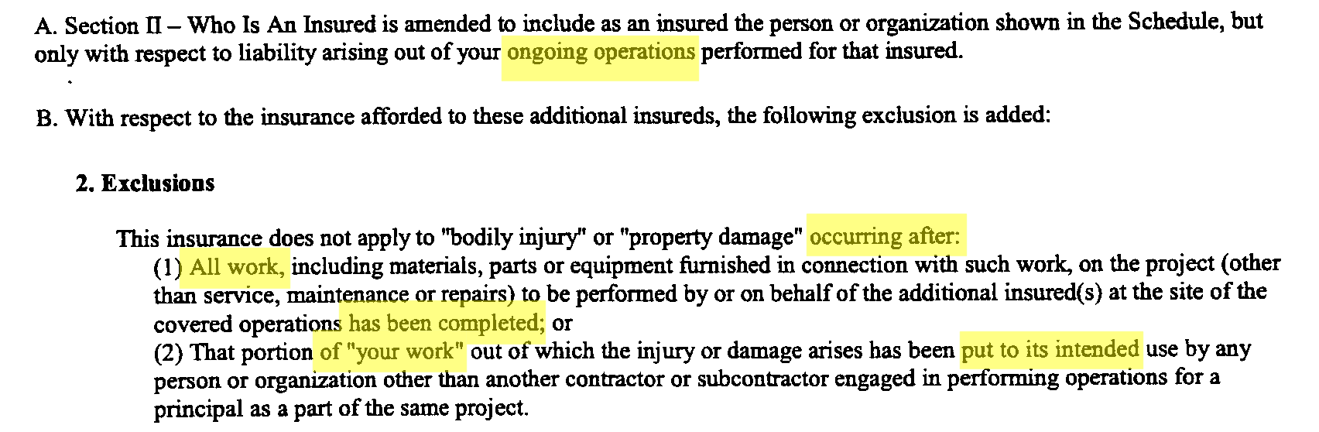
BROAD FORM ENDORSEMENTS (cont.)
COMPLETED OPERATIONS
CG 20 37 10 01
ONGOING OPERATIONS
CG 20 10 10 01

Slide 16
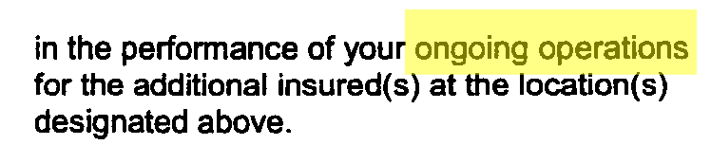
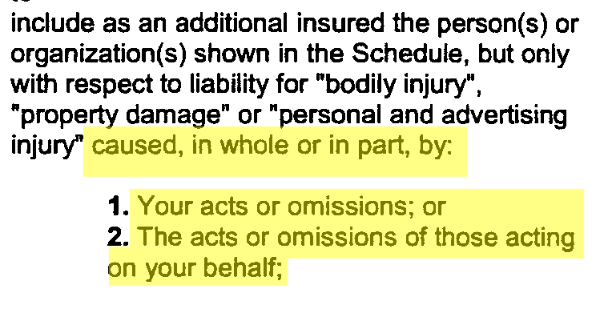
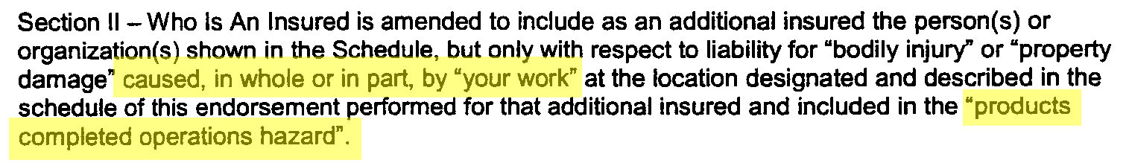
FAULT-BASED ENDORSEMENTS
COMPLETED OPERATIONS/FAULT BASED
CG 20 37 07 04
ONGOING OPERATIONS/FAULT BASED
CG 20 10 07 04

Slide 17
FAULT-BASED (with restrictions)
CG 2010 (04/13)
Ongoing Operations
2037 (04/13)
Completed Operations
Fault-Based
“Caused in whole and in Part”
But……………..
Only to the Extent Permitted by Law (Savings Clause)
No Broader than Coverage Specified in Contract
Most Insurer will Pay is Lesser of:
Contracted Limits
Limits Shown in Declaration

Slide 18
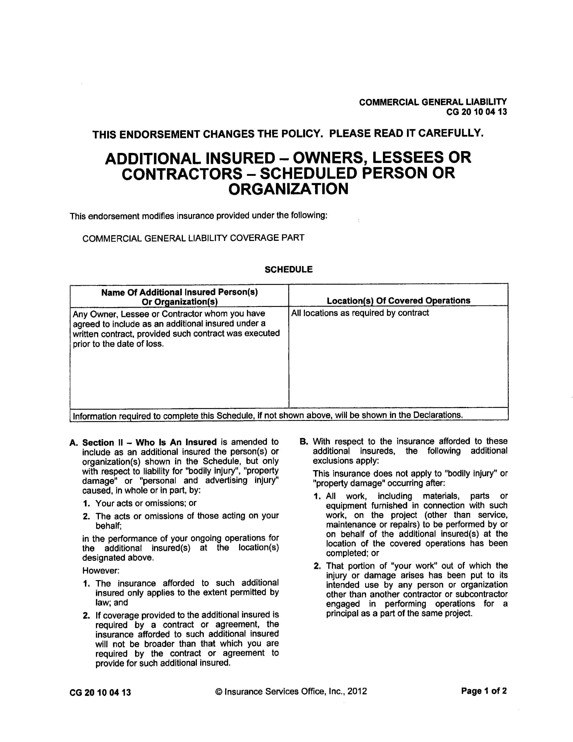
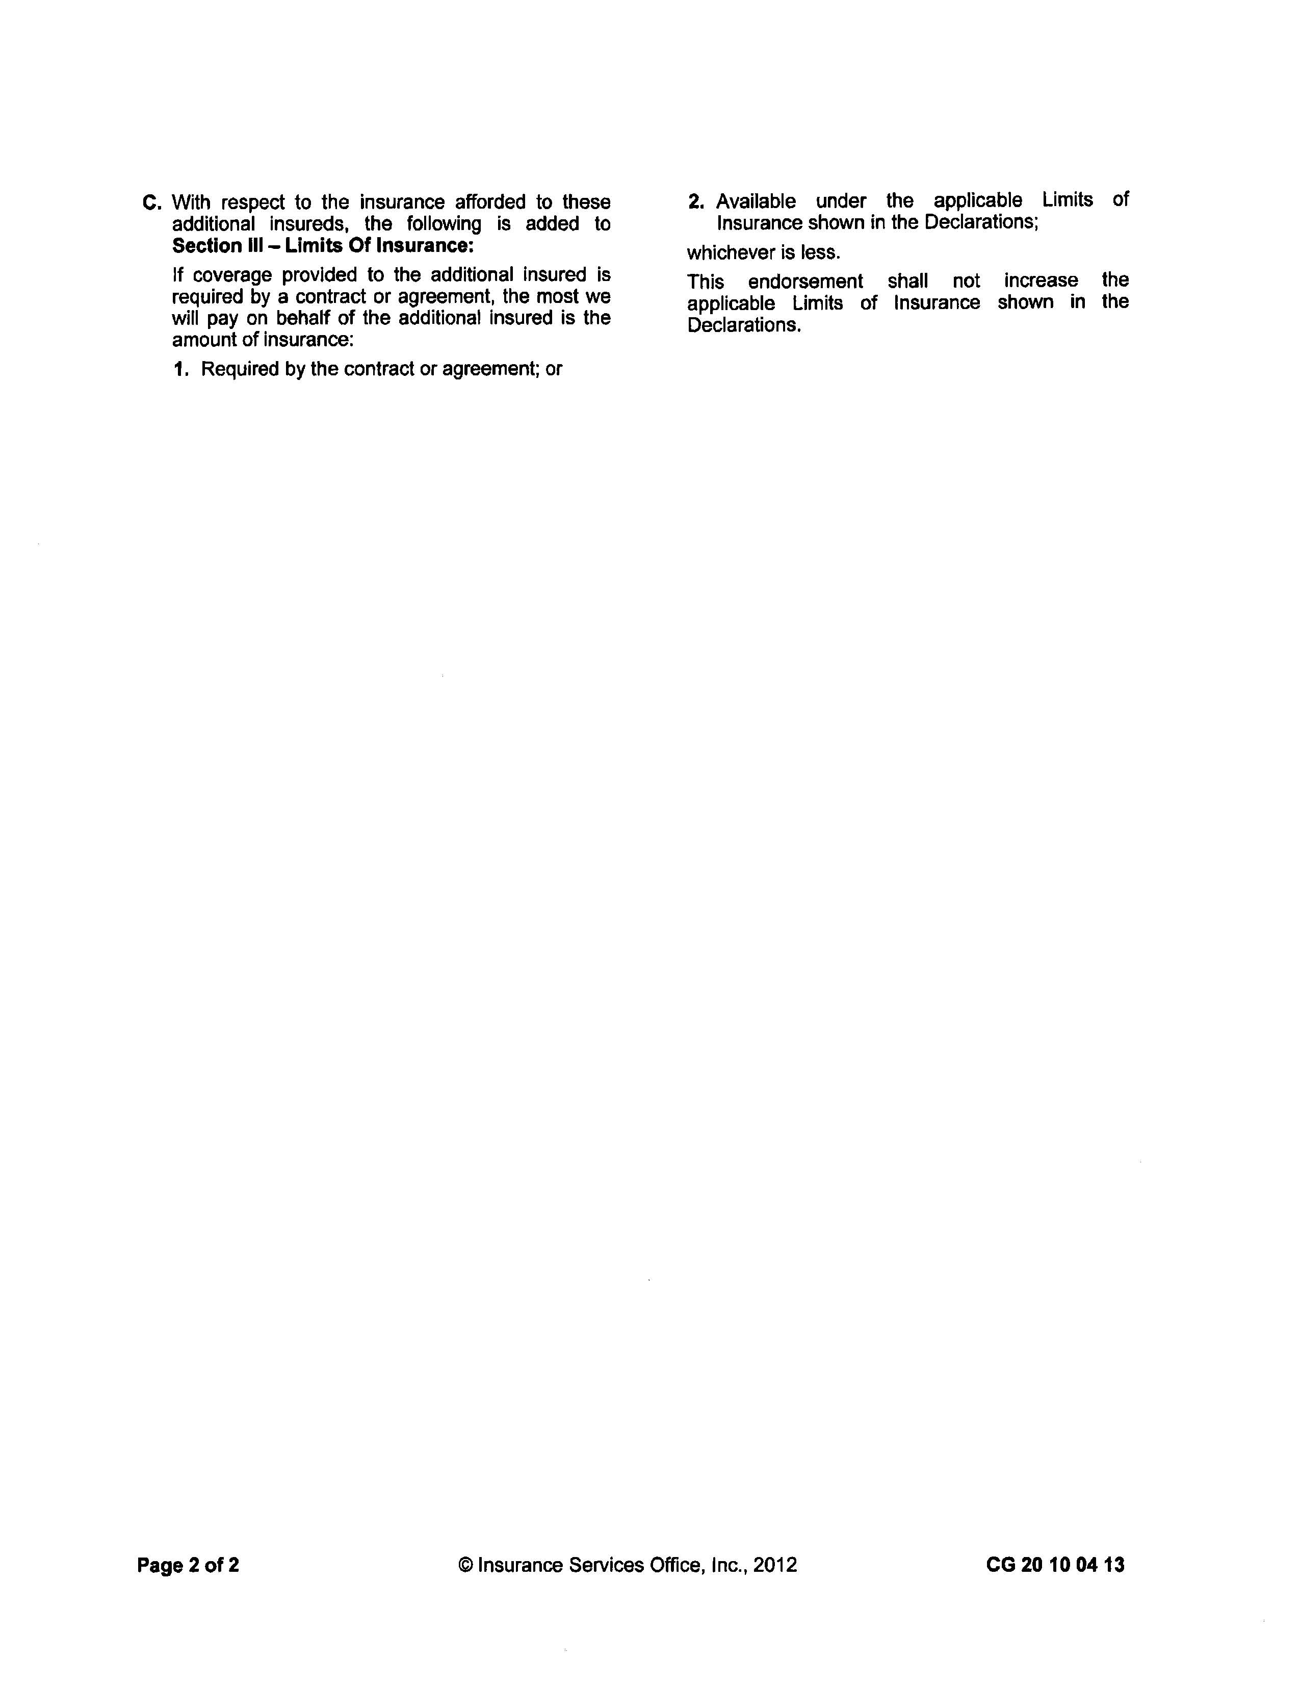

Slide 19
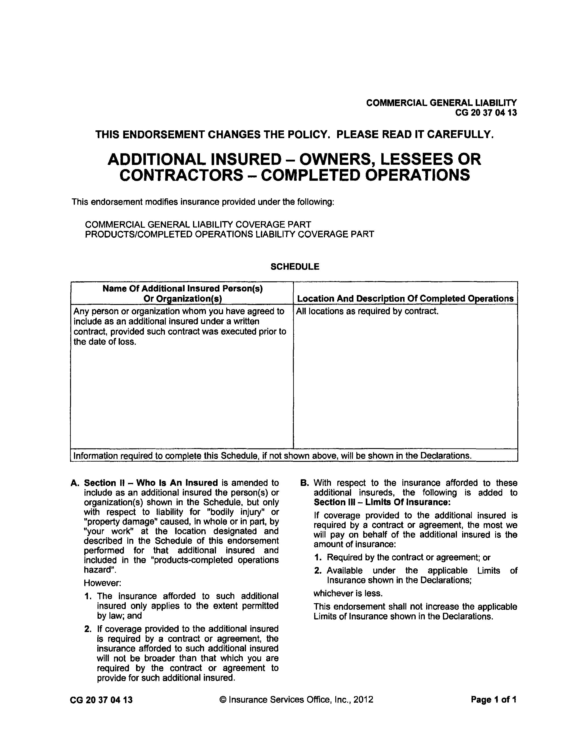

Slide 20
Practice Point
Consider add language substantially similar to the following in the insurance requirements of the contract:
In the event [insured’s] insurance policy(ies) provide greater coverage and/or greater limits than the minimum requirements set forth herein, then the [additional insureds] shall be entitled to the full coverage and limits of such policy(ies), and these insurance requirements will be deemed to require such greater coverage and/or greater limits.

Slide 21
Other Practical Tips When Drafting Insurance Requirements

Slide 22
Builder’s Risk/Property Insurance
A special form of property insurance policy that is designed to cover property in the course of construction
Who Procures? Owner or Contractor?
Full Replacement Cost
materials stored off site / materials in transit
doesn’t typically cover Contractor’s tools, machinery or equipment
Term (when does coverage cease?)
substantial completion / final completion / other (occupancy?)
“No fault”
Deductibles / waiver of subrogation / etc.
Practice Point: Waiver of subrogation should include “any other property insurance” maintained by owner

Slide 23
INSURANCE AGENT / CONSULTANT
Agent versus Independent Consultant
An insurance agent may be motivated by opportunity to sell a policy
A true insurance consultant (i.e., one who doesn’t sell insurance) will not have that potential conflict
Provide Contract
Insurance Requirements
Indemnification Obligations
Other?
Confirm coverage / identify potential gaps
Determine whether additional types/amounts of insurance make sense
Don’t wait!

Slide 24
Other Potential Issues
Primary / Won’t Seek Contribution
Professional Liability Insurance – Retroactive Date
How Long to Maintain Completed Operations
“Occurrence” versus “Claims Made”
Waiver of Claims and Waiver of Subrogation
Certified Copies of Policies versus Declaration Page and Endorsements
Require Periodic Updates to COI?
Notice of Cancellation (from Insurer)
Need Endorsement

Slide 25
Thank You – Questions?
_________________________________________________________
Scott P. Pence
Carlton Fields
spence@carltonfields.com
(813) 229-4322

