Slide 1
Florida Stop-Work Orders
Bennett M. Miller
Dunn & Miller, P.A.

Slide 2

Keeping Your Client Working
Reducing Fines

Slide 3
Applicable Law
Chapter 120, Florida Statutes
Chapter 440, Florida Statutes
Fla. Admin. Code R. 69L-6

Slide 4
Stop-Work Orders: The Basics
Section 440.107, Florida Statutes authorizes the Department of Financial Services, Division of Workers’ Compensation to issue Stop-Work Orders immediately closing your client’s business for failure to obtain workers’ compensation insurance when required by law.

Slide 5
Stop-Work Orders: The Basics
Section 440.107(1)(a), Florida Statutes provides:
“Whenever the department determines that an employer who is required to secure the payment to his or her employees of the compensation provided for by this chapter has failed to secure the payment of workers’ compensation required by this chapter or to produce the required business records under subsection (5) within 10 business days after receipt of the written request of the department, such failure shall be deemed an immediate serious danger to public health, safety, or welfare sufficient to justify service by the department of a stop-work order on the employer, requiring the cessation of all business operations.”

Slide 6
Stop-Work Orders: The Basics
Who must obtain workers’ compensation insurance? — “Employers”
Who is an “employer?” — Any person who engages in “employment”
Both terms are defined at Section 440.02, Florida Statutes, including exceptions to both terms.
Also, applicable federal law and case law may exempt your client
Investigative techniques - use of computer databases

Slide 7
Two Types of Stop-Work Orders
General
Site Specific
Fact driven based on the type of violation

Slide 8
Release of the Stop-Work Order
The Department sought substantial reforms in the process of releasing Stop-Work Orders during a recent legislative session and should be commended for it.
Now, only a down payment of $1,000.00 towards the penalty and an agreement to make periodic payments is required to re-open the business once proof of coverage is presented to the Department. Obviously, if your client is successful at hearing, the payments are returned to them. If not, the periodic payments are applied to the penalty.
Previously, it was the greater of $1,000 or 10% of the penalty, which had an unfair impact on small businesses wrongfully accused of high penalties and sometimes resulted in lengthy delays for innocent employees hoping to return to work.
If there is any prejudice to the client’s hearing rights by entering into a payment agreement, it has not been litigated.

Slide 9
Business Records
What business records will be requested?
See Fla. Admin. Code R. 69L-6.015
Identity, organizational, and occupational records, including payroll checks and W-2s.
Tax Records, Bank Records, Subcontractor Invoices
Copies of all workers’ compensation insurance policies and audits
Retention Schedule: Generally 3 years and must be located at employer’s office or worksite
Good idea to inform your clients of these requirements by mail or newsletter

Slide 10
Payroll
What is Payroll?
Wages, Payments, including cash
Bonuses
Payments made to employees on any basis other than time worked. Includes distributions, profit sharing, and incentive plans
Loans, if not repaid by employee
All income listed on Form 1099 Miscellaneous Income

Slide 11
Penalty Calculation
In addition to any penalty, stop-work order, or injunction, the department shall assess against any employer who has failed to secure the payment of compensation as required by this chapter a penalty equal to 2 times the amount the employer would have paid in premium when applying approved manual rates to the employer’s payroll during periods for which it failed to secure the payment of workers’ compensation required by this chapter within the preceding 2-year period or $1,000, whichever is greater.

Slide 12
Calculation of Penalties
Department uses a worksheet to calculate a penalty
It is not magic
Worksheet is incorporated by rule
Image on following page is taken from an existing case, no finding of liability has been made against the employer.

Slide 13
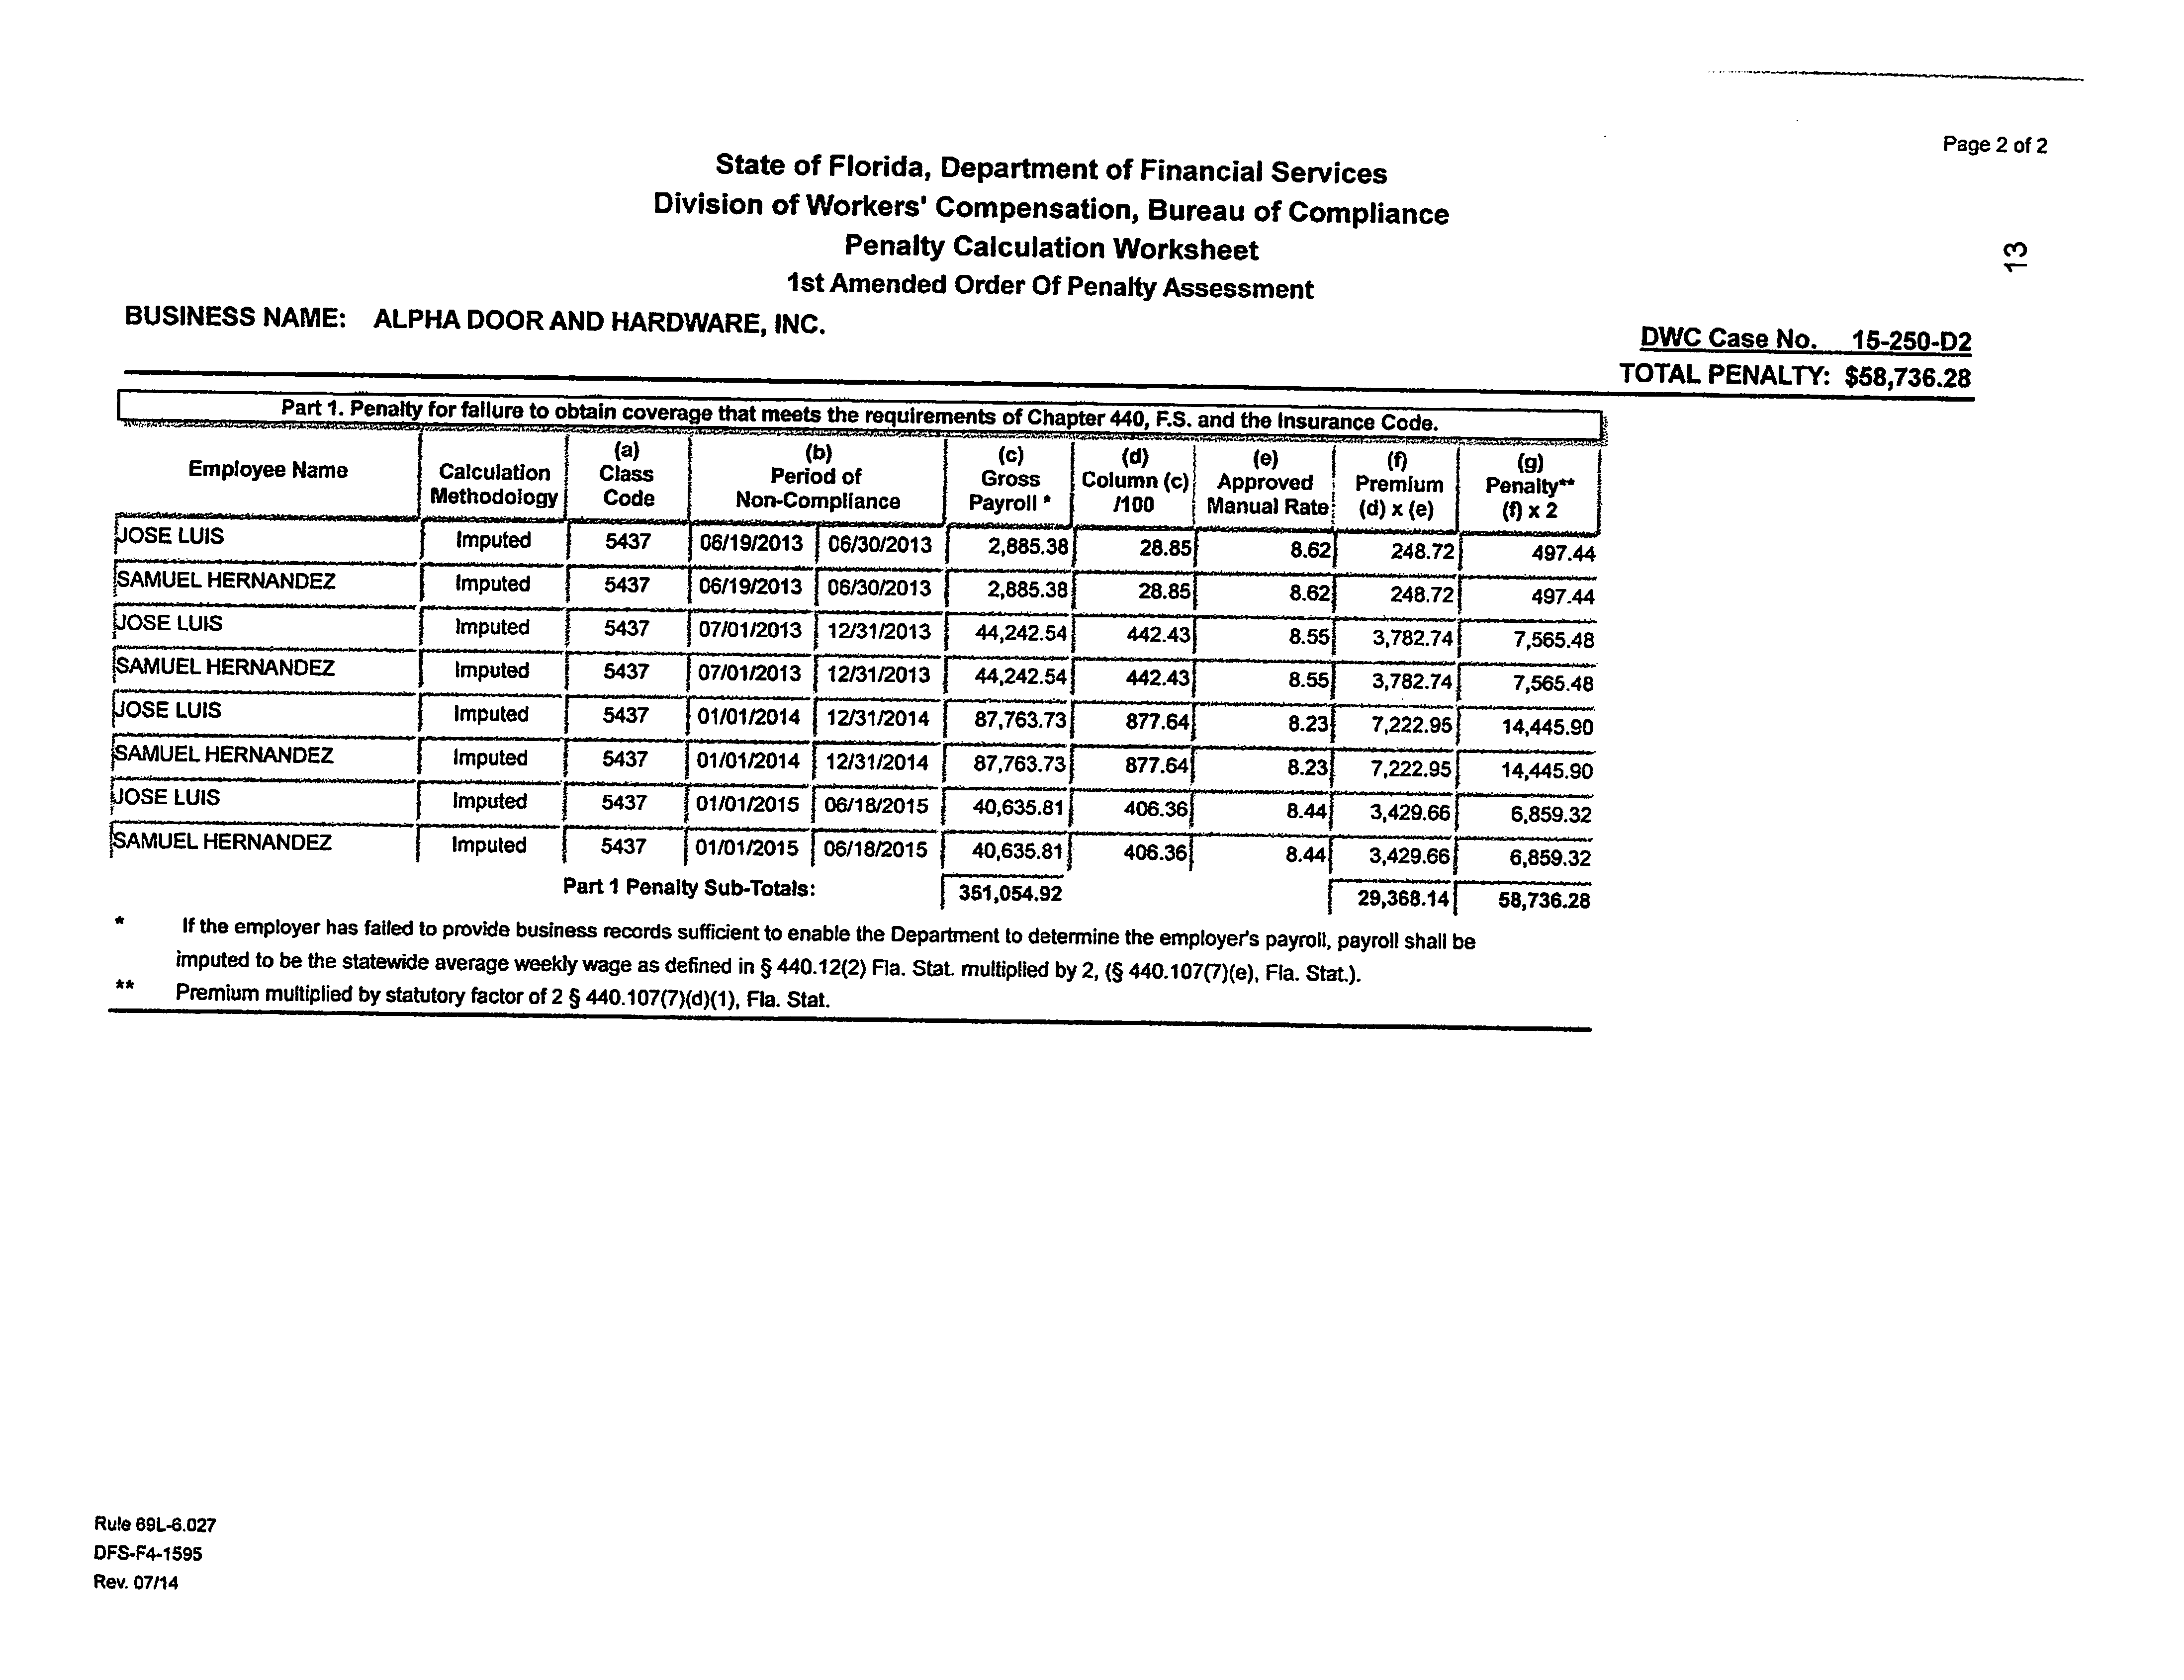


Slide 14
Imputation of Penalties
When an employer fails to provide business records sufficient to enable the department to determine the employer’s payroll for the period requested for the calculation of the penalty provided in paragraph (d), for penalty calculation purposes, the imputed weekly payroll for each employee, corporate officer, sole proprietor, or partner shall be the statewide average weekly wage as defined in s. 440.12(2) multiplied by 2. [Emphasis Added]

Slide 15
Imputation of Penalties
Statewide Weekly Wage is set by the Department of Economic Opportunity
Not incorporated by reference in DFS rule.
Hearsay
Dramatically higher than the wage paid to most employees under investigation, so penalty amount will substantially increase
Be sure to check and see if your client’s employees are making more than the average weekly wage

Slide 16
Additional Penalties
If your client continues to operate in violation of the Stop-Work Order, the client faces an administrative fine of $1,000.00 per day, in addition to criminal prosecution.
The Department of Financial Services, Division of Fraud is a law enforcement agency separate from the Division of Workers’ Compensation that is assigned to investigate these types of incidents.

Slide 17
Representing Your Client
Department Prosecutors and Investigators have limited authority to enter into settlement agreements
Typical contested hearings involve disputed issues of fact regarding the classification of employees on the penalty worksheet and whether a statutory exemption exists for the employer
Homeless person found on construction job site alleged to be employee.
Absence of evidence — Use of business records
Constitutional considerations

Slide 18
Criminal Considerations
Material under reporting
Misrepresent or conceal payroll, classification of workers, or information regarding loss history.
Any subsequent violation
Others

Slide 19
Successor Entities
Stop-work orders and penalty assessment orders issued against a corporation, limited liability company, partnership, or sole proprietorship shall be in effect against any successor corporation or business entity that has one or more of the same principals or officers as the corporation, limited liability company, or partnership against which the stop-work order was issued and are engaged in the same or equivalent trade or activity.

Slide 20
Bennett M. Miller
Dunn & Miller, P.A.
www.dunn-miller.com
bennettmmiller@icloud.com
850-443-4010
bob

Slide 21
Thank you for listening
Happy Holidays

