Slide 1
Coverage under Commercial General Liability Policies
Insurance & surety committee
October 19, 2015
Mark A. Boyle, Esquire
Boyle, Gentile & Leonard, P.A.
2050 McGregor Blvd, Fort Myers, FL
Mboyle@BoyleGentileLaw.com

Slide 2
Overview
Duty to Defend
Occurrence
Property Damage
Trigger
Additional Insured Coverage

Slide 3
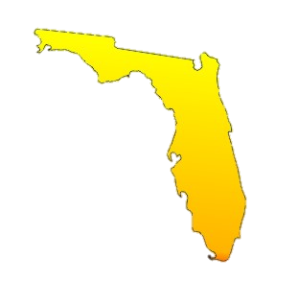
Choice of Law – Important for Determining Coverage
Florida adheres to the rule of lex loci contractus. State Farm Mut. Auto. Ins. Co. v. Roach, 945 So. 2d 1160, (Fla.2006).
In the context of insurance contracts, that rule provides that the law of the jurisdiction where the contract was executed governs the rights and liabilities of the parties in determining an issue of insurance coverage. Id.

Slide 4
Duty to Defend

Slide 5
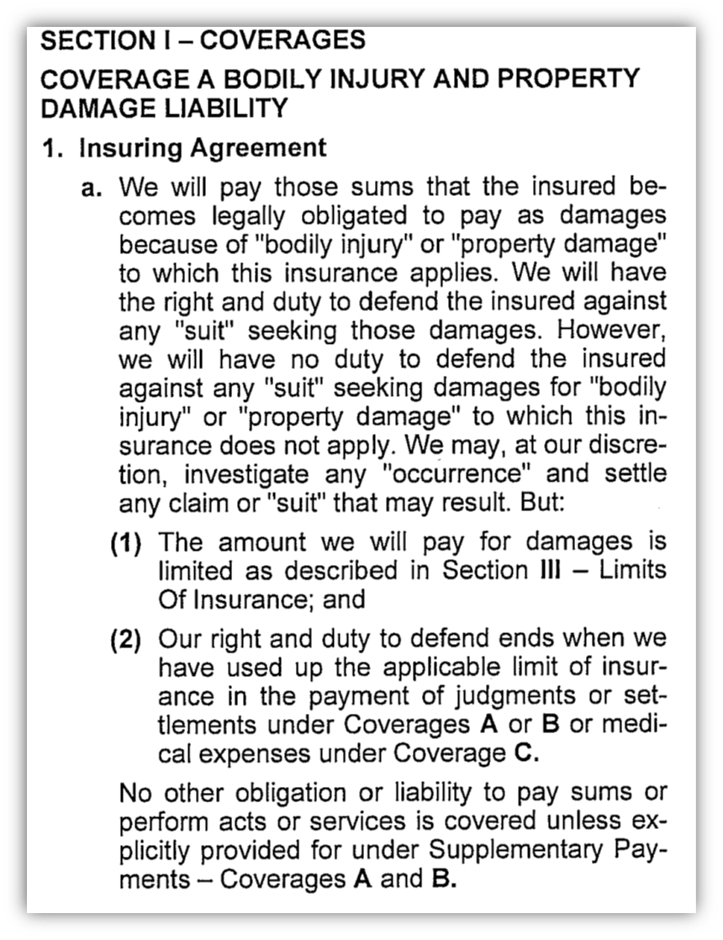
Right & Duty to Defend
Some jurisdictions follow the extrinsic facts rule. In Florida, the duty to defend is analyzed under what is colloquially called the “eight corners” rule.
Nat'l Union Fire Ins. Co. v. Lenox Liquors, Inc., 358 So. 2d 533, 536 (Fla. 1977)
C.A. Fielland, Inc. v. Fid. & Cas. Co., 297 So. 2d 122, 127 (Fla. 2d DCA 1974)
The eight corners refer to the comparison of the “four corners” of the complaint with the “four corners” of the insurance policy.

Slide 6
Duty to Defend
Importantly, the duty to defend is much broader than the duty to indemnify, as it is based solely upon the allegations in the complaint against the insured and should be interpreted broadly.
U.S. Fire Ins. Co. v. J.S.U.B., Inc., 979 So. 2d 871 (Fla. 2007); and
Auto-Owners Ins. Co. v. Pozzi Window Co., 984 So. 2d 1241 (Fla. 2008);
The duty to defend is separate and apart from the duty to indemnify, and the insurer is required to defend the suit even if true facts later show there is no coverage.
Grissom v. Commercial Union Ins. Co., 610 So. 2d 1299 (Fla. 1st DCA 1992); and
BellSouth Telecomms., Inc. v. Church & Tower of Fla., Inc., 930 So. 2d 668 (Fla. 3d DCA 2006, review denied 950 So. 2d 1238 (Fla. 2007)

Slide 7
Duty to Defend
Voeller Constr., Inc. v. S.-Owners Ins. Co., 2014 WL 1779289 (M.D. Fla. May 5, 2014):
Impact:
Voeller refuses to allow extrinsic evidence to create a duty to defend. The exception to the four corners rule involves only “uncontroverted facts outside of the allegations in the underlying complaint that refer to facts that take the case outside of the policy coverage, not those that bring the case within coverage.”
Unresolved issues:
The Court cites Composite Structures and Keen in referring to the exception to the four corners rule, cases in which the extrinsic facts were not only uncontroverted but admitted by the insureds and incontrovertible. What constitutes an uncontroverted extrinsic fact is an open question.
Voeller certainly stands for the proposition that the limited extrinsic evidence exception to the four corners rule is only available to disprove a duty to defend. Composite Structures allows a carrier to disclaim coverage on that basis without filing a declaratory judgment action. An insured’s remedy if the carrier makes an incorrect decision on the duty to defend by relying upon an uncontroverted extrinsic fact is an unresolved question with potential bad faith ramifications.

Slide 8
Duty to Defend Triggered by Chapter 558 Notice?
Altman Contractors, Inc. v. Crum & Forster Specialty Ins. Co., 2015 WL 3539755 (S.D. Fla. 2015):
No, a Chapter 558 notice does not trigger an insurer’s duty to defend because the alternative dispute resolution mechanism contained with Chapter 558 does not constitute a “civil proceeding.”
The court held that “civil proceeding” or “suit” must involve “some sort of forum and some sort of decision maker….”
On appeal to the 11th Circuit right now.

Slide 9
Is Defective Construction an “Occurrence”?

Slide 10
“Occurrence”

Slide 11
Boran Craig Barber Homes, Inc. v. Mid-Continent Cas. Co., Case Number 2:06-cv-00089-UA-SPC (M.D. Fla. Feb. 19, 2009)
In CGL policies, where the term “occurrence” is defined as “an accident, including continuous or repeated exposure to substantially the same general harmful conditions,” the policies will cover multiple occasions of water leakage, as long as that leakage was caused by conditions that were not “substantially the same.”

Slide 12
“Occurrence”
U.S. Fire Ins. Co. v. J.S.U.B., 979 So. 2d 871 (Fla. 2007)
We hold that faulty workmanship that is neither intended or expected from the standpoint of the contractor can constitute an “accident” and thus, an “occurrence” under a post-1986 CGL policy period.
Kvaerner Metals Division of Kvaerner U.S., Inc. v. Commercial Union Ins. Co., 908 A.2d 888 (Pa. 2006)
The definition of “accident” required to establish “occurrence” under the commercial general liability (CGL) insurance policies cannot be satisfied by claims based upon faulty workmanship; such claims simply do not present the degree of fortuity contemplated by the ordinary definition of “accident”.
VS

Slide 13
“Occurrence”
Can there be more than one event?
Why Does it Matter?
Deductible

Slide 14
“Occurrence”
Koikos v. Travelers Ins. Co., 849 So. 2d 263 (Fla. 2003)
Florida Supreme Court interpreted “continuous or repeated exposure” in the definition of “occurrence,” as providing more coverage, not less
Focus is not on whether negligent act arose out of same incident but whether such events were expected or intended from the standpoint of the insured.
Adopted the majority “cause theory”
“cause theory” = cause of damages or injuries
“effect theory” = the number of injured plaintiffs
Must analyze the immediate acts that give rise to the injuries.

Slide 15
“Occurrence”
Mid-Continent v. Basdeo, 742 F.Supp.2d 1293 (S.D. Fla. 2010) aff’d Mid-Continent v. Basdeo, 477 Fed. Appx. 702 (11th Cir. June 12, 2012)
GC making repairs to condo buildings.
3 occurrences transpired:
1) Damages having connection with the insured’s tarping work;
2) Damages caused in connection with the insured’s work on the roofs; and
3) Damages caused in connection with the insured’s work on the mansards.
Each of the 3 categories of property damage resulted from separate forces
The separate forces inflicting the damages are what determine the number of occurrences
Record reflected that the work done on the flat roofs differed substantially from work performed on mansards.
The insured undertook different types of work on different parts of the buildings, and as such, the insured’s work on each of the parts of the buildings set in motion a separate force and the damages stemming from the work on the mansards and the flat roofs constituted two separate occurrences.
While the Southern District recognized that the costs for repairing or removing defective work are not covered by the definition of “property damage”, the costs of repairing damage caused by defective work are covered.

Slide 16
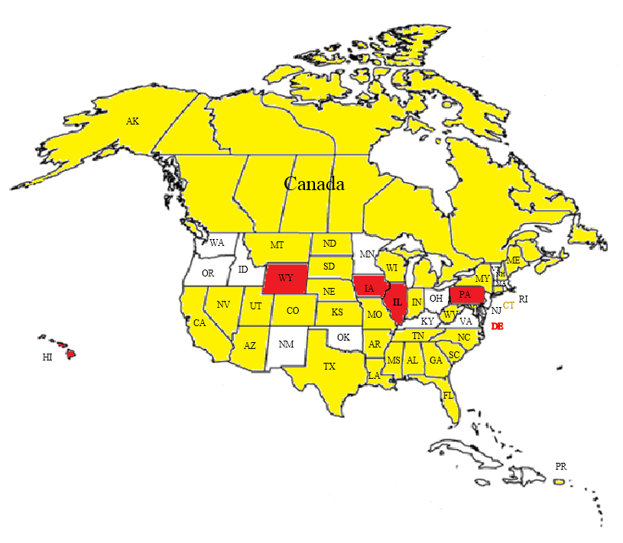
“Occurrence”
= OCCURRENCE
= NO OCCURRENCE
= UNSETTLED

Slide 17
What does “Property Damage” really mean in Florida?

Slide 18
“Property Damage”
Under most policies, “property damage” is defined as:
a. Physical injury to tangible property, including all resulting loss of use of that property. All such loss of use shall be deemed to occur at the time of the physical injury that caused it; or
b. Loss of use of tangible property that is not physically injured. All such loss of use shall be deemed to occur at the time of the “occurrence” that caused it.

Slide 19
What was intended by Insurance Services Office (ISO)?
The insured would have no coverage for damage to his work arising out of his work.
The insured would have coverage for damages to his work arising out of a subcontractor’s work
The insured would have coverage for damage to a subcontractor’s work arising out of the subcontractor’s work
The insured would have coverage for damage to a subcontractor’s work, or if the insured is a subcontractor to a general contractor’s work or another subcontractor’s work, arising out of the insured’s work.
Insurance Services Office Circular, Commercial General Liability Program Instructions Pamphlet, No. GL–86–204 (July 15, 1986).
Insurance Services Office Circular, Broad Form Property Damage Coverage Explained, GL-79-12 (January 19, 1979).

Slide 20
“Property Damage”
FL law is unclear about whether coverage is available when a subcontractor’s defective performance of work damages only the materials of the subcontractor.

Slide 21
Auto-Owners Ins. Co. v. Pozzi Window Co., 984 So. 2d 1241 (Fla. 2008)
Facts: Homeowner bought windows, manufactured by Pozzi, but installed by a subcontractor. Subcontractor incorrectly installed the windows, which caused damage around the windows. The Florida Supreme Court held that the damage was covered.
Construction defects = an “accident” and “occurrence”
Physical injury to tangible property arising out of the defective work = “property damage”

Slide 22

West Orange Lumber Co., Inc. v. Indiana Lumbermans Mut. Ins. Co., 898 So. 2d 1147 (Fla. 5th DCA 2005)
The cost of removing and replacing cedar siding of the wrong grade, installed in breach of contract, was not “property damage.”
Claims solely for “the costs of repairing and replacing the actual defects in ... construction” are not covered under CGL policies.

Slide 23
Amerisure Mut. Ins. Co. v. Auchter Co., 673 F.3d 1294 (11th Cir. 2012)
Limited the definition of covered “property damage” in a standard CGL policy such as the one issued by MCC in this case.
The claim for the costs to repair the defective roof were not claims for “property damage” because the defective installation of the inn's roof did not cause “physical injury to tangible property.
The relevant component for examining the scope of the subcontractor's defective work was not the individually installed roofing tiles, which the Court considered to be the raw materials from which the roof was made, but instead was the entire roof itself.

Slide 24
J.B.D. Const., Inc. v. Mid-Continent Cas. Co., 571 Fed. Appx. 918 (11th Cir. 2014)
Costs to repair the defectively installed roof, doors and windows, these costs were not “property damage” and therefore not covered by the policy under Florida law.
Defective construction qualifies as an occurrence.
Policy’s “your work” exclusion barred coverage of costs to repair damage to fitness center.

Slide 25
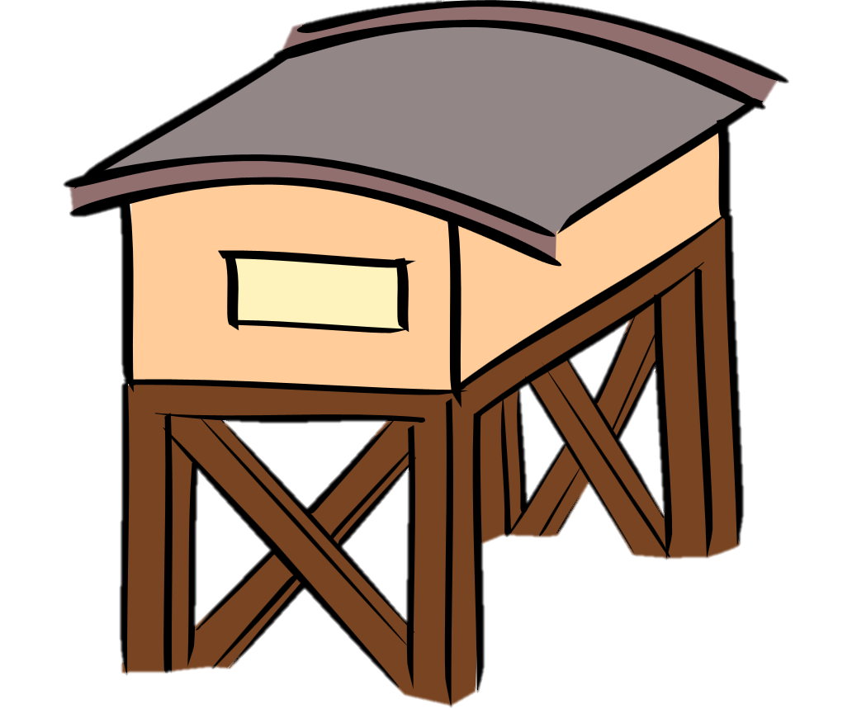
Physical Injury
Threshold for constituting a “physical injury,” a definitional term of “property damage,” is low.
Any physical or material alteration resulting in a detriment constitutes “physical injury” in a CGL policy.
See Zurich Am. Ins. Co. v. Cutrale Citrus Juices USA, Inc., 2002 WL 1433728 (M.D. Fla. 2002)(stating “[t]he accidental introduction of an adulterant is a physical event that causes injury or damage just as surely as the damage resulting from the collision of two automobiles”).
Most courts have rejected the argument that “property damage” must be to property owned by or work performed by a third party.

Slide 26
Carithers v. Mid-Continent Cas., Co., 782 F. 3d 1240 (11th Cir. 2015)
Impact:
In the Eleventh Circuit, damages for an insured’s defective work are covered if the defective work must be replaced in order to repair covered property damage.

Slide 27
Carithers v. Mid-Continent Cas., Co., 782 F. 3d 1240 (11th Cir. 2015)
Holdings and Reasoning:
Damage to brick caused by defective coating was not covered”
Failure of coating caused to damage to brick. Because the Carithers could not prove that different subcontractors performed the brick work and the coating work, the damage was not covered pursuant to U.S. Fire Ins. Co. v. J.S.U.B., Inc., 979 So.2d 871 (Fla. 2007).

Slide 28
Carithers v. Mid-Continent Cas., Co., 782 F. 3d 1240 (11th Cir. 2015)
Holdings and Reasoning:
Damage to tile caused by defective mud base was not covered:
Even though the Carithers had purchased the tile that was damaged, the Eleventh Circuit’s narrow interpretation of Pozzi Window in Auchter precluded coverage. Auchter distinguished between a window, which has many components, and a roof tile, which is one component that goes into a roof.
No coverage for a defective installation when there is no damage beyond the defective work of a single subcontractor. Here, mud base and tile were done by the same subcontractor.

Slide 29
Carithers v. Mid-Continent Cas., Co., 782 F. 3d 1240 (11th Cir. 2015)
Holdings and Reasoning:
Carithers were entitled to cost of rebuilding balcony (get-to damage) ($3,325).
Trial court found that balcony was not covered.
But, trial court found as a fact that, in order to repair the garage (which was covered), the balcony had to be rebuilt.
Mid-Continent did not appeal this fact-finding.
“Under Florida law, the Carithers had a right to ‘the costs of repairing damage caused by the defective work …’ J.S.U.B.”
“Since the district determined that repairing the balcony was part of the cost of repairing the garage, which was defective work, the Carithers were entitled to these damages.”

Slide 30
Carithers v. Mid-Continent Cas., Co., 782 F. 3d 1240 (11th Cir. 2015)
Unresolved Questions:
Who has burden of proof regarding necessity of rebuilding insured’s work in order to repair covered property damage?
What is the extent to which work to the insured’s work becomes compensable? Removal? Replacement? With what? (value of what was there vs. what should have been there in the first place)

Slide 31
Does Loss of Use of a Product Constitute Property Damage?
Eljer Mfg., Inc. v. Liberty Mut. Ins. Co., 972 F.2d 805 (7th Cir. 1992)
Holding that the incorporation of a defective product into another product constituted property damage, as physical injury to tangible property, at the moment of incorporation.
Travelers Ins. Co. v. Eljer Mfg., Inc., 757 N.E.2d 481 (Ill. 2000)
The court disagreed with the policyholders’ argument, holding that the home owners whose systems did not leak suffered no “physical injury to tangible property.” The court also held that the post-1986 edition CGL insurance policies are not triggered if a home is physically damaged by a home owner replacing a nonleaking system; this does not constitute physical injury to tangible property arising from a covered occurrence under the policies.

Slide 32
“because of”
The words “because of” indicate that the legal liability must have as its source, or arise from, physical injury to or loss of use of tangible property. Once “property damage” has been established, the CGL then covers economic losses that flow from the “property damage.”

Slide 33
Help Me Get a Defense!
In Florida, the property damage requirement is met for the general contractor when the work of one subcontractor causes physical damage to the otherwise properly completed work of either:
the GC;
other subcontractors; or
true third party property damage (meaning property not involved in the original construction, i.e. rugs, pictures, etc.)
Pleading one of these three items is key to triggering insurers’ obligation to defend

Slide 34


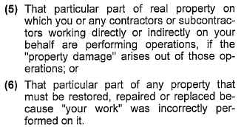
CGL Coverage MAY be limited if the loss occurs during operations.
Key terms in both exclusions is “that particular part”.

Slide 35
Am. Equity Ins. Co. v. Van Ginhoven, 788 So. 2d 388 (Fla. 5th DCA 2001)
FACTS: A general contractor, Van Ginhoven, was contracted to perform remediations at and around a pool at an existing residence. Id. As Van Ginhoven was draining the pool, water table pressure caused the pool to pop out of the ground, resulting in damage to the pool, pump, heating system, deck, screen enclosures and surrounding landscaping, and sprinkler system. Id. The trial court held that all of the damages were covered under Van Ginhoven’s commercial general liability policy. Id. Insurer claimed pool damage was excluded (that particular part) but admitted coverage for all other property damage being claimed by the homeowner. Id.
HELD: The pool, upon which operations were being performed when the damage occurred, was not covered. Rationale was that even though his scope of work was only to replace tile, at the time of the loss, he was working on entire pool (draining pool). Because Van Ginhoven was not working on the plumbing, electrical, deck work, patio, screen enclosure or the residence, any damage to those items is covered.
Factually, the insured was draining the entire pool. Pre-JSUB.
See also Amerisure Mut. Ins. Co. v. Am. Cutting & Drilling Co., Inc., 08-60967-CIV, 2009 WL 700246 (S.D. Fla. 2009); Oak Ford Owners Ass'n v. Auto-Owners Ins. Co., 510 F. Supp. 2d 812 (M.D. Fla. 2007).

Slide 36
Essex Ins. Co. v. Kart Const., Inc., 2015 WL 4730540 (M.D. Fla. 2015)
FACTS:
Kart Construction was hired to weld stiffening parts onto a cell tower.
A fire broke out on and damaged “Sprint antennas, T-Mobile antennas, tower lights, cabling, foundations, and other equipment.”
A fire did not occur where the welding took place.
Kart filed a claim with Essex, its insurer. Essex denied the indemnity claim and filed an action seeking a declaration that it had no duty to indemnify Kart for the loss based on the j(5) exclusion.

Slide 37
Essex Ins. Co. v. Kart Const., Inc., 2015 WL 4730540 (M.D. Fla. 2015)
The dispute centered around of broadly the j(5) exclusion should be interpreted.
Kart argued the exclusion only applied to the exact “particular part,” i.e. the ten-foot tower segment, it worked on.
Essex argued Kart “operated” on the entire tower, and therefore, the whole tower constituted the “particular part” of property excluded from coverage.

Slide 38
Essex Ins. Co. v. Kart Const., Inc., 2015 WL 4730540 (M.D. Fla. 2015)
The Court relying on Van Ginhoven rejected Essex’s argument and concluded that the focus of “operations” is whether those “operations” were being performed at the time of the accident, not the tasks contemplated by the contract.
Additionally, the court rejected Essex’s argument that the entire tower was the “particular part” of property Kart operated on:
“Section (j)(5) excludes from coverage damage to ‘that particular part’ of the real property on which the insured is operating at the time of the accident, and at the time of the accident, Kart (relevant) operations occurred only on a ten-foot portion of the tower.

Slide 39
Most jurisdictions interpret j(5) and j(6) as intended by the ISO.
Fortney & Weygandt, Inc. v. Amer. Man. Mut. Ins. Co. 595 F.3d 308 (6th Cir. 2010):
[D]efective workmanship exclusion in insured contractor’s commercial general liability (CGL) policy, for property damage to that “particular part of any property that must be restored, repaired or replaced because ‘your work’ was incorrectly performed on it,” applied only to cost of replacing building’s distinct component parts on which insured performed defective work, not building parts on which insured performed nondefective work but that were replaced anyway due to insured’s defective work on other parts of building.

Slide 40
J.S.U.B., Inc., 979 So. 2d 871 (Fla. 2007)
The Florida Supreme Court in JSUB recognized what the ISO intended.
Supreme Court specifically recognized that the CGL policy of insurance had been purposely changed from the time of the prior Florida Supreme Court decision interpreting an earlier version of CGL policies.
Moreover, the Insurance Services Office promulgated a circular on July 15, 1986, confirming that the 1986 revisions to the standard CGL policy not only incorporated the “Broad Form” property endorsement but also specifically “cover[ed] damage caused by faulty workmanship to other parts of work in progress; and damage to, or caused by, a subcontractor's work after the insured's operations are completed.” Insurance Services Office Circular, Commercial General Liability Program Instructions Pamphlet, No. GL–86–204 (July 15, 1986).

Slide 41
Issues with Products Completed Operation Hazard (“PCOH”)

Slide 42
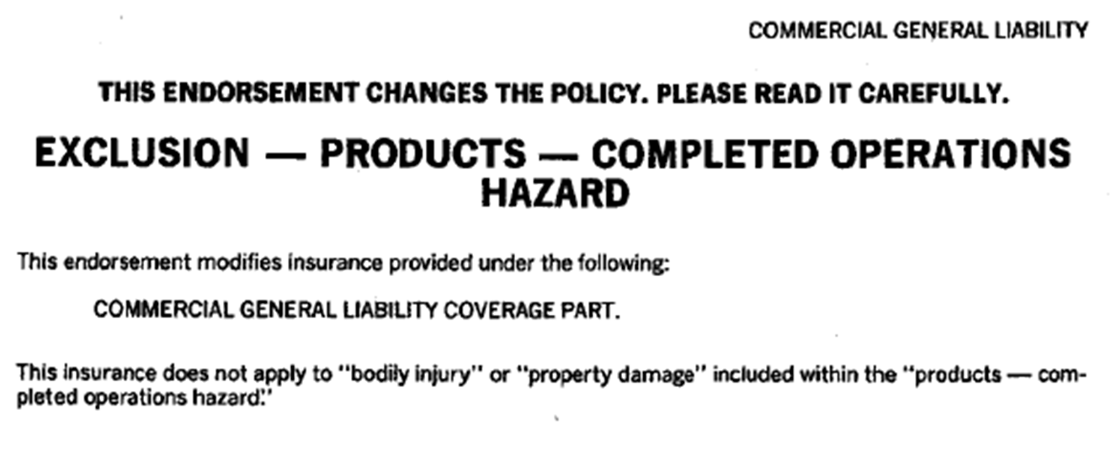

PCOH - BEWARE ENDORSEMENTS!
Endorsement can be deadly to claimants
Always READ the policy in its entirety

Slide 43
PCOH
Bresee Homes, Inc. v. Farmers Ins. Exchange, 293 P.3d 1036 (Or. 2012)
Look to the complaint and policy to determine duty to defend
The court asserted that contractor did not bear the burden of proving that its work was not completed when the alleged property damage occurred, in order to avoid the effects of the “products—completed operations hazard” exclusion.
The court noted that, while carrier had offered evidence that contractor had completed its work prior to alleged damages that evidence was not contained within the complaint and, thereby, could not be considered when evaluating whether carrier had a duty to defend.

Slide 44
Trigger

Slide 45

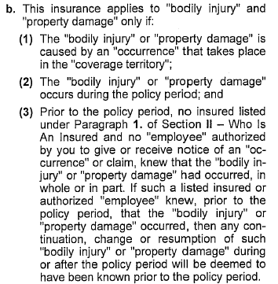

Trigger

Slide 46

Trigger of Coverage
FOUR MAIN THEORIES:
“Injury-in-fact”- All CGL policies are triggered if they are in effect during the time the injury or damage is shown to have actually taken place, even if the injury or damage continues over time.
“Manifestation”-The CGL policy is triggered when the injury or damage is discovered or manifests itself (or in some cases is capable of being discovered) during the policy period. That the injury or damage may be been occurring prior to discovery may not be taken into account in this theory.
“Exposure”- All CGL policies are triggered if they are in effect during exposure to injurious or harmful conditions. Primarily used in asbestos cases, this theory considers bodily injury to begin when a person was first exposed to asbestos, usually at the first inhalation of asbestos fibers.
“Continuous”- All CGL policies are triggered if they are in effect during any of the following times: exposure to harmful conditions; actual injury or damage; and upon manifestation of the injury or damage.
See Auto Owners Ins. Co. v. Travelers Cas. & Surety Co., 227 F.Supp.2d 1248 (M.D. Fla. 2002); and In re Celotex Corp., 196 B.R. 973 (M.D. Fla. 1996); Don’s Building Supply, Inc. v. OneBeacon Ins. Co., 267 S.W. 3d 20 (Tex. 2008).

Slide 47
Injury-in-fact Trigger
Means irrespective of when it was found, who found it, who was capable of finding it, when did the damage actually happen. If it happened in more than one policy period, then multiple policies of insurance may be triggered.
See Axis Surplus Ins. Co. v. Contravest Const. Co., 921 F. Supp. 2d 1338 (M.D. Fla. 2012)
Trovillion Const. & Development, Inc. v. Mid-Continent Cas. Co., 2014 WL 201678 (M.D. Fla. Jan. 17, 2014);
Johnson-Graham-Malone, Inc. v. Amerisure, 18 Fla. L. Weekly Supp. 870a (Fla. April 29, 2011), dismissed Amerisure Ins. Co. v. Johnson-Graham-Malone, Inc., 66 So. 3d 415 (Fla. 1st DCA 2011)
Voeller Const., Inc. v. S.-Owners Ins. Co., 8:13-CV-3169-T-30MAP, 2014 WL 1779289, at *1 (M.D. Fla. 2014)
Trizec Properties, Inc. v. Biltmore Construction Co., 767 F.2d 810 (11th Cir.1985)
Don’s Building Supply, Inc. v. OneBeacon Ins. Co., 267 S.W. 3d 20 (Tex. 2008)

Slide 48
Manifestation Trigger
Determines coverage based on when the damage was found or capable of being found irrespective of when it actually happened.
See Auto Owners v. Travelers Cas. & Surety Co. , 227 F.Supp.2d 1248 (M.D. Fla. 2002).
Query: Can there be more than one manifestation?
Yes → See Boran Craig Barber Homes, Inc. v. Mid-Continent Cas. Co., Case Number 2:06-cv-00089-UA-SPC (M.D. Fla. Feb. 19, 2009)
Policies and the common law may apply a known loss and progress doctrine to eliminate a progressive injury .

Slide 49
Carithers v. Mid-Continent Cas., Co., 782 F. 3d 1240 (11th Cir. 2015)
The Eleventh Circuit adopts the injury-in fact trigger and rejects the manifestation trigger. The Court left the door open for a continuous trigger where it is difficult or impossible to determine when the property was damaged.
The Eleventh Circuit cited to its prior decision in Trizec Properties, Inc. v. Biltmore Construction Co., Inc., 767 F. 2d 810 (11th Cir. 1985), which held “[t]he potential for coverage is triggered when an ‘occurrence’ results in ‘property damage.’ There is no requirement that damages ‘manifest’ themselves during the policy period. Rather, it is the damage itself which must occur during the policy period for coverage to be effective.
Accordingly, the Court held “[p]roperty damage occurs when the damage happens, not when the damage is discovered or discoverable.

Slide 50
Additional Insured (“AI”) Coverage

Slide 51
Why Be an Additional Insured?
An AI has direct rights under the policy, including right to suit whereas a mere contractual indemnitee does not.
See Structural Group, Inc. v. FCCI Commercial Ins. Co., Case No. 11-CV- 81339, Doc. 62 (S.D. Fla. December 12, 2012)
Prohibits insurers indemnitor from subrogation
Increases available limits of insurance
Reinforces risk transfer otherwise accomplished through indemnity agreements even if indemnity agreements are deemed invalid
Avoid loss history, payment of deductibles or self insured retentions and accompanying increased premiums

Slide 52
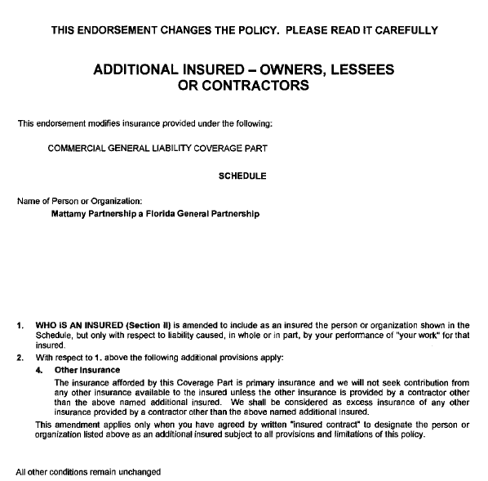
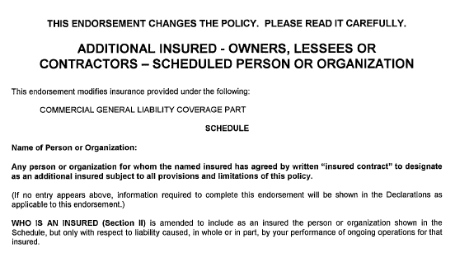
Types of AI
Broad Form
Named Form

Slide 53
Scope of AI Coverage
“arising out of” = broadest
“whole or in part” = intermediate
“because of” or “caused by”= purely vicarious, most limited
WHO IS AN INSURED (Section II) is amended to include as an insured the person or organization shown in the schedule, but only with respect to liability arising out of your ongoing operations performed for that insured.
Koala Miami Realty Holding Co., Inc. v. Valiant Ins. Co., 913 So. 2d 25, 26 (Fla. 3d DCA 2005)
Who is An Insured is amended to include as an additional insured the person(s) or organization(s) shown in the Schedule, but only with respect to the liability for “bodily injury” or “property damage” caused, in whole or in part, by “your work” . . . .
Zep Construction v. Interstate Fire & Cas. Co. , 18 Fla. L. Weekly Supp. 65a (Fla. 12th Cir. 2010).
A covered person means:
[1] You or a family member;
[2] any other person or organization with respect to liability because of acts or omissions of you or a family member; or
[3] any combination of the above.
Garcia v. Fed. Ins. Co., 969 So. 2d 288, 290 (Fla. 2007)

Slide 54

AI Status
Additional insured status is independent of contractual indemnity.
Thus, even when contractual indemnity agreement and accompanying contractual defense obligation are deemed invalid, AI obligations remain.
Cone Bros. Contracting Co. v. Ashland-Warren, Inc., 458 So. 2d 851 (Fla. 2d DCA 1984); Apol v. Shaw, 647 So. 2d 139, 141 (Fla. 1st DCA 1994)

Slide 55

AI – What Does the Subcontract Say?
Add GC/Owner as Additional Insured?
To Which Policies? CGL, Excess, Umbrella,
Insurance Limits Required?
AI on Primary & Noncontributory Basis?
Products Completed Operations Coverage for AI?
Or Only During Operations Coverage
For How Long must AI be Listed on Policies?
Proof of AI?
By endorsements or only by certificates

Slide 56
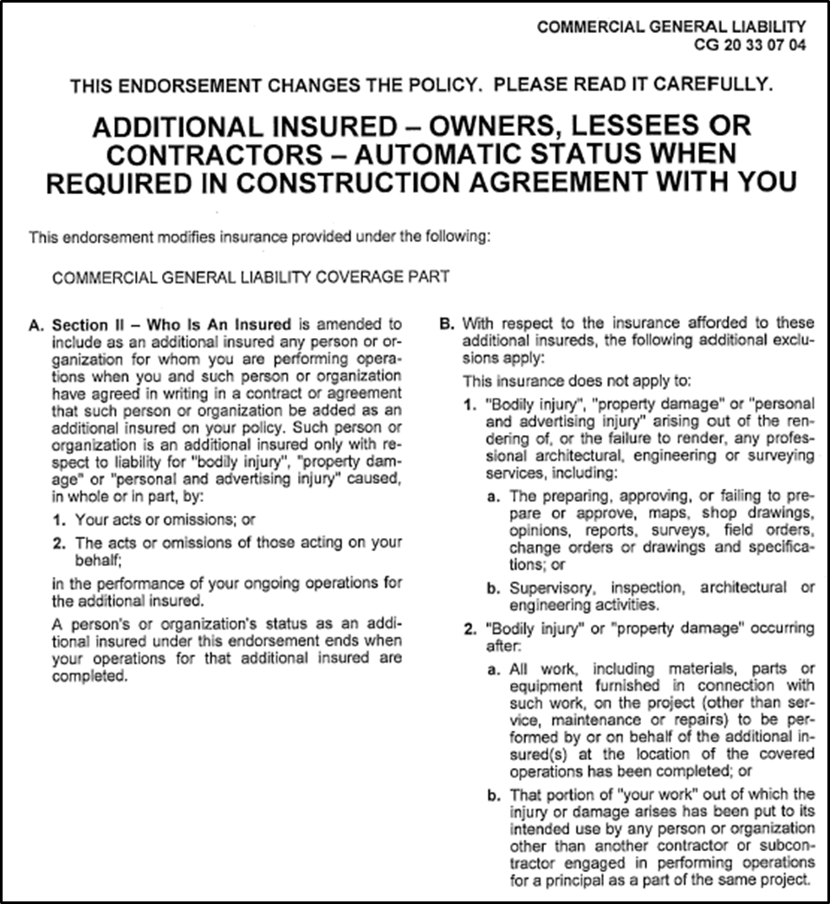
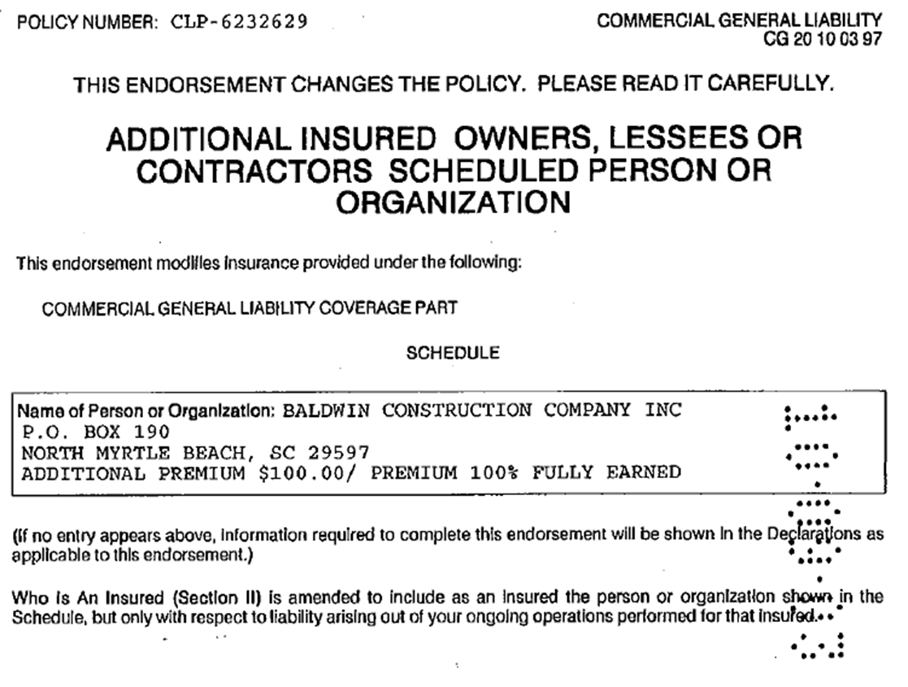
Common Issue: Is AI limited to the time where the subcontract is still on the job?

Slide 57

AI - PCOH
There can be PCOH coverage for damages that arose out of work that occurred during operations.
Am. Contractors Ins. Co. Risk Retention Group v. Zurich Am. Ins. Co., 10-24461-CIV, 2011 WL 6065400 (S.D. Fla. 2011)
Policy did not define the word “operations,” and the Court found that ultimately there is ambiguity in the Policy as to whether operations include the period of time after the subcontractor has finished its work, until the work is accepted; thus construed in favor of insurer.
Pardee Const. v. Ins. Co. West, 77 Cal App. 4th 1340 (4th Cir. 2000)
PCOH in CGL that was not limited by policy language as to time or particular project in either policy or endorsement language adding GC as AI provided coverage to GC as AI for its vicarious liability for Subs’ acts on operations completed prior to inception of policy.
Tristar Theme Builders v. Onebeacon Ins., 426 Fed. Appx. 506 (Az. 9th Cir. 2011)
Even when subs’ policy AI endorsement limits coverage to during operations, there can be coverage for damages arising out of work that was performed during operations.

Slide 58
Common Issues with AI Coverage

Slide 59
Whose policy is primary?
SUBCONTRACTOR’S POLICY IS PRIMARY
4. Other Insurance
If other valid and collectible insurance is available to the insured for a loss we cover under Coverages A or B of this Coverage Part, our obligations are limited as follows:
a. Primary Insurance
This insurance is primary except when b. below applies. If this insurance is primary, our obligations are not affected unless any of the other insurance is also primary. Then, we will share with all that other insurance by the method described in c. below.
b. Excess Insurance
This insurance is excess over: Any other primary insurance available to you covering liability for damages arising out of the premises or operations for which you have been added as an additional insured by attachment of an endorsement.

Slide 60
Evolution of ISO AI Coverage
1985
CG 20 10 11 85 “Arising out of”
1993
CG 20 10 10 93 Limits coverage to “ongoing operations”
2001
2004
2013
CG 20 10 10 01 Excludes coverage for completed operations
CG 20 37 10 01 Reinstates completed operations coverage
CG 20 10 07 04 Replaces “arising out of” with “caused in whole or in part.” Excludes completed operations
CG 20 37 07 04 Includes completed operations coverage
CG 20 10 04 13 Adds: “will no be broader than” language; limits = contract; permitted by law
CG 20 37 04 13 Includes completed operations coverage

Slide 61
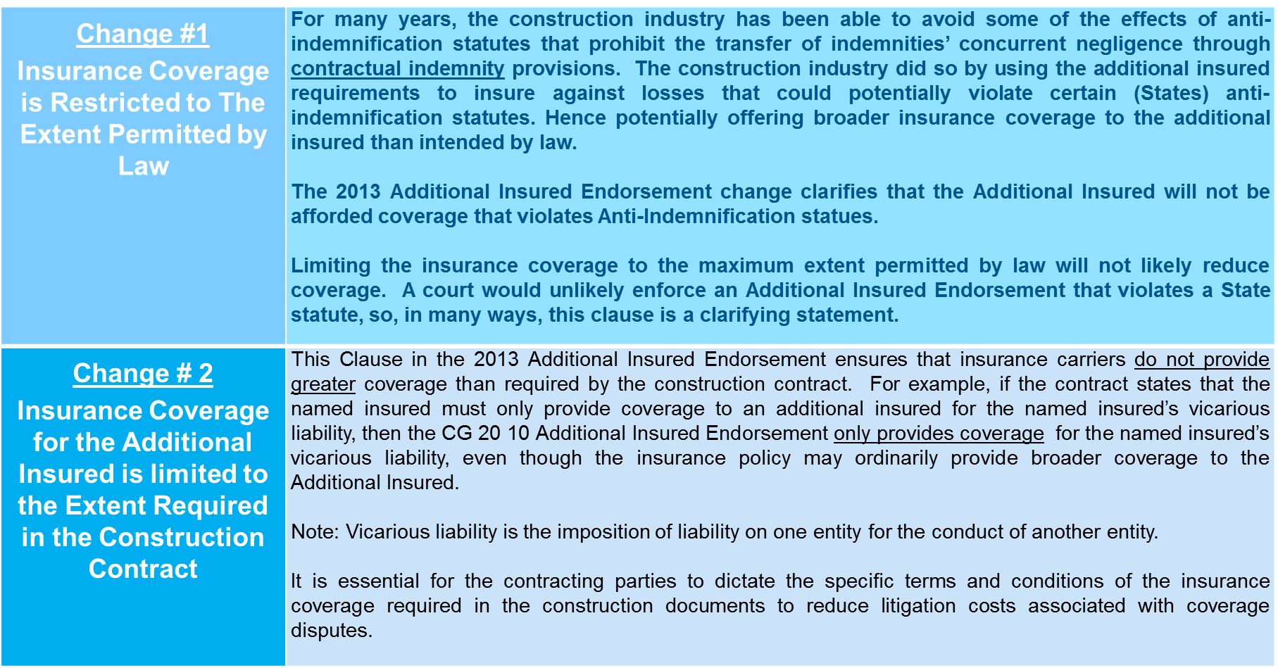
ISO Form Changes (2013)

Slide 62
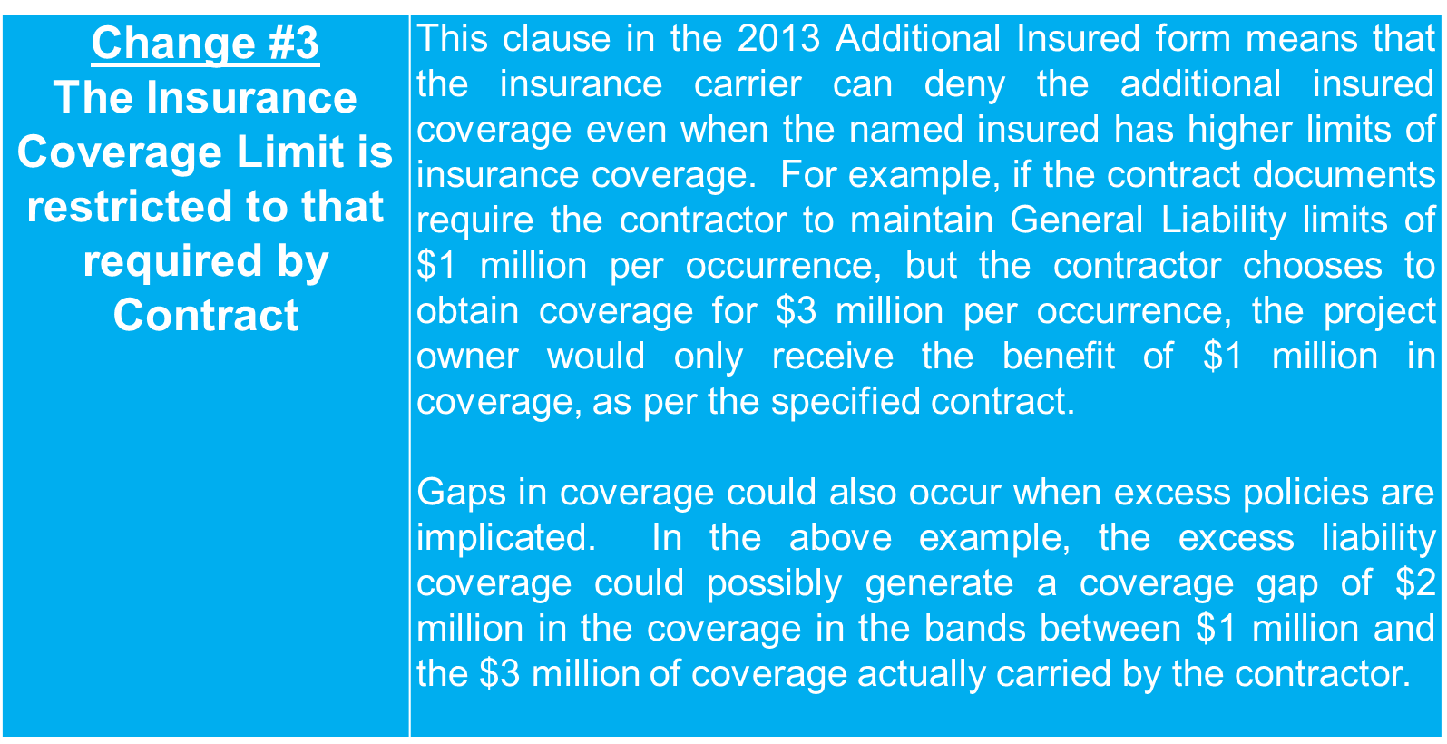
ISO Form Changes (2013)

Slide 63
Questions?
Mark A. Boyle, Esquire
Boyle, Gentile & Leonard, P.A.
2050 McGregor Blvd, Fort Myers, FL
Mboyle@BoyleGentileLaw.com

