Slide 1
Legal and Regulatory Framework, Ethical Response Requirements, and Insurance Coverage for Cyber Risk and Reality
April 20, 2015
Presentation to the Florida Bar's Insurance & Surety Committee
Roberta D. Anderson
K&L GATES, LLP roberta.anderson@klgates.com

Slide 2

PRESENTER
Roberta D. Anderson
Partner, K&L Gates, LLP
+1.412.355.6222
roberta.anderson@klgates.com
@RobertaEsq
2

Slide 3
TOPICS
Practical Risk and Exposure
Legal and Regulatory Framework
Trends
Potential Coverage Under “Legacy” Policies
  Potential Coverage
  Limitations of “Legacy” Insurance Policies
“Cyber” Insurance Market Evolution
Cutting Edge “Cyber” Insurance Products
  Remember the Snowflake
  Avoid the Traps
Technology E&O Coverage
Tips for a Successful Placement
Audience Q&A
3

Slide 4
Practical Risk and Exposure

Slide 5
Practical Risk and Exposure
  Lost or stolen mobile and other
  portable devices
  Vendors/outsourcing
  (the function but not the risk)
  & the “cloud”
  Human error
  The Internet of Things/
  Medical Devices
  Malicious attacks
          Advanced Persistent Threats
          Social engineering
          Viruses, Worms, Trojans
          DDoS attacks
  Data breach
  Software vulnerability
  (HeartBleed)
  Unauthorized access (spyware)
  Inadequate security and system glitches
  Employee mobility and disgruntled employees
5

Slide 6
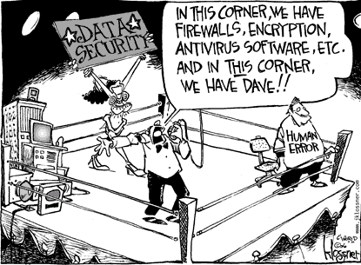

oops!!
back
link

Slide 7
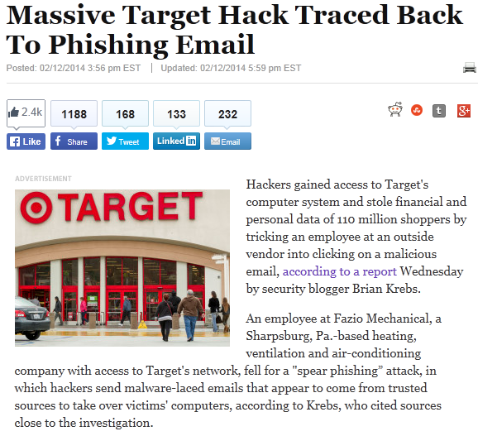
7

Slide 8
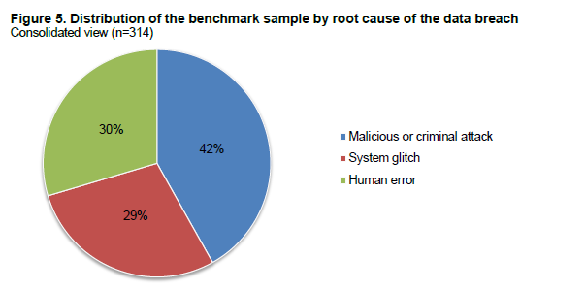
Practical Risk and Exposure
Source: Ponemon Institute 2014 Cost of Data Breach Study – Global

Slide 9
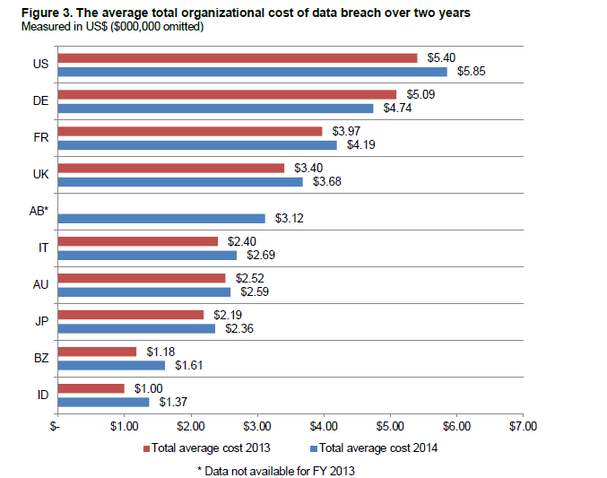
Source:
Ponemon Institute LLC
Cost of Data Breach Study:
Global Analysis
(May 2014)
9

Slide 10
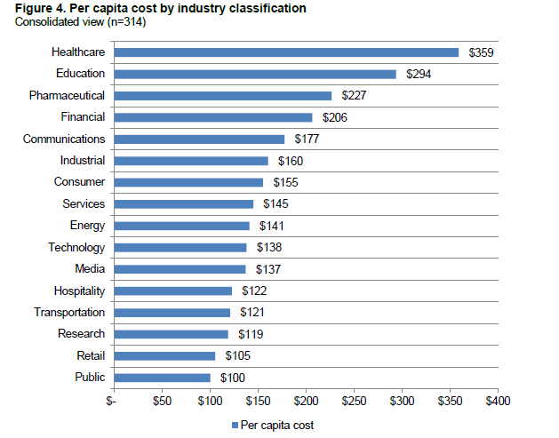
Source:
Ponemon Institute LLC
Cost of Data Breach Study:
Global Analysis
(May 2014)
10

Slide 11
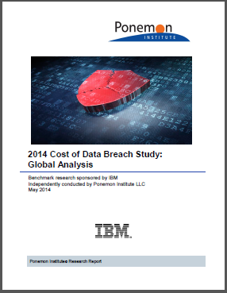
Practical Risk and Exposure
“[T]he average total cost of a data breach for the companies participating in this research increased
15 percent to $3.5 million”
“The average cost paid for each lost or stolen record containing sensitive and confidential information increased more than 9 percent from $136 in 2013 to $145 in this year’s study.”
“However, German and US organizations on average experienced much higher costs at $195 and $201, respectively.”
“These countries also experienced the highest total cost (US at $5.85 million and Germany at $4.74 million)”
“[W]e do not include data breaches of more than approximately 100,000 compromised records in our analysis.”

Slide 12
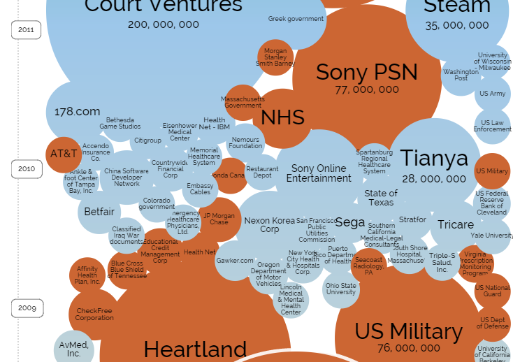
http://www.informationisbeautiful.net/visualizations/worlds-biggest-data-breaches-hacks/
12

Slide 13
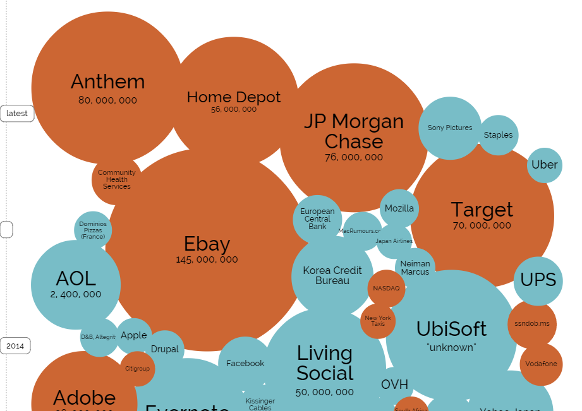
http://www.informationisbeautiful.net/visualizations/worlds-biggest-data-breaches-hacks/
13

Slide 14
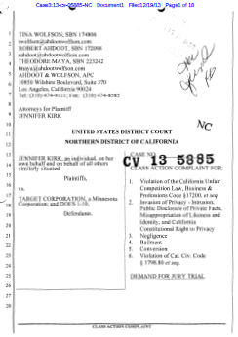
Practical Risk and Exposure
Breach Notification Costs/Identity Monitoring
Computer Forensics/PR Consulting
Loss of Customers/Revenue
Damaged Reputation/Brand
Regulatory Actions/Fines/Penalties/Consumer Redress
Lawsuits & Defense Costs
Loss of “Crown Jewels”
Business Interruption & Supply Chain Disruption
Drop in Stock Price/Loss of Market Share
Potential D&O Suits (Target)
14

Slide 15
“[T]here are only two types of companies: those that have been hacked and those that will be.
“[T]here are only two types of companies: those that have been hacked and those that will be. And even they are converging into one category: companies that have been hacked and will be hacked again.”
Robert S. Mueller, III, Director, Federal Bureau of Investigation, RSA Cyber Security Conference San Francisco, CA (Mar. 1, 2012)
15

Slide 16
Legal And Regulatory Framework

Slide 17
Legal And Regulatory Framework
  Federal Cybersecurity/Data Privacy Laws
      FCC Act
      GLBA
      HIPAA/HITECH
      FCRA/FACTA
      FTC Act
  State Cybersecurity/Data Privacy Laws/Consumer Protection Statutes
      47 states, D.C., & U.S. territories breach notification laws
      State Security Standards (MA, CA, CT, RI, OR, MD, NV)
  SEC Cybersecurity Guidance
  NIST Cybersecurity Framework
  Industry Standards, e.g., PCI DSS
17

Slide 18
Legal And Regulatory Framework
  Federal Laws, e.g., Federal Trade Commission Act
      Section 5 empowers the FTC to “prevent . . . unfair or deceptive acts or practices in or affecting commerce”:
      The Commission is hereby empowered and directed to prevent persons, partnerships, or corporations, except banks, savings and loan institutions described in section 57a(f)(3) of this title, Federal credit unions described in section 57a(f)(4) of this title, common carriers subject to the Acts to regulate commerce, air carriers and foreign air carriers subject to part A of subtitle VII of Title 49, and persons, partnerships, or corporations insofar as they are subject to the Packers and Stockyards Act, 1921, as amended [7 U.S.C.A. § 181 et seq.], except as provided in section 406(b) of said Act [7 U.S.C.A. § 227(b) ], from using unfair methods of competition in or affecting commerce and unfair or deceptive acts or practices in or affecting commerce.
      (15 U.S.C.A. § 45(a)(2).)

Slide 19
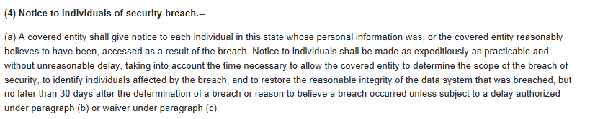
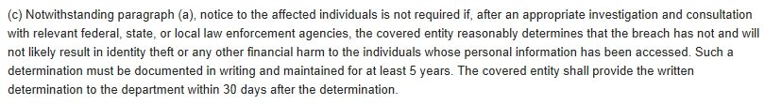
Legal And Regulatory Framework
  State Laws, e.g., Florida Information Protection Act of 2014
19

Slide 20
Legal And Regulatory Framework
  State Laws, e.g., Florida Information Protection Act of 2014
    Expands the definition of “personal information” triggering notification obligations to include online account credentials, health insurance policy numbers and medical history
    Expands the definition of “breach” from “unlawful and unauthorized acquisition” of personal information to “unauthorized access”
    Reduces the deadline for notifying affected individuals to 30 days after discovery (45 days for good cause)
    Requires notification to the Florida AG of breaches affecting over 500 individuals (and notification to consumer reporting agencies for breaches affecting over 1000 individuals)
    Requires provision of copies of forensic reports and “policies regarding breaches” to the Florida AG upon request
    Requires “reasonable measures” to protect and securely dispose of personal information
    Retains imposition of daily monetary fines for late notice
20

Slide 21
Legal And Regulatory Framework
  “[A]ppropriate disclosures may include”:
      “Discussion of aspects of the registrant’s business or operations that give rise to material cybersecurity risks and the potential costs and consequences”;
      “To the extent the registrant outsources functions that have material cybersecurity risks, description of those functions and how the registrant addresses those risks”;
      “Description of cyber incidents experienced by the registrant that are individually, or in the aggregate, material, including a description of the costs and other consequences”;
      “Risks related to cyber incidents that may remain undetected for an extended period”; and
      “Description of relevant insurance coverage.”
21
Cybersecurity: Five Tips to Consider When Any Public Company Might be the Next Target, http://media.klgates.com/klgatesmedia/epubs/GBR_July2014/

Slide 22
Legal And Regulatory Framework
    “We note your disclosure that an unauthorized party was able to gain access to your computer network ‘in a prior fiscal year.’ So that an investor is better able to understand the materiality of this cybersecurity incident, please revise your disclosure to identify when the cyber incident occurred and describe any material costs or consequences to you as a result of the incident. Please also further describe your cyber security insurance policy, including any material limits on coverage.”
22
Alion Science and Technology Corp. S-1 filing (March 2014)

Slide 23
Legal And Regulatory Framework
    “We note that your network-security insurance coverage is subject to a $10 million deductible. Please tell us whether this coverage has any other significant limitations. In addition, please describe for us the ‘certain other coverage’ that may reduce your exposure to Data Breach losses”
23
Target Form 10-K (March 2014)

Slide 24
Legal And Regulatory Framework
    “Given the significant cyber-attacks that are occurring with disturbing frequency, and the mounting evidence that companies of all shapes and sizes are increasingly under a constant threat of potentially disastrous cyber-attacks, ensuring the adequacy of a company's cybersecurity measures needs to be a critical part of a board of director’s risk oversight responsibilities . . . .
    Thus, boards that choose to ignore, or minimize, the importance of cybersecurity oversight responsibility, do so at their own peril.”
24
Luis Aguilar, SEC Commissioner, speech given at NYSE June 10, 2014

Slide 25
Legal And Regulatory Framework
  NIST Cybersecurity Framework—provides a common taxonomy and mechanism for organizations to:
      Describe their current cybersecurity posture;
      Describe their target state for cybersecurity;
      Identify and prioritize opportunities for improvement within the context of a continuous and repeatable process;
      Assess progress toward the target state;
      Communicate among internal and external stakeholders about cybersecurity risk.
  The Framework is voluntary (for now)
25

Slide 26
Legal And Regulatory Framework
85% of security budgets
currently go here
According to Gartner:
By 2020, 75% of security budgets will go towards detection and response
NIST Unveils Cybersecurity Framework,
http://www.klgates.com/nist-unveils-cybersecurity-framework-02-17-2014/
26

Slide 27
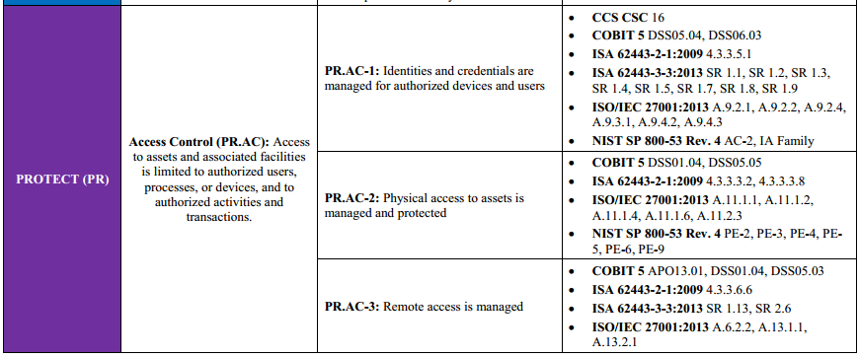
Legal And Regulatory Framework
27

Slide 28
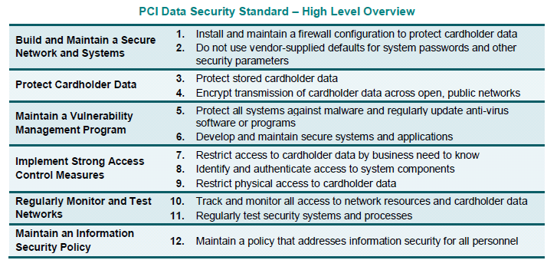
Legal And Regulatory Framework
  “PCI DSS provides a baseline of technical and operational requirements designed to protect cardholder data.”
28

Slide 29
Trends

Slide 30
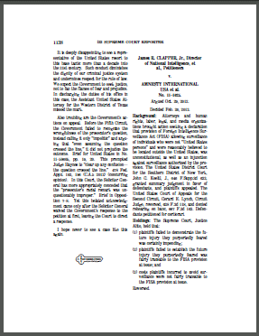
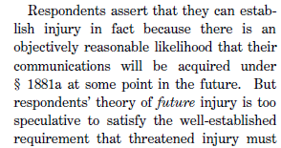
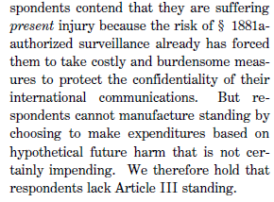
Trends—Article III Standing—Clapper
30

Slide 31
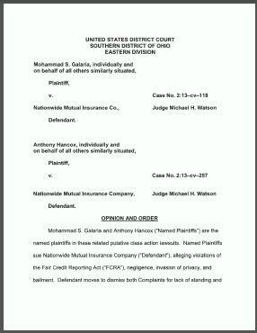

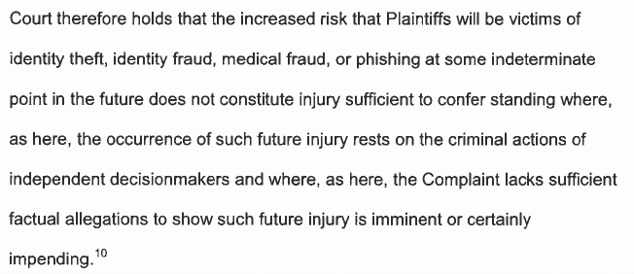
Trends—Article III Standing—Galaria
31

Slide 32
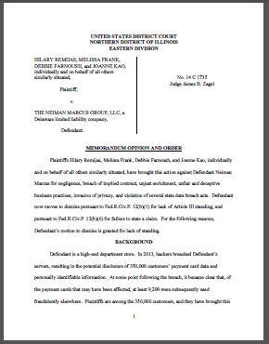
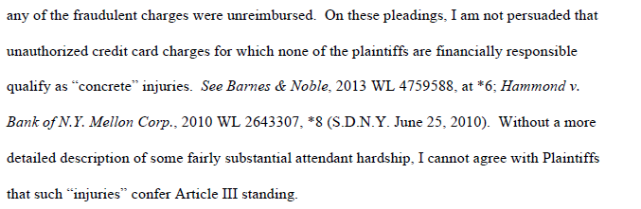
Trends—Article III Standing—NM
32

Slide 33
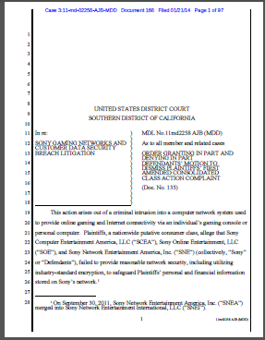
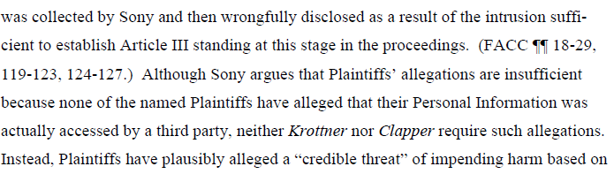
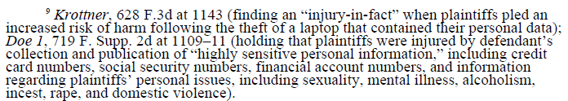
Trends—Article III Standing—Sony
33

Slide 34
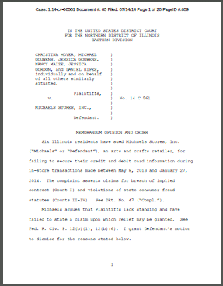
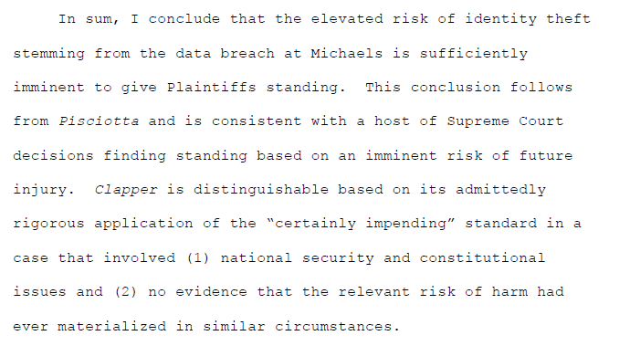
Trends—Article III Standing—Michaels
34

Slide 35
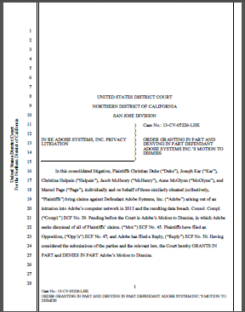


Trends—Article III Standing—Adobe
35

Slide 36
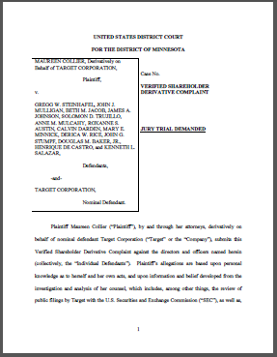
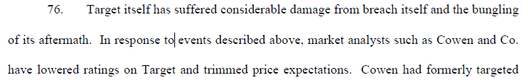
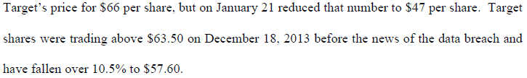
Trends—Derivative litigation—target
36

Slide 37
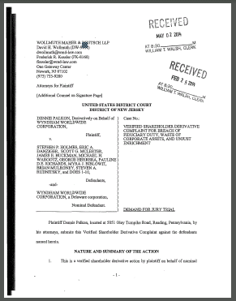
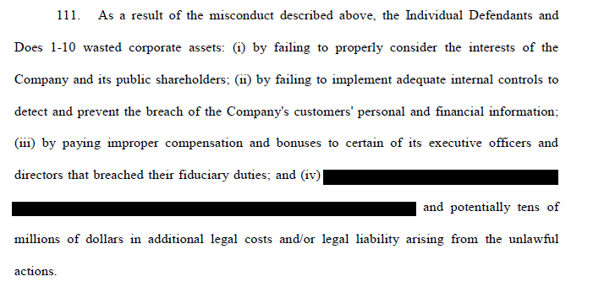
Trends—Derivative litigation—wyndham
37

Slide 38
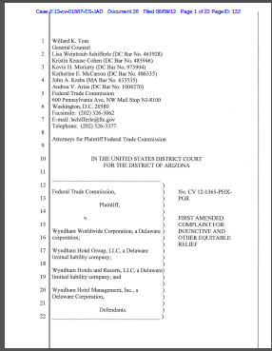
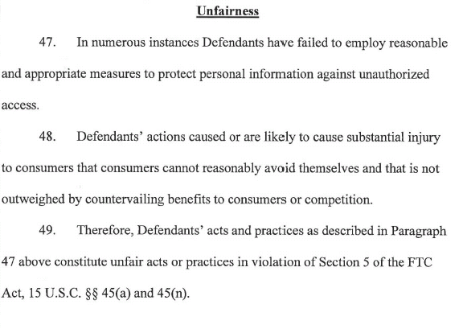
Trends—FTC—Wyndham
38

Slide 39
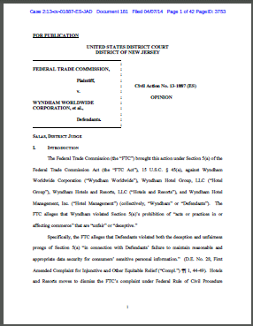
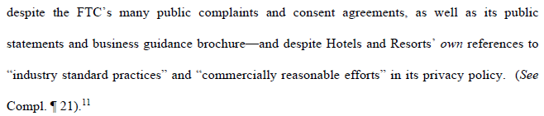

Trends—FTC
39

Slide 40

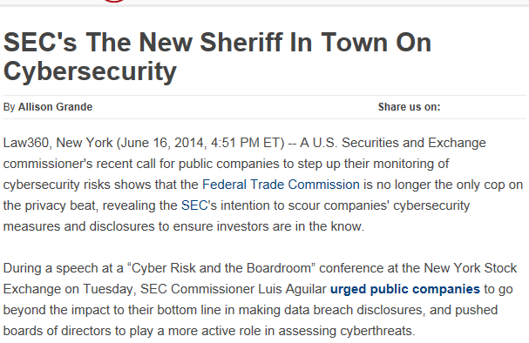
Trends—SEC—“The New Sheriff”
40

Slide 41
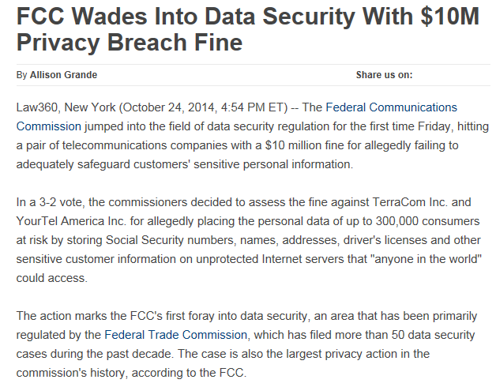
Trends—FCC
41

Slide 42
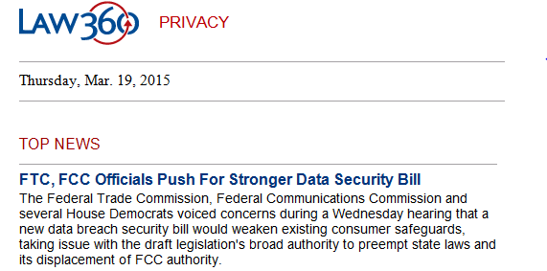
Trends—FCC—This just in
42

Slide 43
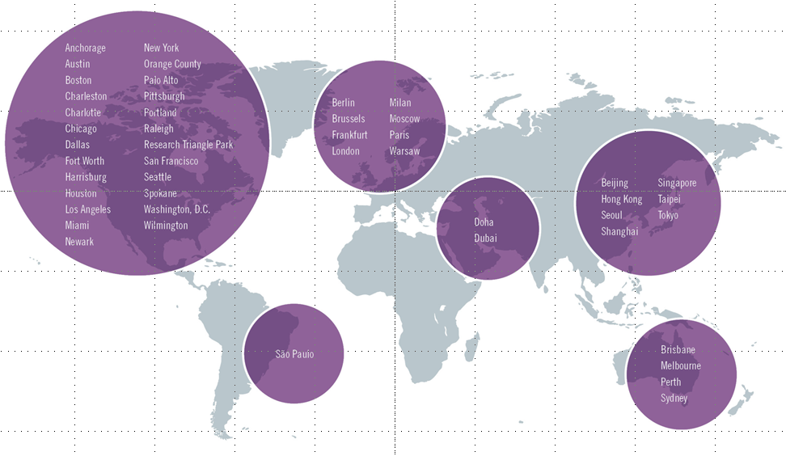


AN INTERNATIONAL ISSUE
43

Slide 44
Potential Coverage Under “Legacy” Policies

Slide 45
POTENTIAL COVERAGE
  Directors’ and Officers’ (D&O)
  Errors and Omissions (E&O)/Professional Liability
  Employment Practices Liability (EPL)
  Fiduciary Liability
  Crime
    Retail Ventures, Inc. v. National Union Fire Ins. of Pittsburgh, Pa., 691 F.3d 821 (6th Cir. 2012) (DSW covered for expenses for customer communications, public relations, lawsuits, regulatory defense costs, and fines imposed by Visa and Mastercard under the computer fraud rider of its blanket crime policy)
  Property
  Commercial General Liability (CGL)
45

Slide 46
POTENTIAL COVERAGE
  Coverage B Provides Coverage for Damages Because of “Personal and Advertising Injury”
  “Personal and Advertising Injury”: “[o]ral or written publication, in any manner, of material that violates a person’s right of privacy”
    What is a “Person’s Right of Privacy”?
    What is a “Publication”?
    Does the Insured Have to “Do” Anything Affirmative And Intentional to Get Coverage?
46

Slide 47
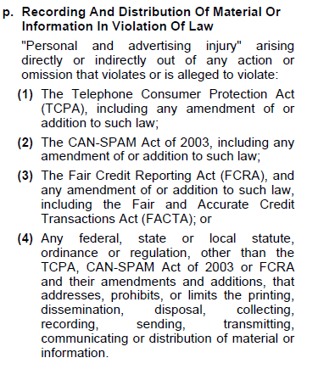
POTENTIAL LIMITATIONS
47

Slide 48
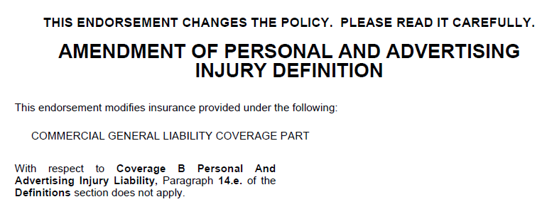


POTENTIAL limitations
48

Slide 49
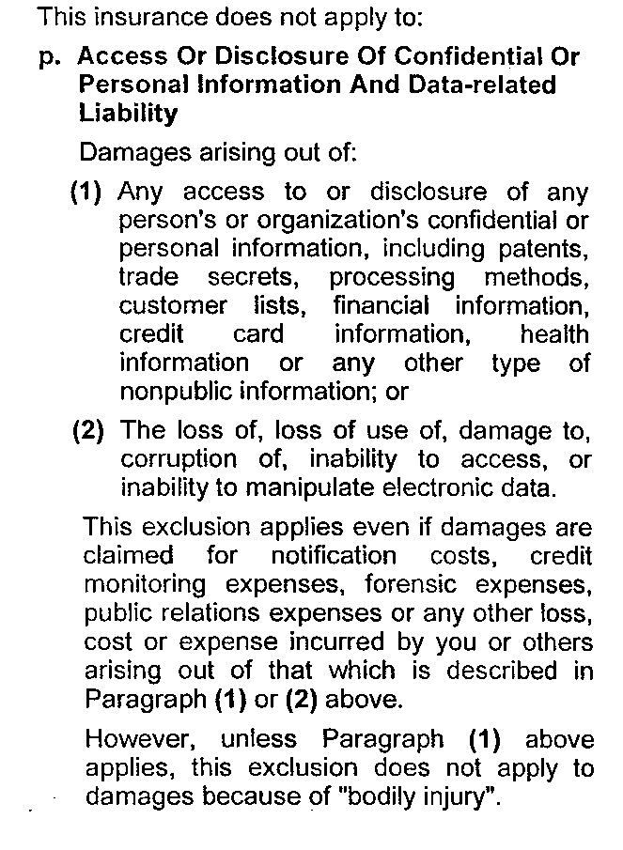
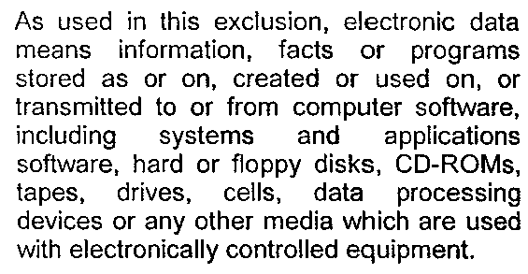
POTENTIAL limitations
ISO states that “when this endorsement is attached, it will result in a reduction of coverage due to the deletion of an exception with respect to damages because of bodily injury arising out of loss of, loss of use of, damage to, corruption of, inability to access, or inability to manipulate electronic data.”
49

Slide 50
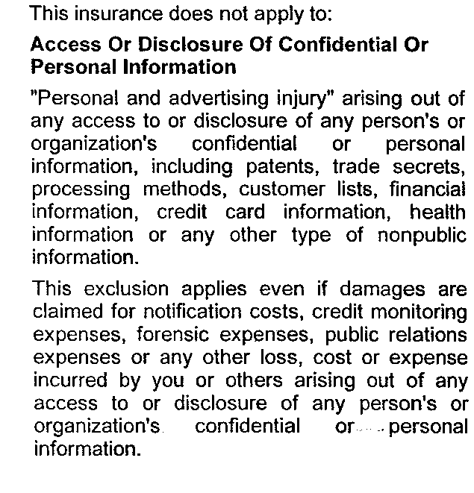
POTENTIAL limitations
50

Slide 51
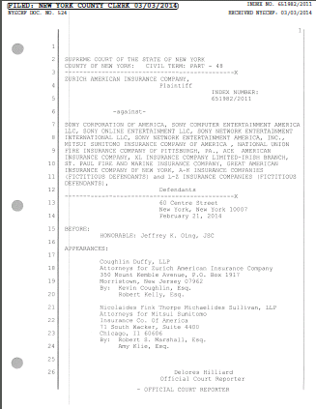
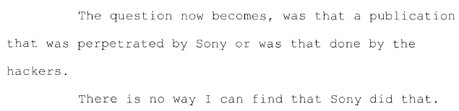
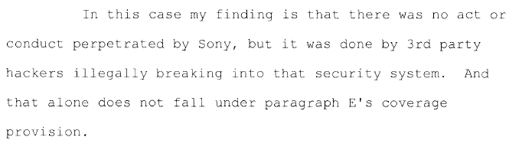
POTENTIAL limitations
Zurich American Insurance Co. v. Sony Corp. of America et al.
51

Slide 52
“Cyber” Insurance Market Evolution

Slide 53
“Cyber” Insurance MARKET EVOLUTION
  Cyber Insurance Introduced
  Crisis
  MGNT
  Costs
  Broad Privacy
  Coverage
  Reg.
  Fines & Penalties
  PCI
  Fines & Penalties
  Full Limit Policies
  System
  Failure
1998
2000
2002
2004
2006
2008
2010
2012
2013
HIPAA
GLB
SB1386
PCI
HITECH
SEC
Card
Systems
Epsilon/
Sony
Adobe/
Target
TJX
Heartland
MA Data Protection Law
  Insurance History
  Regulatory/Industry History
  Claims/Losses History
53

Slide 54
“Cyber” Insurance MARKET EVOLUTION
  Higher limits demanded by CEOs/D&O Concern
  Market shift on POS retail/ Demand increases
  Markets considering change in supporting large placements
  Interest in Network Business Interruption cover spikes
  Kiln & AIG offer contingent BI & PD
DEC 2013
Feb 2014
March 2014
Spring 2014
Sept 2014
Oct 2014
DEC 2015
Jan 2015
Feb 2015
Several retail breaches
German steel mill suffers massive physical damage
Obama files new Federal Consumer Protection Legislation/ Signs Cyber Threat Intelligence Sharing Bill
JPMorgan Chase Breach
Home Depot Breach
Target Breach
Sony Breach
Anthem Breach
  Insurance History
  Regulatory/Industry History
  Claims/Losses History
54

Slide 55
Cutting Edge “Cyber” Insurance Products

Slide 56
“Cyber” Insurance Policies
  Privacy And Network Security
    Provides Coverage for Liability (Defense and Indemnity) Arising Out of Data breaches, Transmission of Malicious Code, Denial of Third-Party Access to the Insured’s Network, and Other Network Security Threats
  Regulatory Liability
    Provides Coverage for Liability (Defense and Indemnity) Arising Out of Administrative or Regulatory Investigations, Proceedings, Fines and Penalties
  Crisis Management
    Provides Coverage for Forensics Experts, Notification, Call Centers, ID Theft Monitoring, PR and Other Crisis Management Activities
  Media
56

Slide 57
“Cyber” Insurance Policies
  Network Interruption And Extra Expense (and CBI)
    Provides Coverage for Lost Business Income and Extra Expense Caused By Malicious Code, DDoS Attacks, Unauthorized Access to, or Theft of, Information, and Other Network Security Threats
  Digital Asset Coverage
    Provides Coverage for Damage To or Theft of the Insured’s Own Systems and Data
  Cyber Extortion
    Provides Coverage for Losses Resulting From Extortion, e.g., Payment of an Extortionist’s Demand to Prevent a Cybersecurity Incident
  Emerging Markets
57

Slide 58

Remember the Snowflake
back

Slide 59

AVOID THE TRAPS

Slide 60
60

Slide 61
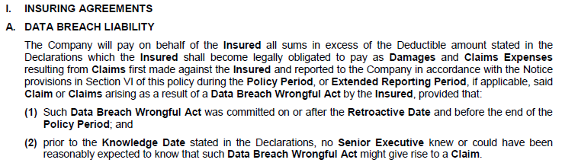
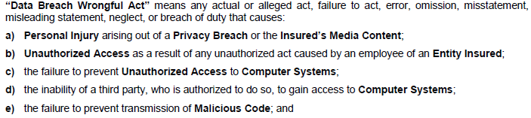
TRAP EXAMPLE
61

Slide 62

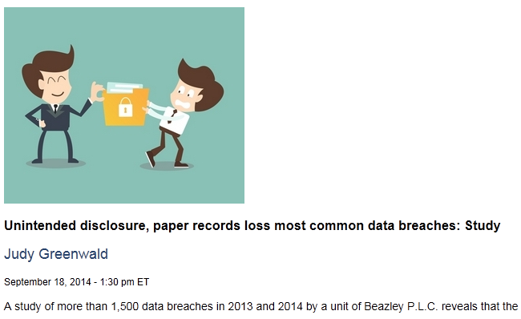
62

Slide 63


TRAP EXAMPLE
63

Slide 64

TRAP EXAMPLE
64

Slide 65



AVOID THE TRAPS
65

Slide 66


AVOID THE TRAPS
66

Slide 67
Technology E&O Coverage

Slide 68
Technology E&O Coverage
  Essential for a provider of e-commerce-related solutions
  Covers
    Errors & Omissions in the Provision of Technology Services
    Failure of Technology Products to Serve Their Purpose
  Triggered By a “Claim” That Alleges An Act or Omission
  May Not Include Breach Notification Costs, Which is Viewed As More of a “First-Party” Loss
  May Contain Exclusions
68

Slide 69
Technology E&O Coverage
  Make Sure the Covered Products and Services are Accurate and Complete
    Designing, building, installing, or providing of services related to telecommunications or wireless networks, solutions, and services?
    Software development?
    Internet access services?
    Electronic mail services?
    IT consulting services?
69

Slide 70
Tips For a Successful Placement

Slide 71

Remembering the Snowflake
TIPS FOR A SUCCESSFUL
PLACEMENT

Slide 72
TIPS FOR A SUCCESSFUL PLACEMENT
  ■ Embrace a Team Approach
  ■ Understand the Risk Profile
  ■ Review Existing “Legacy” Coverages
  ■ Purchase Specialty “Cyber” Coverage as Needed
  ■ Remember the “Cyber” Misnomer
  ■ Spotlight the “Cloud”
  ■ Consider the Amount of Coverage
  ■ Pay attention to the Retroactive Date and ERP
  ■ Look at Defense and Settlement Provisions
  ■ Engage Coverage Counsel
72

Slide 73
  BEWARE
  THE
  FINE
  PRINT
73

Slide 74

74

Slide 75
“A well drafted policy will reduce the likelihood that an insurer will be able to avoid or limit insurance coverage in the event of a claim.”
Roberta D. Anderson, Partner, K&L Gates LLP (April 20, 2015)
75

Slide 76
Q & A

Slide 77
THANK YOU

Slide 78
This presentation is for informational purposes and does not contain or convey legal advice. The information herein should not be used or relied upon in regard to any particular facts or circumstances without first consulting a lawyer.

