Slide 1
Data Breach Trends and Best Practices for Preparation and Response
Jeremy Henley
ID Experts
March 16, 2015

Slide 2

Presentation Speaker
Jeremy Henley, CHPC Director of breach services and an insurance solutions executive for ID Experts.
Direct oversight for all breach incident management services
Certified by the Healthcare Compliance Association for Healthcare Privacy and Compliance
Responsible for establishing and maintaining relationships with insurance carriers offering cyber and privacy liability coverage and works with insurance brokers and risk managers to minimize the risks of breach
Manages ID Experts’ activities and engagements with cyber insurers and their breach coaches

Slide 3
Data Breach Basics

Slide 4
What is a Data Breach*?
Data Breach is a “Legal” Construct
All breaches start as incidents, but not all incidents end up as breaches
"Incident" = attempted or successful unauthorized access, use, disclosure, modification, or destruction of PHI/PII
"Breach" = acquisition, access, use, or disclosure of PHI/PII [that poses a significant risk of financial, reputational, or other harm]*
* The definition of “data breach” varies across specific legislation and rules. In US states, many include a “harm threshold”

Slide 5
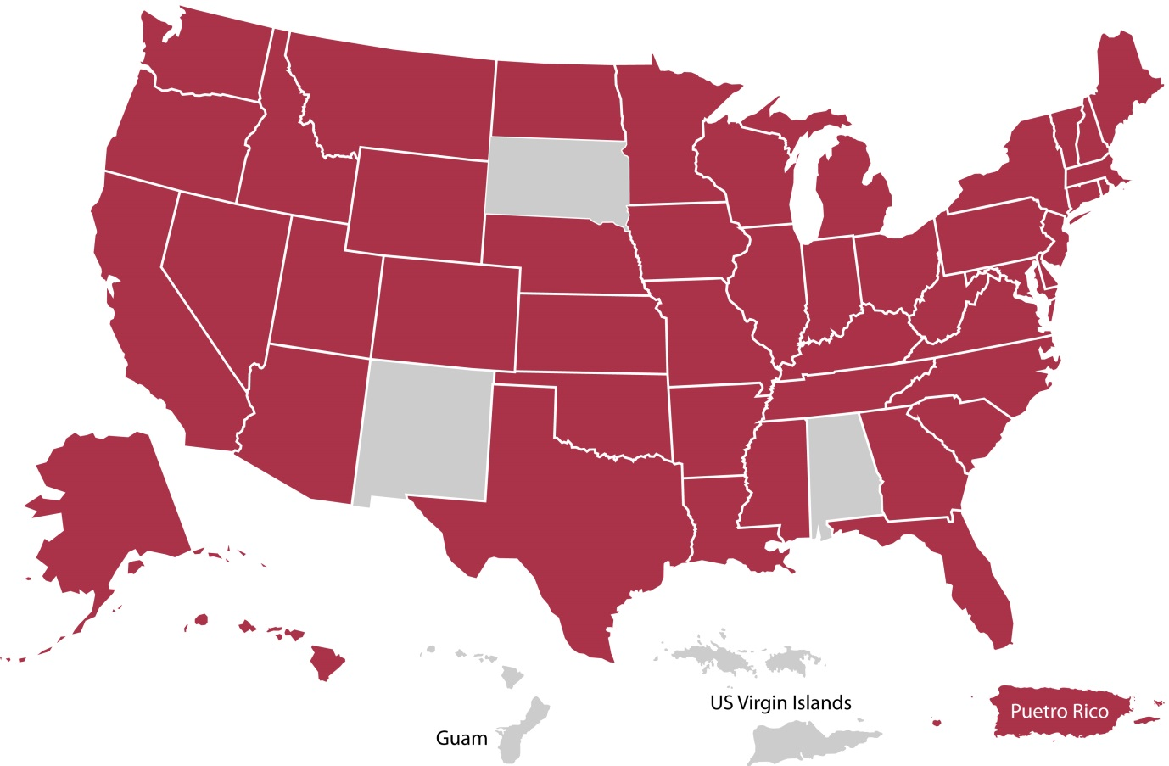
Complex web of breach laws
Organizations that hold regulated data must comply with data breach notification laws.
Data Breach Notification Laws:
47 state laws
3 U.S. territories
HIPAA Final Breach Notification Rule
Gramm–Leach–Bliley Act (GLBA)

Slide 6
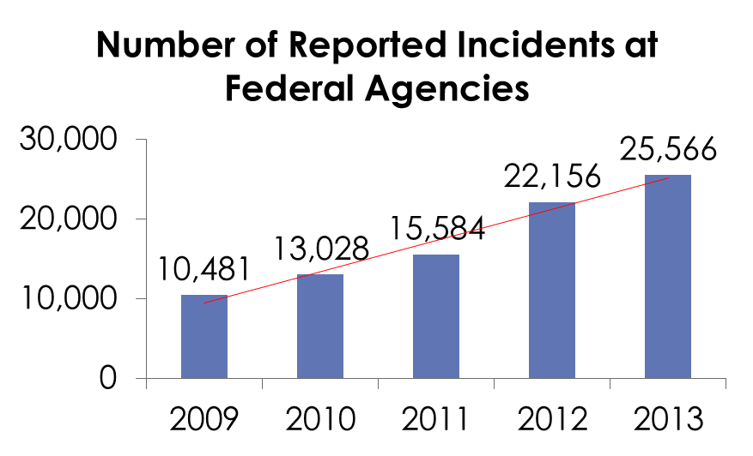
Volume of incidents is skyrocketing
Verizon’s DBIR found 50 organizations reported 63,437 incidents in 2013 – this equates to 1,268 incidents per organization per year.
In healthcare, over 93,000 breaches have been reported to HHS since 2009.
Figures from the US GAO indicate that information security incidents more than doubled in recent years
Source: US GAO analysis of US-CERT data for fiscal years 20009-2013

Slide 7
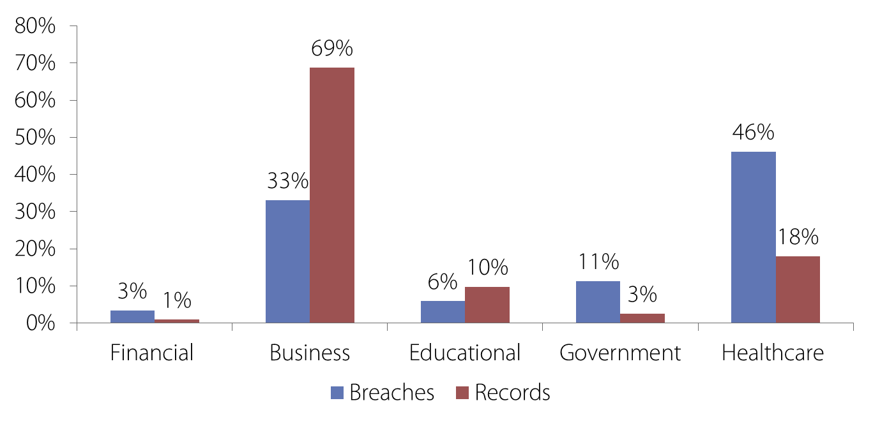
Data Breach Summary
% of Breaches and Lost Records by Industry
Source: Identity Theft Resource Center, June 2014

Slide 8
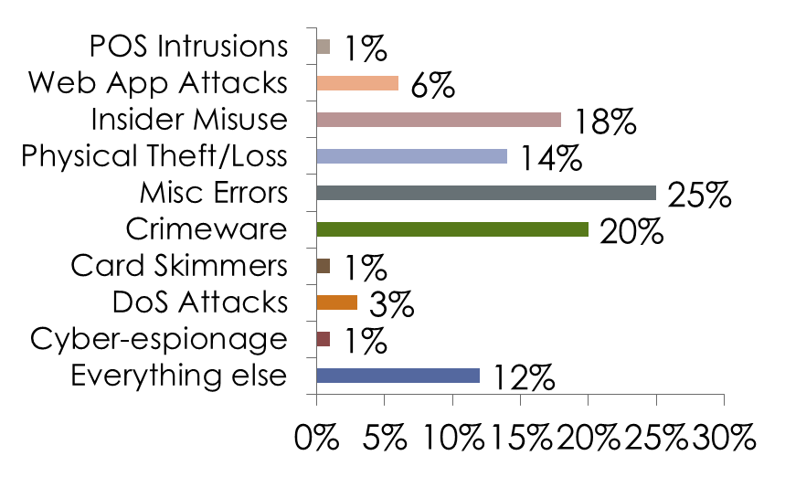
Many sources of data incidents
Security incidents are caused by wide-range of sources. Traditional security approaches may not address some of the most common causes.
Root Causes of Incidents
Source: 2014 Data Breach Investigations Report, Verizon

Slide 9
What This Means to You

Slide 10
What’s my risk…
What data do you have?
What industry are you in?
What laws does this expose you too?
How often are your peers being breached?
How much have I done to prevent/limit a breach?
Am I prepared to respond?

Slide 11
If You Do Nothing Else…
Do a privacy and security risk assessment
A risk assessment will
Inventory your organization’s data to understand your data breach risk exposure
Review privacy & security policies/procedures to identify gaps
Evaluate security technologies and controls
Review insurance for data breach coverage

Slide 12
Lowering the Threats

Slide 13
Lowering the internal threats
Physical Security
Controlled Access
Monitoring
Logging

Slide 14
Lowering the internal threats
Technical Security
Layered Approach
Firewalls
Anti-Virus
Database Management
Intrusion Detection Systems

Slide 15
Lowering the internal threats
Administrative Security
Policies and Procedures
Documented Training program
Audits
Management

Slide 16
When a Breach Happens

Slide 17
Breaches are like snowflakes
Breaches occur in all shapes and sizes and no two are alike - most require an investigation to fully evaluate
47 states have their own breach laws which separately defines personal information and what constitutes a data breach in addition to their own set of deadlines
This makes determining if you have just an incident or a notifiable data breach very challenging
An even greater challenge is ensuring that you follow a process that is consistent, repeatable and well-documented in case you are investigated

Slide 18
When a Data Breach Occurs
Have a plan
Businesses must rely on a trusted partner
Help you determine if your incident is a breach
Develop a proportionate and compliant breach response
Provide the proper level of concern and care to the affected individuals (customers)
Limit the financial, legal and reputational risks

Slide 19
Cyber Insurance
From a Vendor’s perspective
What are you expectations from a carrier?
Companies want coverage and fast
They may want access to specialists
They want to make their own choices vendors and legal assistance
They want coverage for: Legal, Forensics, Crisis PR, Notifications, Call Centers, ID Monitoring. Funds for 3rd party liability.

Slide 20
Cyber Insurance
From a Vendor Perspective

Slide 21
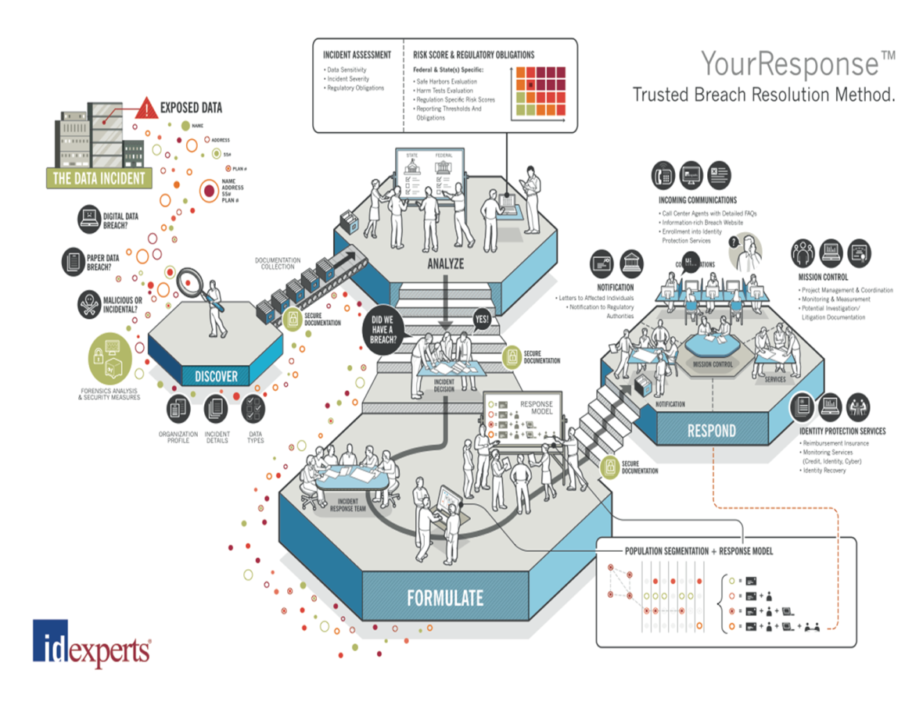

Slide 22
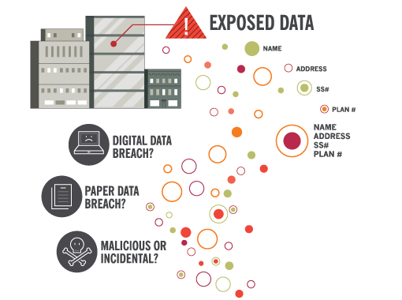
Data Exposure

Slide 23
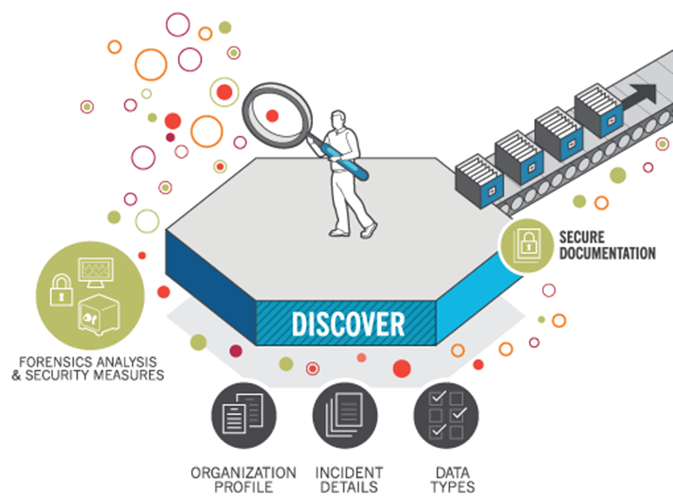
Discovery

Slide 24
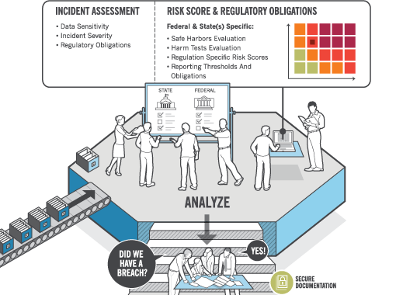
Analyze

Slide 25
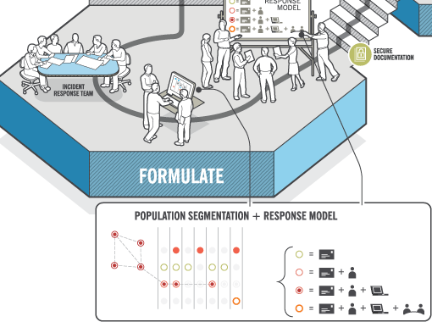
Formulate

Slide 26
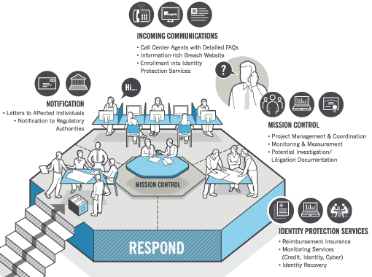
Respond

Slide 27
Questions?
Jeremy Henley
Director of Breach Services
760-304-4761
Jeremy.henley@idexpertscorp.com

