Slide 1
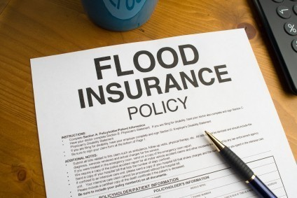



IMPACTS OF THE BIGGERT WATERS
FLOOD INSURANCE REFORM ACT OF 2012
Presented by:
Christopher W. Heidrick, CPCU, ANFI, CFP®
Heidrick & Co. Insurance & Risk Management Services LLC
&
Brad Loar, CFM
Director, Mitigation Division at FEMA Region IV

Slide 2


Biggert Waters
Flood Insurance Reform
Act of 2012

Slide 3
TIMELINE
NFIP established by Congress in 1968
Program as we know it started in 1974 – implementation of mapping
1975 – Brad Loar begins working with the NFIP
By 2004…$25B cumulative premium, $18B cumulative losses
2005 Hurricane Katrina - $16.2B loss
2008 – Congress cannot agree on a 5-year re-authorization of NFIP
2008 – 2012 – 16 short-term re-authorizations
July 6, 2012 – Biggert-Waters re-authorizes NFIP for 5 years
October 29, 2012 – Superstorm Sandy Hits NY/NJ - $8.3B loss

Slide 4
TIMELINE (con’t)
March 29, 2013 – FEMA releases guidance regarding BW12
& defines full-rate risk
April 2013 – Affordability Study called for in BW12 due – deadline missed
January 1, 2013 – Flood insurance 25% increases begin
August 2013 – FEMA releases Full Rate Risk Rates for pre-FIRM policies
October 1, 2013 – Section 205 of BW12 fully implemented
November 22, 2013
NFIP debt $24B; Losses from Katrina & Sandy $23.5B
5.5 million policies in force (37% in Florida), with $3.5 annual premium

Slide 5
IMPORTANT TERMS
FIRM: Acronym for Flood Insurance Rate Map.
Participating Community: A community for which FEMA has authorized the sale of flood insurance under the NFIP.

Slide 6
IMPORTANT TERMS (con’t)
Pre-FIRM: Pre-Flood Insurance Rate Map (FIRM) buildings are those built before the effective date of the first Flood Insurance Rate Map (FIRM) for a community. This means they were built before detailed flood hazard data and flood elevations were provided to the community and usually before the community enacted comprehensive regulations on floodplain regulation. Pre-FIRM buildings can be insured using "subsidized" rates. These rates are designed to help people afford flood insurance even though their buildings were not built with flood protection in mind.

Slide 7
IMPORTANT TERMS (con’t)
Post-FIRM: Post-Flood Insurance Rate Map (FIRM) buildings are new construction and those built after the effective date of the first FIRM for a community. Insurance rates for Post-FIRM buildings are dependent on the elevation of the lowest floor in relation to the Base Flood Elevation (BFE).

Slide 8
IMPORTANT TERMS (con’t)
Subsidized Rate: Subsidized rates are rates for Pre‐FIRM properties in Special Flood Hazard Areas (SFHAs) that are rated without using elevation data. Subsidized rates are estimated to produce premiums that are less than sufficient to fund the reserves for anticipated losses and expenses that will occur within the subsidized rate classes. Post‐FIRM rates used for all zone classes are not subsidized. The PRPs issued under the Eligibility Extension are not subsidized; nor are policies using Post‐FIRM rating tables under the NFIP Grandfather procedures. (FEMA Bulletin W-13026)

Slide 9
IMPORTANT TERMS (con’t)
Full Risk Rate: Rate calculated as a Post-FIRM structure using an Elevation Certificate.

Slide 10
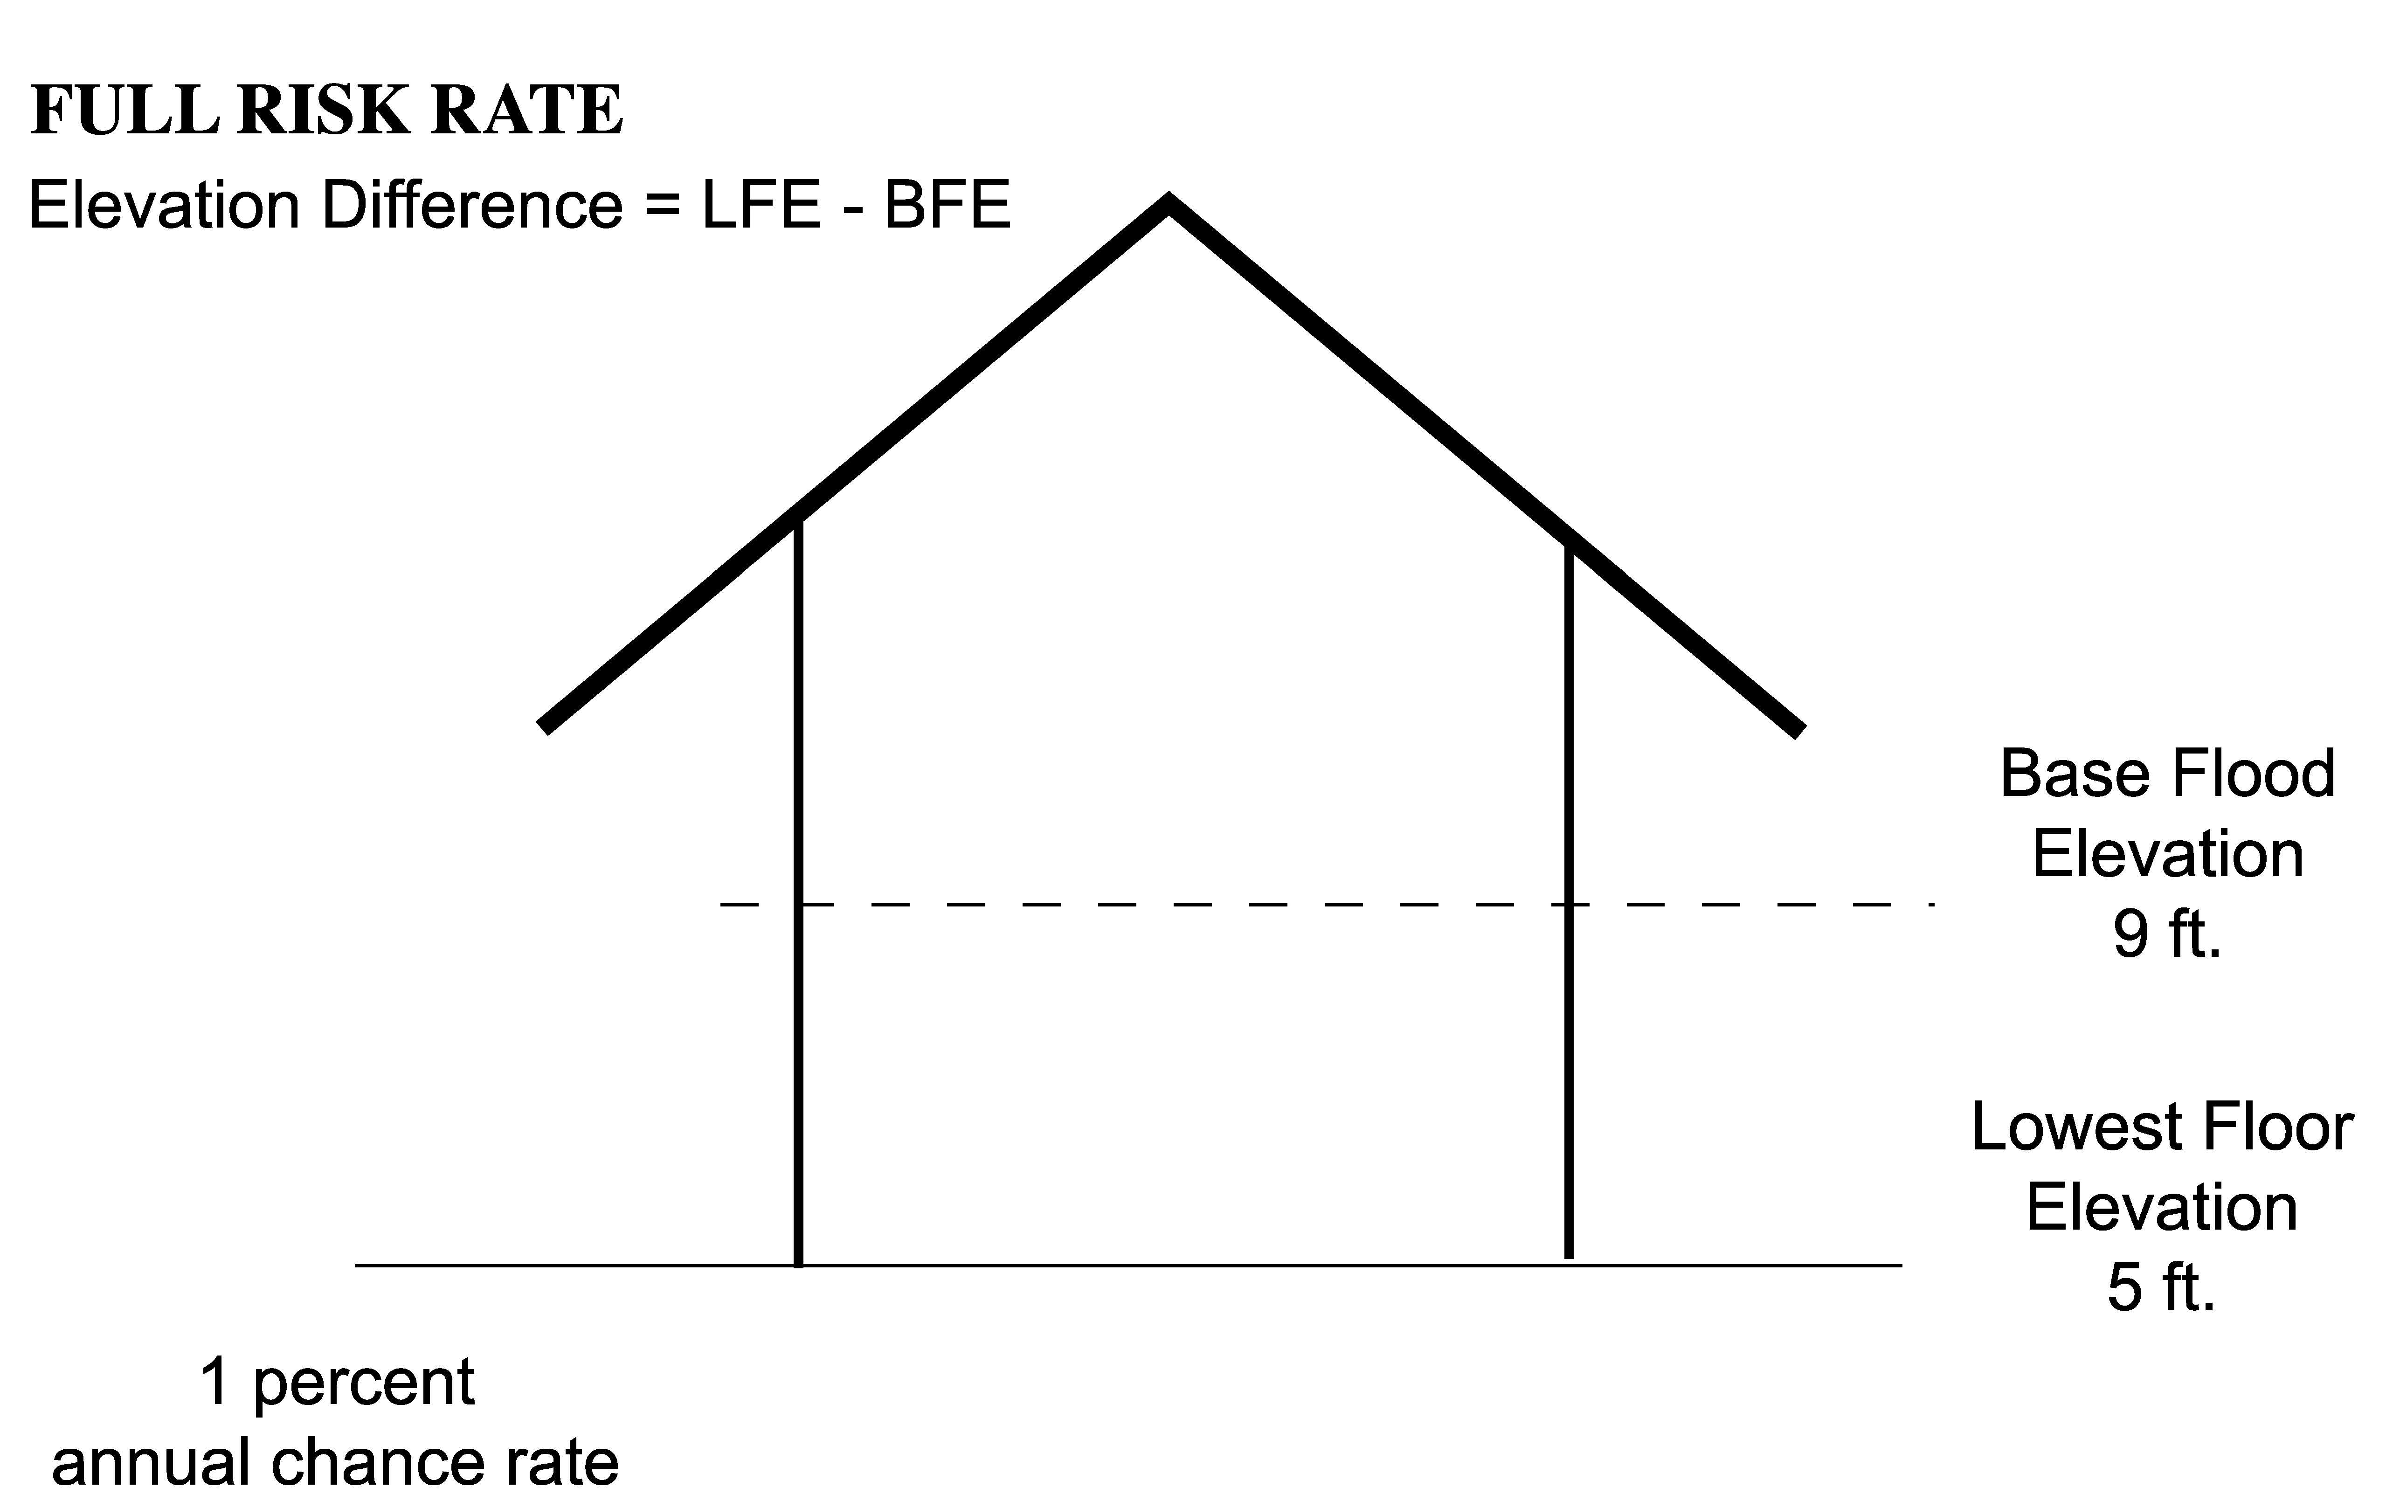

Slide 11
IMPORTANT TERMS (con’t)
Special Flood Hazard Area (SFHA):
A-Zone - Areas subject to inundation by the 1-percent-annual-chance flood event determined by detailed methods. Base Flood Elevations (BFEs) are shown. Mandatory flood insurance purchase requirements and floodplain management standards apply.
V-Zone - Areas along coasts subject to inundation by the 1-percent-annual-chance flood event with additional hazards associated with storm-induced waves.

Slide 12
IMPORTANT TERMS (con’t)
Grandfathering: - Under NFIP administrative grandfathering, Post-FIRM buildings in the Regular Program built in compliance with the floodplain management regulations in effect at the start of construction will continue to have favorable rate treatment even though higher Base Flood Elevations (BFEs) or more restrictive, greater risk zone designations result from FIRM revisions. Policyholders who have remained loyal customers of the NFIP by maintaining continuous coverage (since coverage was first obtained on the building) are also eligible for administrative grandfathering.

Slide 13
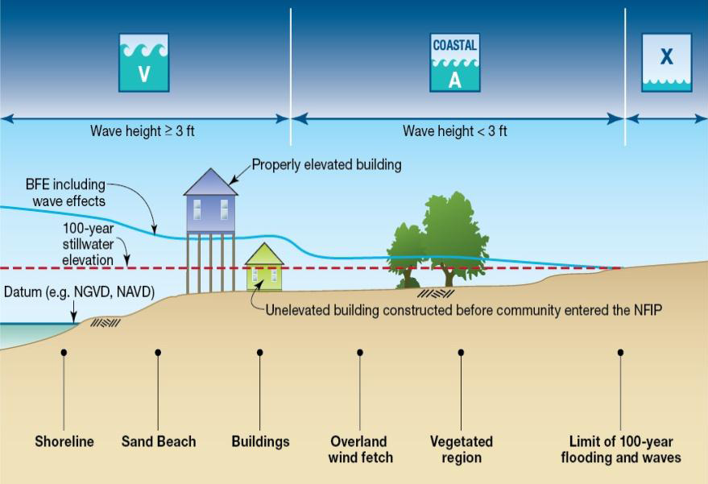

Slide 14
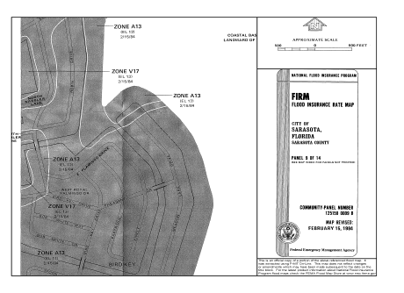

Slide 15
SIGNIFICANT PROVISIONS
OF BW12
Section 100205
Section 100207
Other Provisions

Slide 16
IMPACT OF
SECTION 100205 (pre-FIRM)

Slide 17
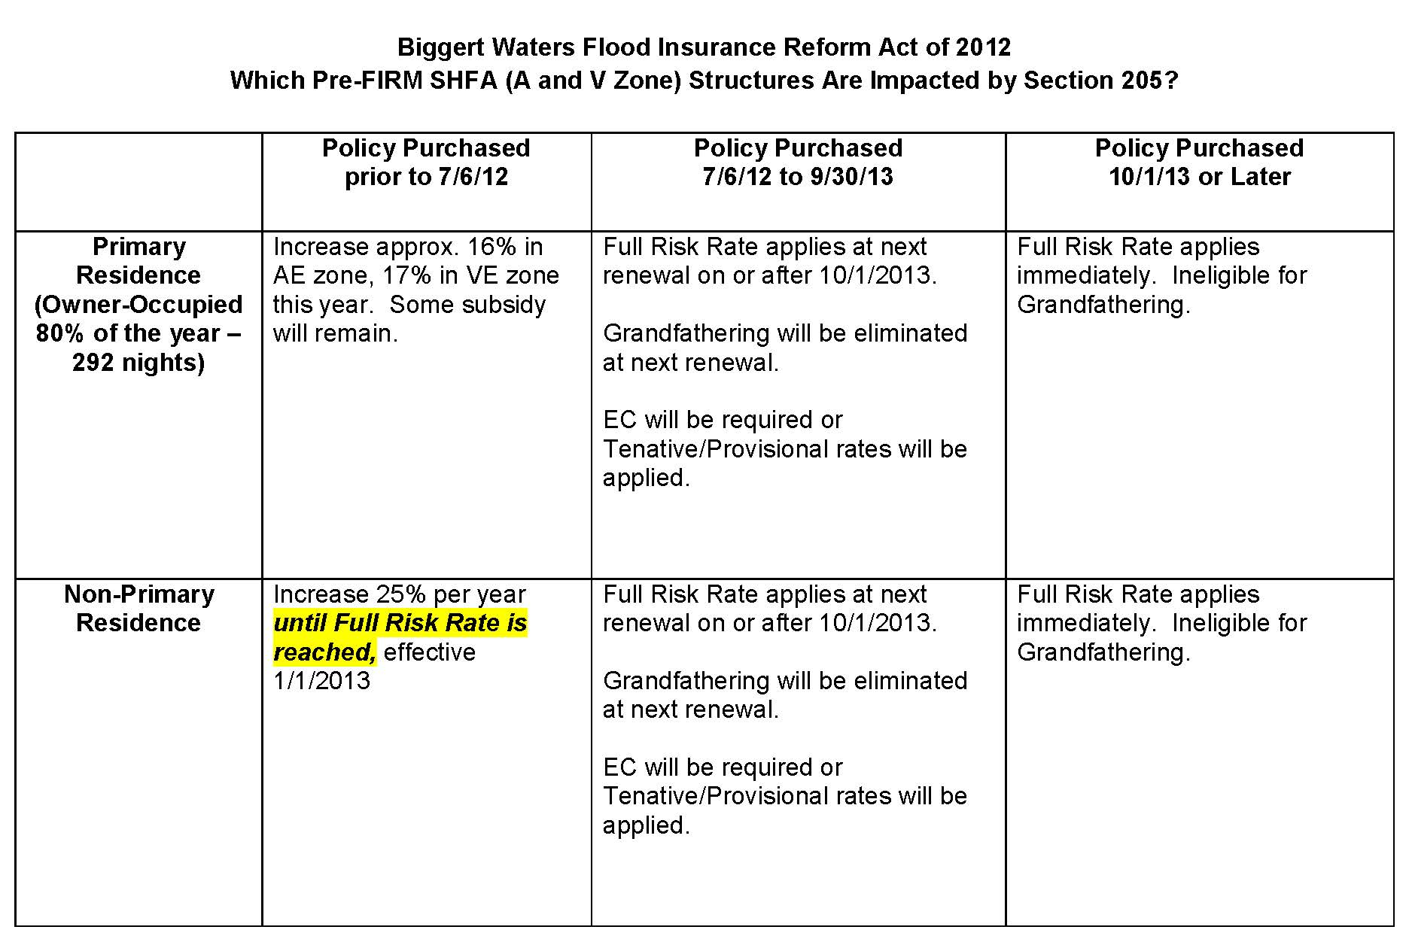

Slide 18
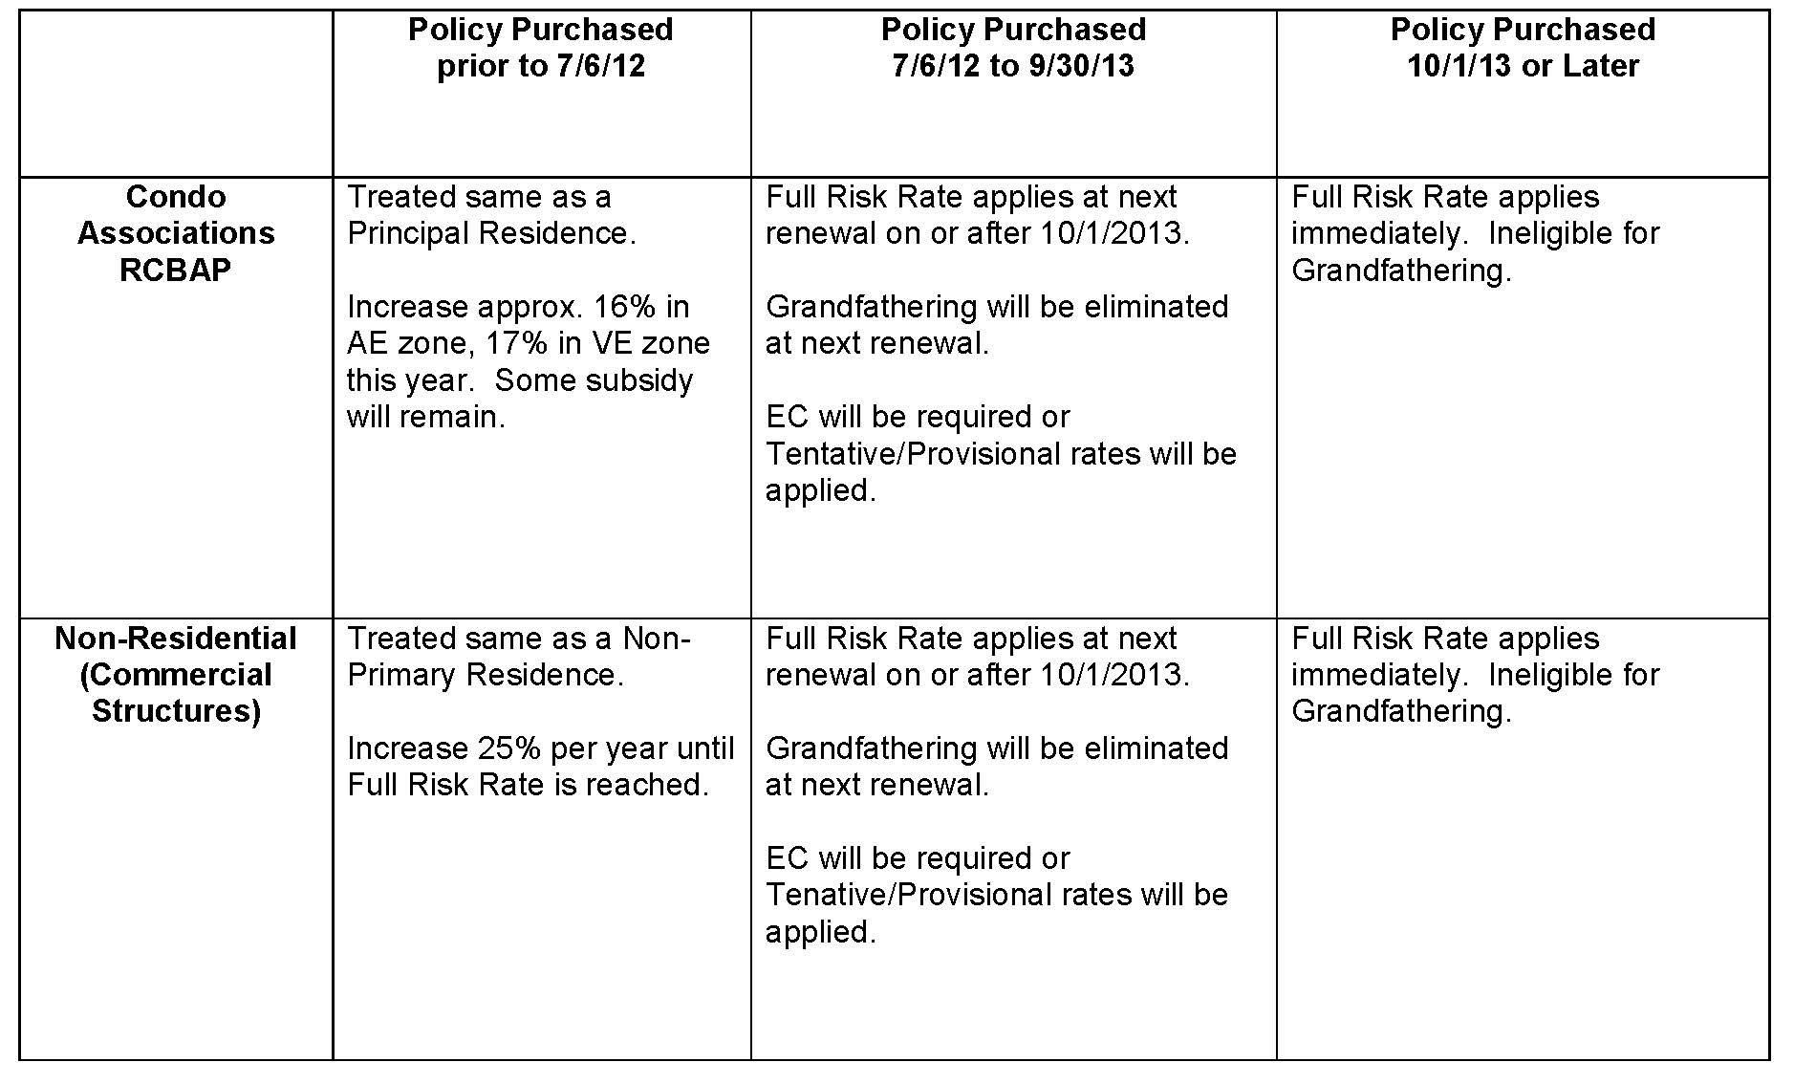

Slide 19
5%
81%
10%
4%

Slide 20
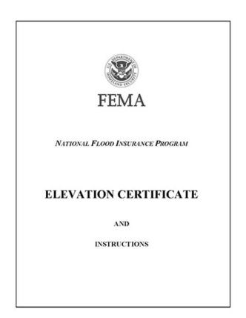
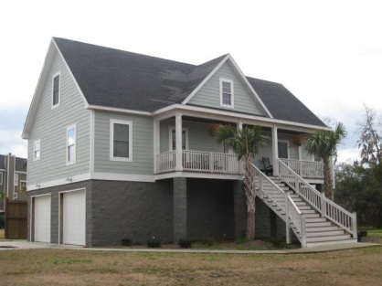


ADDRESS YOUR RISK
LEARN YOUR RISK Get an Elevation Certificate for your home (risk can change)
GET INSURED
REDUCE YOUR RISK
5%
Resilient
81%
Be
proactive:
don’t risk the Dconsequences
of a flood
Building or Rebuilding? Build
higher
than
current standards
Elevation
Certificate
10%
4%
STAY INSURED Letting your flood insurance policy lapse could be costly

Slide 21
FLORIDA NFIP POLICYHOLDERS
UNDER SECTION 205
87 percent of NFIP policyholders (1,789,559 policies) in Florida are not subsidized. These policyholders will not be affected by Section 205, but may see routine annual rate increases.
Only 2 percent of all Florida NFIP policies (50,496) will see immediate 25 percent increases. This includes non-primary residences, businesses and severe repetitive loss properties. These properties will see immediate changes to their premiums.

Slide 22
FLORIDA NFIP POLICYHOLDERS
UNDER SECTION 205 (con’t)
5 percent of all Florida policies (103,258) cover subsidized primary residences, which will remain subsidized, unless or until:
The property is sold (new rates will be charged to the next owner)
The policy lapses
The property suffers severe, repeated flood losses
A new policy is purchased

Slide 23
FLORIDA NFIP POLICYHOLDERS
UNDER SECTION 205 (con’t)
The remaining 6 percent of Florida policies (114,894) include subsidized condo and non-condo, multi-family structures. These policyholders will keep their subsidies until FEMA develops guidance for their removal.

Slide 24
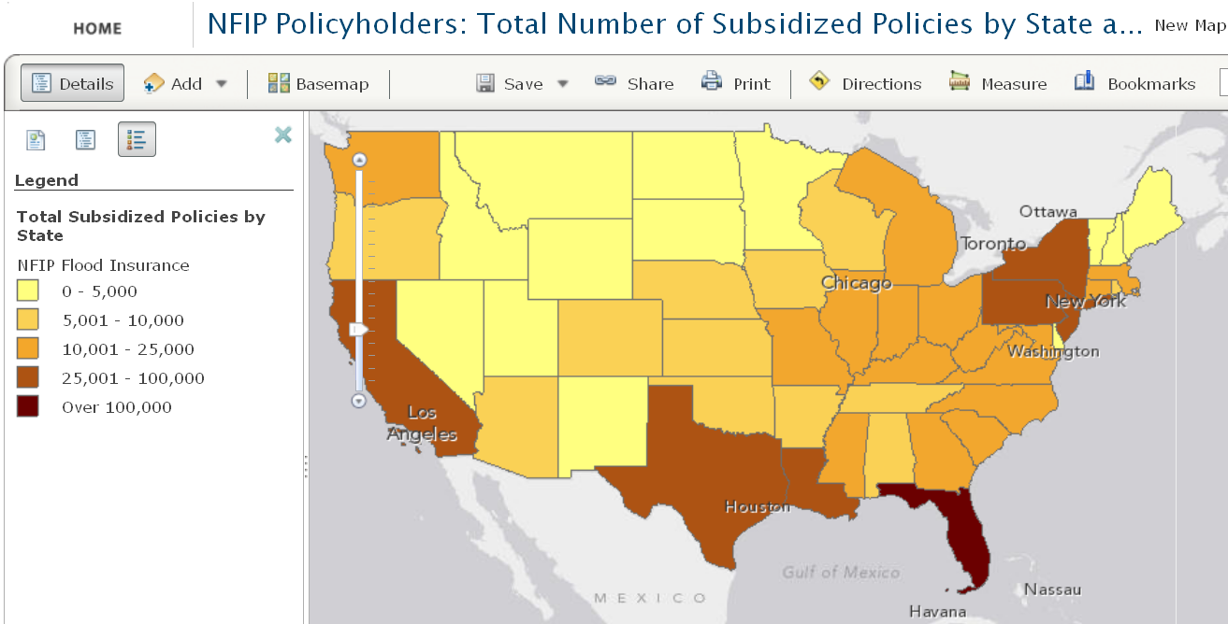
POLICYHOLDER SUBSIDIES

Slide 25
IMPACT OF
SECTION 100207

Slide 26
WHAT ABOUT GRANDFATHERING?
Grandfathering will be phased out BW-12 calls for a phase-out of discounts, including grandfathering provisions, and a move to full actuarial rates.
The Biggert-Waters Act Section 100207 calls for phase-out of grandfathering discounts for properties shown on Flood Insurance
Rate Maps that are updated. New rates will be gradually phased in at 20% per year for five years.
Section 100207 implementation anticipated in late 2014 Phase-in to full-risk rates anticipated to begin in late 2014.

Slide 27
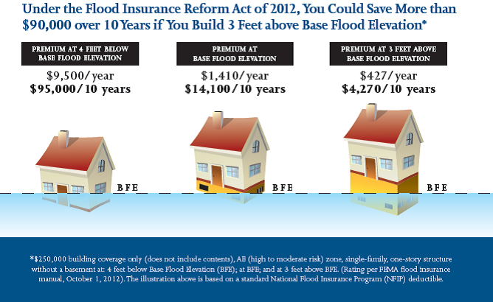
IMPACT OF RETROFITTING
& ELEVATION IN REBUILDING

Slide 28
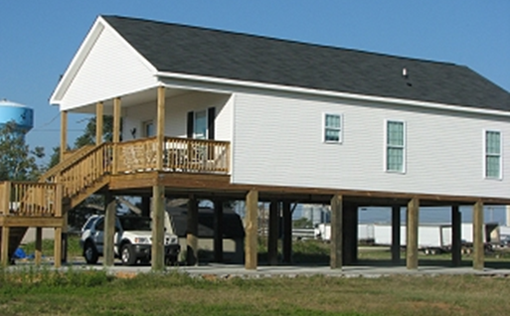
SAVING MONEY ON FLOOD INSURANCE
FEMA has programs to help owners reduce their risk and save money on flood insurance
Community-wide discounts through the Community Rating System (CRS)
FEMA grant programs support rebuilding and relocating
Use of higher deductibles to lower premium costs
THE SMARTEST WAY
TO SAVE MAY BE
TO BUILD HIGHER

Slide 29
KEY TAKEAWAY
If property owners in your community are rebuilding or building new, inform them that:
Flood risk changes over time
Their building or rebuilding decisions now can affect their long-term flood insurance premiums
Elevating their buildings and ensuring the right type of construction helps decrease their risk and reduce future flood insurance premiums

Slide 30
LEGISLATIVE UPDATES
Menendez-Isakson Homeowner Affordability Act (SB 1610)
and H.R. 3370
MS Insurance Dept. vs. US Dept. of Homeland Security
Florida OIR Guidelines: Private Flood Insurance

Slide 31
INDIRECT IMPACTS OF BW12

Slide 32
INDIRECT IMPACTS OF BW12
Increased uncertainty/risk of owning real estate.
Reduction in tax base. Shift in tax burden.
Increased rents for residential and commercial tenants.
Business closures. Reduction in employment.
Slower recovery after a loss event.

Slide 33
INDIRECT IMPACTS OF BW12
Risk of blight in some communities.
More contentious/political map revision process.
Increased litigation against Participating Communities
(Cities and Counties)
Increased E&O exposure for Attorneys, Insurance Agents, Realtors, Lenders.

Slide 34
QUESTIONS?

Slide 35
ADDITIONAL RESOURCES
Sign up for WYO Alerts – http://www.nfipiservice.com/mailing_list.html
Training is available through FEMA for insurance agents, adjusters
& lenders www.fema.gov/business/nfip/trainagt.shtm
Sign up for agent training emails –
https://public.govdelivery.com/accounts/USDHSFEMA/subscriber/new?topic_id=USDHSFEMA_212
NFIP Training offers workshops and webinars
www.nfipiservice.com/training/schedule_agents.html

Slide 36
ADDITIONAL RESOURCES (con’t)
FEMA Flood Map Changes Course
http://www.h2opartnerusa.com/nfiptraining/mapping_changes.html
Fact Sheets – http://www.riskmap6.com/Resources.aspx
FloodSmart for Consumers – www.FloodSmart.gov
FloodSmart for Agents – www.Agents.FloodSmart.gov
Flood Insurance Manual – http://www.fema.gov/flood-insurance-manual
Risk Communication Guidebook for Local Officials
http://www.riskmap6.com/guidebook.aspx
Food Insurance Reform Act Webpage – http://www.fema.gov/bw12

Slide 37
CONTACTS AT FEMA REGION 4
Brad Loar, Director, Mitigation Division, 770-220-5416
brad.loar@fema.dhs.gov
Janice Mitchell, Insurance Specialist, 770-220-5441
janice.mitchell@fema.dhs.gov
Susan Wilson, Floodplain Management & Insurance, 770-220-5414
susan.wilson@fema.dhs.gov

Slide 38
Christopher W. Heidrick, CPCU, ANFI, CFP®
Heidrick & Co. Insurance & Risk Mgmt. Services LLC
1648 Periwinkle Way, Suite A :: Sanibel, Florida 33957
(239) 579-0660 :: chris@sanibelinsurance.com
Brad G. Loar, CFM
Director, Mitigation Division
FEMA Region IV
(770) 220-5416 :: brad.loar@fema.dhs.gov

