Slide 1
2013 ISO CGL
Changes for Construction Risk
Gregory D. Podolak, Esq.
David G. Jordan, Esq.
Saxe Doernberger & Vita, P.C.
March 18, 2013
Notes:
GDP
SDV Intro
Who we are
What we do
Different hats we wear (transactional advice vs. litigation)

Slide 2
April 1, 2013
Additional Insured
Other Insurances
Professional Services
Personal/Advertising Injury
Insured Contract

Slide 3
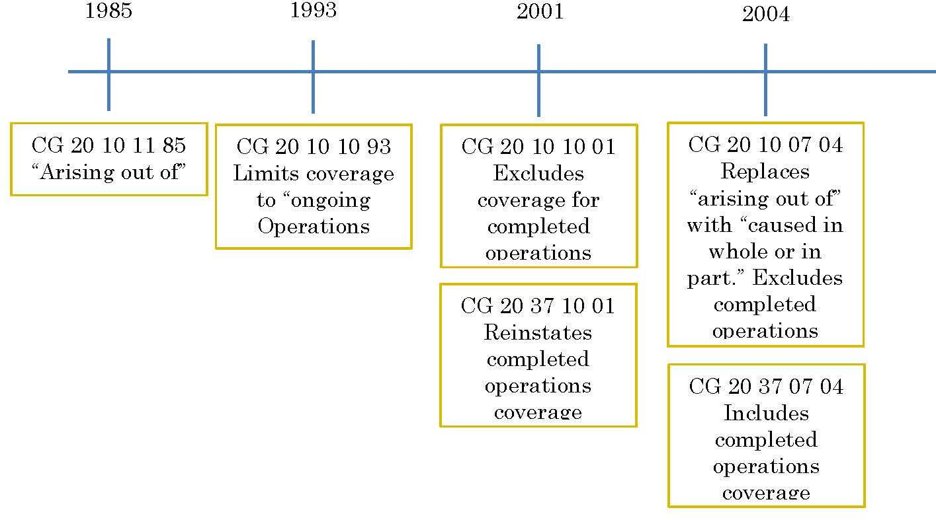
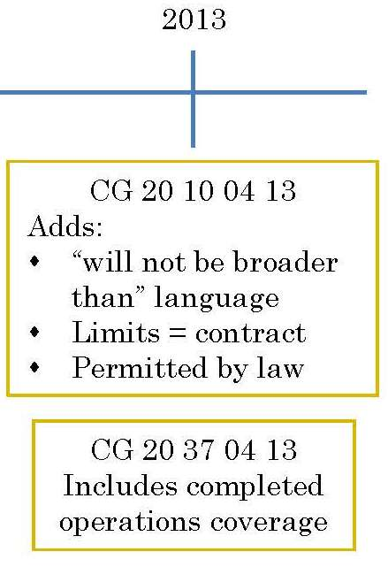
Evolution of ISO AI Coverage
Notes:
GDP
Note 2013 includes other changes

Slide 4
Additional Insured Issues “Follow Form” Additional Insured Coverage?
ALERT!
However, AI insurance “will not be broader than that which [the named insured is] required by the contract or agreement to provide. . .”
Change #1
CG 20 10 04 13
CG 20 37 04 13
Notes:
GDP
Important distinction – revision to the 04 endorsement, NOT the 01 (the interplay between “caused in whole or in part” and “will not be broader” (as opposed to “arising out of”) may be very significant)
Revised Endorsements
♦ CG 20 03 – Additional Insured – Concessionaires Trading Under Your Name
♦ CG 20 05 – Additional Insured – Controlling Interest
♦ CG 20 07 – Additional Insured – Engineers, Architects, Or Surveyors
♦ CG 20 10 – Additional Insured – Owners, Lessees Or Contractors –
Scheduled Person Or Organization
♦ CG 20 11 – Additional Insured – Managers Or Lessors Of Premises
♦ CG 20 12 – Additional Insured – State Or Governmental Agency Or
Subdivision Or Political Subdivision – Permits Or Authorizations
♦ CG 20 13 – Additional Insured – State Or Governmental Agency Or
Subdivision Or Political Subdivision – Permits Or Authorizations Relating
To Premises
♦ CG 20 15 – Additional Insured – Vendors
♦ CG 20 18 – Additional Insured – Mortgagee, Assignee Or Receiver
♦ CG 20 23 – Additional Insured – Executors, Administrators, Trustees Or
Beneficiaries
♦ CG 20 24 – Additional Insured – Owners Or Other Interest From Whom
Land Has Been Leased
♦ CG 20 26 – Additional Insured – Designated Person Or Organization
♦ CG 20 27 – Additional Insured – Co-Owner Of Insured Premises
♦ CG 20 28 – Additional Insured – Lessor Of Leased Equipment
♦ CG 20 29 – Additional Insured – Grantor Of Franchise
♦ CG 20 30 – Oil Or Gas Operations – Nonoperating, Working Interests
♦ CG 20 31 – Additional Insured – Engineers, Architects Or Surveyors
♦ CG 20 32 – Additional Insured – Engineers, Architects Or Surveyors Not
Engaged By The Named Insured
♦ CG 20 33 – Additional Insured – Owners, Lessees Or Contractors –
Automatic Status When Required In Construction Agreement With You
♦ CG 20 34 – Additional Insured – Lessor Of Leased Equipment – Automatic
Status When Required In Lease Agreement With You
♦ CG 20 35 – Additional Insured – Grantor Of Licenses – Automatic Status
When Required By Licensor
♦ CG 20 36 – Additional Insured – Grantor Of Licenses
♦ CG 20 37 – Additional Insured – Owners, Lessees Or Contractors –
Completed Operations
♦ CG 29 35 – Additional Insured – State Or Governmental Agency Or
Subdivision Or Political Subdivision – Permits Or Authorizations

Slide 5
Additional Insured Issues “Follow Form” Additional Insured Coverage?
Vague and undefined
Unprecedented emphasis on underlying contract terms
Buyer Beware!
Notes:
GDP
This language is used to create follow form excess coverage. Radil v. Nat'l Union Fire Ins. Co. of Pittsburg, PA, 233 P.3d 688, 695 (Colo. 2010) (“The language of National Union's endorsement states that the UM/UIM insurance its policy provides ‘will not be broader than the insurance coverage provided by [Great American’s] policy.’ I would read that language to mean exactly—and only—what it says: National Union’s insurance will not be broader than the insurance coverage provided by Great American.”).

Slide 6
Additional Insured Issues “Follow Form” Additional Insured Coverage?
Subcontractor shall maintain commercial general liability that provides:
Limits not less than $1M/occurrence, $2M gen. agg.
ISO occurrence form CG 00 01 (or equivalent)
Liability arising from:
Premises
Operations
Independent contractors
Products completed operations
Personal & advertising injury
Liability assumed under contract, including tort liability
Contractor shall be included as an additional insured for both ongoing and completed operations
ISO CG 20 10 and 20 37 (or equivalent)
Notes:
GDP

Slide 7
Additional Insured Issues Limits: No more than contract provides
Change #2
CG 20 10 04 13
CG 20 37 04 13
“The most we will pay on behalf of the additional insured is the amount of insurance:
Required by the contract or agreement; or
Available under the applicable Limits of Insurance shown in the Declarations; whichever is less.”
Notes:
GDP
Absent express policy language to the contrary, the AI gets full access to limits even if the base contract from which the AI status stems requires the named insured to provide AI coverage in an amount less than the policy’s limits. See Mobil Oil Corp. v. Maryland Cas. Co. 681 N.E.2d 553 (Ill App. 1998) (absent language limiting coverage, AIs are entitled to full limits). Some AI endorsements will, however, make such an explicit reference to the terms of the underlying contract, thereby limiting the AI to those limits proscribed in the contract. See Bovis Lend Lease LMB, Inc., et al. v. Great Am. Ins. Co., 53 A.D.3d 140, 155-60 (N.Y. App. Div. 1st Dept. 2008) (interpreting one such endorsement and upholding a policy provision limiting coverage for an AI to the minimum amount required by contract).
Revised Endorsements
♦ CG 20 03 – Additional Insured – Concessionaires Trading Under Your Name
♦ CG 20 05 – Additional Insured – Controlling Interest
♦ CG 20 07 – Additional Insured – Engineers, Architects, Or Surveyors
♦ CG 20 10 – Additional Insured – Owners, Lessees Or Contractors –
Scheduled Person Or Organization
♦ CG 20 11 – Additional Insured – Managers Or Lessors Of Premises
♦ CG 20 12 – Additional Insured – State Or Governmental Agency Or
Subdivision Or Political Subdivision – Permits Or Authorizations
♦ CG 20 13 – Additional Insured – State Or Governmental Agency Or
Subdivision Or Political Subdivision – Permits Or Authorizations Relating
To Premises
♦ CG 20 15 – Additional Insured – Vendors
♦ CG 20 18 – Additional Insured – Mortgagee, Assignee Or Receiver
♦ CG 20 23 – Additional Insured – Executors, Administrators, Trustees Or
Beneficiaries
♦ CG 20 24 – Additional Insured – Owners Or Other Interest From Whom
Land Has Been Leased
♦ CG 20 26 – Additional Insured – Designated Person Or Organization
♦ CG 20 27 – Additional Insured – Co-Owner Of Insured Premises
♦ CG 20 28 – Additional Insured – Lessor Of Leased Equipment
♦ CG 20 29 – Additional Insured – Grantor Of Franchise
♦ CG 20 30 – Oil Or Gas Operations – Nonoperating, Working Interests
♦ CG 20 31 – Additional Insured – Engineers, Architects Or Surveyors
♦ CG 20 32 – Additional Insured – Engineers, Architects Or Surveyors Not
Engaged By The Named Insured
♦ CG 20 33 – Additional Insured – Owners, Lessees Or Contractors –
Automatic Status When Required In Construction Agreement With You
♦ CG 20 34 – Additional Insured – Lessor Of Leased Equipment – Automatic
Status When Required In Lease Agreement With You
♦ CG 20 35 – Additional Insured – Grantor Of Licenses – Automatic Status
When Required By Licensor
♦ CG 20 36 – Additional Insured – Grantor Of Licenses
♦ CG 20 37 – Additional Insured – Owners, Lessees Or Contractors –
Completed Operations
♦ CG 29 35 – Additional Insured – State Or Governmental Agency Or
Subdivision Or Political Subdivision – Permits Or Authorizations

Slide 8
Additional Insured Issues Limits: No more than contract provides
Why?
To capture parties’ intent
What’s next?
Assume contract limitations will govern AI limits
Notes:
GDP
Absent express policy language to the contrary, the AI gets full access to limits even if the base contract from which the AI status stems requires the named insured to provide AI coverage in an amount less than the policy’s limits. See Mobil Oil Corp. v. Maryland Cas. Co. 681 N.E.2d 553 (Ill App. 1998) (absent language limiting coverage, AIs are entitled to full limits). Some AI endorsements will, however, make such an explicit reference to the terms of the underlying contract, thereby limiting the AI to those limits proscribed in the contract. See Bovis Lend Lease LMB, Inc., et al. v. Great Am. Ins. Co., 53 A.D.3d 140, 155-60 (N.Y. App. Div. 1st Dept. 2008) (interpreting one such endorsement and upholding a policy provision limiting coverage for an AI to the minimum amount required by contract).
Revised Endorsements
♦ CG 20 03 – Additional Insured – Concessionaires Trading Under Your Name
♦ CG 20 05 – Additional Insured – Controlling Interest
♦ CG 20 07 – Additional Insured – Engineers, Architects, Or Surveyors
♦ CG 20 10 – Additional Insured – Owners, Lessees Or Contractors –
Scheduled Person Or Organization
♦ CG 20 11 – Additional Insured – Managers Or Lessors Of Premises
♦ CG 20 12 – Additional Insured – State Or Governmental Agency Or
Subdivision Or Political Subdivision – Permits Or Authorizations
♦ CG 20 13 – Additional Insured – State Or Governmental Agency Or
Subdivision Or Political Subdivision – Permits Or Authorizations Relating
To Premises
♦ CG 20 15 – Additional Insured – Vendors
♦ CG 20 18 – Additional Insured – Mortgagee, Assignee Or Receiver
♦ CG 20 23 – Additional Insured – Executors, Administrators, Trustees Or
Beneficiaries
♦ CG 20 24 – Additional Insured – Owners Or Other Interest From Whom
Land Has Been Leased
♦ CG 20 26 – Additional Insured – Designated Person Or Organization
♦ CG 20 27 – Additional Insured – Co-Owner Of Insured Premises
♦ CG 20 28 – Additional Insured – Lessor Of Leased Equipment
♦ CG 20 29 – Additional Insured – Grantor Of Franchise
♦ CG 20 30 – Oil Or Gas Operations – Nonoperating, Working Interests
♦ CG 20 31 – Additional Insured – Engineers, Architects Or Surveyors
♦ CG 20 32 – Additional Insured – Engineers, Architects Or Surveyors Not
Engaged By The Named Insured
♦ CG 20 33 – Additional Insured – Owners, Lessees Or Contractors –
Automatic Status When Required In Construction Agreement With You
♦ CG 20 34 – Additional Insured – Lessor Of Leased Equipment – Automatic
Status When Required In Lease Agreement With You
♦ CG 20 35 – Additional Insured – Grantor Of Licenses – Automatic Status
When Required By Licensor
♦ CG 20 36 – Additional Insured – Grantor Of Licenses
♦ CG 20 37 – Additional Insured – Owners, Lessees Or Contractors –
Completed Operations
♦ CG 29 35 – Additional Insured – State Or Governmental Agency Or
Subdivision Or Political Subdivision – Permits Or Authorizations

Slide 9
Additional Insured Issues Limits: No more than contract provides
Policy Limits
$10 Million
Contract Requirements
$5 Million
$1 Million GAP
$1 Million
$1 Million
$2 Million
Notes:
GDP
Scenario where contract separates primary and excess requirements.
Contract issues
“Not less than” “a minimum of”

Slide 10
Additional Insured Issues Limits: No more than contract provides
Upstream
Review/modify the contract
Avoid where possible
Downstream
Better reflects the parties’ intent
Carefully assess contract requirements
Notes:
GDP
Pressure on the drafter of the contract:
E.g. “If Subcontractor’s policy limits are greater than the minimum limits of liability stated in this agreement, those greater policy limits, and any applicable excess policy limits, shall also apply and be available to the Additional Insureds’ coverage.”
Subcontractor further agrees that the amount of insurance available to additional insureds shall be for the full amount of the loss up to policy limits of liability and shall not be limited to the minimum requirements of this Subcontract.

Slide 11
Additional Insured Issues Limiting the reach of Anti-Indemnity Statutes
Change #3
CG 20 10 04 13
CG 20 37 04 13
“The insurance afforded to such additional insured only applies to the extent permitted by law”
Notes:
GDP
**This discussion does not address those anti-indemnity statutes that specifically apply to insurance.
Avoids impact of nullifying AI coverage in jurisdictions where AI coverage is limited to NI’s own negligence.
Example of “inextricably tied” - See Transcon. Ins. Co. v. Nat’l Union Fire Ins. Co. of Pittsburgh, 278 Ill. App.3d 357 (1996).
Many courts enforce savings clauses. See Thrash Commercial Contractors, Inc. v. Terracon Consultants, Inc., 3:11CV577TSL-MTP, 2012 WL 2407551 (S.D. Miss. June 25, 2012) (collecting authority from Massachusetts, New York, North Carolina, Illinois, Indiana).
At least 15 states have held “savings clause” cures non-compliant language
We are aware that Arizona, Connecticut, Delaware, Indiana, Maryland, Massachusetts, Michigan, Minnesota, Mississippi, Nebraska, New York, North Carolina, Rhode Island, West Virginia and Wisconsin have case law holding that a savings clause will be effective.
NOTE: Consider implications on Additional Insured’s ability to take advantage of receiving AI coverage broader than required by contract – can Named Insured/Insurer argue AI is only entitled to “that which is permitted by law” and no more?
Revised Endorsements
♦ CG 20 03 – Additional Insured – Concessionaires Trading Under Your Name
♦ CG 20 05 – Additional Insured – Controlling Interest
♦ CG 20 07 – Additional Insured – Engineers, Architects, Or Surveyors
♦ CG 20 10 – Additional Insured – Owners, Lessees Or Contractors –
Scheduled Person Or Organization
♦ CG 20 11 – Additional Insured – Managers Or Lessors Of Premises
♦ CG 20 12 – Additional Insured – State Or Governmental Agency Or
Subdivision Or Political Subdivision – Permits Or Authorizations
♦ CG 20 13 – Additional Insured – State Or Governmental Agency Or
Subdivision Or Political Subdivision – Permits Or Authorizations Relating
To Premises
♦ CG 20 15 – Additional Insured – Vendors
♦ CG 20 18 – Additional Insured – Mortgagee, Assignee Or Receiver
♦ CG 20 23 – Additional Insured – Executors, Administrators, Trustees Or
Beneficiaries
♦ CG 20 24 – Additional Insured – Owners Or Other Interest From Whom
Land Has Been Leased
♦ CG 20 26 – Additional Insured – Designated Person Or Organization
♦ CG 20 27 – Additional Insured – Co-Owner Of Insured Premises
♦ CG 20 28 – Additional Insured – Lessor Of Leased Equipment
♦ CG 20 29 – Additional Insured – Grantor Of Franchise
♦ CG 20 30 – Oil Or Gas Operations – Nonoperating, Working Interests
♦ CG 20 31 – Additional Insured – Engineers, Architects Or Surveyors
♦ CG 20 32 – Additional Insured – Engineers, Architects Or Surveyors Not
Engaged By The Named Insured
♦ CG 20 33 – Additional Insured – Owners, Lessees Or Contractors –
Automatic Status When Required In Construction Agreement With You
♦ CG 20 34 – Additional Insured – Lessor Of Leased Equipment – Automatic
Status When Required In Lease Agreement With You
♦ CG 20 35 – Additional Insured – Grantor Of Licenses – Automatic Status
When Required By Licensor
♦ CG 20 36 – Additional Insured – Grantor Of Licenses
♦ CG 20 37 – Additional Insured – Owners, Lessees Or Contractors –
Completed Operations
♦ CG 29 35 – Additional Insured – State Or Governmental Agency Or
Subdivision Or Political Subdivision – Permits Or Authorizations

Slide 12
Additional Insured Issues Limiting the reach of Anti-Indemnity Statutes
Application of anti-indemnity statutes to additional insured requirements
“Inextricably tied”
Notes:
GDP
**This discussion does not address those anti-indemnity statutes that specifically apply to insurance - 9 states have in some way extended anti-indemnity statutes scope to limit AI (Texas, California, OR, LA, MA, MT, MO, OK, NM)
Example of “inextricably tied” - See Transcon. Ins. Co. v. Nat’l Union Fire Ins. Co. of Pittsburgh, 278 Ill. App.3d 357 (1996).
Many courts enforce savings clauses. See Thrash Commercial Contractors, Inc. v. Terracon Consultants, Inc., 3:11CV577TSL-MTP, 2012 WL 2407551 (S.D. Miss. June 25, 2012) (collecting authority from Massachusetts, New York, North Carolina, Illinois, Indiana).
At least 15 states have held “savings clause” cures non-compliant language
We are aware that Arizona, Connecticut, Delaware, Indiana, Maryland, Massachusetts, Michigan, Minnesota, Mississippi, Nebraska, New York, North Carolina, Rhode Island, West Virginia and Wisconsin have case law holding that a savings clause will be effective.
NOTE: Consider implications on Additional Insured’s ability to take advantage of receiving AI coverage broader than required by contract – can Named Insured/Insurer argue AI is only entitled to “that which is permitted by law” and no more?
Revised Endorsements
♦ CG 20 03 – Additional Insured – Concessionaires Trading Under Your Name
♦ CG 20 05 – Additional Insured – Controlling Interest
♦ CG 20 07 – Additional Insured – Engineers, Architects, Or Surveyors
♦ CG 20 10 – Additional Insured – Owners, Lessees Or Contractors –
Scheduled Person Or Organization
♦ CG 20 11 – Additional Insured – Managers Or Lessors Of Premises
♦ CG 20 12 – Additional Insured – State Or Governmental Agency Or
Subdivision Or Political Subdivision – Permits Or Authorizations
♦ CG 20 13 – Additional Insured – State Or Governmental Agency Or
Subdivision Or Political Subdivision – Permits Or Authorizations Relating
To Premises
♦ CG 20 15 – Additional Insured – Vendors
♦ CG 20 18 – Additional Insured – Mortgagee, Assignee Or Receiver
♦ CG 20 23 – Additional Insured – Executors, Administrators, Trustees Or
Beneficiaries
♦ CG 20 24 – Additional Insured – Owners Or Other Interest From Whom
Land Has Been Leased
♦ CG 20 26 – Additional Insured – Designated Person Or Organization
♦ CG 20 27 – Additional Insured – Co-Owner Of Insured Premises
♦ CG 20 28 – Additional Insured – Lessor Of Leased Equipment
♦ CG 20 29 – Additional Insured – Grantor Of Franchise
♦ CG 20 30 – Oil Or Gas Operations – Nonoperating, Working Interests
♦ CG 20 31 – Additional Insured – Engineers, Architects Or Surveyors
♦ CG 20 32 – Additional Insured – Engineers, Architects Or Surveyors Not
Engaged By The Named Insured
♦ CG 20 33 – Additional Insured – Owners, Lessees Or Contractors –
Automatic Status When Required In Construction Agreement With You
♦ CG 20 34 – Additional Insured – Lessor Of Leased Equipment – Automatic
Status When Required In Lease Agreement With You
♦ CG 20 35 – Additional Insured – Grantor Of Licenses – Automatic Status
When Required By Licensor
♦ CG 20 36 – Additional Insured – Grantor Of Licenses
♦ CG 20 37 – Additional Insured – Owners, Lessees Or Contractors –
Completed Operations
♦ CG 29 35 – Additional Insured – State Or Governmental Agency Or
Subdivision Or Political Subdivision – Permits Or Authorizations

Slide 13
Additional Insured Issues Eliminating Contractual Privity Disputes
Change #4
CG 20 33 04 13
Current Language
20 33 07 04
AI status when “you [the named insured] and such person [the party seeking AI status] have agreed in writing in a contract or agreement”
Problem
Contract privity necessary to trigger additional insured coverage?
Notes:
GDP
Current form = CG 20 33 07 04 (ongoing operations)
Draw distinction with 20 37 (completed ops)?
Revised Endorsements
♦ CG 20 03 – Additional Insured – Concessionaires Trading Under Your Name
♦ CG 20 05 – Additional Insured – Controlling Interest
♦ CG 20 07 – Additional Insured – Engineers, Architects, Or Surveyors
♦ CG 20 10 – Additional Insured – Owners, Lessees Or Contractors –
Scheduled Person Or Organization
♦ CG 20 11 – Additional Insured – Managers Or Lessors Of Premises
♦ CG 20 12 – Additional Insured – State Or Governmental Agency Or
Subdivision Or Political Subdivision – Permits Or Authorizations
♦ CG 20 13 – Additional Insured – State Or Governmental Agency Or
Subdivision Or Political Subdivision – Permits Or Authorizations Relating
To Premises
♦ CG 20 15 – Additional Insured – Vendors
♦ CG 20 18 – Additional Insured – Mortgagee, Assignee Or Receiver
♦ CG 20 23 – Additional Insured – Executors, Administrators, Trustees Or
Beneficiaries
♦ CG 20 24 – Additional Insured – Owners Or Other Interest From Whom
Land Has Been Leased
♦ CG 20 26 – Additional Insured – Designated Person Or Organization
♦ CG 20 27 – Additional Insured – Co-Owner Of Insured Premises
♦ CG 20 28 – Additional Insured – Lessor Of Leased Equipment
♦ CG 20 29 – Additional Insured – Grantor Of Franchise
♦ CG 20 30 – Oil Or Gas Operations – Nonoperating, Working Interests
♦ CG 20 31 – Additional Insured – Engineers, Architects Or Surveyors
♦ CG 20 32 – Additional Insured – Engineers, Architects Or Surveyors Not
Engaged By The Named Insured
♦ CG 20 33 – Additional Insured – Owners, Lessees Or Contractors –
Automatic Status When Required In Construction Agreement With You
♦ CG 20 34 – Additional Insured – Lessor Of Leased Equipment – Automatic
Status When Required In Lease Agreement With You
♦ CG 20 35 – Additional Insured – Grantor Of Licenses – Automatic Status
When Required By Licensor
♦ CG 20 36 – Additional Insured – Grantor Of Licenses
♦ CG 20 37 – Additional Insured – Owners, Lessees Or Contractors –
Completed Operations
♦ CG 29 35 – Additional Insured – State Or Governmental Agency Or
Subdivision Or Political Subdivision – Permits Or Authorizations

Slide 14
Additional Insured Issues Eliminating Contractual Privity Disputes
Owner
General Contractor
Subcontractor
Notes:
GDP
Although current language only requires a (that is, any) contract or agreement in writing that evinces AI status, and does not require a contract directly between the parties - Pro Con, Inc. v. Interstate Fire & Cas. Co., 2011 WL 2579825 (D.Me. 2011) (general contractor was an AI on a sub-subcontractor’s policy despite not having a written contract with the sub-subcontractor due to absence of language such as “with you” in the AI endorsement) - some courts have misinterpreted this or similar language to require just the opposite. See, e.g., Brooklyn Hosp. Ctr. v. One Beacon Ins., 799 N.Y.S.2d 158 (2004); Venable v. Hilcorp Energy Co., Inc., 2010 WL 1817757 (E.D. La. 2010).

Slide 15
Additional Insured Issues Eliminating Contractual Privity Disputes
ISO’s approach – addition versus clarification
New Endorsement (20 38 04 13)
“Any other person or organization you [the named insured] are required to add as an additional insured under the contract or agreement described in Paragraph 1. above.”
Notes:
GDP
New form = CG 20 38 04 13

Slide 16
Additional Insured Issues Eliminating Contractual Privity Disputes
Owner
General Contractor
Subcontractor
Notes:
GDP
ISO’s new language solves the privity dispute – under the new forms.
Under the old forms, debate continues.

Slide 17
“Other Insurance” Additional Insured Policies Pay First
Change #5
CG 00 01 04 13
This insurance is excess over:
(b) Any other primary insurance available to you . . .
for which you have been added as an additional insured
by attachment of an endorsement.
Notes:
DGJ
Revised Forms/Endorsements (“Attachment of Endorsement”)
♦ CG 00 01 - Commercial General Liability Coverage Form (Occurrence)
♦ CG 00 02 - Commercial General Liability Coverage Form (Claims-made)
♦ CG 27 10 - Supplemental Extended Reporting Period Endorsement
♦ CG 27 11 - Supplemental Extended Reporting Period Endorsement For
Specific Accidents, Products, Work Or Locations

Slide 18
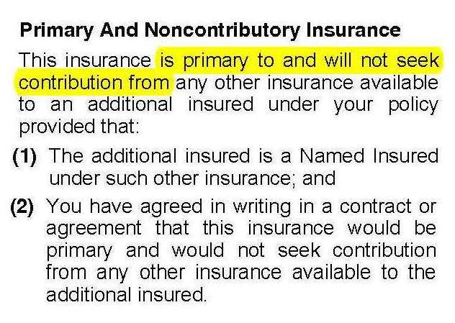
“Other Insurance” Additional Insured Policies Pay First
Change #6
CG 20 01 04 13
Notes:
DGJ
On new forms, primary and non-contributory language will apply where:
The AI is a named insured on another policy of insurance and
There is a written contract between the named insured and the AI indicating that the policy will be primary and not seek contribution from any other insurance available to the AI
New Endorsement (“Primary and Noncontributory”)
♦ CG 20 01 - Primary And Noncontributory – Other Insurance Condition

Slide 19
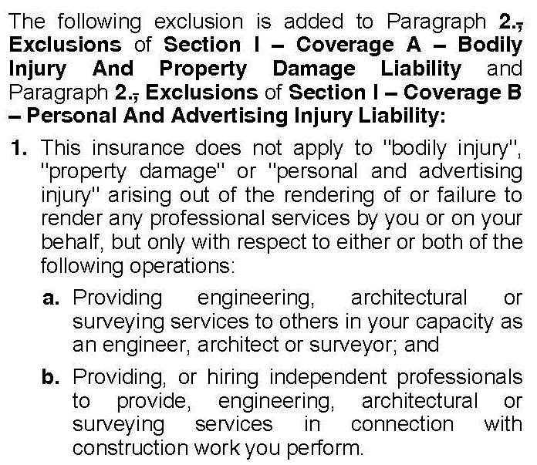
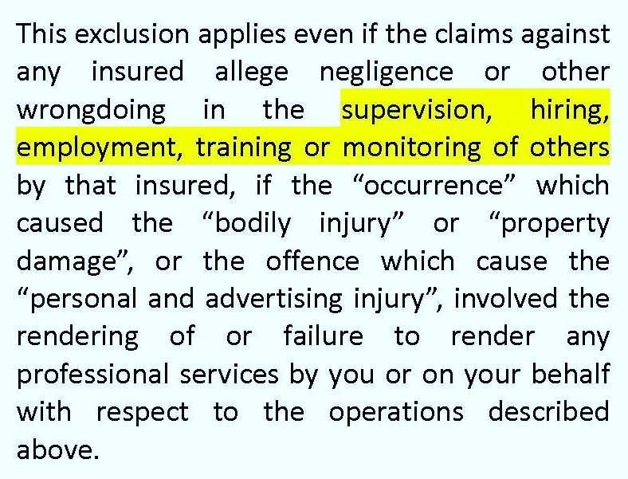
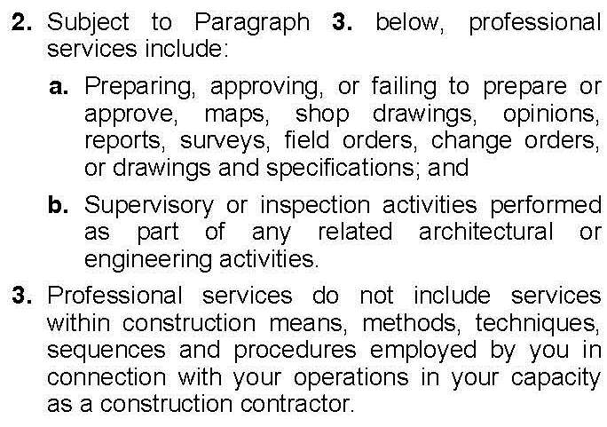
Professional Services Exclusion Expanded Scope
Change #7
CG 22 79 04 13
Notes:
DGJ
Issue: Uncertainty over coverage for negligent supervision claims
ISO Solution: “hiring, employment, training, supervision, and monitoring”
it is not hard to imagine that these revisions could lead to a substantial increase in coverage litigation, as bodily injury claims – especially in the construction context – are routinely coupled with allegations of negligent supervision.
Liberty v. Travelers, 4th Cir. 1999 – negligent supervision claim = covered
20 33 includes this language!
Revised Endorsements
CG 21 16 - Exclusion – Designated Professional Services
♦ CG 21 52 - Exclusion – Financial Services
♦ CG 21 56 - Exclusion – Funeral Services
♦ CG 21 57 - Exclusion – Counseling Services
♦ CG 21 58 - Exclusion – Professional Veterinarian Services
♦ CG 21 59 - Exclusion – Diagnostic Testing Laboratories
♦ CG 22 24 - Exclusion – Inspection, Appraisal And Survey Companies
♦ CG 22 32 - Exclusion – Professional Services – Blood Banks
♦ CG 22 33 - Exclusion – Testing Or Consulting Errors And Omissions
♦ CG 22 34 - Exclusion – Construction Management Errors And Omissions
♦ CG 22 36 - Exclusion – Products And Professional Services (Druggists)
♦ CG 22 37 - Exclusion – Products And Professional Services (Optical And
Hearing Aid Establishments)
♦ CG 22 39 - Exclusion – Camps Or Campgrounds
♦ CG 22 43 - Exclusion – Engineers, Architects Or Surveyors Professional
Liability
♦ CG 22 44 - Exclusion – Services Furnished By Health Care Providers
♦ CG 22 45 - Exclusion – Specified Therapeutic Or Cosmetic Services
♦ CG 22 48 - Exclusion – Insurance And Related Operations
♦ CG 22 69 - Druggists
♦ CG 22 71 - Colleges Or Schools (Limited Form)
♦ CG 22 72 - Colleges Or Schools
♦ CG 22 75 - Professional Liability Exclusion – Computer Software
♦ CG 22 76 - Professional Liability Exclusion – Health Or Exercise Clubs Or
Commercially Operated Health Or Exercise Facilities
♦ CG 22 77 - Professional Liability Exclusion – Computer Data Processing
♦ CG 22 79 - Exclusion – Contractors – Professional Liability
♦ CG 22 80 - Limited Exclusion – Contractors – Professional Liability
♦ CG 22 87 - Exclusion – Adult Day Care Centers
♦ CG 22 88 - Professional Liability Exclusion – Electronic Data Processing
Services And Computer Consulting Or Programming Services
♦ CG 22 90 - Professional Liability Exclusion – Spas or Personal Enhancement
Facilities
♦ CG 22 91 - Exclusion – Telecommunication Equipment Or Service Providers
Errors And Omissions
♦ CG 22 96 - Limited Exclusion – Personal And Advertising Injury – Lawyers
♦ CG 22 98 - Exclusion – Internet Service Providers And Internet Access
Providers Errors And Omissions
♦ CG 22 99 - Professional Liability Exclusion – Web Site Designers
♦ CG 23 01 - Exclusion – Real Estate Agents Or Brokers Errors Or Omissions
♦ CG 31 15 - Construction Projection Management Protective Liability
Coverage

Slide 20
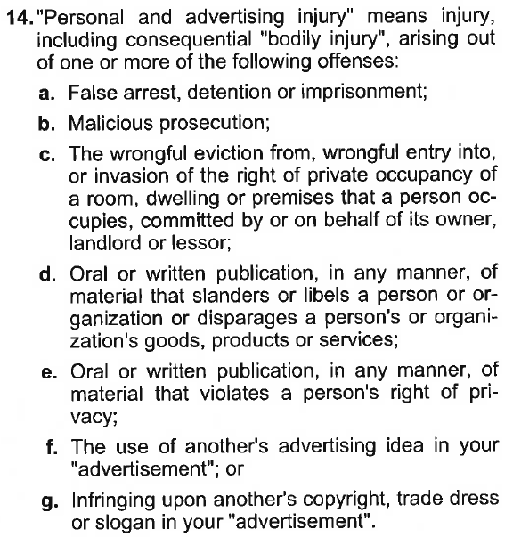
Personal & Advertising Injury Coverage Narrowed Scope
Change #8
CG 24 13 04 13
Notes:
DGJ
The purpose of this deletion, as stated by ISO, is to restrict coverage. The impact of this removal may be hard to predict without court assessment, given that insurers may seek to apply an interpretation of this clause that is broader than the insured’s interpretation.
Arguably, many claims of damage to reputation can also be considered a violation of privacy rights.
New Endorsement
♦ CG 24 13 - Amendment Of Personal And Advertising Injury Definition

Slide 21
“Insured Contract” Named Insured Must Have Caused Injury
Change #9
CG 24 26 04 13
“Such part of a contract or agreement shall only be considered an “insured contract” to the extent your assumption of the tort liability is permitted by law”
Language is limitation upon coverage, but impact is unknown
May have implications in “joint and several” liability circumstances
Notes:
DGJ
NOTE: Change is to insured contract endorsement, not the policy form.
Revised Forms
♦ CG 24 26 - Amendment Of Insured Contract Definition
♦ CG 24 27 - Limited Contractual Liability – Railroads

Slide 22
“Insured Contract” Named Insured Must Have Caused Injury
Why does an insured contract matter?
Exception to contractual liability exclusion
What is it?
Any agreement where the promisor assumes the tort liability of the promisee
Notes:
DGJ
Discuss significance of potential over extension of contractual liability exclusion (encompassing any breach of contract related claims) and consequent importance of exception
NOTE: Change is to insured contract endorsement, not the policy form.
Revised Forms
♦ CG 24 26 - Amendment Of Insured Contract Definition
♦ CG 24 27 - Limited Contractual Liability – Railroads

Slide 23
Take Aways
Work closely with your brokers
More emphasis on contract than ever before
Be aware of where the changes are being made

Slide 24
Thank You
Gregory D. Podolak, Esq.
203-287-2114
gdp@sdvlaw.com
David G. Jordan, Esq.
203-287-2111
dgj@sdvlaw.com

