Slide 1
Business Interruption And Related Time Element Coverage
Florida Bar Association
November 19, 2012
Patrick J. O’Connor, Jr.
Faegre Baker Daniels LLP
Patrick.Oconnor@faegreBD.com

Slide 2
Insuring Against Business Loss
Business Interruption (BI)
Extra Expense
Contingent BI
Civil Authority
Ingress/Egress
Service Interruption

Slide 3
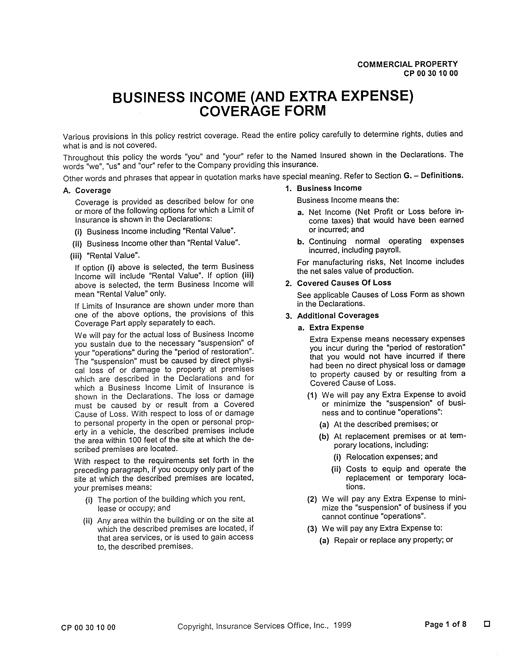
Core Coverage Grant:

Slide 4
Conditions of Coverage
Establishing Physical Damage to Covered Property
Covered “Cause of Loss” Must Cause Physical Damage
Excluded causes (poor work/design)
Sublimits (e.g., flood)
Multiple causes
Collapse

Slide 5
3 Requirements:
A. Must be direct physical damage to insured property caused by covered peril.
B. That physical damage must itself result in an interruption of insured’s business that causes actual monetary loss.
C. The monetary loss must occur during the “Period of Restoration” — defined by the policy.

Slide 6
A Closer Look:
A. Must be direct physical damage to insured property caused by covered peril.

Slide 7
2 Causation Links:
covered peril ↓ physical property damage
causes
physical damage ↓ business interruption
causes

Slide 8
BI must result directly from covered physical damage — not simply from the covered peril.

Slide 9
Total vs. Partial Suspension
Most policies require a “necessary suspension” of business.
The word “suspension” historically has not been a defined term in BI policies.

Slide 10
Majority Rule = Complete cessation of business is required.

Slide 11
Form CP 00 30 10 00 is a newer ISO BI form.
An old term now has a new definition:

Slide 12
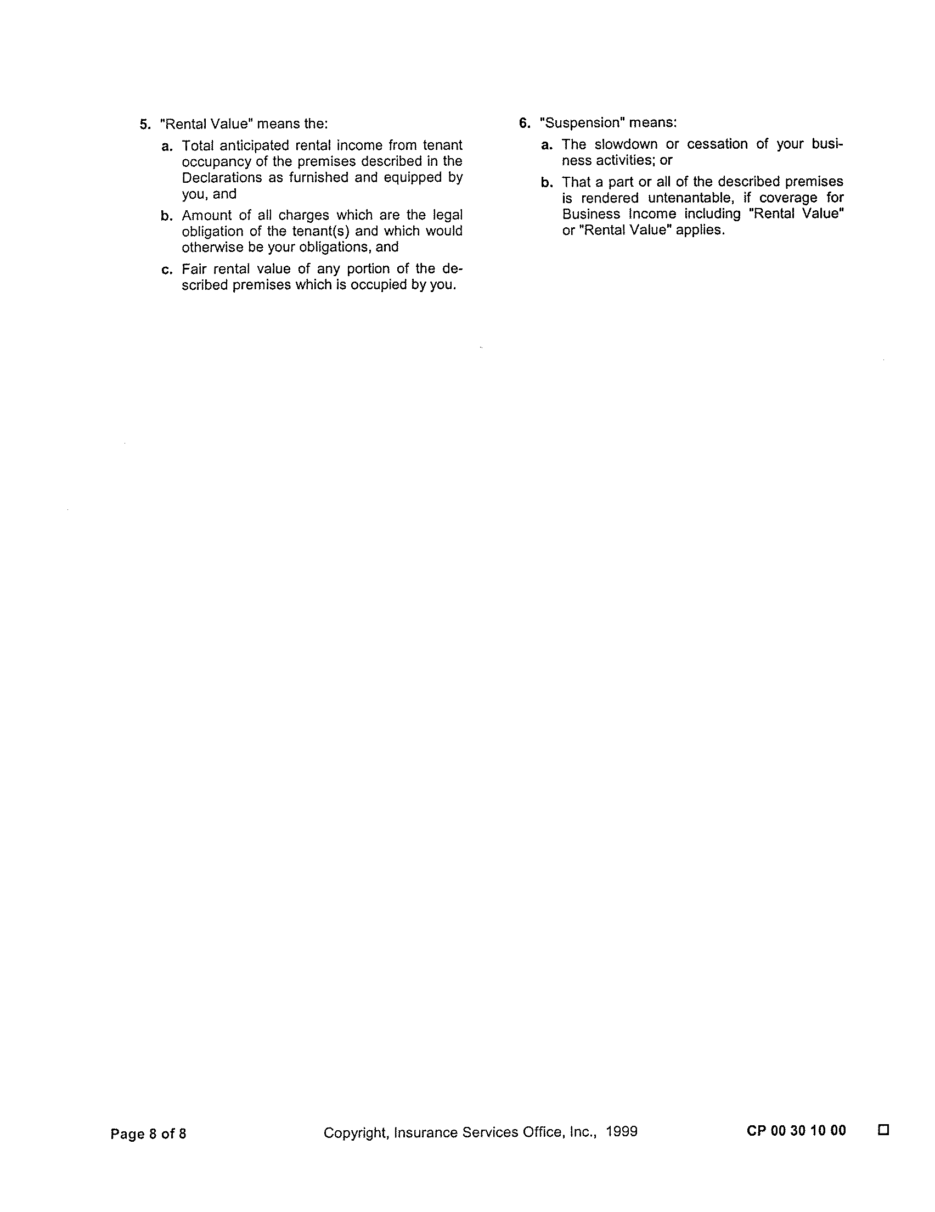

Slide 13
Complete cessation of business is not required with the newest ISO forms.
“Suspension” includes “slow down or cessation” of business activities.
Caveat: Newer ISO forms still not in widespread use.

Slide 14
C. The monetary loss must occur during the “Period of Restoration.”

Slide 15
When is the “Period of Restoration”?
“Period of Restoration” is a defined term, with a beginning . . .

Slide 16
Period of Restoration . . .
Begins: 72 hours after physical loss (for BI claim).
and an end . . .

Slide 17
Period of Restoration . . .
Ends: “The date when the property . . . should be repaired, rebuilt, or replaced with reasonable speed and similar quality; . . . .”

Slide 18
Period of Restoration . . .
Not: The actual time required to rebuild.
(Although the actual time to rebuild would be probative.)

Slide 19
Period of Restoration . . .
is a hypothetical concept:
Assuming, hypothetically, the property is rebuilt or repaired with reasonable speed, by when will it be completed?

Slide 20
Calculating the Payout

Slide 22
The Concept:
Gross Earnings Coverage
(earnings before taxes)

Slide 23
ISO’s business income coverage forms are essentially gross earnings-type forms.
In the U.S., gross earnings coverage is the most commonly encountered type of BI insurance.

Slide 24
Gross earnings-type business interruption insurance covers the reduction in the net income, plus continuing normal expenses.

Slide 25
Result:
Compensation for reduced earnings.
Expenses no longer incurred during the interruption are not covered.
Continuing expenses, such as payroll, lease expenses, and expenses that continue to be incurred regardless of the business’ condition, are covered.

Slide 26
Theoretical Goal:
To protect the earnings an insured would have enjoyed had there been no interruption.

Slide 27
Rationale:
To indemnify the insured for losses sustained from the inability to use the premises.

Slide 28
What is paid?
An estimate is paid — How much income would have been received if no loss had occurred?

Slide 29
What is paid?
Basis for estimate:
The actual experience of the business prior to loss.
The probable experience during the period of interruption had no loss occurred.

Slide 30
Extra Expense (EE) Coverage

Slide 31
What EE covers?
Extra expenses necessary to remain in business or shorten down time, incurred because of the property loss.

Slide 32
Example . . .
Costs of renting temporary space to continue operations after the premises destroyed by fire.

Slide 33
Three key criteria for EE coverage:
Must be necessary
Timing: incurred during period of restoration
“but for” cause: but for a covered property loss, no EE incurred.

Slide 34
Conceptually EE rewards the insured for mitigating the BI loss:
EE avoid or minimize downtime
EE promotes continued operations of business.

Slide 35
Contingent Business Interruption Coverage

Slide 36
Contingent Business Interruption Claims
Coverage is triggered where covered damage to suppliers or customers negatively affects your business operations
Coverage applies even where insured’s own property is not damaged
Covered Losses include:
Additional expenses incurred to obtain supplies and raw materials
Diminished revenue because of losses suffered by customers
Other expenses due to damage to suppliers or customers

Slide 37
Civil Authority Coverage

Slide 38
Civil Authority Coverage
Order of Civil Authority Prohibiting Access
Degree of restriction
Order Must Cause Loss (9/11 Cases)
Causation
Sublimits
Waiting Period
Maximum Duration of Liability

Slide 39
Ingress/Egress Coverage

Slide 40
Ingress/Egress
Like Civil Authority Without The Necessity of A Public Act
Sublimits
Waiting Period
Maximum Duration of Liability

Slide 41
Requirements for Ingress/Egress Coverage:
Ingress or egress must be wholly impaired. Not sufficient that ingress or egress is simply more difficult.
The event preventing ingress/egress must be an insured peril.
Lack of ingress/egress must be the cause of the BI loss.
Physical damage may not be required – policies differ.

Slide 42
Service Interruption Coverage

Slide 43
Service Interruption Coverage
Covers loss of income or extra expense resulting from interruption of utility services
water
communications
power
gas
sewage

