Slide 1
Certificates of Insurance
Rich Scislowski
Senior Research Analyst
International Risk Mgmt. Inst.
Dallas, TX

Slide 2

About Me
Former Appellate Court Clerk
Former insurance coverage litigator
Now an RA with IRMI
Co-Editor, Commercial Liab. Ins.
Contributing Author, Contractual Risk Transfer
Studied COI issues for several years
Rich.s@irmi.com

Slide 3
Road Map
Enforceability of COIs
History
Legal theories to support enforcement
Notice of cancellation
Recent Trends
Recommendations
Waiver of COI + Insurance Requirements
Circumstances that have been found to be implied waivers
Recommendations

Slide 4
Enforceability of COIs
If the COI contains extra coverage terms (more AIs), can you get coverage enforced per the terms of the COI?

Slide 5
History of Certificates
First used in 1840s (fire insurance)
First used in construction in 1930s
Traditional Contract Analysis
Effect of COI depends on parties’ intent
If COI had extra provisions, then it must have been meant to amend policy (“Traditional” COI)
If COI mirrored policy, it must have been meant to provide information, only (“Limited” COI)
About 80/20 split: 80% Trad – 20% Ltd

Slide 6
History (Cont’d)
Equitable / Promissory Estoppel Analysis
Holders should be entitled to rely on COI
It is unfair to enforce policy restrictions against someone who never read the policy
Statutes based in historic view
Licensing statutes (must give agency NOC)
Environmental Statutes (recites minimum coverages)
UCC 1-307 (holder is entitled to rely on COI)
Notes:
Fla. Stat. § 507.04 = requires (1) household movers must (a) maintain at least $10,000 in cargo insurance, (a) provide Dept of Ag & Cons Srvs a COI, and (2) COI must give Dept 30 days NOC
F.A.C. Rule 15B-9.006 = requires wrecker operators who want to get on Highway Patrol call list must file COI with Dept of Highway Safety & MVs, and COI must give Dept 30 days NOC
UCC 1-307 = COI “shall be prima facie evidence . . . of the facts stated in the document”

Slide 7
History (Cont’d)
Traditional Insurance specs said COIs must:
Include statement that Holder + others is an AI
Refer to contract number
Recite (expand?) indemnity agreement
Give holder a right to NOC (more on this later)
Translation = Upstream party wants a “Traditional” COI with legal effect
Agents / Insurers only want to provide a “Ltd” COI

Slide 8
History (Con’t)
1976 – Establishment of ACORD
Goal: Increase prevalence of “Limited” COIs
Enhanced COI Disclaimers
COI does not “amend, extend or alter” policy
Insurance is subject to terms & conditions of policy
COI cannot add AI without an endorsement
Now about 10/90 split: 10% Trad - 90% Ltd
Post – 1976 Case Law

Slide 9
Theories for Overcoming COI Disclaimers
Totality of the Circumstances
Special Representation of Policy Existence, AI Status
COI = “Binder” (CA)
Reformation
Trend: Judicial Rebellion
See Int’l Ship Repair v. Northern Assur. Co., 2011 U.S. Dist. LEXIS 135347 (M.D. Fla., Nov. 23, 2011) (Lazzara, J.) (“disclaimers and limiting language [in COI] does not alter the fact that the certificate holder enjoys status as an additional insured”)
Notes:
Disclaimer “insurance is subject to terms & conditions of policy” reinforces the impression that a policy exists, & that the holder is an AI

Slide 10
Notice of Cancellation
If the policy of a Sub, Tenant, or Service Provider is canceled, how can the upstream party protect itself?

Slide 11
NOC in Certificates
Frequently Requested by Cert Holders & AI’s
Contract Requirement for NOC in Cert
Fed / State / Municipal Laws requiring NOC in Cert
Problems for Insurers & Agents
Tracking Cert Holders & AI’s entitled to NOC
Could Impede Cancellation
Notice of Reinstatement?
Increases Agent E&O Exposure

Slide 12
Prior Practice
Modify the old ACORD 25:
Should any of the above described policies be canceled before the expiration date thereof, the issuing insurer will endeavor to mail ______ days' written notice to the certificate holder named to the left, but failure to mail such notice shall impose no obligation or liability of any kind upon the company, its agents or representatives.
Source: Certificate Form 25 (2001/08) © ACORD Corporation, 1988
Notes:
Legally effective? I think so.

Slide 13
Issues with Modifying COI
For Insurers
Uncontrolled Expansion of Policy Coverage
Must Modified Certs Be Filed for Approval?
Regulatory Penalties for Using Unapproved Forms
Unknown Premium Impact
For Agents
Violates Agency Agreement with Insurer
Violates ACORD License
Increased admin. cost and E&O exposure

Slide 14
Three Industry Responses
Changes to ACORD Cert Form
Sept 2009
State DOI Cert Bulletins
30+ States
Model Cert Laws by Agent Trade Groups
10 States

Slide 15
(1) Changes to COIs
ACORD / ISO certificates changed
Delete “Endeavor To” Language + Disclaimer
New Cancellation Language:
Should any of the above described policies be canceled before the expiration date thereof, notice will be delivered in accordance with the policy provisions.
Source: Certificate Form 25 (2010/05) © 2010 ACORD Corporation.
Notes:
Just made it harder to modify COI

Slide 16
(2) COI Bulletins
Give Agents “Ammunition” vs. Upstream Parties
Generally say:
COIs Cannot Create Policy Rights (like NOC)
COIs must be Supported by the Policy
Unsupported NOC in COI = “Misrepresentation”
Agents Could be Subject to Discipline
License Revoked
Fines
Criminal Penalties
Notes:
First response

Slide 17
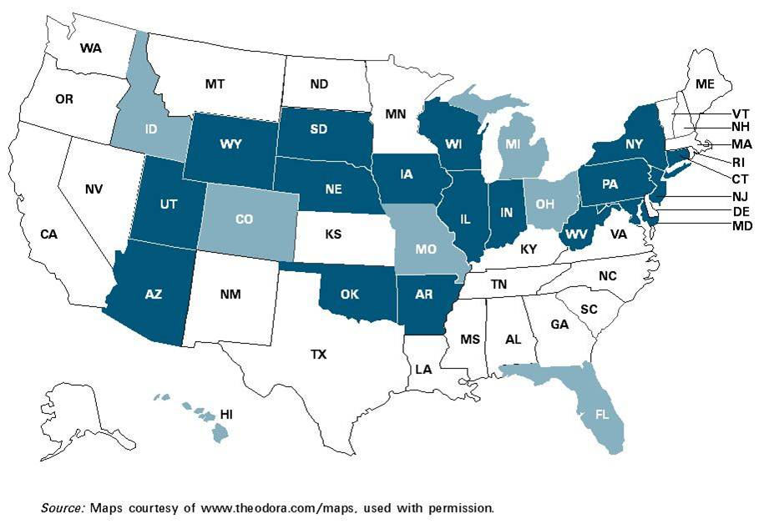
States with COI Bulletins
Notes:
Dark Blue = States with “Hard” Bulletin, saying agents may not use Cert to make changes (e.g., add NOC) under any circumstances
Light Blue = States with “soft” Bulletin, merely saying agents shouldn’t do that, or that Agents should make sure they have authority before doing that, or that any Certs making policy changes should be filed for approval.

Slide 18
Florida OIR Memorandum
OIR-03-003M
Insurer is not bound when Agent modifies COI without authorization (express authority?)
Unauthorized alteration of COI = “misrepresentation” of policy, subjecting Agent to discipline
Problems with OIR Memo
Not binding
May conflict with Florida Statutory Law
Arguably incorrect with respect to “Traditional” COIs
IMO, not helpful to resolve conflicts

Slide 19
(3) New COI Statutes
Model Cert Statutes
IIABA (“Big I”)
Nat’l Ass’n of PIA + NCOIL
Adopted in about 10 States
Common Features
Cert Cannot Create Policy Rights (like NOC)
Cannot Modify ACORD or ISO Cert
Proprietary Certs must be filed for approval

Slide 20
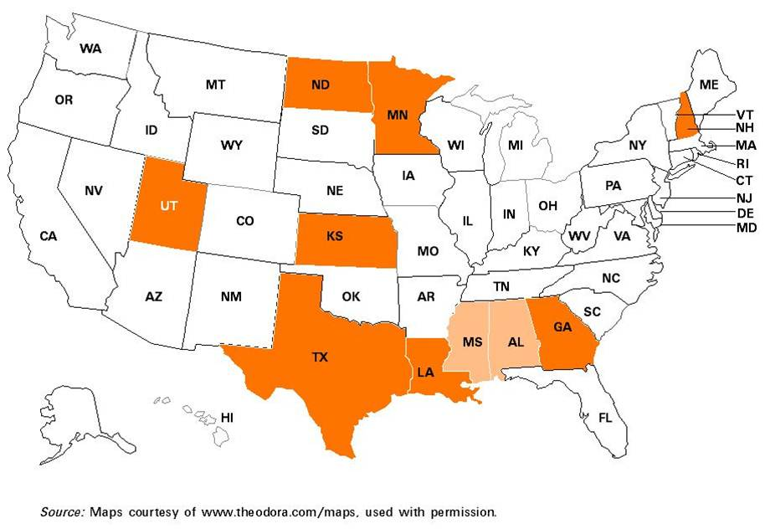
States with COI Statutes
Notes:
Dark Orange = Statute; Light Orange = Regulation

Slide 21
Conflicts in Statutes
Under Agent-Sponsored COI Laws:
Cert cannot contain NOC without NOC Endt
Under NOC statutes based on Traditional view:
Cert must contain NOC, regardless of NOC Endt
Resolution of Conflict Unclear
State COI Law vs. Fed NOC law = Fed Law Controls
State COI Law vs. State NOC law = ?
One State Law must be Amended (like MN)
Notes:
McCarran Ferguson Act reverse-preempts federal law when in conflict with state insurance law, unless the federal law specifically addresses insurance.
State law vs State Law, courts may try to resolve the conflict by (1) enforcing the later one over the earlier one, or (2) enforcing the one that is more specific or more targeted over the one that is more general.

Slide 22
Other Concerns
COI laws force holders to accept “Limited” COIs
But this is “unreasonable as a matter of law”
Trend: NY courts rejecting COIs
Facts:
GC sues Sub for failure to procure insurance
Sub moves for SJ, proffers COI
Holding: COI does not qualify as evidence of coverage
So why are we forcing people to accept them?

Slide 23
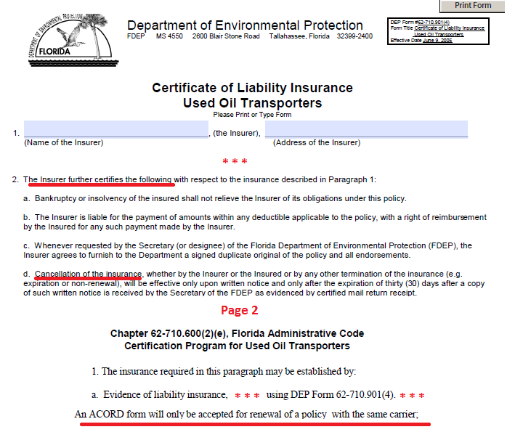
Notes:
Florida Dep't of Envt'l Protection, DEP Form 62-710.901(4) = COI for Used Oil Transporters ("An ACORD form will only be accepted for renewal of a policy with the same carrier")

Slide 24
Options re: NOC
Reject ACORD Cert; Use Proprietary COI form?
Accept ACORD cert as-is; Stop requesting NOC (HI)?
Periodic COIs (every 30 days; or every pay app)?
Pre-2009 Editions of ACORD cert?
NOC by Agent?
IMO, Require NOC endt to be attached to COI
IMO, Get involved!
Notes:
See 2010 Hawaii State Comptroller’s memo (http://hawaii.gov/dags/cm/memo/CM2010-39.pdf ), which instructs all other state agencies to accept ACORD certs and waive any NOC requirements

Slide 25
Waiver
If you require a COI in your insurance specs, but you allow the Sub, Tenant, or Service Provider to perform contract without it, what are the consequences?

Slide 26
Implied Waiver of COI + Ins
Case Law finding waiver:
Allowing Tenant to Possess Space w/o COI
Allowing Contractor to begin Work w/o COI
Entering New Phases of Construction w/o COI
Completing the Contract w/o COI
Submitting final Pay Application w/o COI
Waiver Extends:
To obligation to furnish COI
To obligation to have insurance in the first place

Slide 27
Protecting Against Waiver
Rigorous Enforcement of COI Requirement
Contract Remedy Clauses
Failure to Furnish COI = Owner may cancel K
No COI = waiver of the remedy
Non-Waiver Clauses
Best: All waivers must be in writing
Sub-Optimal: “Owner’s failure to enforce insurance requirements shall not act as a waiver”
Notes:
Owner’s actions that contradict the “not a waiver” clause will override contractual language.

Slide 28
Thank You for Listening
For more information about the topics discussed in this presentation, see Contractual Risk Transfer, a reference manual published by IRMI

