Slide 1
THE CDC Order: NATIONWIDE CHALLENGES UPDATE
JUNE 3, 2021
Kevin S. Rabin, Esq. – senior Staff AttorneY, Three Rivers Legal Services, Inc.
Jeffrey S. Hittleman, Esq. – Staff attorney, Coast to coast legal aid of South Florida, inc.
Co-Chairs of the Florida Housing Umbrella Group

Slide 2
About the speakerS
Kevin S. Rabin is a senior staff attorney with Three Rivers Legal Services, Inc. in Gainesville, FL. He has litigated hundreds of eviction, debt collection, wage garnishment, foreclosure, and affirmative consumer, fair housing, and tenants’ rights suits to completion in his seven years of practice across North-Central Florida. He is currently a co-chair of the Florida Housing Umbrella Group. He is a graduate of the University of Missouri (B.A. Political Science 2010) and the University of Florida Levin College of Law (J.D. cum laude 2013). He is a member of the Florida Bar, and is admitted in the United States District Courts for the Middle and Northern Districts of Florida and the U.S. Court of Appeals for the Eleventh Circuit.
Jeff Hittleman is an attorney with the Senior Citizen Law Project at Coast to Coast Legal Aid of South Florida. He handles housing, consumer, and domestic violence cases for seniors. Prior to joining Coast to Coast Legal Aid, Jeff was as an Assistant Public Defender in Broward County. He is currently a co-chair of the Florida Housing Umbrella Group. He is a proud “Double Gator” having earned a Juris Doctorate from the University of Florida in 2012 and a Bachelor of Arts in Political Science from the University of Florida in 2009.

Slide 3
CDC ORDER CHALLENGES
Six major federal district court decisions to date (one new case – all six are on appeal):
  Brown v. Azar, No. 1:20-CV-03702, 2020 WL 6364310 (N.D. Ga. Oct. 29, 2020), appeal docketed, No. 20-14210 (11th Cir. Nov. 9, 2020).
  Chambless Enterprises, LLC v. Redfield, No. 3:20-CV-01455, 2020 WL 7588849 (W.D. La. Dec. 22, 2020) appeal docketed, No. 21-30037 (5th Cir. Jan. 22, 2021).
  Terkel v. Ctr. for Disease Control and Prev., No. 6:20-CV-00564, 2021 WL 742877 (E.D. Tex. Feb. 25, 2021), appeal docketed, No. 21-40137 (5th Cir. Mar. 3, 2021).
  Skyworks, Ltd. v. Ctr. for Disease Control and Prev., No. 5:20-CV-2407, 2021 WL 911720 (N.D. Ohio Mar. 10, 2021), appeal docketed, No. 21-3443 (6th Cir. May 7, 2021).
  Tiger Lily, LLC v. U.S. Dep’t of Hous. and Urban Dev., No. 2:20-CV-02692, 2021 WL 1171887 (W.D. Tenn. Mar. 15, 2021), appeal docket and stay denied, No. 21-5256, 2021 WL 1165170 (6th Cir. Mar. 29, 2021).
  Alabama Ass’n of Realtors v. Dep’t of Health & Human Services, No. 1:20-CV-3377 (D.D.C. May 5, 2021), appeal docketed No. 21-5093 (D.C. Cir. May 5, 2021).
  Other relevant challenges:
    KBW Investment Properties LLC v. Azar, No. 2:20-CV-04852 (S.D. Ohio) (voluntarily dismissed after denial of preliminary injunction); Dixon Ventures, Inc. v. USA, 4:20-CV-1518 (E.D. Ark.) (filed on Dec. 30, 2020); Mossman v. CDC, 1:21-CV-00028 (N.D. Iowa) (filed on Mar. 18, 2021); and Fla. Ass’n of Realtors v. Ctr. for Disease Control and Prev., No. 8:21-CV-1196 (M.D. Fla.) (filed on May 17, 2021).

Slide 4
Brown v. AzaR
No. 1:20-CV-03702, 2020 WL 6364310 (N.D. Ga. Oct. 29, 2020), appeal docketed, No. 20-14210 (11th Cir. Nov. 9, 2020).
Update: oral argument conducted before 11th Circuit Court of Appeals.
  Panel features Judges Grant, Tjoflat, and Branch.
  Full recording is available on the 11th Circuit’s website: https://www.ca11.uscourts.gov/system/files_force/oral_argument_recordings/20-14210.mp3?download=1
  Irreparable harm appears a big sticking point, again worth noting this appeal, unlike some of the other cases, was from a denial of a preliminary injunction – procedural posture is more favorable for the government.

Slide 5
Chambless Enterprises, LLC v. Redfield
No. 3:20-CV-01455, 2020 WL 7588849 (W.D. La. Dec. 22, 2020), appeal docketed, No. 21-30037 (5th Cir. Jan. 22, 2021).
Appellant’s brief filed March 22, 2021; appellee’s brief filed April 21, 2021; reply brief filed May 13, 2021; ready to be set for oral argument.
  Amici Curiae include Disability Rights Texas, the Constitutional Accountability Center, American Academy of Pediatrics, American Medical Association, Center for Health Policy and Law at Northeastern University School of Law, Children's Healthwatch, George Consortium, GLMA, Health Professionals Advancing LGBTQ Equality, Louisiana Fair Housing Action Center, National Hispanic Medical Association, National Medical Association, Public Health Law Watch, Southeast Louisiana Legal Services, Southern Poverty Law Center, and the National Housing Law Project.
Joined with Terkel for purposes of appeal.

Slide 6
Terkel v. Ctr. for Disease Control and Prev.
No. 6:20-CV-00564, 2021 WL 742877 (E.D. Tex. Feb. 25, 2021), appeal docketed, No. 21-40137 (5th Cir. Mar. 3, 2021)
Appellant’s brief filed April 26, 2021; appellee’s brief filed May 26, 2021; nearly ready to be set for oral argument.
  Amici Curiae include the Constitutional Accountability Center, Come Dream Come Build, Connect Community, the National Low Income Housing Coalition, Mr. Matthew Desmond (Professor at Princeton University and Author of Evicted), Texas Appleseed, American Civil Liberties Union Foundation of Texas and the ACLU, the NAACP, the COVID-19 Eviction Defense Project, the National Housing Law Project, and the American Academy of Pediatrics.
Joined with Chambless Enterprises for purposes of appeal.

Slide 7
Skyworks, Ltd. v. Ctr. for Disease Control and Prev.
No. 5:20-CV-2407, 2021 WL 911720 (N.D. Ohio Mar. 10, 2021), appeal docketed, No. 21-3443 (6th Cir. May 7, 2021)
Rule 59(e) Motion to Alter or Amend Judgment to extend to plaintiff’s members nationwide docketed on April 7, 2021; reply in opposition filed April 29, 2021 and supplemented on May 7, 2021 (appeal stayed pending resolution of underlying motion).
  Ruling could come at any time.
Outcome will be unlikely to vacate order nationwide to all landlords, since that exceeds the scope of the requested alteration or amendment, but could be extended beyond the named plaintiffs to members nationwide.
Any such order likely to generate a request for stay in the 6th Circuit.

Slide 8
Tiger Lily, LLC v. U.S. Dep’t of Hous. and Urban Dev.
No. 2:20-CV-02692, 2021 WL 1171887 (W.D. Tenn. Mar. 15, 2021), Appeal docketed and stay denied, No. 21-5256, 2021 WL 1165170 (6th Cir. Mar. 29, 2021).
Appellant government’s brief filed May 12, 2021, appellee’s brief due soon.
Only amicus is the Constitutional Accountability Center.
Underlying order extended in the Western District of Tennessee only, unlikely to affect Florida in any notable way.

Slide 9
Alabama Ass’n of Realtors v. Dept. of Health & Human Services
No. 1:20-CV-3377, 2021 WL 1779282 (D.D.C. May 5, 2021), appeal docketed No. 21-5093 (D.C. Cir. May 5, 2021)
May 5, 2021 – District court sides with the analyses in Skyworks and Tiger Lily, but goes further by ordering a nationwide vacatur of the CDC Order.
  Statutory text did not extend to the actions taken by the CDC, therefore it is unlawful agency action.
  District court gives extremely little attention to the Congressional ratification argument, joining the rationale that, somehow, Congress could extend unlawful agency action under the Public Health Services Act without actually ratifying that the action was legitimate. Memo. Op. 17 – 19.
Government moved for stays in the district court and D.C. Circuit Court of Appeals – administrative stay granted by the district court for a limited time while considering the full stay pending appeal.
May 14, 2021 – District court grants stay pending appeal granted – 2021 WL 1946376
  District court says there is no likelihood of success on the merits…but the other factors – irreparable harm, risk of injury to the plaintiffs, and public interest – weigh in favor of the CDC.
Emergency motion to lift stay filed May 17, 2021, government response on May 24, 2021, reply on May 26, 2021.

Slide 10
Alabama Ass’n of Realtors (CONt.)
D.C. Circuit Court of Appeals rejects stay request, citing that “we conclude that HHS has made a strong showing that it is likely to succeed on the merits.” Order at 2.
Four points:
  CDC Order falls within plain text of 42 U.S.C 264(a) (siding with the reading of the Brown and Chambless Enterprises courts).
  Congressional ratification in the Consolidated Appropriations Act of 2021.
  The structure of 42 U.S.C. 264 beyond the core statutory authority supports an expansive, rather than constrained, view on the CDC’s options. “Indeed, contrary to their cramped reading of Section 264(a), appellees acknowledge in their reply brief (at page 5) that Section 264’s regulatory power includes the power to prevent the interstate movement ‘of contagious persons[.]’ That is the objective of the eviction moratorium.” Id. at 4.
  The Commerce Clause, Tenth Amendment, and non-delegation arguments fail – the opinion highlights the Terkel court’s analytical flaws.
Absent a stay sought in the Supreme Court, unlikely that this appeal will finalize before June 30, 2021.

Slide 11
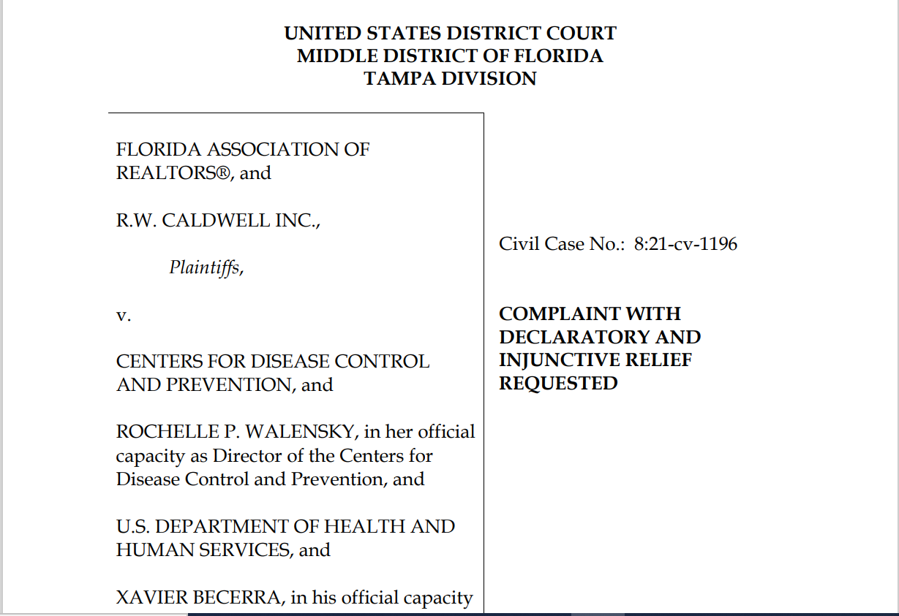
FlA. Ass’n of Realtors v. Ctr. for Disease control and Prev.
No. 8:21-cv-01196 (m.d. fl.) (filed MAy 17, 2021)

Slide 12
CDC ORDER CHALLENGES
So what’s the focus? – the Public Health Service Act, 42 U.S.C § 264 (“Regulations to control communicable disease), and specifically, § 264(a) – “For purposes of carrying out and enforcing such regulations, the Surgeon General may provide for such inspection, fumigation, disinfection, sanitation, pest extermination, destruction of animals or articles found to be so infected or contaminated as to be sources of dangerous infection to human beings, and other measures, as in his judgment may be necessary.”
Brown and Chambless Enterprises hold that the list is not exhaustive, and that the delegation must be read as a whole with the rest of § 264, whereas Skyworks, Tiger Lily, and now Alabama Association of Realtors hold that the list modifies the broad “and other measures” language, thus limiting it to actions akin to the enumerated list.
  The five decisions split on the statutory grant of authority, avoiding constitutional questions (or answering them without hesitation) to tackle the real issue at hand.
  Only Terkel and minor dicta in Skyworks suggest that Congress lacks the authority to regulate public health by imposing an eviction moratorium, and the decision rests on a re-characterization of what Congress provided by statute by what the CDC did with the delegated authority (i.e. it conflated two separate concepts entirely).
    Terkel remains the hotly-contested anomaly.
  6th Circuit’s decision in denying stay pending appeal seems to agree with Tiger Lily court’s rationales; we’ll see what happens in Skyworks.
  Congressional ratification given short-shrift by Tiger Lily, Skyworks, and Alabama Association of Realtors courts – any extension implies Congress approved of the nature of the action underlying the CDC Order.

Slide 13
Questions? Comments? Concerns?
Emails:
  kevin.rabin@trls.org
  jhittleman@legalaid.org

