Slide 1
THE CDC Order: Extended through June 2021 and its constitutional concerns April 22, 2021
Kevin S. Rabin, Esq. – senior Staff AttorneY, Three Rivers Legal Services, Inc.
Jeffrey S. Hittleman, Esq. – Staff attorney, Coast to coast legal aid of South Florida, inc.
Co-Chairs of the Florida Housing Umbrella Group

Slide 2
About the speakerS
Kevin S. Rabin is a senior staff attorney with Three Rivers Legal Services, Inc. in Gainesville, FL. He has litigated hundreds of eviction, debt collection, wage garnishment, foreclosure, and affirmative consumer, fair housing, and tenants’ rights suits to completion in his seven years of practice across North-Central Florida. He is currently a co-chair of the Florida Housing Umbrella Group. He is a graduate of the University of Missouri (B.A. Political Science 2010) and the University of Florida Levin College of Law (J.D. cum laude 2013). He is a member of the Florida Bar, and is admitted in the United States District Courts for the Middle and Northern Districts of Florida and the U.S. Court of Appeals for the Eleventh Circuit.
Jeff Hittleman is an attorney with the Senior Citizen Law Project at Coast to Coast Legal Aid of South Florida. He handles housing, consumer, and domestic violence cases for seniors. Prior to joining Coast to Coast Legal Aid, Jeff was as an Assistant Public Defender in Broward County. He is a proud “Double Gator” having earned a Juris Doctorate from the University of Florida in 2012 and a Bachelor of Arts in Political Science from the University of Florida in 2009.

Slide 3
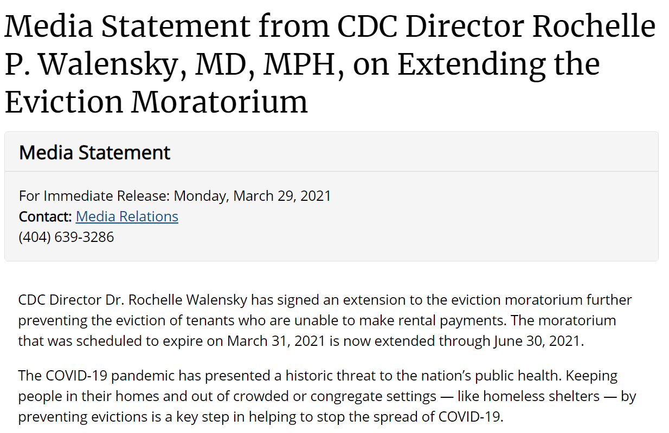
Outline of topics for today
The Centers for Disease Control and Prevention (CDC) Order – Extension and Modifications
Constitutional Challenges to the CDC Order – Current State of Play
Notes:
Presentation will focus mostly on identifying potential issues and claims more than litigating cases – advocates doing work in family law, public benefits, elder law, or housing law can benefit from issue spotting for clients who may be experiencing extreme debt issues (especially post COVID-19)
NCLC resources are fantastic starting point in identifying and building cases, TRLS (and JALA) have access online and books (Gainesville office books live in Mikel or my office)

Slide 4
Origins of the CDC Order
August 8, 2020 – Former President Trump issues executive order requesting broad protective action for tenants facing eviction and homeowners facing foreclosure (Exec. Order No. 13,945, 80 Fed. Reg. 49,935 (Aug. 8, 2020) – “It is the policy of the United States to minimize, to the greatest extent possible, residential evictions and foreclosures during the ongoing COVID-19 national emergency.”
September 1, 2020 – CDC responds and enact CDC eviction moratorium effective Sept. 4.
Potentially applies to all residential dwellings nationwide – no exceptions except by territory (American Samoa, any state wherein the state provided a greater set of protections –
Florida did not have greater protections, and its sole protections expired on September 30, 2021 (Fla. Exec. Order 20-211 expired, and Governor’s office stated it was to avoid any confusion about application of CDC Order).
“A landlord, owner of a residential property, or other person with a legal right to pursue eviction or possessory action shall not evict any covered person from any residential property in any State. . . in which there are documented cases of COVID-19 that provides a level of public-health protections below the requirements listed in this Order.” 85 Fed. Reg. 55,294, 55,296 (emphasis added).
Who gets the protections? “Covered persons” - any tenant, lessee, or resident of a residential property who provides to their landlord, the owner of the residential property, or other person with a legal right to pursue eviction or a possessory action,” a declaration under penalty of perjury contains 5 specific statements.

Slide 5
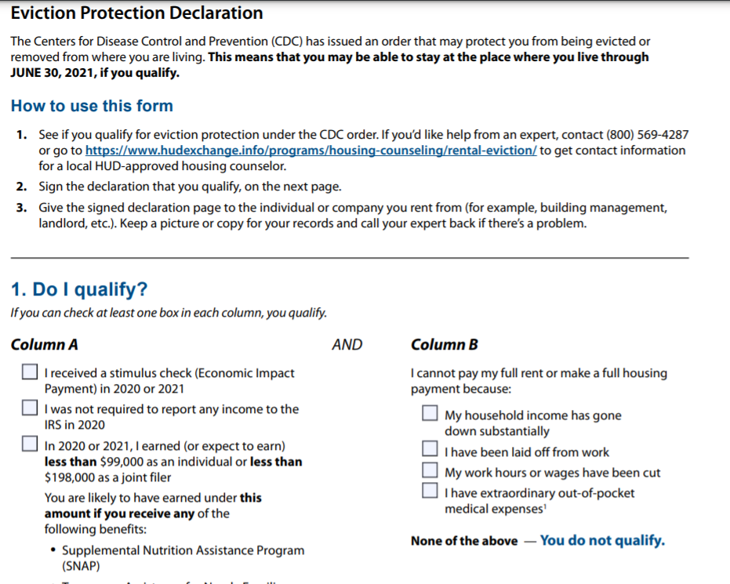
CDC Declaration form
CDC Declaration Form – OMB Control No. 0920-1303 - [FORM] Declaration Under Penalty of Perjury for the Centers for Disease Control and Prevention’s Temporary Halt in Evictions to Prevent Further Spread of COVID-19 (CDC Form Declaration) - https://www.cdc.gov/coronavirus/2019-ncov/downloads/EvictionDeclare_d508.pdf.
Now a check box form, has been modified at each extension.

Slide 6
Extensions OF THE CDC ORDER
The CDC Order was extended by Consolidated Appropriations Act of 2021 (Pub. L. 116-260, § 502) until January 31, 2021, and again by two reauthorization CDC Orders: the first on January 29, 2021 extending until March 31, 2021 (86 Fed. Reg. 8020 (Feb. 3, 2021), and the second on March 29, 2021, extending until June 30, 2021 (no federal register citation available).
The 2 newer CDC Orders cover American Samoa, but are otherwise substantially similar to the Sept. 4, 2020 original CDC Order.
March 29, 2021 CDC Order had several small modifications worth noting:
No new declaration required – any declaration served after Sept. 4, 2020 by a “covered person” has the same effect. CDC Order at 10 (Mar. 29, 2021) (“A signed declaration submitted under a previous order remains valid notwithstanding the issuance of this extended and modified order, and covered persons do not need to submit a new declaration under this Order.”).
Tenants DO NOT have to use the form – any written document containing the same information along with a perjury statement is sufficient.
Order does not prohibit evictions for criminal activity but clarifies that a “covered person” may not be evicted “on the sole basis that they are alleged to have committed the crime of trespass (or similar state-law offense) where the underlying activity is a covered person remaining in a residential property despite nonpayment of rent.”
Does this apply to section 83.58, Florida Statutes and holdover tenants?
Order addresses some of the arguments raised in certain court challenges – CDC Order at 10 (Mar. 29, 2021) (“Even if a particular eviction, standing alone, would not always result in interstate displacement, the mass eviction that would occur in the absence of this Order would inevitably increase the interstate spread of COVID-19. Moreover, increases in intrastate spread further facilitate interstate spread in the context of communicable disease spread.”) (emphasis added).

Slide 7
What does the cdc order actually prevent?
https://www.cdc.gov/coronavirus/2019-ncov/more/pdf/CDC-Eviction-Moratorium-03292021.pdf
“Subject to the limitations under ‘Applicability,” a landlord, owner of residential property, or other person with a legal right to pursue eviction or possessory action, shall not evict any covered person from any residential property in any jurisdiction to which this Order applies during the effective period of this Order.” CDC Order at 1 (Mar. 29, 2021).
“Evict” and “residential property” are both defined terms, the CDC also has FAQs on how it interprets those definitions.
It does not remove liability for rent or other housing payments, and does not preclude actions to collect those charges outside of an eviction from the property (i.e. breach of contract suit).
Does not prohibit evictions in 5 explicit situations:
Criminal activity on the premises;
Threatening health or safety of other residents (does not include COVID-19 if the person complies with legal requirements, or refusal to be tested);
Damaging or posing an immediate and significant risk of damage to the property;
Violating any applicable building code, health ordinance, or similar regulation relating to health and safety; or
Violating any other contractual obligation, other than timely payment of rent or similar housing-related payment (i.e. late fees, penalties, or interest).
So, it restricts nonpayment eviction and any other type of eviction that is closely tied to it (like eviction for nonpayment of pet fees, late fees, utilities, or other financial charges imposed for housing itself) – may also prohibit holdover tenancy evictions if the non-renewal is premised on nonpayment (see Modifications).
Many state courts have limited the “eviction” to only judgment or the issuance and execution of a writ of possession – little doubt that a writ of possession is restricted if the tenant is a “covered person.”

Slide 8
CDC ORDER CONSTITUTIONALITY CHALLENGES
Five major federal district court decisions to date:
Brown v. Azar, No. 1:20-CV-03702, 2020 WL 6364310 (N.D. Ga. Oct. 29, 2020), appeal docketed, No. 20-14210 (11th Cir. Nov. 9, 2020).
Chambless Enterprises, LLC v. Redfield, No. 3:20-CV-01455, 2020 WL 7588849 (W.D. La. Dec. 22, 2020) appeal docketed, No. 21-30037 (5th Cir. Jan. 22, 2021) (denying a preliminary injunction against the eviction moratorium, and discussing that the federal government can “unquestionably” regulate rental of real estate as interstate commercial activity under the Commerce Clause).
Terkel v. Ctr. for Disease Control and Prev., No. 6:20-CV-00564, 2021 WL 742877 (E.D. Tex. Feb. 25, 2021), appeal docketed, No. 21-40137 (5th Cir. Mar. 3, 2021) (holding that the eviction moratorium exceeded the scope of federal Commerce Clause power, but restraining the holding to the parties involved in the action)
Skyworks, Ltd. v. Ctr. for Disease Control and Prev., No. 5:20-CV-2407, 2021 WL 911720 (N.D. Ohio Mar. 10, 2021) (holding that the eviction moratorium exceeded statutory authorization, but restraining the holding to the parties involved in the action)
Tiger Lily, LLC v. U.S. Dep’t of Hous. and Urban Dev., No. 2:20-CV-02692, 2021 WL 1171887 (W.D. Tenn. Mar. 15, 2021) (holding that the eviction moratorium exceeded statutory authorization, but only extending its holding within the Western District of Tennessee), stay denied, No. 21-5256, 2021 WL 1165170 (6th Cir. Mar. 29, 2021).
Other challenges:
KBW Investment Properties LLC v. Azar, No. 2:20-CV-04852 (S.D. Ohio) (voluntarily dismissed after denial of preliminary injunction); Alabama Assn. of Realtors v. Dept. of Health & Human Services, No. 1:20-CV-3377 (D.D.C.) (hearing on cross motions set for April 29, 2021 at 10 A.M.); Dixon Ventures, Inc. v. USA, 4:20-CV-1518 (E.D. Ark.) (filed on Dec. 30, 2020); and Mossman v. CDC, 1:21-CV-00028 (N.D. Iowa) (filed on Mar. 18, 2021).

Slide 9
Brown v. Azar (First in time) No. 1:20-CV-03702, 2020 WL 6364310 (N.D. Ga. Oct. 29, 2020), appeal docketed, No. 20-14210 (11th Cir. Nov. 9, 2020).
Note: On Appeal (No. 20-14210) – 11th Circuit – appeal is expedited, oral argument to be held in week of May 10, 2021
Plaintiffs include the National Apartment Association (NAA), procedural posture was preliminary injunction (almost all these cases have been decided at that stage)
Four elements – (1) substantial likelihood of success on the merits; (2) irreparable injury without injunction; (3) threatened injury to the movant outweighs prejudice to opposing party; and (4) injunction, if issued, is not adverse to the public interest.
Three challenges (substantial likelihood prong) – (1) CDC Order lacks statutory and regulatory basis; (2) even if authorized by Congress, action is arbitrary and capricious per APA; and (3) violates right of access to the courts.
(1) Statutory and regulatory basis – Court holds that Congress’s delegation was broad (42 U.S.C. § 264) and its intent was clear – “Congress gave the Secretary of HHS broad power to issue regulations necessary to prevent the introduction, transmission and spread of communicable diseases. Because . . . the Order is necessary to control the COVID-19 pandemic, the CDC was authorized to issue it.” Id. at *7.
Court looked further at the second sentence of 42 U.S.C. § 264(a), and concluded that, when read with the other companion provisions of 264(b) (detention of individuals), 264(c) (limiting detention to those coming from abroad generally), and 264(d) (permitting detention of those traveling between States in limited situations), the list in 264(a) is not exhaustive.
Cited to Independent Turtle Farmers of La. v. U.S., 703 F. Supp. 2d 604 (W.D. La. 2010) – common case cited by all opinions
“In sum, the clear and broad delegation of authority in the first sentence of § 264(a); the context provided by the subsequent subsections; the parroting language of § 70.2, which specifically uses the term including—a term of enlargement; and persuasive authority from the Independent Turtle Farmers court all point to the same conclusion: the Order has statutory and regulatory authority, and the CDC may take those measures that it deems reasonably necessary to prevent the spread of disease, so long as it determines that the measures taken by any state or local government are insufficient to prevent the spread of the disease.”
Discussion of several statutory canons, concluding none sufficiently support the plaintiffs.

Slide 10
Brown (CONT.)
(2) APA arbitrary and capricious – Court finds no issue, given APA requires “exceedingly deferential” review for agency conclusions based on its specialized expertise. Id. at *11.
Court rejects the arguments largely because of the CDC Order’s specific and tailored findings, citing that “the CDC need not show that the eviction moratorium is the only measure that will prevent the spread of COVID-19 or the most pressing concern.” Id.
Court also rejects that CDC did not show sufficient evidence that measures taken by States were insufficient – though not raised, the reaction by States like Florida to remove their restrictions in favor of the CDC’s is probative.
(3) Right of access to the courts – Court rejects this argument because (a) the eviction moratorium narrowly applies to only a subset of evictions (nonpayment of rent and only where the tenant is a “covered person”) and is temporary, (b) it does not preclude other remedies (suit for money damages from breach of contract), and (c) “[a]s clarified by the CDC, under the Order, landlords are therefore not precluded from serving their tenants with any required non-payment notices, commencing court proceedings, attending trials or obtaining judgments. The Order only delays the actual eviction.”
Irreparable injury – (1) Court rejects three grounds, largely based on plaintiffs’ ability to receive compensation through monetary damages.
Remaining factors – (1) Court finds that plaintiffs failed to devote any real discussion to weight of injunction vs. harm to the public and (2) any harm alleged by plaintiffs is insufficient to outweigh the public interest of avoiding additional COVID-19 infection.
SUMMARY – Court denies plaintiffs’ motion for preliminary injunction, finding in favor of CDC Order at preliminary stage.

Slide 11
Chambless Enterprises, LLC v. Redfield No. 3:20-CV-01455, 2020 WL 7588849 (W.D. La. Dec. 22, 2020), appeal docketed, No. 21-30037 (5th Cir. Jan. 22, 2021).
Note: On Appeal (No. 21-30037) – 5th Circuit – associated for purposes of appeal with Terkel (next up) – still in initial briefing.
Plaintiffs include the Apartment Association of Louisiana, Inc., procedural posture was preliminary injunction.
Three challenges (substantial likelihood prong) – (1) CDC Order lacks statutory and regulatory basis (like Brown); (2) non-delegation doctrine; (3) even if authorized by Congress, action occurred without notice and comment rulemaking procedures required by APA.
(1) Statutory and regulatory basis – Court concurs with Brown court that the CDC Order falls within the scope of delegated authority - “This Court finds that the plain text of the statute is unambiguous and evinces a legislative determination to defer to the ‘judgment’ of public health authorities about what measures they deem ‘necessary’ to prevent contagion. Congress's use of the phrase ‘such regulations as in his judgment are necessary’ shows that it intended to defer to agency expertise, as ‘Congress knows to speak in plain terms when it wishes to circumscribe, and in capacious terms when it wishes to enlarge, agency discretion.’” Id. at *5 (citations omitted).
Court relies, in part, on the persuasive guidance of Turtle Farmers, and highlights that, contrary to plaintiffs’ arguments, the examples in the list in 264(a) actually demonstrates that breadth of Congressional delegation – showing that it may infringe on both personal liberties and property rights where appropriate to protect public health. Id.
Like the Brown court, it rejected canons of construction as unneeded against the demonstration of Congressional intent.
(2) Non-delegation doctrine – Court finds no violation of the non-delegation doctrine, as Congress clearly provided an “intelligible principle” to guide the agency in its actions. Id. at *10.
(3) APA – Court finds against APA notice and comment violation, since the CDC Order is not a “rule” per APA and rather, an emergency action; Court reminds that CDC can dispense with notice and comment under the APA when good cause exists – where “notice and public procedure thereon are impracticable, unnecessary, or contrary to the public interest.” Id. at *11.
Other prongs – Court largely mirrors Brown court reasoning.
SUMMARY – Court denies plaintiffs’ motion for preliminary injunction, finding in favor of CDC Order at preliminary stage.

Slide 12
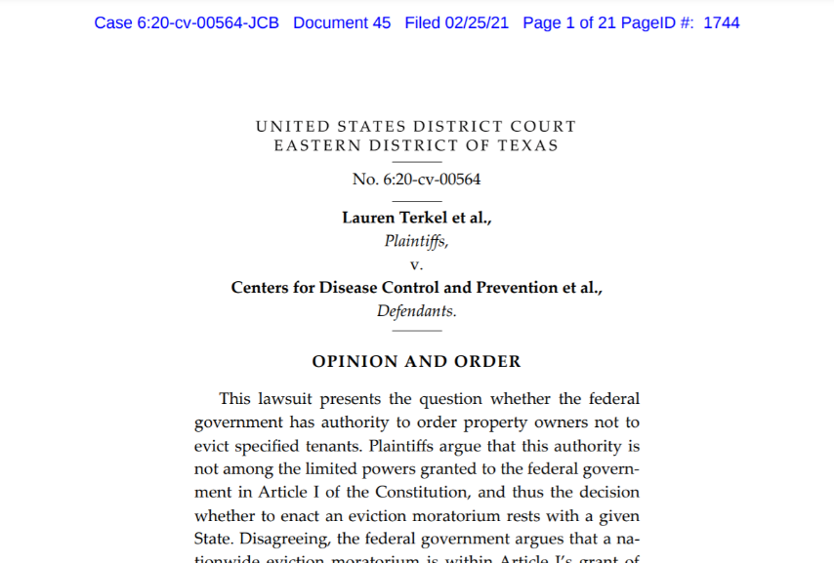
Terkel v. Ctr. for Disease Control and Prev. No. 6:20-CV-00564, 2021 WL 742877 (E.D. Tex. Feb. 25, 2021), appeal docketed, No. 21-40137 (5th Cir. Mar. 3, 2021)
Note: On Appeal (No. 21-40137) – 5th Circuit – associated for purposes of appeal with Chambless Enterprises – still in initial briefing.
First decision to hold the CDC Order unconstitutional, and an anomaly relative to the other two decisions (Tiger Lily and Skyworks).
Plaintiffs sought declaratory relief, and filed motion for preliminary injunction – Plaintiffs invited the Court to construe the preliminary injunction motion as a motion for summary judgment on declaratory claims – Plaintiff limited its challenges accordingly.
Challenges – CDC Order exceeds Commerce Clause power and Necessary and Proper clause power.

Slide 13
Terkel (cont.)
Court determines that regulating evictions is beyond the power of Congress (citing Lopez, Morrison, Raich, and Wickard) - “Here, the regulated activity is not the production or use of a commodity that is traded in an interstate market. Rather, the challenged order regulates property rights in buildings—specifically, whether an owner may regain possession of property from an inhabitant. 86 Fed. Reg. at 8,021 (defining “eviction” as any action “to remove or cause the removal of a covered person from a residential property”). Real estate is inherently local. Residential buildings do not move across state lines. And eviction is fundamentally the vindication of the property owner's possessory interest.”) Id. at *6.
But see Chambless Enterprises, 2020 WL 7588849 at *7 (“Indeed, the federal government has a long history of regulating the rental housing market, including, most recently, in the form of a similar temporary eviction moratorium enacted as part of the CARES Act.”) (citation omitted).
Court used the test set forth in Morrison – (1) Whether the regulated activity involves “‘commerce’ or any sort of economic enterprise;” (2) whether the regulation contains an “express jurisdictional element” limiting its reach to circumstances connected with interstate commerce;” (3) whether there are explicit legislative findings linking the regulated activity to effects on interstate commerce; and (4) whether the proffered link between the regulated activity and interstate commerce is attenuated.
However, note the Court’s characterization – the Court focuses on what the CDC Order does, not what the statute at issue provides the CDC the authority to regulate – the Public Health Services Act is a comprehensive statute that regulates a specific aspect of interstate commerce (public health emergency response) and it is immaterial that some purely local activities may be swept up in public health order issued pursuant to the Act. Gonzalez v. Raich, 545 U.S. 1, 22 (2005) (“That the regulation ensnares some purely intrastate activity is of no moment. As we have done many times before, we refuse to excise individual components of that larger scheme.”); see id. at 37 (Scalia, J., concurring) (“The regulation of an intrastate activity may be essential to a comprehensive regulation of interstate commerce even though the intrastate activity does not itself ‘substantially affect’ interstate commerce.”).
Commentary – Congress has routinely and regularly regulated residential rental markets and housing purchase markets – the Terkel Court’s ruling is incredibly audacious and re-characterizes the action taken in order to sever it from the comprehensive authority provided by the statute.
The next two cases – Skyworks and Tiger Lily – demonstrate where the actual disputes lie.

Slide 14
Skyworks, Ltd. v. Ctr. for Disease Control and Prev. No. 5:20-CV-2407, 2021 WL 911720 (N.D. Ohio Mar. 10, 2021)
NOT appealed by the U.S. – Plaintiffs (National Association of Home Builders) requested alteration or amendment of judgment to expand effect to nationwide members
Parties, like in Terkel, agreed to expedite merits determination to summary judgment-like review.
Challenges – (1) CDC Order lacks statutory and regulatory basis (like Brown and Chambless Enterprises); (2) non-delegation doctrine; (3) even if authorized by Congress, action occurred without notice and comment rulemaking procedures required by APA and is arbitrary and capricious in violation of the APA.
“The most natural and logical reading of the statute as a whole does not extend the CDC's power as far as Defendants maintain. Such a broad reading of the statute, and the term ‘other measures’ in particular, would authorize action with few, if any, limits—tantamount to creating a general federal police power. . . . But the text does not authorize such boundless action or depend on the judgment of the Director of the CDC or other experts for its limits. The eviction moratorium in the CDC's orders exceeds the statutory authority Congress gave the agency.” Id. at *10.
Court acknowledges Brown and Chambless Enterprises, but notes that it believes the “decisions have the feel of adopting strained or forced readings of the statute, stretching to rationalize the governmental policy at issue.” Id. at *11.
Court notes “the CDC moratorium is not [narrowly] tailored . . .. It allows some evictions to proceed, including those based on criminal conduct, damage to property, or reasons other than nonpayment of rent. Such evictions have as much chance of spreading Covid-19 as those subject to the moratorium.”
Since this decision occurred after Congressional action that extended the CDC Order (Consolidated Appropriations Act of 2021), Court considered whether this was an expression of Congressional ratification. “Put another way, ‘Congress may, by enactment not otherwise inappropriate, ratify acts which it might have authorized and give the force of law to official action unauthorized when taken.’” Id. at *12 (citing Swayne & Hoyt v. United States, 300 U.S. 297, 301 – 02 (1937)).
“But Congress did not speak to the merits of the policy at issue, as it did in the CARES Act. Nor did Congress amend the organic statute, Section 361 of the Public Health Services Act, either to create a new subsection authorizing an eviction moratorium or add such an action to the list of permissible agency actions in subsection (a). All Congress did was change the expiration date of the first order. In context, such a limited action makes sense.” Id.
Court sets aside CDC Order under APA, avoids discussion of non-delegation doctrine challenge; declines to issue injunction, grants only declaratory relief.

Slide 15
Tiger Lily, LLC v. U.S. Dep’t of Hous. and Urban Dev. No. 2:20-CV-02692, 2021 WL 1171887 (W.D. Tenn. Mar. 15, 2021), stay denied, No. 21-5256, 2021 WL 1165170 (6th Cir. Mar. 29, 2021).
Note: On Appeal (No. 21-5256) – 6th Circuit – stay of decision below denied by 6th Circuit panel, citing gov’t’s lack of likely success on the merits.
Same general procedural posture as Terkel and Skyworks – judgment effectively on pleadings/summary judgment (but here, motion for preliminary injunction had been denied – denied on lack of irreparable harm).
Challenges – (1) CDC Order lacks statutory and regulatory basis (like Brown, Chambless Enterprises, and Skyworks); (2) violation of constitutional due process; (3) even if authorized by Congress, action occurred without notice and comment rulemaking procedures required by APA and is arbitrary and capricious in violation of the APA.
“Though much has recently been made by other litigants in other courts concerning similarly alleged constitutional violations or the absence of same, this Court seeks to avoid constitutional entanglement altogether by construing the statute narrowly at the outset as it was written for the limited purpose for which it was designed.” Id. at *5.
“The CDC was given broad authority to make and enforce regulations, and the statute specifically identifies the measures to be taken. To hold otherwise would be to construe the statute so broadly as to grant this administrative agency unfettered power to prohibit or mandate anything, which would ignore the separation of powers and violate the non-delegation doctrine.” Id. at *8.
Court finds that the time-limited extension of the CDC Order in the Consolidated Appropriations Act of 2021, while it may constitute Congressional ratification, is “moot” since there was a temporal extension. Id. at *10.
Note: this is a flimsy rationale – ratification would mean that the CDC Order is a valid exercise of delegated authority, so why would the time limitation be relevant? Could Congress allow for impermissible regulation as long as it’s only as short as Congress decides?

Slide 16
CDC ORDER CONSTITUTIONALITY CHALLENGES
So what’s the focus? – 42 U.S.C § 264(a) – “For purposes of carrying out and enforcing such regulations, the Surgeon General may provide for such inspection, fumigation, disinfection, sanitation, pest extermination, destruction of animals or articles found to be so infected or contaminated as to be sources of dangerous infection to human beings, and other measures, as in his judgment may be necessary.”
Brown and Chambless Enterprises hold that the list is not exhaustive, and that the delegation must be read as a whole with the rest of § 264, whereas Skyworks and Tiger Lily hold that the list modifies the broad “and other measures” language, thus limiting it to actions akin to the enumerated list.
The four decisions split on the statutory grant of authority, avoiding constitutional questions (or answering them without hesitation) to tackle the real issue at hand.
Only Terkel and minor dicta in Skyworks suggest that Congress lacks the authority to regulate public health by imposing an eviction moratorium, and the decision rests on a re-characterization of what Congress provided by statute by what the CDC did with the delegated authority (i.e. it conflated two separate concepts entirely).
6th Circuit’s decision in denying stay pending appeal seems to agree with Tiger Lily court’s rationales.
Congressional ratification given short-shrift by both Tiger Lily and Skyworks courts – any extension implies Congress approved of the nature of the action underlying the CDC Order.

Slide 17
CDC ORDER CONSTITUTIONALITY CHALLENGES
Scope of rulings:
In effect, only applies to the litigants involved in those cases and, in the case of Tiger Lily, throughout the Western District of Tennessee; the Skyworks plaintiffs have filed a motion to amend or alter judgment to apply to their members nationwide.
Declaratory judgments from federal district courts have no binding effect on any state court anywhere in the United States except where the parties involved are the same. U.S. ex rel. Lawrence v. Woods, 432 F.2d 1072 (7th Cir. 1970) (“On the other hand, because lower federal courts exercise no appellate jurisdiction over state tribunals, decisions of lower federal courts are not conclusive on state courts.”); John Harrison, Severability, Remedies, and Constitutional Adjudication, 83 Geo. Wash. L. Rev. 56, 87-88 (2014) (“When a court declares that a statutory rule is not applicable to a party because the rule is unconstitutional, the declaratory judgment again resembles a judicial act of invalidation with respect to the parties involved.”).
No constitutional or statutory ruling binding any Florida courts to date
Some county courts have found the CDC Order unconstitutional (including for grounds unrelated like Takings Clause violations or otherwise), but are of limited persuasive value (several have been appealed).
Most other county court have simply applied the CDC Order in case-by-case situations.
So what is the take away?
CDC Order in effect through June 30, 2021 unless a party to one of these decisions or in the Western District of Tennessee.
Landlords can challenge constitutionality either through declaratory relief (federal or state court) or in individual eviction cases, but likely must implead the United States to defend itself (there would certainly be no effect beyond a single case unless the United States is a party).
CFPB and FTC may still take action against landlords who violate the CDC Order: https://www.consumerfinance.gov/about-us/newsroom/cfpb-acting-director-uejio-and-ftc-acting-chairwoman-slaughter-issue-joint-statement-on-preventing-illegal-evictions/. Implications under debt collection laws at issue.
Fast moving, and these cases evade review to an extent – judicial minimalism.

Slide 18
Questions? Comments? Concerns?
Emails:
kevin.rabin@trls.org
jhittleman@legalaid.org

