Slide 1
Federal Executive Actions Update: Impact on the Construction Industry
April 14, 2025

Slide 2
Agenda
Constitutional Framework
Overview of Federal Actions
Cut Costs
Cut Regulations
Shift Policy Requirements/Enforcement
Downstream Impacts to Construction Industry
Practical Tips for Navigating Regulatory Risk & Funding Risk
Notes:
Yesterday Trump EO to recognize the Lumbee Tribe of North Carolina

Slide 3
Constitutional Framework

Slide 4
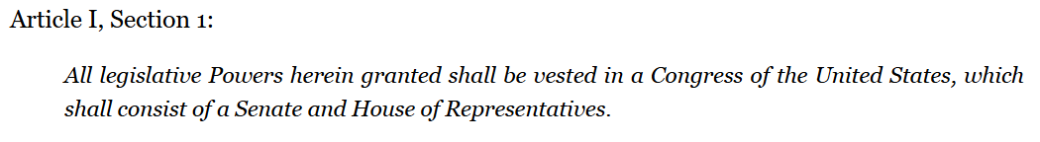

Legislative Branch: Makes the Law
Nondelegation Doctrine – limited impact
Administrative Procedures Act (notice/comment, judicial review)
N/A to agency management / loans, grants, contracts, benefits / good cause
No more Chevron deference (violates APA)

Slide 5
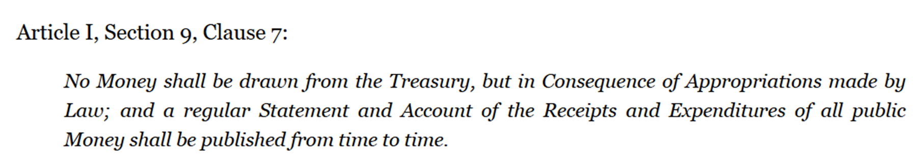



Legislative Branch: Appropriates Funds
Appropriations authorize a specific amount of expenditure from a specified source of public funds for designated purposes; time limited
Executive and judicial branches cannot incur obligations or pay debts without appropriation authorization made by Congress

Slide 6
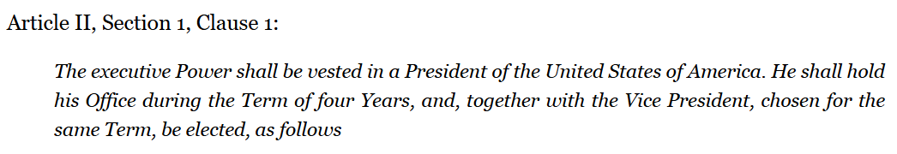
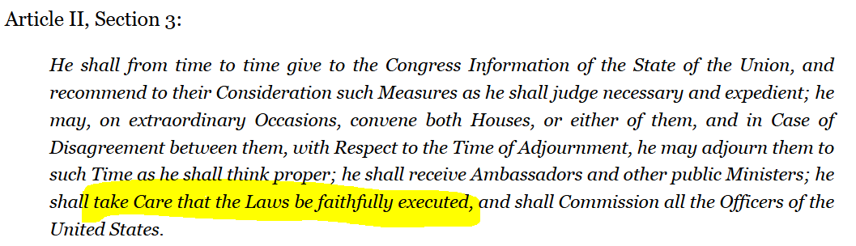

Executive Branch: Takes Care to Execute Laws

Slide 7
Executive Branch: Takes Care to Execute Laws
President can delegate authority
Executive Orders, Memoranda, Proclamations
President can interpret the law
Can President “take care” by not spending appropriated funds?
Impoundment = action or inaction that results in delay or refusal to spend appropriated funds; operates like a line-item veto
SCOTUS has not ruled on Constitutionality of impoundment authority
1974 Impoundment Control Act – limits executive authority; requires rescission requests to Congress
Enforced by Congress Government Accountability Office (GAO)

Slide 9
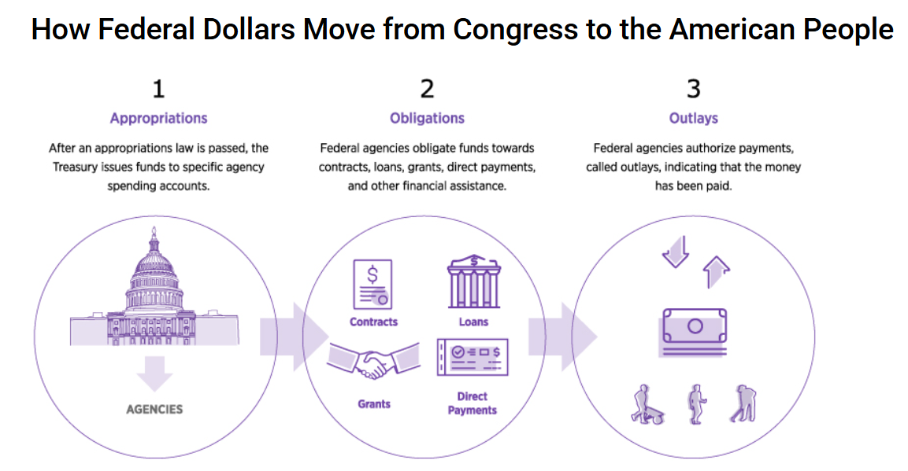
Credit: St. Louis Fed

Slide 10
Overview of Federal Priorities

Slide 11
Policy Agenda
Policy throughline – what is favored and disfavored
Executive policy tools
President: Executive Orders, Memoranda, Proclamations
Departments/Agencies: Regulations, Enforcement, Directives, Memoranda
Spending appropriations – contracts, grants, loans, workforce
DOGE Mandate
Deregulate
Cut Costs

Slide 12
Cost Efficiency Initiative
Executive Actions, Roadmap, Actions To-Date, Policy Reprise

Slide 13
Key Cost Efficiency Executive Actions:
EO 14158 – Establishing DOGE – Jan 20
Memo – Temporary Pause Agency Grant, Loan, Assistance – Jan 27
EO 14210 – DOGE Workforce Optimization Initiative – Feb 11
EO 14222 – DOGE Cost Efficiency Initiative – Feb 26
EO 14240 – Consolidating Procurement – Mar 20
EO 14243 – Eliminating Information Silos – Mar 20

Slide 14
5-Part DOGE Cost Efficiency Initiative Roadmap
Each Agency must:
Justify contracts and grants
Review/terminate contracts and grants
Approve contracts and grants
Freeze contracting officer credit cards
Dispose of real estate
Led by: Agency/Department head and the agency's DOGE Team Lead

Slide 15
Covered Contracts and Grants
Broadly defined to include all discretionary spending through federal contracts, grants, loans, and related instruments
Not direct individual assistance,
Not expenditures for immigration or law enforcement, military, public safety, intelligence community, or other critical, acute or emergency spending
Agency/DOGE-specific exceptions are available

Slide 16
1. Contract and Grant Justification
Build a centralized agency IT system to record every payment issued under the agency’s covered contracts and grants
Brief justification for each payment required; or payment paused.
Post all payment justifications publicly to the maximum extent permitted by law and deemed practicable

Slide 17
2. Contract and Grant Review
Review all covered contracts and grants
Where “appropriate and consistent with applicable law” terminate, modify, renegotiate them
Goal: reduce overall federal spending or reallocate spending for efficiency or to advance Trump policies
Deadline: March 28, 2025
Prioritize contracts and grants to educational institutions and foreign entities for waste, fraud, and abuse

Slide 18
3. Contract and Grant Approval
Agencies to issue guidance for when new contracts and grants can be signed or modified
Before the guidance is issued, new contracts and grants may only be issued on a case-by-case basis
Going forward the agency must prepare a monthly report on contracting activities, which must include all payment justifications

Slide 19
4. Credit Card Freeze
All federal employee credit cards frozen until March 28, 2025, with exceptions for disaster relief, disaster response, and other critical services, all subject to approval

Slide 20
5. Real Property Disposition
By March 5, 2025, make sure the Federal Real Property Management System accurately reflects the complete and current inventory of the agency's real property
By March 28, 2025, identify all termination rights agencies have under existing leases of government-owned real property and determine whether to terminate the leases
By April 27, 2025, GSA must submit a plan to OMB for the disposition of government-owned real property that has been deemed by the agency as no longer needed

Slide 21
Deregulatory Agenda
Executive Actions, Roadmap, Key Agencies, Progress To-Date

Slide 22
Key Deregulatory Executive Actions
Memo – Regulatory Freeze Pending Review – Jan 20
EO 14192 – Unleashing Prosperity Through Deregulation – Jan 31
EO 14215 – Ensuring Accountability for All Agencies – Feb 18
No more independent agencies; centralized rulemaking; enforcement focus
EO 14217 – Commence Reduction of Federal Bureaucracy – Feb 19
EO 14219 – DOGE Deregulatory Initiative – Feb 19
EO 14238 – Continuing Reduction of Federal Bureaucracy – Mar 14

Slide 24
Step 1: Use Litmus Test To Identify Targeted Regs
By April 20, 2025, agency heads must work with DOGE to prepare a list of all agency regulations that fall into any of the following categories:
1. Unconstitutional regulations and regulations that raise serious constitutional concerns (such as exceeding executive authority);
2. Regulations based on unlawful delegations of legislative power;
3. Regulations based on anything other than the "best reading" of statutory authority or prohibition;
4. Regulations that implicate matters of social, political, or economic significance that are not authorized by clear statutory authority;

Slide 25
Step 1: Use Litmus Test To Identify Targeted Regs
5. Regulations that impose significant costs upon private parties that are not outweighed by public benefits;
6. Regulations that harm the national interest by impeding technological innovation, infrastructure development, disaster response, inflation reduction, R&D, economic development, energy production, land use, and foreign policy objectives; and
7. Regulations that impose undue burdens on small business and impede private enterprise and entrepreneurship.

Slide 26
Step 2a: Adopt (De)Regulatory Unified Agenda
Office of Information and Regulatory Affairs (OIRA) within the Office of Management and Budget (OMB) works with agencies
Adopts Unified Regulatory Agenda that specifically targets those regulations for rescission or modification.
Watch for the Spring 2025 Unified (De)Regulatory Agenda

Slide 27
Step 2b: Triage Enforcement
De-prioritize enforcement of regulations based on “anything other than the best reading of a statute” and that go beyond the power vested in the federal government by the Constitution
Agencies must identify any ongoing enforcement actions that are inconsistent with law and Administration policy and work with OMB to terminate enforcement actions that do not align
President/Attorney General have final say on interpretations of federal law by all executive agencies

Slide 28
Step 3: Apply Litmus Test to New Regs
Agencies must continue to submit new regulations to OIRA and consult with DOGE and OIRA on new potential regulations as soon as practicable
In evaluating and new proposed regulations, OIRA will make sure they passed the 7-step litmus test

Slide 29
Policy Shifts – Requirements and Enforcement
Anti-Discrimination, Immigration, Climate/Energy, Trade/International

Slide 30
Policy Shift: Anti-Discrimination
EO 14151: directs agencies to terminate DEI-related contracts/grants
EO 14173: revokes 11246 (affirmative action) and expressly creates potential False Claims Act (FCA) liability for federal contractors with “unlawful” DEI programs via certification provision.
EO 14186: declares that the United States will only recognize two sexes - male and female. No gender identity labels; use “sex” label
EO 14188: directs agencies to prevent and punish Anti-Semitism
EO 14202: directs agencies to prevent and punish anti-Christian bias

Slide 31
Policy Shift: Immigration
EO 14159 Protecting the American People Against Invasion
Revoked Biden orders
Focus on enforcement
Identify and remove unregistered “illegal aliens” (this term is back)
Construction and operation of detention facilities
Withholding federal funds from "sanctuary" jurisdictions
Increase the number of agents and officers
Many other executive and agency actions…
Refugee admissions program stopped, “remain in Mexico” back

Slide 32
Policy Shift: Climate/Energy
EO 14156: declares a national energy emergency, directs agencies to remove barriers to domestic energy production, expedite permits
EO 14154: aims to unleash American energy and directs agencies to rescind burdensome regulations, expedite LNG and mining permits; rescinds climate policies; tried to pause IRA/IIJA funds
EO 14213: establishes the national energy dominance council
No more: “Green Energy” “Environmental Justice” – IRA Projects??
Future of tax credits, loans paused, grants frozen, terminated
NEPA – CEQ Regs (environmental review regs) rescinded

Slide 33
Policy Shift: Trade
Using the International Emergency Economic Powers Act – fentanyl/drugs, illegal immigration
Universal tariffs – 10% // Reciprocal tariffs paused
China - ranges, generally 145%, some exemptions (electronics)
Canada/Mexico – no additional tariffs if complies with USMCA; outside of USMCA = 25% general, but only 10% energy products from Canada, potash from either. 25% tariffs postponed

Slide 34
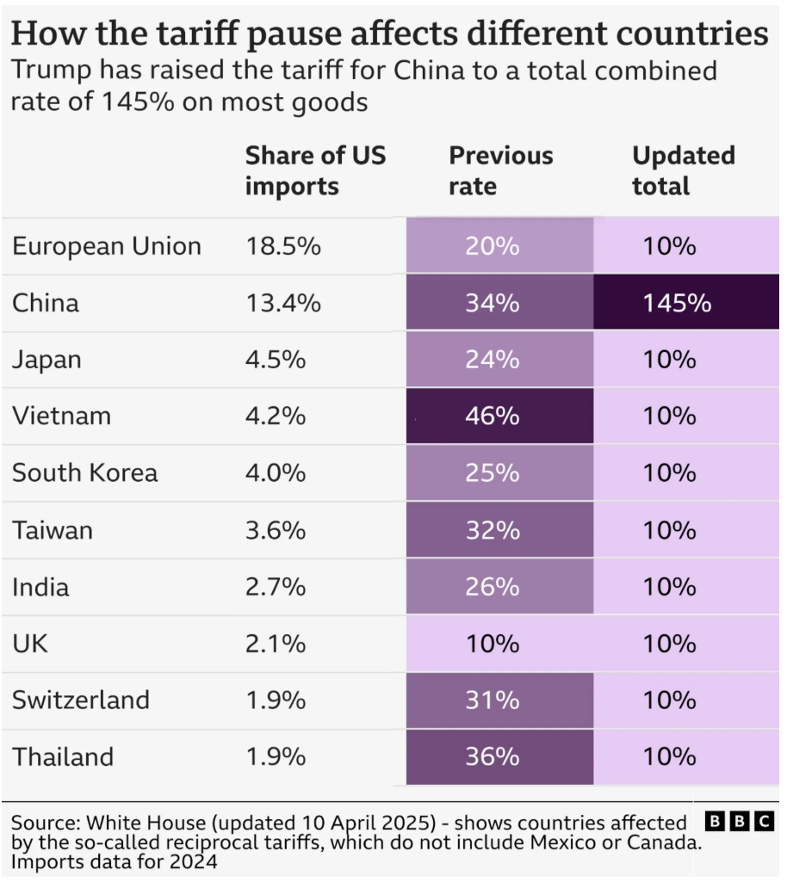
Policy Shift: Trade

Slide 35
Policy Shift: Trade
National Security Tariffs (Sec 232 Trade Expansion Act)
Steel and aluminum 25%
Harmonized Tariff Schedule - Chapter 73 (steel) and 76 (aluminum)
For derivative products (not in Ch 73/76), duty will apply only to the value of steel or aluminum in the product – these are not in place yet
Importers to report countries of smelt and cast
CBP directed to monitor imports for misclassifications, max penalty
Copper, timber and lumber – under evaluation – Nov 2025 expect report on national security implications of imports

Slide 36
Policy Shift: Trade
Domestic preference: Make it here
BABAA - grants
BAA/TAA - contracts
USDOT/FHWA – Buy America Requirements for Manufactured Products – no more waiver for manufactured products
delay of rule effective date to March 20, 2025 – but this is now in effect
Manufactured in US – funds obligated on/after 10/1/2025
Manufactured in US + Component cost test – funds obligated 10/1/2026

Slide 37
Downstream Impacts

Slide 38
Cost Cutting Actions To-Date
Treasury Outlays – Held, Even When Due
Payment freeze – court cases
Many contractors/grantees unpaid – legal right to payment; how to enforce
Agency Obligations – Contracts Stopped/Terminated
Existing agreements – terminations – legal right to closeout costs
Existing agreements – stop work orders – legal right to SWO costs
Refusal to spend appropriations – Impoundment Act and Rescission Requests – court cases
Future budget?

Slide 39
Deregulation Crowdsourcing
OMB RFI for deregulation ideas – get involved!
“OMB solicits ideas for deregulation from across the country. Commenters should identify rules to be rescinded and provide detailed reasons for their rescission. OMB invites comments about any and all regulations currently in effect.”
Written comments due May 12, 2025

Slide 40
Policy Shifts and Contract Terms
Future contract and grant terms will require adherence to new policy priorities
Grants – OMB 2 CFR Part 200; agency supplements
Contracts – Federal Acquisition Regulations (FAR); agency supplements
Already seeing class “deviations”
Bi-lateral agreements – accept money, agree to conditions

Slide 41
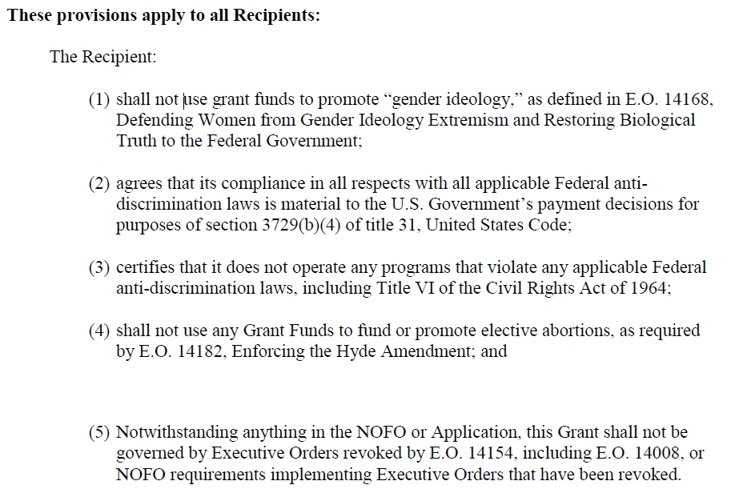






Slide 42
Conclusion
Policy pulled through regulations; attached to money/approvals
New polices easiest to impose on federal grantees and contractors; will flow down to vendors
Centralize/downsize/streamline efforts – making it harder to get things from agencies; but oversight/enforcement risks are lower…
…Except for high priority enforcement areas:
Civil Rights, Immigration

Slide 43
Navigating Funding Risk and Regulatory Risk

Slide 44
Risk Assessment – Funding Risks
Define all ways that federal funding supports your organization. Try to track those sources to the source – agency, program, appropriation – do they flow through other entities first (prime contractor, state agency, etc.).
Are those programs likely to be targeted by DOGE cost cutting?
How dependent is your organization on federal funds?
Dispute risks involving your organization
Disruptions caused by disputes not involving your organization

Slide 45
Risk Assessment – Regulatory Risks
Define regulations that impact your organization – for better or worse
How do they fare under the 7-part litmus test?
Is enforcement a priority for the agency? Can others enforce it?
Are there similar or conflicting regulations at the state or local level?
Costs of compliance v. risks of noncompliance
Stakeholder perspectives
Company values

Slide 46
Decide How You Will Decide/Trust Your Process
Triage defined risks based on your unique situation and risk tolerance
Consider the following:
Establish standard operating procedures (SOPs) to guide your response to regulatory changes over time. Using a defined process helps ensure your organization cuts out the noise and only uses signals to work through decisions.
Create a decision tree to help your organization navigate dynamic risks and make sound decisions that align with your organization’s values and risk tolerance
Equip professionals throughout your organization with the tools they need to make decisions that are appropriate to their level of authority and discretion
Cut out the noise and trust your process

Slide 47
Discussion

Slide 48

Presenter
Nena Lenz
Attorney
612.492.7427
nlenz@fredlaw.com

