Slide 1

Analysis of the Potential Impacts on Discovery in Response to the Proposed Rule Changes from the Judicial Management Council Workgroup on Improved Resolution of Civil Cases
June 13, 2022
Katherine Heckert, Esq. – Carlton Fields, P.A.
Jade Davis, Esq. – Shumaker, Loop & Kendrick, LLP
Construction Law Committee

Slide 2

Framework of Presentation
Workgroup on Improved Resolution of Civil Cases
The Rules
  Current Rules & Proposed Changes by the Workgroup on Improved Resolution of Civil Cases
  Feedback and Comments
Recent Case Law Developments Interpreting the Rules
The Practice
  Practical Pointers and Recommendations

Slide 3

Judicial Management Council Workgroup on Improved Resolution of Civil Cases
On November 15, 2021, the Florida Supreme Court Judicial Management Counsel Workgroup issued a 330-page report on Improved Resolution of Civil Cases.
This report proposes procedural rule changes that would impose more judicial control on civil cases and tighten rules (including tougher sanctions) for discovery, depositions, and continuances.
The goals, the workgroup said, are to improve the clearance rate of civil cases (which even before the COVID-19 pandemic was not keeping up with new cases filed), reduce the time and cost of litigation making it a more attractive alternative for resolving disputes, and make more effective use of court resources.
For discovery specifically, the Workgroup based “its recommendations on a review of the legal literature, available research, and practice in the states and federal jurisdiction, along with Workgroup members' extensive experience as practitioners and judges.”
The report overhauls the Rules as we know them; however, today we are discussing the key issues that could impact discovery.

Slide 4
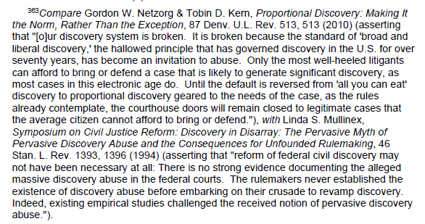

Recurring Theme: Proportional Discovery

Slide 5
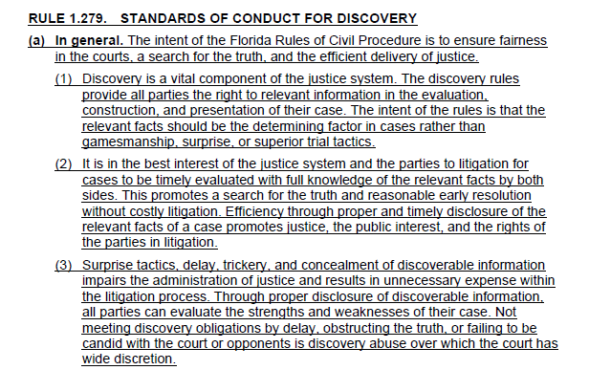

Standards of Conduct for Discovery
New Rule:
Fla. R. Civ. P. 1.279
Subdivision (a) summarizes essential principles.

Slide 6
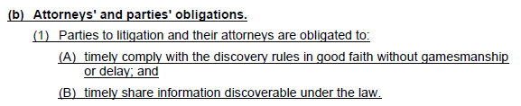
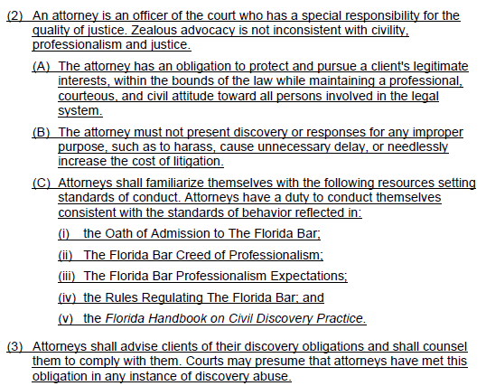
Standards of Conduct for Discovery – 1.279(b)
Subdivision (b) lays out the obligations of attorneys and parties.
In particular, subdivision (b)(3) directs attorneys to advise clients of their discovery obligations and states that courts may presume that attorneys have done so.
Subdivision (b)(2)(C) lists multiple sources delineating appropriate standards of conduct, including the Oath of Admission to The Florida Bar, The Florida Bar Creed of Professionalism, The Florida Bar Professionalism Expectations, and the Florida Handbook on Civil Discovery Practice.

Slide 7
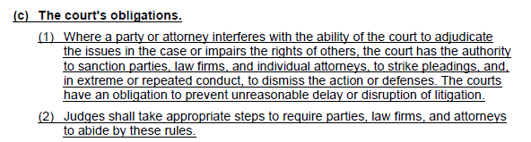
Standards of Conduct for Discovery – 1.279(c)
Subdivision (c)(1) reminds the court of its authority to sanction parties and attorneys for discovery abuse and of its obligation to prevent unreasonable litigation delay
Subdivision (c)(2) directs courts to take appropriate steps to ensure compliance with the discovery rules

Slide 8
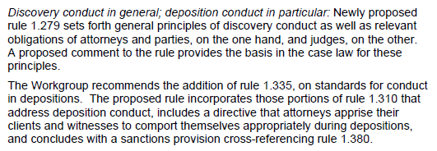
Conduct
Rules implicated: Fla. R. Civ. P. 1.310, 1.380 plus addition of 1.279, 1.335

Slide 9
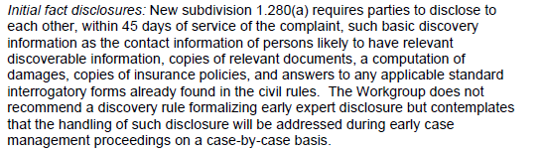
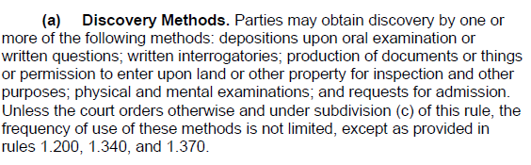
Discovery Rules Implicated by Proposed Changes
Fla. R. Civ. P. 1.280(a)
Currently, the Rules do not include an initial disclosure requirement

Slide 10
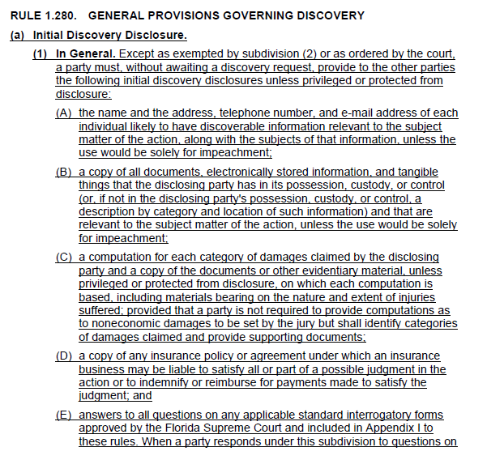

General Provisions Regarding Discovery
New Subdivision: Fla. R. Civ. P. 1.280(a)(1)
Initial discovery disclosures
All documents except for docs used for impeachment only
Computation of damages
Insurance policy
Standard interrogatories

Slide 11
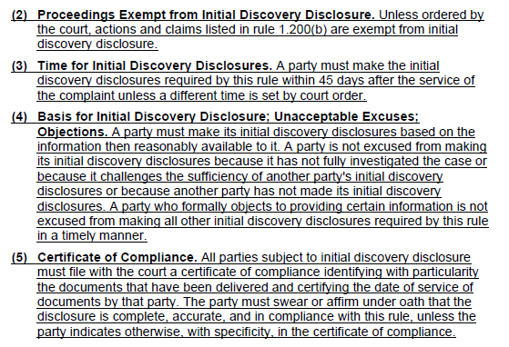
General Provisions Regarding Discovery
New Subdivision: Fla. R. Civ. P. 1.280(a)(2)
Exemptions
45-day requirement
Ongoing investigation does not excuse disclosures
Certificate of compliance required

Slide 12
Discovery Supplementation
Fla. R. Civ. P. 1.280(f)
"A party who has responded to a request for discovery with a response that was complete when made is under no duty to supplement the response to include information thereafter acquired.“
Fla. R. Civ. P. 1.280(f). See also Binger v. King Pest Control, 401 So. 2d 1310, 1312 n.4 (Fla. 1981) ("There is no continuing duty of disclosure under Florida's Rules of Civil Procedure, as there is under our criminal rules. See Fla. R. Crim. P. 3.220(f).").

Slide 13
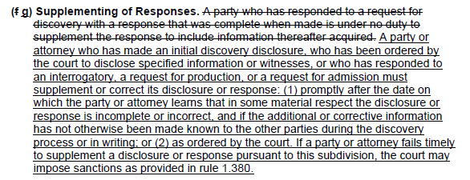

Discovery Supplementation
Fla. R. Civ. P. 1.280(f) → 1.280(g)

Slide 14
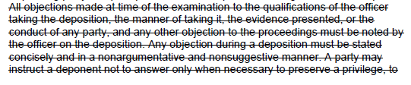

Depositions
Fla. R. Civ. P. 1.310 Changes

Slide 15
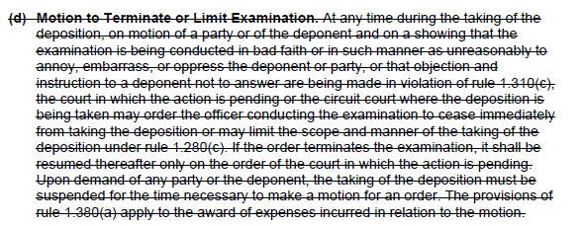
Depositions
Fla. R. Civ. P. 1.310 Changes

Slide 16
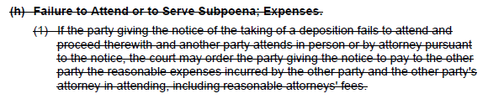
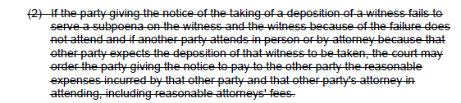
Depositions
Fla. R. Civ. P. 1.310 Changes

Slide 17
"Standards for Conduct in Depositions, Objections, Claims of Privilege, Termination or Limit, Failure to Appear, and Sanctions”
Fla. R. Civ. P. 1.335
“To address abuses that occur all too frequently during depositions, the Workgroup recommends the creation of a new rule . . . Proposed rule 1.335 includes a transfer from rule 1.310 of those portions that address deposition conduct.
See also R. Regulating Fla. Bar 4-3.4(d) ("A lawyer must not: . . . (d) in pretrial procedure, make a frivolous discovery request or intentionally fail to comply with a legally proper discovery request by an opposing party.").

Slide 18
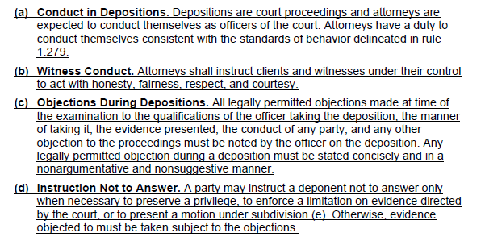
"Standards for Conduct in Depositions, Objections, Claims of Privilege, Termination or Limit, Failure to Appear, and Sanctions”
Fla. R. Civ. P. 1.335

Slide 19
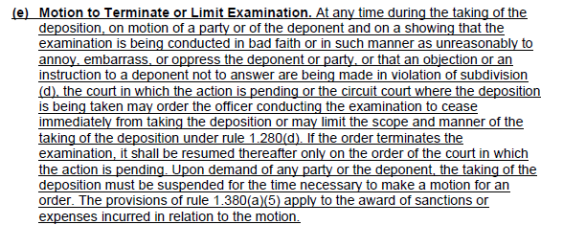
"Standards for Conduct in Depositions, Objections, Claims of Privilege, Termination or Limit, Failure to Appear, and Sanctions”
Fla. R. Civ. P. 1.335

Slide 20
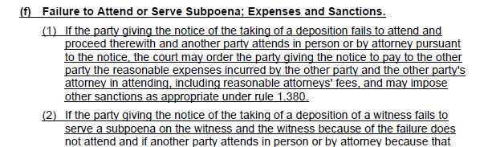

"Standards for Conduct in Depositions, Objections, Claims of Privilege, Termination or Limit, Failure to Appear, and Sanctions”
Fla. R. Civ. P. 1.335

Slide 21
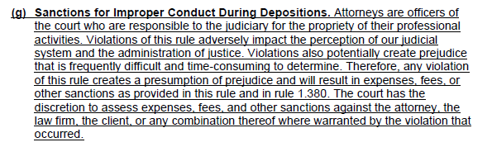
"Standards for Conduct in Depositions, Objections, Claims of Privilege, Termination or Limit, Failure to Appear, and Sanctions”
Fla. R. Civ. P. 1.335

Slide 22
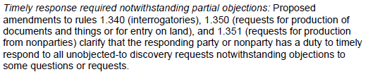
Timely Responses to Unobjected-To Requests
Rules implicated: Fla. R. Civ. P. 1.340, 1.350, 1.351

Slide 23
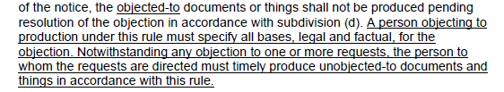

Objections by Non-Parties
Fla. R. Civ. P. 1.351(c)-(d)

Slide 24
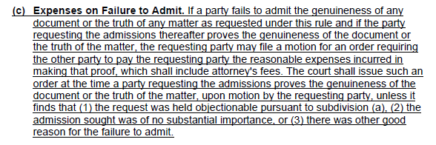
Requests for Admission
Fla. R. Civ. P. 1.370(e) – Requests for Admission, new subsection providing for expenses, removed from 1.380(c)

Slide 25
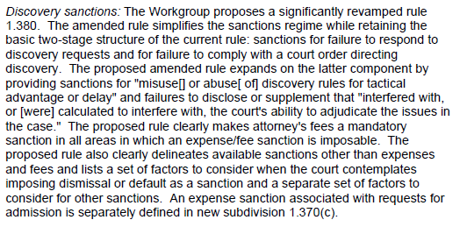
Sanctions
Rules implicated: Fla. R. Civ. P. 1.380
Sanctions added for
misuse or abuse of rules for tactical advantage or delay
Failure to disclose or supplement for interference
Mandatory atty fees
Centralizing scattered sanctions

Slide 26
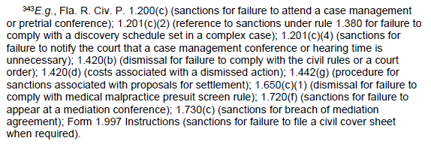
Scattered Sanctions
Sanctions are currently scattered throughout the Rules. The Workgroup stated, “The current rule is disorganized and has a number of internal inconsistencies.”
The Report provided the following examples of scattered sanctions:

Slide 27
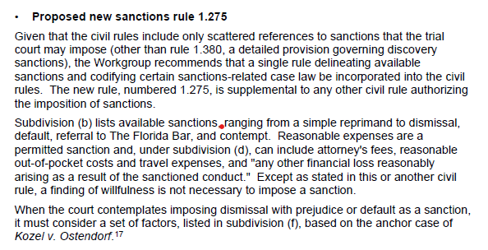
Additional Sanctions
Rules implicated: Fla. R. Civ. P. 1.275
New sanctions rule codifying sanctions-related case law to include dismissal, default, referral to the Florida Bar, and contempt.

Slide 28
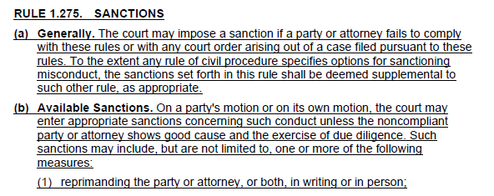
Additional Sanctions: Fla. R. Civ. P. 1.275(a)-(b)

Slide 29
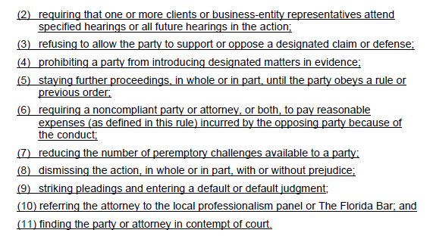
Additional Sanctions: Fla. R. Civ. P. 1.275(b) cont-

Slide 30
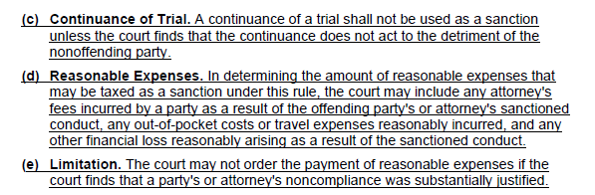
Additional Sanctions: Fla. R. Civ. P. 1.275(c)-(e)

Slide 31
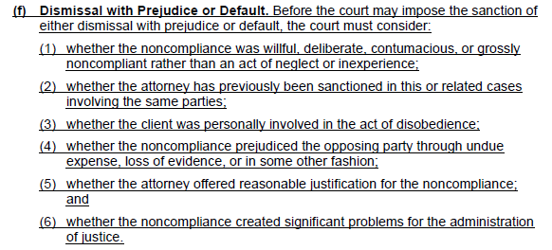
Additional Sanctions: Fla. R. Civ. P. 1.275(f)

Slide 32
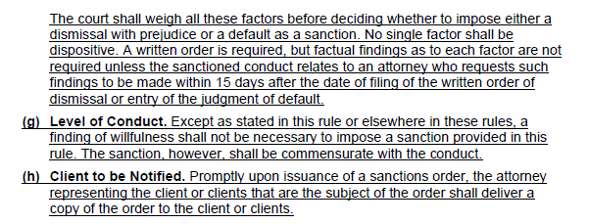
Additional Sanctions: Fla. R. Civ. P. 1.275(f)

Slide 33
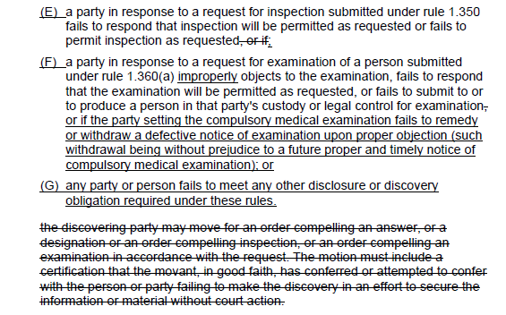
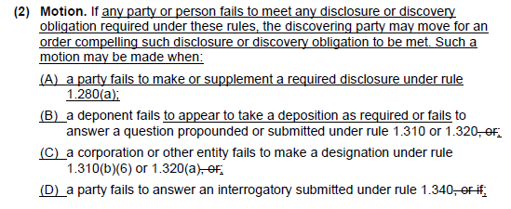
Sanctions
Fla. R. Civ. P. 1.380(a), change excerpts

Slide 34
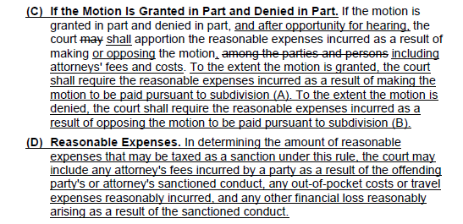
Sanctions
Fla. R. Civ. P. 1.380(a)(5)(C) & (D)

Slide 35
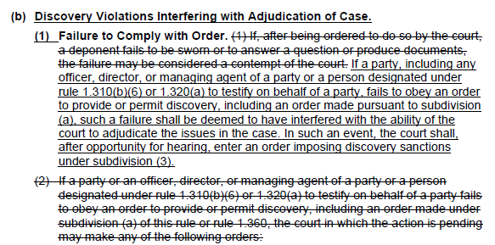
Sanctions
Fla. R. Civ. P. 1.380(b)(1)

Slide 36
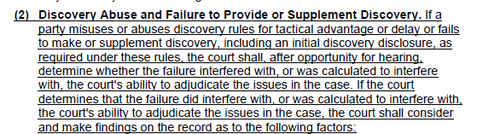
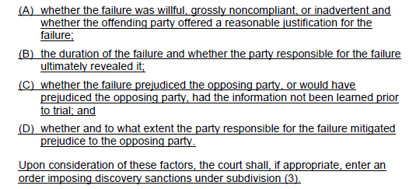
Sanctions
Fla. R. Civ. P. 1.380(b)(2)

Slide 37
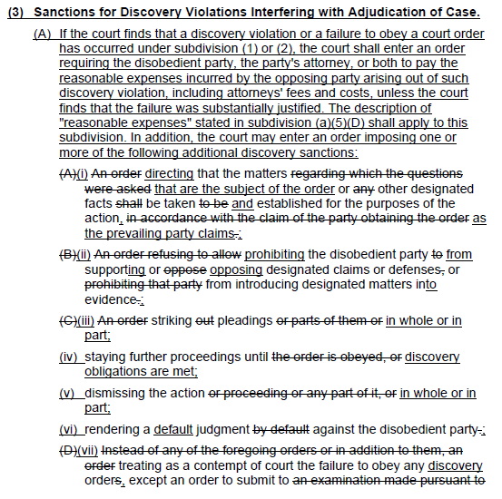
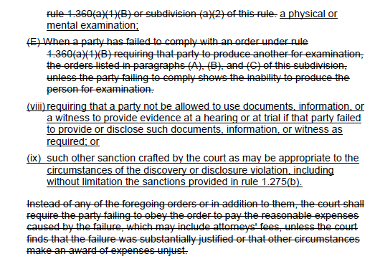
Sanctions - Fla. R. Civ. P. 1.380(b)(3)(A)

Slide 38
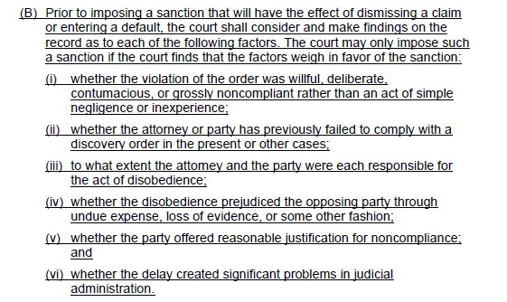
Sanctions - Fla. R. Civ. P. 1.380(b)(3)(B)

Slide 39
Summary of Comments by RPPTL
Disclosure Rule - the “Initial Disclosures” set forth in Fla. R. Civ. P. 1.280(a) are more extensive in comparison to those utilized in the Federal Court system.
Requires the immediate production of all documents, electronically stored information and tangible things in a compressed time period at the very beginning of a lawsuit and prohibits the parties from independently stipulating to any revision to the disclosure deadlines that are more appropriate for a given action.
In contrast, Rule 26 of the Federal Rules of Civil Procedure only requires the parties to provide a “description by category and location” allowing each party to request the production of specific categories at the appropriate time. Additionally, the parties are free to stipulate to modifications to the Federal rule and tailor the rule to the specific action.

Slide 40
Recommendations & Comments by RPPTL
Disclosure Rule
Option for parties to consent to early mediation and stay the initial disclosures or, in the alternative, adopt a system like that utilized in Federal Court that requires the disclosure of categories, not the actual production of documents
Timing of the Initial Disclosures - While plaintiffs have an unlimited amount of time to prepare their Initial Disclosures because they choose when to file the lawsuit, defendants will use a significant portion of their 45-day window to engage competent counsel, who must first gain an understanding of the lawsuit, claims, mandatory counterclaims, and affirmative defenses, then prepare an appropriate response to the complaint, deal with incoming production from opposing counsel and then timely make the mandatory Initial Disclosures.
If the complaint is vague, indefinite, or does not state proper causes of action, the defense is entitled to no relief unless the defense is able to obtain a court order entered in the short period between responding to the complaint and the disclosure deadline.

Slide 41
Recommendations & Comments by RPPTL
Disclosure Rule & Financial Loss
If the Court does not change the rule to require the disclosure of categories of documents instead of the actual production of documents, the Section believes Defendants should be provided additional time to provide their Initial Disclosure without the necessity of obtaining a court order.
Initial Fact Disclosures should allow for stipulation
It is not clear what “any other financial loss” means and presumably could include lost profits, special damages, or other damages caused by unintended consequences. The financial loss language is also contained in Rule 1.275(d). To prevent sanctions motions from creating unnecessary and additional hearings which could detract from the ultimate progress of the case, the Court should consider removing the financial loss language and limit sanctions to fees and reasonable costs.

Slide 42
Recommendations & Comments by RPPTL
Inconsistencies in Standard for Awarding Expenses
The standard to avoid sanctions in Rule 1.275 appears to be inconsistent.
Part (b) of the Rule prohibits the Court from ordering the payment of reasonable expenses as a sanction if the party or attorney shows “good cause and the exercise of diligence.”
Part (e) provides the court may not order payment of reasonable expenses if the court finds the party or attorney’s noncompliance was “substantially justified.
The standard should be consistent.
“Good Cause” standard is recommended as that standard is fairly well-defined in existing case law.

Slide 43
Recommendations & Comments by RPPTL
Remove Ethical Obligations from Rules
Rule 1.279 should be deleted in its entirety. This revision
codifies ethical obligations as a rule of civil procedure.
While the goal of this rule is laudable and the goals and
aspirations stated therein are how every attorney should
practice, allowing this to become a rule of civil procedure
may only invite abuse and allow attorneys to weaponize
aspirational goals and subjective terms during the
discovery process. This Rule should be limited to a
comment for Rule 1.280 or Rule 1.275 and be amended to
exclude Rule 1.279 from being subject to sanctions.

Slide 44
Recent Case Law Developments Interpreting the Rules
Cell Phones / Bring Your Own Device
In re Skanska 2021 WL 4953239 (N.D. Fla. Aug. 5, 2021)
As part of the litigation, the court considered what Skanska’s production obligations were with respect to the personal cell phone of Tugboat Captain Hill (not a company-issued phone), but the Claimants sought to have Skanska extract and search Hill’s cell phone data as done with other custodians who had company-issued phones.
Skanska objected to extracting and searching some of the cell phone data from Hill’s cell phone, arguing the phone is Hill’s private cell phone, over which they have no possession, custody, and control, and Hill’s privacy interest in his phone.
The court pointed to FRCP 34(a), which requires a party to “produce relevant documents … that are in the possession, custody, or control of the party upon whom the request is served. Control is defined not only as possession, but as the legal right to obtain documents upon demand, and courts have construed it broadly. The burden of establishing control over the documents sought is on the party seeking production.”

Slide 45
Skanska – Court’s Reasoning
An employer has “control” of a current employee and the legal right to obtain business communications from a current employee regardless of whether the communication is located on a personal cell phone. The court cited State Farm Mutual Automobile Ins. Co. v. Precious Physical Therapy, 2020 WL 7056039, at * 5 (E. D. Mich. Dec. 2, 2020), in which the court granted a motion to compel production of emails from employees’ personal email accounts, to explain that “As a practical matter, if an employer were able to avoid producing business documents by simply maintaining anything potentially discoverable in an employee’s personal email account, this could have the potential to incentivize employers to require the use of personal accounts for business purposes or to store business documents in personal accounts.
Thus, Skanska cannot shuck its discovery obligations simply because it did not issue the cell phone to Hill.
That obligation, however, does not extend to requiring Skanska to extract and review all the cell phone data on Hill’s cell phone. Instead, even in those cases where the court has found that an employer has “control” over an employee’s personal device, courts have only required the employer to ask the employee to search and produce the responsive information. Moreover, while there is evidence Hill sent or received work-related text messages on the phone, there is no evidence other cell phone data on Hill’s phone would produce responsive information. Thus, the burden of requiring all the data to be extracted and reviewed outweighs any potential benefit.
Court denied the motion for sanctions since Skanska has already agreed to review and produce responsive text messages from Hill’s phone and Claimants already deposed Hill.

Slide 46
Practical Pointers & Tips
Interview Questions Should You Ask Your Client - eDiscovery
Timeframe: Have there been any migration/implementation of email servers or document management systems within this timeframe; or any decommissioned servers?
Email Storage: Short-term storage: Central server (e.g. Microsoft Exchange) or multiple servers? Longer-term: cloud, mail store server, or email vault?
– What is kept, for how long, is there one place that stores emails from all servers, and when were these various long-term storage options implemented?
- Are backup tapes used to take a snapshot of the server on regular basis? If so, has the litigation hold memo created a suspension of rotation/recycling/overwriting of the tapes? If not, then legal needs to follow up and have IT stop the rotation of tapes.
- When/how often are snapshots taken?
- How often are tapes rotated? (in other words, how far back is the info stored)?
- Backup tapes are a last resort (data not obtained from other sources)
- Are custodians allowed to save emails in local pst files that are not on the server?

Slide 47
Practical Pointers & Tips
Interview Questions Should You Ask Your Client
How are non-email documents are stored:
  Custodial level: Is there a centralized location on the server to store Word, Excel, pdf and other types of documents prepared by custodians, or do custodians store them in their own location?
  Department level:
    Is there centralized department storage (e.g. Company’s S drive)?
    Are there any applicable departments (e.g. Finance) and do they have their own server? Does the legal department have its own server?
    Are there any databases/enterprise systems/or any sort of application that houses a discrete set of information that might be applicable (e.g. a database or calendaring system that tracks corporate contracts)
  Have these servers been migrated/updated/instituted/decommissioned since _____?

Slide 48
Practical Pointers & Tips
Interview Questions Should You Ask Your Client
Personal Devices:
  Are they firm issued and/or supported?
  Are custodians permitted to use their personal devices for business? Is this enforced?
  Are all emails routed through Client’s server or are they saved in pst files per device?
  How is this data maintained/captured?
Tell us about Text Messaging or IM:
  Is this data logged or simply deleted?
  Where is log maintained?
  Collect from personal devices

Slide 49
Practical Pointers & Tips
Interview Questions Should You Ask Your Client
Tell us about Voicemail:
  Is it saved?
  Are new messages emailed to users?
  Where is the data maintained and in what format?
  How is the data accessed?
Tell us about proprietary software, document management systems, or databases that you may use:
  What programs or databases are used?
  Who has access to each one?
  How can this data be collected from these sources?

Slide 50
Practical Pointers & Tips
Litigation Holds
Litigation Hold Memo distributed to:
  What persons and teams?
  Should it be distributed to anyone else?
ESI Mail and document retention secured for:
  What persons and teams?
  Should there be any other custodians?

Slide 51
Practical Pointers & Tips
Collections
Preference is to collect data by the custodian (from a server, not self-collection)
  Imported into our document management system where we can run analytics and/or key term searches to find responsive documents
Preference is to have a Certified third-party vendor collect ESI
  Unbiased party which keeps the chain of custody log
  Can supply an affidavit regarding legally defensible collection
  Can testify as to the accuracy and scope of the collection in the event
Does the Client have someone in the IT department who can collect the data and is certified to testify in the event the opposing party questions authenticity or scope of collection (this is becoming a very common tactic in today’s litigation) – or – does the client have a preferred vendor?

Slide 52
Practical Pointers & Tips
New Data to Be Mindful Of
Zoom, Microsoft Teams, Slack, WebEx, and others are technologies that skyrocketed from luxuries to necessities during the pandemic.
We went from getting back to normal to the “new normal.” The option to connect with anyone, anywhere, anytime, in the blink of an eye, or with a few simple clicks will never go away.
Accelerated workplace changes have created a great deal of responsibility for maintaining, understanding, preserving, and producing electronic information.

Slide 53
Practical Pointers & Tips
Content Continues to Grow and Expand
Virtual meetings – the normal scribbled notes or typed minutes have transformed into recorded, archived, stored away, and reproducible in a few clicks. Chats that are functionality utilized allow users to save messages. Real-time messaging all the time.
Workstations - “Shadow IT” is simply unmanageable. Headquarters has multiplied into numerous decentralized information systems operating simultaneously.
The Cloud - Platforms such as Zoom allow meeting participants to upload both audio and video records to file storage cloud services like Dropbox or streaming services like YouTube.

Slide 54
Practical Pointers & Tips
Ephemeral Information
Do company-owned mobile devices have installed applications that allow ephemeral messaging (i.e., Snapchat-DingTalk-Signal-Wickr—which allow messages to disappear after viewing; Facebook or Instagram “vanish-mode” that mimics Snapchat; talk-to-type audio recordings that disappear after being listened to via text messages)
It is important to understand if the applications or settings are purely ephemeral (stored briefly without back-up), quasi or non-ephemeral.

Slide 55

Questions?

