Slide 1
Construction Law Committee of the RPPTL Section of the Florida Bar
Issues of Bias & Diversity for the Construction Law Practitioner
May 10, 2021

Slide 2
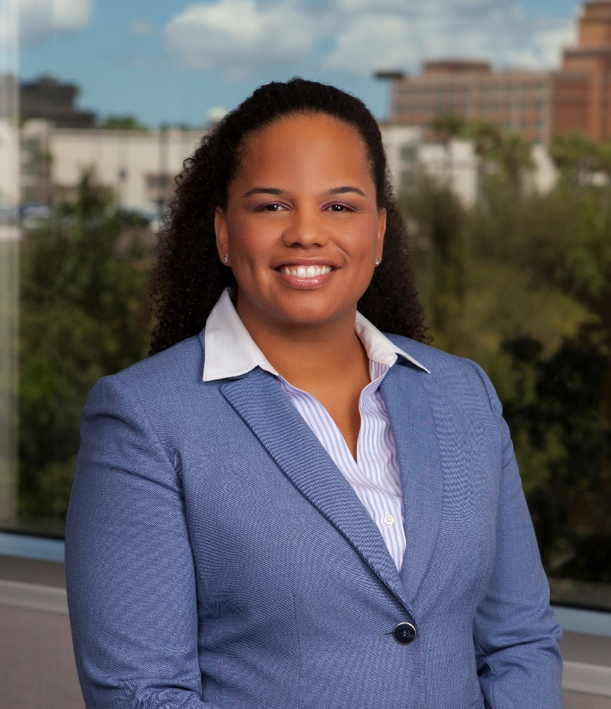
Meredith A. Freeman mfreeman@shutts.com
Board Certified in Construction Law
Partner
Woman
Black
Mother
Athlete
Notes:
Diversity and inclusion can be uncomfortable to talk about.
To have make any of this worth our time and effort we need to create a safe space to have a discussion. You are welcome to participate. Ask questions, make comments, share experiences – as long as you follow my rules. But you don’t have to . Remember I’m a lawyer- I like to talk and even worse I like to hear myself talk so share or don’t share I’m fine with it either way. Ok so hear are the rules.

Slide 3
Empathy
“Empathy is seeing with the eyes of another, listening with the ears of another and feeling with the heart of another.” – Alfred Adler.

Slide 4
Definitions
Bias is a particular tendency, trend, inclination, feeling, or opinion, especially one that is preconceived or unreasoned
Diversity means “the practice or quality of including or involving people from a range of different social and ethnic backgrounds and of different genders, sexual orientations, etc.”

Slide 5
Definitions
Implicit bias is attitudes or stereotypes that impact our understanding, decision making, and behavior without our even realizing it.
Affinity bias is the tendency for people to extend greater trust, greater positive regard, cooperation, and empathy to people they perceived as similar to themselves.

Slide 6
Rule 6-10.3(b) of the Rules Regulating
Each member must complete a minimum of 33 credit hours of approved continuing legal education activity every 3 years. At least 5 of the 33 credit hours must be in approved legal ethics, professionalism, bias elimination, substance abuse, or mental illness awareness programs

Slide 7
Oath of Admission to the Florida Bar
To opposing parties and their counsel, I pledge fairness, integrity, and civility, not only in court, but also in all written and oral communications…

Slide 8
2020 Statistics
5% of all lawyers in the U.S. were African American, even though African Americans were 13% of the U.S. population
Profile of the Legal Profession 2020, American Bar Association

Slide 9
2020 Statistics
Male Attorneys 63%
Female Attorneys 37%
Profile of the Legal Profession 2020, American Bar Association

Slide 10
2019 Statistic
9.6% of partners in law firms were lawyers of color, including Hispanic, African American, Asian, Native American or mixed race. While efforts have been made to increase the number of women and diverse lawyers in law, these efforts have complex challenges.
Profile of the Legal Profession 2020, American Bar Association

Slide 11
Bias in Lawfirms
The Nextions 2014 “Written in Black & White” Report

Slide 12
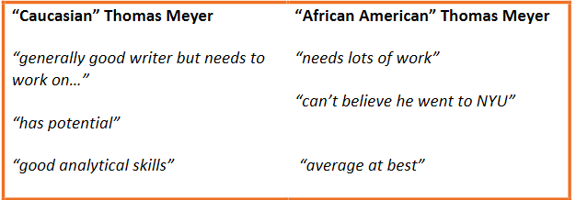
The Nextions 2014 “Written in Black & White” Report

Slide 13
Gender Bias
What happened when a man and a woman switched email signature blocks at work for a week?

Slide 14
Diversity in the Judicial System
At this Court’s direction, both the Bar and the State Court System have for many years worked diligently to assure a system of justice that is fair for all and that treats all individuals as equal under the law. This Court is steadfast in its firm commitment to these ideals. I believe that these ideals are best advanced when individuals with very different backgrounds and experiences work together. This is because our experiential differences often result in starkly different modes of thought and perception—including deeply divided perceptions surrounding concepts as facially straightforward as “fairness” and “justice.”
It is when those who perceive and think differently come together in an environment of mutual respect and genuine concern for the well-being of others that we can best gain the understanding necessary to fully advance the ideals underpinning our judicial system. It is essential that we continue this work, and I am grateful to the Bar and its sections for their continued pursuit of these core ideals that are central to further advancing the cause of freedom for all, secured for all through the rule of law.
In re: Amendments to the Rules Regulating the Florida Bar, No. SC21-284 (Fla. April 15, 2021)(Lawson, J. specially concurring)

Slide 15
Diversity in Construction Law
Laws and policies implementing programs designed to increase participation of minority businesses in government contracting are subject to strict scrutiny by Courts such that they must be narrowly tailored measures that further a compelling governmental interest. See Adarand Constructors, Inc. v. Pena, 515 U.S. 200 (1995).

Slide 16
Diversity in Construction Law
Program | Administrative Agency or Entity | Legal Authority
Disadvantaged Business Enterprise (DBE) Program | U.S. Department of Transportation through the Federal Highway Administration, the Federal Aviation Administration and the Federal Transit Administration | 49 CFR § 26.3
Airport Concessions Disadvantaged Business Enterprise (ACDBE) | Federal Aviation Administration | Title 49, Part 23
The 8(a) Business Development Program (8a) | Small Business Administration | 15 U.S.C. § 636 15 U.S.C. § 637
Minority Owned Business Enterprises (MBE) & Woman Owned Business Enterprises (WBE) | Office of Supplier Diversity | § 287.09451, Fla. Stat; § 287.093, Fla. Stat; F.A.C. 60A-9
Florida Department of Transportation DBE Program | Equal Opportunity Office | 49 CFR § 26.3

Slide 17
Stories From the Trenches
Repeatedly Establishing Credentials
Potential for Overlooking Valuable Relationships & Partnerships
Bias In Analyzing Construction Disputes

Slide 18
Deep Thoughts
Owning your responsibility as a lawyer for ensuring a just and fair judicial system
Strategies for combating Bias

Slide 19
Empathy
“Empathy is seeing with the eyes of another, listening with the ears of another and feeling with the heart of another.” – Alfred Adler.

Slide 20
Thank you

