Slide 1

DESIGN PROFESSIONALS DODGING DEFECTS DANGERS
Presented by:
George Truitt, ESQ.

Slide 2
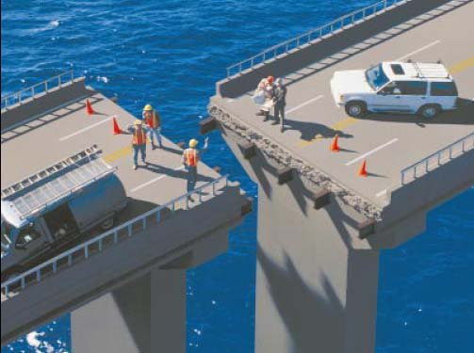
Is the Design Professional Liable?

Slide 3
Overview
Limited Duty to Non-Privities and The Laws of Entropy
I can Hadley Remember It.
Violations of the Florida Building Code
Statutory Negligence
Restatement of Torts
Negligence Case Law
The Renaissance of Common Sense
Chapter 558, Florida Statutes: Limitation of Liability
Hadley Makes a Comeback
Who Takes a Subro Claim Seriously?

Slide 4
Responsibilities of Design Professionals
Professional who is required to meet the standard of care prevailing in the profession, time, and geography where his or her services are offered. See Moransais v. Heathman, 744 So. 2d 973, 975-976 (Fla. 1999) (“the law imposes a duty to perform the requested services in accordance with the standard of care used by similar professionals in the community under similar circumstances.”).
Trikon Sunrise Associates, LLC v. Brice Bldg. Co., Inc., 41 So. 3d 318 (Fla. 4th DCA 2010) there exist situations in which an engineer may perform architectural services that are purely incidental to his or her engineering practice, or likewise that an architect may perform engineering services that are purely incidental to his or her architectural practice.

Slide 5
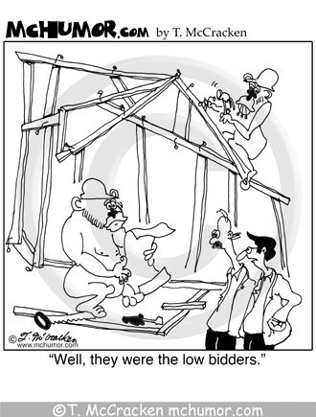

Slide 6
Contract Provisions Arguably Raise the Standard of Care
Sample provisions:
The Architect's services shall be performed as expeditiously as is consistent with that degree of professional skill and care ordinarily possessed by architects in the design of projects of comparable size, scale,programmatic features and complexity, practicing under similar circumstances.
The minimum requirements of the design quality management program are to achieve enhancement of the design in order to develop the appeal, spirit and function of the Project and its status as a world class facility.

Slide 7
Violations of the Florida Building Code
Section 553.84, Florida Statutes:
Statutory civil action.—Notwithstanding any other remedies available, any person or party, in an individual capacity or on behalf of a class of persons or parties, damaged as a result of a violation of this part or the Florida Building Code, has a cause of action in any court of competent jurisdiction against the person or party who committed the violation; however, if the person or party obtains the required building permits and any local government or public agency with authority to enforce the Florida Building Code approves the plans, if the construction project passes all required inspections under the code, and if there is no personal injury or damage to property other than the property that is the subject of the permits, plans, and inspections, this section does not apply unless the person or party knew or should have known that the violation existed.

Slide 8
Violations of the Florida Building Code
Section 553.84 provides for a direct cause of action against design professionals for violationa of the Florida Building Code.
See Edward J. Seibert, A.I.A. v. Bayport Beach and Tennis Club Assoc., Inc., 573 So. 2d 889 (Fla. 2nd DCA 1990).

Slide 9
Penalties for a Design Professional for a Violation of the Florida Building Code
Section 554.781, Florida Statutes, sets forth the penalties, which can be a fine of between $500-$5,000 per material violation. A professional licensing board disciplinary investigation and/or an investigation by the Florida Department of Business and Professional Regulation (“DBPR”) may be conducted. Records regarding material violations shall be maintained by local jurisdictions and by the DBPR, and such records are to be readily accessible by the public.

Slide 10
Negligence, pursuant to Section 481.221(8), Florida Statutes
(8) Final construction documents or instruments of service which include plans, drawings, specifications, or other architectural documents prepared by a registered architect as part of her or his architectural practice shall be of a sufficiently high standard to clearly and accurately indicate or illustrate all essential parts of the work to which they refer.

Slide 11
Restatement of Torts: Section 552
This provision provides for a cause of action against one who, in the course of his business, profession, or employment, supplies false information for the guidance of others in their business transaction.
See Gilchrist Timber v. Rayonier, 696 So. 2d 334 (Fla. 1997) (false misrepresentation).

Slide 12
Negligence: Case Law
Hewett-Kier Construction, Inc. v. Lemuel Ramos & Associates, Inc., 775 So.2d 373 (Fla. 4th DCA 2000)
Moransais v. Heathman, 744 So.2d 973 (Fla. 1999)
Lochrane Engineering, Inc. v. Willingham Realgrowth Investment Fund, Ltd., 552 So. 2d 228, (Fla. 5th DCA 1989)
Shepard v. Palatka, 414 So.2d 1077 (Fla. 5th DCA 1981)
Navajo Circle, Inc. v. Dev. Concepts Corp., 373 So.2d 689 (Fla. 2d DCA 1979)
A. R. Moyer, Inc. v. Graham, 285 So.2d 397 (Fla. 1973)

Slide 13
Chapter 558, Florida Statutes: Limitation of Liability
558.0035 Design professionals; contractual limitation on liability.
(1) A design professional … not individually liable for damages resulting from negligence occurring within . . . course and scope of firm’s contract if:
(a) The contract is made between the business entity and a claimant or with another entity for the provision of professional services to the claimant;
(b) The contract does not name as a party to the contract the individual employee or agent who will perform the professional services;
(c) The contract includes a prominent statement, in uppercase font that is at least 5 point sizes larger than the rest of the text, that, pursuant to this section, an individual employee or agent may not be held individually liable for negligence;
(d) The business entity maintains any professional liability insurance required under the contract; and
(e) Any damages are solely economic in nature and the damages do not extend to personal injuries or property not subject to the contract.
(

Slide 14
Uncommon Defenses
Comparative Fault Act Gets a Fresh Look
Apportionability and Fabre Defendants
Its Only Insurance Money – and not mine –
Property Insurance and Subrogation Waivers.
Hadley Gets Back on the Horse! It’s Better to Be Needed than Only Wanted

Slide 15
Uncommon Defenses
Broward County, Florida, v. CH2M Hill, Inc., and Triple R Paving, Inc., 4D18-3401, 2020 WL 4197936 (Fla. 4th DCA July 22, 2020), the Fourth District Court of Appeal answered the following questions in a construction defect claim:
WHETHER SECTION 768.81(3) APPLIES TO A BREACH OF CONTRACT ACTION AGAINST AN ENGINEER FOR BREACHING A DUTY OF CARE PROVISION, THUS QUALIFYING THAT ACTION AS A “NEGLIGENCE ACTION” PURSUANT TO SECTION 768.81(1)(c).
AND, WHETHER IN SUCH A CASE, SECTION 768.81(3) CAN EXTEND TO OTHER PARTIES’ BREACH OF CONTRACT CLAIMS, WHERE THOSE OTHER PARTIES ARE NOT PROFESSIONALS UNDER SECTION 768.81(1)(c), BUT WHOSE CAUSES OF ACTION ARE NECESSARILY INTERTWINED WITH THE BREACH OF CONTRACT CLAM AGAINST THE ENGINEER.

Slide 16
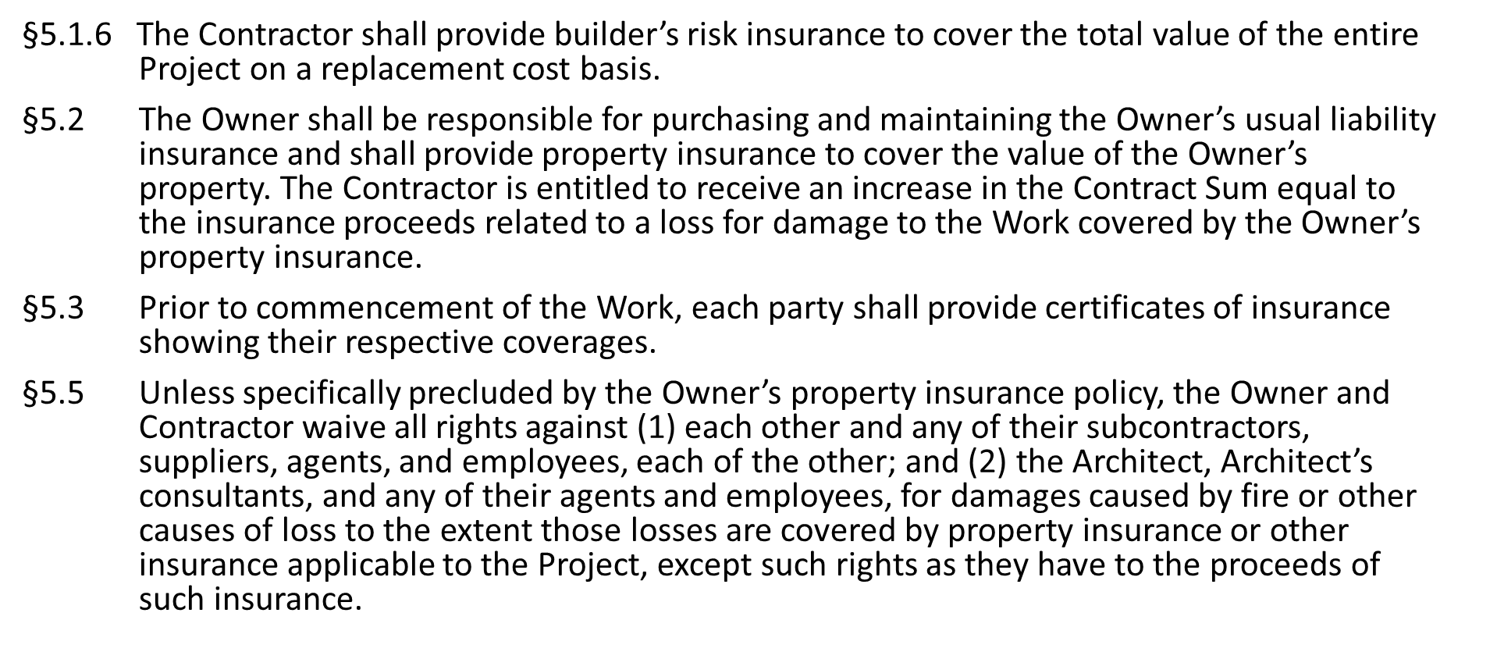
A105-2017

Slide 17
What Builder’s Risk Insurance is Not:
'
Standardized, one‐size‐fits‐all insurance that covers everything that could go wrong during construction

Slide 18
Structure of a Builder's Risk Policy

Slide 19
Four Main Components:
Declarations
Insuring Agreement
Lists insureds, insurer, policy number, covered property, policy limits, policy period, forms and endorsements.
States what policy covers.
Policy
Exclusions
Conditions
Provisions that eliminate coverage from Insuring Agreement (e.g. excluded causes of loss and property).
Obligations imposed on insured (e.g. file proof of loss, cooperate with insurer).

Slide 20
Every word has meaning:
Coverage for hundreds of millions of dollars of construction losses has turned on how courts interpreted the following terms (not a complete list):
“Collapse” | “Structure” | “Property of Others for
“Arising out of” | “Dwelling” | Which You are Liable”
“Caused by” | “Policy” | “Completed value”
“Occurrence” | “Application” | “Construction”
“Sudden and accidental” | “Property damage” | “Physical loss or damage”
“And” | “Subcontractor” | “Work”
“Or” | “Materialman” | “Contractor”
“Workmanship” | “Making good” | “Builder”
“Building materials” | “Resulting Damage” | “Owned by the insured”
“Pollutant” | “Occupancy” | “Similar property”
“You” | “Roof”
“Accident” | “Covered Property”
“Complete falling in” | “Loss”

Slide 21
Be Named as an Insured
Key reasons: Right to file claim directly against insurer and subrogation protection.
Confirm status as named insured on declarations and endorsements.
Note: A “loss payee” is not an insured.

Slide 22
Covered Property

Slide 23
 | Commonly Covered Property:
 | Building or structure under construction | Property stored off‐site Property of others
 | Foundations Fixtures and machinery Building materials and supplies onsite Temporary structures Property in transit | Office trailers Underground pipes Landscaping materials Personal property of insured or within insured’s care, custody and control (could include contractor’s tools)
 | © 2014 Seth D. Lamden Neal, Gerber & Eisenberg LLP |  | 13

Slide 24
 | Commonly Excluded Property:
 | Existing property Contractors tools, equipment, | Water Animals
 | and machinery (consider separate policy or coverage extension) Land, including fill and backfill materials at project site prior to commencement of the project Landscaping materials, including trees, grass, shrubbery, etc. | Waterborne and/or airborne property Motor vehicles, aircraft, and watercraft Signs Transmission or distribution lines, poles, towers and attached equipment Accounts, bills, currency,
 | Timber and crops | money, and securities
 | © 2014 Seth D. Lamden Neal, Gerber & Eisenberg LLP |  | 14

Slide 25
Covered Causes of Loss

Slide 26
Two Forms of Builder's Risk Policies:
“All Risk”: Covers direct physical loss from all causes except those that are expressly excluded in the policy.
“Specified Peril” or “Named Peril”: Covers direct physical loss from causes that are expressly stated in the policy.

Slide 27
Example of “All Risk” Insuring Agreement:
This Policy . . . insures against all risks of direct physical loss of or direct physical damage to Insured Property while at the construction site, stored off‐site, or in the course of transit within the Territorial Limits . . . during the Period of Insurance of each Insured Project.

Slide 28
Coverage for Losses Caused By Defective Design or Workmanship

Slide 29
Defective Design and Workmanship:
Most policies exclude coverage for some losses caused by faulty design and workmanship.
Wording (and scope of coverage) can vary significantly from policy to policy.
A few words could be the difference between full coverage and no coverage.

Slide 30
First, what is “workmanship”?
Defective completed product or performance of work (e.g. accident or equipment malfunction)?
Only defective completed product?
Ambiguous?

Slide 31
Scenario 1:
Insured Seeks Coverage for Cleanup Costs and Delay Damages Caused by Crane Collapse at Worksite Due to Operator’s Negligence
Court’s Interpretation of Exclusion:
Insured wins: Losses caused by crane collapse were covered because “faulty workmanship” refers to flawed products, not process of performing work.
See 1765 First Associates, LLC v. Cont’l. Cas. Co., 817 F. Supp. 2d 374
S.D.N.Y. 2011
Note: One month earlier, the Nevada Supreme Court had held that a contractor’s failure to properly secure a tarp, which resulted in water damage, was “faulty workmanship” because “workmanship” includes both defective products and defective processes.
Fourth St. Place v. Travelers Indem. Co., 270 P.3d 1235 (Nev. 2011)

Slide 32













London Market Design Exclusions (DE) and London Engineering Group (LEG) Model Exclusions
DE1:
DE2:
Extended Defective Condition Exclusion
DE3:
Limited Defective Condition Exclusion
DE4:
Defective Part Exclusion
DE5:
Design Improvement Exclusion
Outright Defect Exclusion
Least coverage
Most coverage
LEG 1/96
‘Outright’ Defects Exclusion
LEG 2/96 –
‘Consequences’ Defects Exclusion
LEG 3/06
‘Improvement’ Defects Exclusion

Slide 33
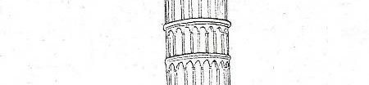
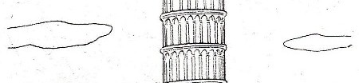
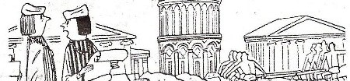
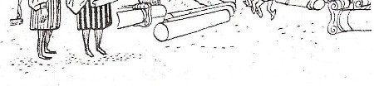
Scenario 2:
Mere Presence of Defect in Design, Plan, Specification, Materials, or Workmanship (New tower being built in Pisa, Italy).
“I skimped a little on the foundation, but no one will ever know it!!"

Slide 34
Scenario 2:
Mere Presence of Defect in Design, Plan, Specification, Materials, or Workmanship (New tower being built in Pisa, Italy).
DE1 (1995) Outright Defects Exclusion:
Covered Damage
“This policy excludes loss of or damage to the Property Insured due to defective design, plan, specification, materials, or workmanship.”
None
DE2 (1995) Limited Defective Condition Exclusion: DE3 (1995) Limited Defective Condition Exclusion: DE4 (1995) Defective Part Exclusion:
DE5 (1995) Design Improvement Exclusion:
“For the purpose of the Policy and not merely this Exclusion, the Property Insured shall not be regarded as lost or damaged solely by virtue of the existence of any defect in design, plan, specification, materials, or workmanship in the Property Insured or any part thereof.”
None

Slide 35




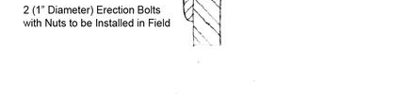


Scenario 3:
Defect Causes Physical Damage to Defective Property and Non‐ Defective Property
One temporary angle piece used during structural steel erection not compliant with specifications
As Designed As Built

Slide 36
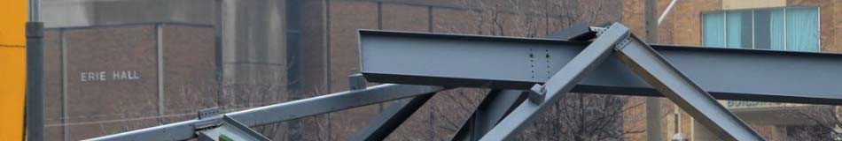
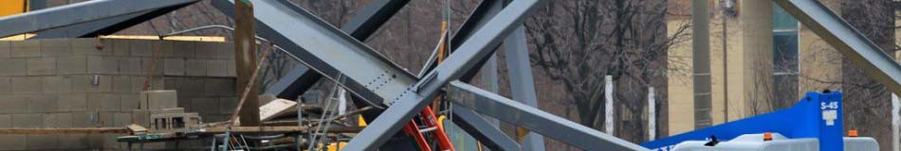
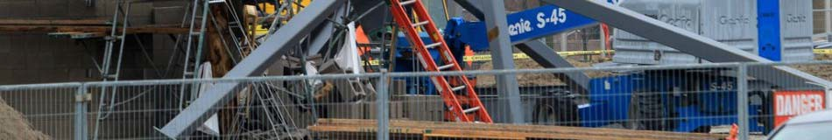

Scenario 3:
Defect Causes Physical Damage to Defective Property and Non‐ Defective Property
Angle piece fails, which leads to collapse of steel beam held in place by defectively‐installed piece.
Collapsed beam was on highest level of structure.
Weight of falling beam causes other beams to collapse, and also damages other property.
It is possible that other angle pieces were installed in the same defective manner.

Slide 37
Scenario 3:
Defect Causes Physical Damage to Defective Property and Non‐ Defective Property
DE1 (1995) Outright Defects Exclusion | Covered Damage
“This policy excludes loss of or damage to the Property Insured due to defective design, plan, specification, materials, or workmanship.” | None

Slide 38
Scenario 3: Defect Causes Physical Damage to Defective Property and Non‐ Defective Property
 | DE2 (1995) Extended defective condition exclusion | Covered Damage
 | “This policy excludes loss of or damage to and the cost necessary to replace, repair or rectify: | Not Covered: Defective angle
 | (a) Property Insured which is in a defective condition due to defect in | piece(s) that have
 | design, plan, specification, materials, or workmanship of such Property Insured or any part thereof; | not failed. Defective angle
 | (b) Property Insured which relies for its support or stability on (a) above; | piece that failed. Steel beam
 | (c) Property Insured lost or damaged to enable the replacement, repair, | supported by angle
 | rectification of Property Insured excluded by (a) and (b) above | piece that failed.
 | Exclusion (a) and (b) above shall not apply to other Property Insured
 | which is free of the defective condition but is damaged in consequence | Covered:
 | thereof. | All other property
 | For the purpose of the Policy and not merely this Exclusion, the Property | damage resulting
 | Insured shall not be regarded as lost or damaged solely by virtue of the | from failed angle
 | existence of any defect in design, plan, specification, materials, or | piece.
 | workmanship in the Property Insured or any part thereof.”
 | © 2014 Seth D. Lamden Neal, Gerber & Eisenberg LLP | 30

Slide 39
Scenario 3: Defect Causes Physical Damage to Defective Property and Non‐ Defective Property
 | DE3 (1995) Limited Defective Condition Exclusion | Covered Damage
 | “This policy excludes loss of or damage to and the cost necessary to replace, repair, or rectify: | Not Covered: Defective angle piece(s) that have not failed. Defective angle piece that failed. Covered: All other property damage resulting from failed angle piece, including steel beam held in place by angle piece that failed.
 | (a) Property Insured which is in a defective condition due to a defect in design, plan, specification, materials, or workmanship of such Property Insured or any part thereof;
 | (b) Property Insured lost or damaged to enable the replacement, repair, rectification of Property Insured excluded by (a) above
 | Exclusion (a) above shall not apply to other Property Insured which is free of the defective condition but is damaged in consequence thereof.
 | For the purpose of the Policy and not merely this Exclusion the Property Insured shall not be regarded as lost or damaged solely by virtue of the existence of any defect in design plan specification material or workmanship in the Property Insured or any part thereof.”
 | © 2014 Seth D. Lamden Neal, Gerber & Eisenberg LLP | 31

Slide 40
Scenario 3: Defect Causes Physical Damage to Defective Property and Non‐ Defective Property
 | DE4 (1995) Defective Part Exclusion | Covered Damage
 | “This policy excludes loss of or damage to and the cost necessary to replace, repair, or rectify: | Not Covered: Defective angle
 |  | piece(s) that have
 | (a)Any component part or individual item of the Property Insured which is defective in design, plant, specification, materials, or workmanship; or | not failed. Defective angle
 |  | piece that failed.
 | (b)Property Insured lost or damaged to enable the replacement, repair or
 | rectification of Property Insured excluded by (a) above.
 |  | Covered:
 | Exclusion (a) above shall not apply to other Property Insured which is free | All other property
 | of the defective condition but is damaged in consequence thereof. | damage resulting
 |  | from failed angle
 | For the purpose of the Policy and not merely this Exclusion, the Property | piece, including
 | Insured shall not be regarded as lost or damaged solely by virtue of the | steel beam held in
 | existence of any defect in design, plan, specification, materials, or | place by angle
 | workmanship in the Property Insured or any part thereof.” | piece that failed.
 | © 2014 Seth D. Lamden Neal, Gerber & Eisenberg LLP | 32

Slide 41
Scenario 3: Defect Causes Physical Damage to Defective Property and Non‐ Defective Property
 | DE5 (1995) Design Improvement Exclusion | Covered Damage
 | “This policy excludes: | Not Covered: Defective angle
 | (a) The cost necessary to replace repair or rectify any Property Insured | piece(s) that have
 | which is defective in design, plan, specification, materials, or workmanship. | not failed.
 | (b) Loss or damage to the Property Insured caused to enable replacement
 | repair or rectification of such defective Property Insured.
 |  | Covered:
 | But should damage to the Property Insured which is free of such defective | All other property
 | condition (other than damage as defined in (b) above) result from such a | damage resulting
 | defect this exclusion shall be limited to the costs of additional work | from failed angle
 | resulting from and the additional costs of improvement to the original | piece, including
 | design plan specification materials or workmanship. | steel beam held in
 |  | place by angle
 | For the purpose of the policy and not merely this Exclusion the Property | piece that failed
 | Insured shall not be regarded as lost or damaged solely by virtue of the | and defective angle
 | existence of any defect in design plan specification materials or | piece that failed.
 | workmanship in the Property Insured or any part thereof.”
 | © 2014 Seth D. Lamden Neal, Gerber & Eisenberg LLP | 33

Slide 42
Scenario 3:
Defect Causes Physical Damage to Defective Property and Non‐ Defective Property
What if the policy also excludes loss caused by “collapse” . . .
“We will not pay for loss caused by or resulting from . . . collapse, except as provided for in Coverage Extensions. But if loss by a Covered Cause of Loss results in collapse at the location(s) described in the Declarations, we will pay for that resulting loss.”
And defective workmanship is not a “covered cause of loss”?
“For the purpose of the policy and not merely this Exclusion the Property Insured shall not be regarded as lost or damaged solely by virtue of the existence of any defect in design, plan, specification, materials, or workmanship in the Property Insured or any part thereof.”
Is this policy ambiguous?
Is there coverage if it is ambiguous?

Slide 43
Coverage Extensions:
Can provide coverage for types of property or loss that would not otherwise be covered.
Some exclusions can be “bought back ”
Often subject to sub‐limits

Slide 44
Coverage For Construction Delays

Slide 45
Coverage For Construction Delays
Most policies expressly exclude soft cost coverage, but coverage can be purchased.
Even without express exclusion, coverage often limited to “hard costs” (repair of direct physical loss).
Costs included in insured value?

Slide 46
Example of “Soft Cost” Exclusion:
“This policy excludes consequential loss, damage or expense of any kind or description including but not limited to loss of market or delay, liquidated damages, performance penalties, penalties for non‐completion, delay in completion, or non compliance with contract conditions, whether caused by a peril insured or otherwise.”

Slide 47
Elements of a Covered Delay Claim:
Soft Costs Caused by Delay*
Covered Damage
Delay in Schedule
*Although policy language varies, in general, soft costs must be:
Resulting from covered physical damage;
Specifically described in the policy;
Actually incurred by insured;
Necessary and reasonable; and
Would not have been incurred but for the delay.

Slide 48
How Does a Deductible Work?
Insured pays
Example:
$1M
Covered $12M Loss
Insurer pays
$10M
$1M Deductible
Insured pays
$10M Policy Limit
$1M

Slide 49
When Does Coverage End?

Slide 50
When Does Coverage End?
Substantial Completion?
Acceptance by Purchaser?
Certificate of Occupancy?
End of Maintenance Period?
Policy Expiration Date?

Slide 51
Example of Policy Termination Clause:
Coverage will end when one of the following first occurs:
a.
b.
This policy expires or is cancelled;
The covered structure or building is accepted by
the purchaser;
Your interest in the property ceases;
You abandon the construction with no intention to complete it;
The structure of building has been completed for
c.
d.
e.
more than 90 days;
No work has been performed for at least 90 days.
f.

Slide 52
Using Commercial Property Insurance to Cover Construction Risks

Slide 53
Commercial Property Insurance
Lack of adequate coverage, including for property located off premises and while in transit. (i.e. lower limits, fewer specified perils, etc.).
Contractor is not an insured.
Claims could lead to increased premiums for owner, or disputes with contractor if owner does not want to make claim.

Slide 54
Buying a Builder’s Risk Policy

Slide 55


























Buying a Builder’s Risk Policy
Insureds
Property and Locations Covered Causes of Loss
Amount of Coverage
Project owner
All contractors and subcontractors (except soft cost/delay)
Other stakeholders?
Structure/construction site
Fixtures
Scaffolding and temporary structures
Tools and equipment
Off‐site storage
Property in transit
Existing property and land
Named peril or all risk?
Faulty design and workmanship –ensuing loss
Testing
Boiler and machinery
Collapse
Earth movement
Wear and tear – ensuing loss
Actual cash value or replacement value
Demolition and increased cost of construction
Limits, sublimits and deductibles: per occurrence and aggregate
Estimated value or contract price
Additional Coverage
Subrogation
Termination of Coverage
Delay in Completion
Debris removal
Expediting expenses
Expense to reduce loss or delay
Pollution
Terrorism
Law and ordinance
Claim preparation expenses
Insured permitted to waive recovery rights against others before loss
Waiver of subrogation
Policy expiration
Occupancy
Acceptance by owner
Other specified event
Loss of income/rent
Soft costs
Expense incurred to reduce delay
Indemnity period: commencement and expiration

Slide 56

Absent Notice You May Get “Shafted” On Consequential Damages
Hadley v. Baxendale, 9 Ex. 341, 156 Eng.Rep. 145 (1854), is the leading common law case on liability for consequential damages caused by failure or delay in carrying out a commercial undertaking.
The engine shaft in plaintiffs' corn mill had broken and they hired the defendants, a common carrier, to transport the shaft to the manufacturer, who was to make a new one using the broken shaft as a model. The carrier failed to deliver the shaft within the time promised. With the engine shaft out of service the mill was shut down. The plaintiffs sued the defendants for the lost profits of the mill during the additional period that it was shut down because of the defendants' breach of their promise. The court held that the lost profits were not a proper item of damages, because “in the great multitude of cases of millers sending off broken shafts to third persons by a carrier under ordinary circumstances, such consequences (the stoppage of the mill and resulting loss of profits) would not, in all probability, have occurred; and these special circumstances were here never communicated by the plaintiffs to the defendants.” 9 Ex. at 356, 156 Eng.Rep. at 151.
Evra Corp. v. Swiss Bank Corp., 673 F.2d 951, 955 (7th Cir. 1982)
The rule of Hadley: Consequential damages will not be awarded unless the defendant was put on notice of the special circumstances giving rise to them.

Slide 57
Waiver of Claims for Consequential Damages
Damages incurred by the Owner for rental expenses, for loss of use, income, profit, financing, business and reputation, and for loss of management or employee productivity or of the services of such persons,
and
Damages incurred by the Contractor for principal home office expenses including the compensation of personnel stationed there, for loss of financing, business, and reputation, and for loss of profit except for anticipated profit arising directly from the work.

Slide 58
Consequential Damages Waivers – Pump the Brakes
Keystone Airpark Auth. v. Pipeline Const., Inc., 2019 Fla. App. LEXIS 961; 44 Fla. L. Weekly D 304; 2019 WL 323775
Airpark sues engineer – Theories limited to CA and evaluation of suitability of materials. Primary damages were repair of deteriorating taxiways and hangar.
Holding – Completely barred by consequential damages waiver in favor of engineer. Damages do not necessarily flow from breach.
Waiver is not against public policy when parties are sophisticated.

Slide 59
Consequential Damages Waivers
Reserve Bank of Richmond v. Wright, 392 F.Supp. 1126, 1131 (E.D. Va. 1975) (finding a property owner's cost to correct structural defects that resulted from defective plans prepared by an architect constituted indirect damages);
McCloskey & Co., Inc. v. Wright, 363 F.Supp. 223, 226 n. 1, 230 (E.D. Va. 1973) (finding the cost to repair a leaking roof caused by an architect's defective plans constituted consequential or incidental damages).

