Slide 1
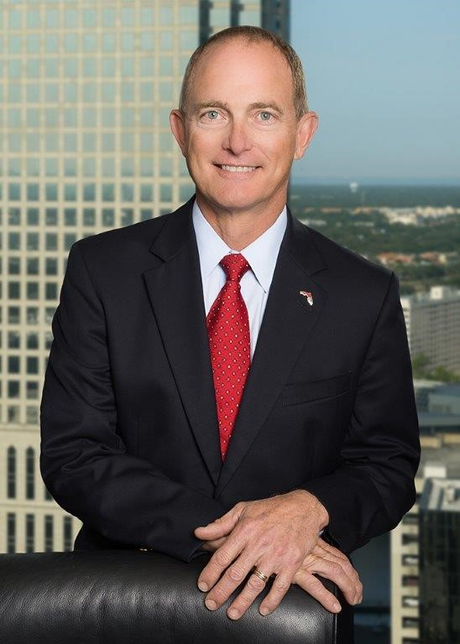
“The Care and Feeding of Your Mediator”
George Spofford Law, P.A.
Gspofford@GspoffordLaw.com
(813)390-1524

Slide 2
My Background
  35 years as a construction litigator
  Board Certified in Construction Law
  Former owner of $40MM/ year heavy civil construction company
  Certified Mediator
  Certified Arbitrator
  FDOT Disputes Review Board Panelist
  Statewide practice
h rather than Judges and opposing counsel.
George Spofford Law, P.A.
Gspofford@GspoffordLaw.com
(813)390-1524

Slide 3
But wait! There’s more!
George Spofford Law, P.A.
Gspofford@GspoffordLaw.com
(813)390-1524

Slide 4

“Retired” from Gray Robinson, P.A. in September to focus on annoying Caribbean bartenders and gamefish rather than continuing to annoy judges and opposing counsel.

Slide 5
Purpose of today’s presentation
Intended to provide litigation counsel with insights to improve the odds for a successful mediation.
George Spofford Law, P.A.
Gspofford@GspoffordLaw.com
(813)390-1524

Slide 6
Three phases of mediation for today’s presentation:
Prior to the mediation
During the mediation
After the mediation
George Spofford Law, P.A.
Gspofford@GspoffordLaw.com
(813)390-1524

Slide 7
Prior To The Mediation
  Seems Obvious, but…..
    Know the law
    Know your facts
    Know your damages
    Be realistic regarding your damages
    Written mediation statement vs an outline
    Manage client expectations
      Be realistic and have the frank discussion prior to the mediation
George Spofford Law, P.A.
Gspofford@GspoffordLaw.com
(813)390-1524

Slide 8
  Prior to the Mediation (Con’t)
    Is the mediation merely checking a box?
    Identify challenges to settlement
      Personalities (my client/opposing counsel/the mediator is a jackass)
      Experience of opposing counsel
      Emotions
      Monetary
      Politics- Public entity or private entity
      Need for additional discovery
      Identify significant legal issues
      Identify whether the parties are gamblers or risk adverse
George Spofford Law, P.A.
Gspofford@GspoffordLaw.com
(813)390-1524

Slide 9
    Prior to the Mediation (Con’t)
    Identify “Levers”
      Monetary
      Key witnesses no longer with the client
      Previously mentioned-
        Limitation of liability clause- worked both ways
        Whether can bind non-signing spouse
      DPBR involvement if negative verdict
George Spofford Law, P.A.
Gspofford@GspoffordLaw.com
(813)390-1524

Slide 10
    Prior to the Mediation (Con’t)
    Solutions
      Money vs Something else
      Future business opportunities,
      Wacky ideas- Don’t be constrained by reality
      Identify the undisputed facts
      Do not fear the partial settlement
George Spofford Law, P.A.
Gspofford@GspoffordLaw.com
(813)390-1524

Slide 11
At the Mediation
  Actually listen
    To opposing counsel
    To opposing party
    To the mediator
  The lawyer is the advocate and counselor, but the client is the decision maker
  I almost always ask rhetorically, “How much do you think this will cost to get to trial?”
  Be patient
    Let the parties vent
    Let your mediator see the body language
    Let your mediator build rapport with you and your client, rather than go straight to the numbers
George Spofford Law, P.A.
Gspofford@GspoffordLaw.com
(813)390-1524

Slide 12
  At the Mediation (Con’t)
  Be creative
    Broke defendant, but useful specialty equipment
    It might not be about the money
  Take a partial settlement if that’s all that can be accomplished
  If facts in dispute, recess for limited discovery
  Bring a template settlement agreement with your favorite clauses
George Spofford Law, P.A.
Gspofford@GspoffordLaw.com
(813)390-1524

Slide 13
After the Mediation
  Pay your mediator or die!
George Spofford Law, P.A.
Gspofford@GspoffordLaw.com
(813)390-1524

Slide 14
Questions?
Comments?
Curses?
George Spofford Law, P.A.
Gspofford@GspoffordLaw.com
(813)390-1524

