Slide 1
Climate Issues and Shoreline Management
State and Local Level
Climate Change Considerations for
Development
Aaron C. Dunlap
adunlap@carltonfields.com

Slide 2
Specific Issues We’ll Discuss
Seawalls
FEMA Flood Maps
Water and Sewage Considerations
Usage, Septic, Saltwater Intrusion
State/Local Political Challenges
Costs: Infrastructure, Impact Fees, & Other

Slide 3
What Types of Clients Will Be Affected
Developers
Large-scale, small scale, boutique builders
Condominium
Contractors/Builders
Purchasers
Everyone in Your Firm (transactional, litigation)
Lenders
Institutional
Traditional
Mezzanine
Governmental
Insurers
Investors/Bond Markets
Everyone in Your Firm (personal)

Slide 4
Goals for Today
Raising Awareness:
What CURRENTLY impacts your clients.
Do they know? Are they considering?
What MAY affect your clients and their collateral/business?
Proper planning? Strategy in place?
What WILL affect your client?
It’s coming, are you and your client ready to address the issues?

Slide 5
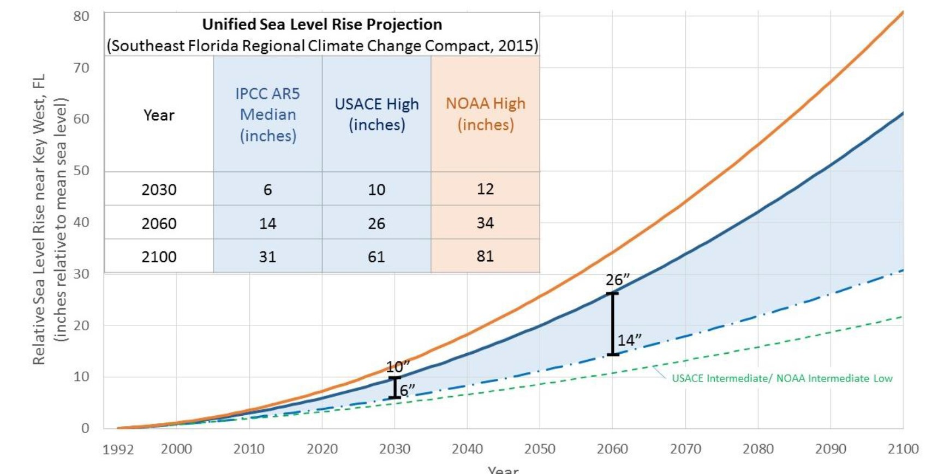
Seawalls

Slide 6
Seawalls
South Florida Regional Climate Change Compact (2015)
If seawalls are already being topped on king tides and during storm surge now, add 3 feet to it and would a seawall be of any use at all?
Adding to an existing seawall versus new seawall – all an individual examination.
Costs, physical integrity.
Approvals.
Time.
Regulations.
Min/Max heights, new ordinances.

Slide 7
Seawalls
Example – 2016 Ft. Lauderdale study during implementation of their new seawall ordinance:
Fort Lauderdale owns 4 miles of seawall (~21,000 linear feet).
Cost for raising seawall height to total replacement of seawalls ranged from $2M to $26M ($95/linear ft to $1,200/linear ft).
Polled local seawall contractors for possible individual homeowner costs on reconstruction/repair:
“They quoted $650-$2000 per linear foot depending on the depth of the waterway and location of the seawall. Engineering and permitting services were $2000-$5000 per job. Repair of broken/spalled concrete areas in the cap $60 per cubic foot of epoxy mortar. To add a 12” cap to an existing seawall is estimated at $75 - $125 per linear foot.”

Slide 8
Seawalls
FL SB 7016: Statewide Office of Resiliency within Governor's office.
Passed by the Senate, died in the House.
Proposed a sea level rise taskforce.
Did you know about this? Did your clients know about this?
Did they work to influence:
Members?
Goals/Outcomes?
Ideas?
Will they next year?

Slide 9
FEMA Flood Maps
What is a FEMA Flood Map?
“Official public source for flood hazard information produced in support of the National Flood Insurance Program (NFIP).”
– FEMA Flood Map Service Center
20,000 Communities participate in the National Flood Insurance Program.
Each community broken down into a number of maps which show flood hazard areas, base elevation of that area, etc.

Slide 10
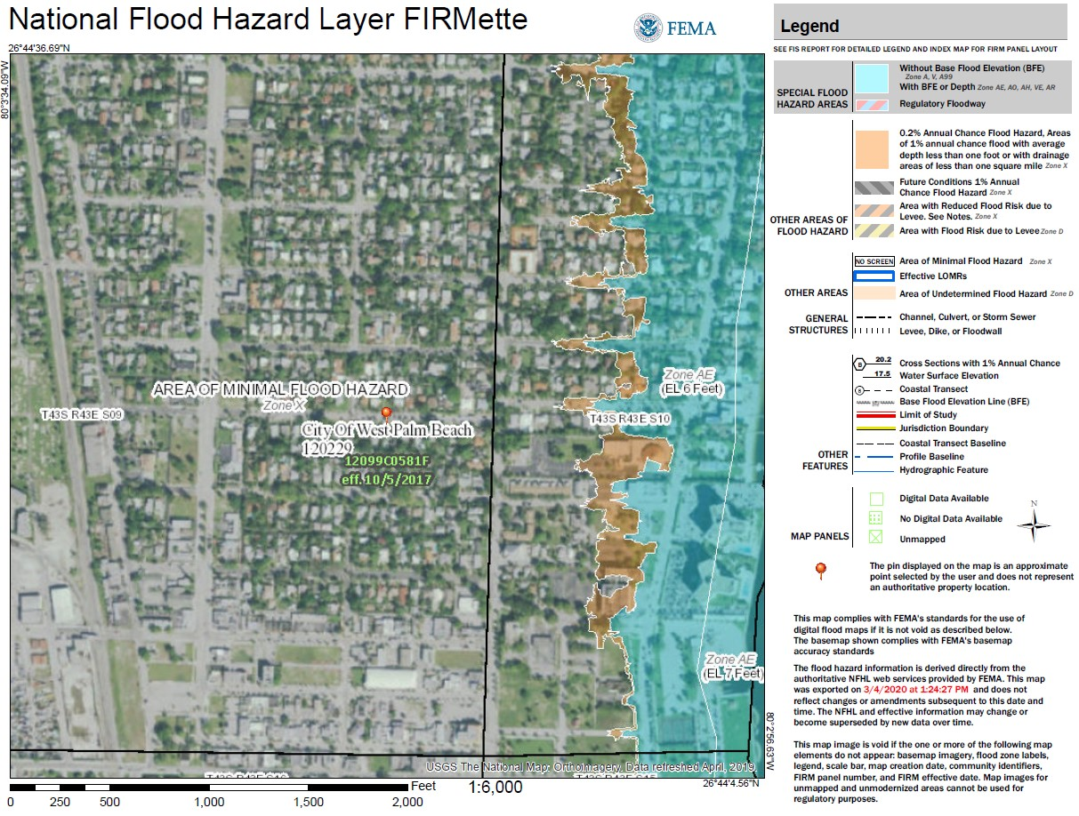
FEMA Flood Maps

Slide 11
FEMA Flood Maps - Amendments
FEMA initiated map amendments.
Only focuses on those areas where development is the greatest with the most outdated maps.
Local government initiated amendments.
Changes to Special Flood Hazard Map Area (1%+ annual chance of flooding).
Nat’l Flood Ins. Program Community initiated.
Updated through hydrologic/hydraulic modeling, mapping, floodplain boundary changes, topographic changes, etc.

Slide 12
FEMA Flood Maps - Amendments
Done Through Physical Map Edit or Letter Revision.
Physical Map Revision – where one or more panels are completely revised and republished.
Community comment period, 6 month compliance period to update ordinances.
Incredibly time intensive and affects greatest number of people.
18 month process. All supporting data is updated and the whole map panel is redone. Not regularly done. Must be requested by “CEO of community.”

Slide 13
FEMA Flood Maps - Amendments
Letter of Map Revision (LOMR).
Official modification to an effective Flood Insurance Rate Map (FIRM). LOMRs can result in a physical change to the existing regulatory floodway, the effective Base Flood Elevations (BFEs), or the Special Flood Hazard Area (SFHA). Smaller areas included, so affects fewer people, smaller area of data and modeling.

Slide 14
FEMA Flood Maps - Amendments
Actual map revisions must be initiated through the local government.
However – owners can petition to change a property’s Flood Zone Designation.
Submit application to FEMA for a formal determination of location/elevation in relation to an identified Special Flood Hazard Area (1% chance or greater of flooding in any given year, i.e. the 100 year floodplain).
After FEMA reviews the map change request, it will issue a Determination Document, either approving or denying the map change. If FEMA grants the map amendment or revision request, the property owner may no longer be required to pay flood insurance. The property owner may send the Determination Document to their lender and request that the federal flood insurance requirement for the structure be removed. (https://www.fema.gov/change-flood-zone-designation-online-letter-map-change)

Slide 15
Water and Sewage
Water Use
In Florida Managed by Water Management Districts via consumptive use permits.
What water is actually available, beneficial uses, alternative sources, etc.
Consumptive use permits can be locked in years in advance.
Sector Plans – may obtain permits for duration of the long-term master plan (ex., Deseret Ranch’s LTMP has a build-out date of 2070).

Slide 16
Water and Sewage
Water bottlers – Currently $115 permit fee for right to take almost 1M gallons/day.
CS/CS/SB 712 (Environmental Resource Management) includes a provision that requires the Department of Environmental Protection to coordinate with water management districts and conduct a study on the bottled water industry and what springs are being used for bottled water, minimum flows, impacts, conservation measures, economic impacts and costs, and a cost benefit analysis on the industry and use of springs in Florida.
Must complete a report with findings by 6/2021.

Slide 17
Water and Sewer
This arose from media attention connected to a renewal permit that was pending on the west coast of Florida.
Permit was for 1M+ gallons/day, and that permit holder currently, and would continue, to sell the water to Nestle for bottling.
Amount of water at permit max would be 8.7M bottles of water/day.
Staff recommendation to Suwannee WMD board to deny permit. Already administrative challenge to DOAH, so everything still pending.
Ongoing disagreement over agricultural versus bottling versus environmental versus economics/jobs.
https://www.nytimes.com/2020/03/08/business/nestle-florida-water.html; https://www.ocala.com/news/20200309/nestl-decision-on-hold-after-springs-owners-file-petition

Slide 18
Water and Sewage
Another water and sewer bill that passed this past session was CS/CS/HB1091 Environmental Accountability.
The bill increased and clarified various statutory penalties for violations of environmental laws, including specifying that for certain violations each day during any portion of which the violation occurs constitutes a separate offense.
Specifying that each day the cause of an unauthorized discharge of domestic wastewater is not addressed constitutes a separate offense until the violation is resolved by order or judgment.
With respect to sanitary sewer laterals (the portion of the sewer network connecting individual private properties to the public sewer system) the bill encouraged each county and municipality to establish an evaluation and rehabilitation program for sanitary sewer laterals on residential and commercial properties within the county’s or municipality’s jurisdiction to identify and reduce extraneous flow from leaking sanitary sewer laterals by July 1, 2022.
Requires a seller of real property, before executing a contract for sale, to disclose to a prospective purchaser any known defects in the property’s sanitary sewer lateral.

Slide 19
Saltwater Intrusion
Saltwater Intrusion into coastal freshwater aquifers.
Hydraulic connection between groundwater and saltwater. Freshwater pushes towards saltwater, and vice versa. Increase in pumping, reduces the groundwater push, causing saltwater to intrude farther inland into the water table.
Lower quality, and in extreme cases, forced to abandon the sources.
Sea-level rise exacerbates the problem, moving transition zones and saline ground water further inland.
Remember – 90% of drinking water in Florida comes from ground water.
(https://www.usgs.gov/mission-areas/water-resources/science/saltwater-intrusion?qt-science_center_objects=0#qt-science_center_objects)

Slide 20
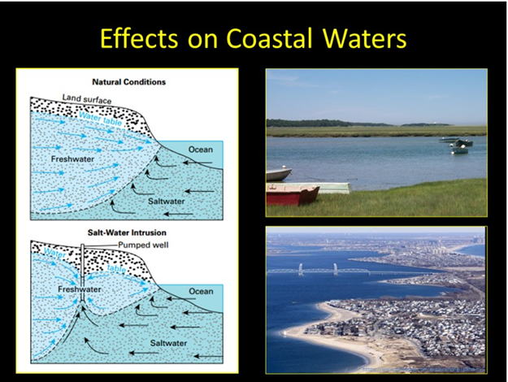
Saltwater Intrusion

Slide 21
Saltwater Intrusion
Storm surge also impacts saltwater intrusion
6 months post-Hurricane Dorian, Grand Bahama is struggling for fresh water.
30 foot storm surge.
Overflowed into drinking wells.
Still salty today.
Unuseable for drinking and cooking.
Also impacts on trees, plants, groundcover which die off post-surge.
Geographic features of South Florida and Bahamas are almost identical.
https://www.wlrn.org/post/six-months-after-dorian-grand-bahama-scrambles-clean-drinking-water#stream/0

Slide 22
State and Local Political Challenges
In Florida – Local Actually Means STATE and Local.
Annual Preemption Battles.
How are these affecting local government resiliency regulations?
Does your client have a plan in place to influence both local and state?
Administrative Regulations.
Florida Administrative Code Rules Fights.
Does your client know if administrative rules are being changed? Part of the process?
Inter-Agency Battles via Cabinet and Legislature.
Most recently has played out with Dep’t of Ag. and Legislature re. Florida Office of Energy (energy policy and program development).
Connections/reliance they have now may not be there in a year.

Slide 23
State and Local Political Challenges Administrative Agency Deference No More
2018 Florida Constitution Revision Commission placed a bundled amendment on the ballot, ultimately approved by the electorate.
Florida Constitution, Article V, Section 21:
In interpreting a state statute or rule, a state court or an officer hearing an administrative action pursuant to general law may not defer to an administrative agency’s interpretation of such statute or rule, and must instead interpret such statute or rule de novo.
Applies to administrative law judges as well for DOAH hearings.

Slide 24
Local Political Challenges
Local Development/Use that’s actually regulated on the state level:
Septic Issues – Department of Health.
Water Consumptive Use – Regional Water Management Districts.
Agricultural Best Management Practices – Dep’t of Agriculture (very limited exceptions)
Nutrient management (fertilizer & manure).
Irrigation management.
Water resource protection.
Florida Right to Farm Act – restricts local government regulation of agricultural activity related to water quality if following state level BMP recommendations.

Slide 25
Local Political Challenges – What Does it Mean?
What the client doesn’t know can hurt them:
Are there pending ordinances concerning resiliency issues they’re not considering?
New local infrastructure requirements for public improvements?
Road elevations, drainage requirements, stormwater requirements, seawall requirements.
Definitional changes on how density/intensity is calculated or heights are considered?
Open, non-livable first floors not counting towards floor height?
Increase in base elevation of pads?
Do they have someone tracking ordinances/legislation? Proactive vs. Reactive

Slide 26
Local Political Challenges – What Does it Mean?
What can the client do?
Proactive discussions with staff and commission regarding:
Pending and recently passed ordinances.
Initiating/negotiating beneficial code changes.
Getting engaged in the local governmental processes.
Meeting a wall? Question if local action is warranted/the best option?
Charter County.
Consider state-level action:
Get an agency involved.
Planning legislative changes.

Slide 27
Resiliency and Increased Costs
Changes in Infrastructure Requirements = Increase in Costs.
Raising Roads.
Stormwater management components.
Changes in potable water and sewage requirements:
Depth of pipes, change in types of pipes.
Lift station mechanics changes.
Location of improvements.
Water Reuse Requirements.
Desalination or Reverse Osmosis.
Community Development District/Special District Bonds

Slide 28
Resiliency and Increased Costs
Municipal/CDD bond rates.
Landscaping/buffering.
Stormwater.
Setbacks.
Easements
More or larger easements? Changes in flood areas?
Changes in actual development requirements.

Slide 29

Contact Information
Aaron C. Dunlap
Attorney at Law
Florida Bar Board Certified in City, County and Local Government Law
215 S. Monroe St., Ste. 500
Tallahassee, Florida 32301-1866
Direct: 850.425.3395 | Fax: 850.222.0398
ADunlap@carltonfields.com
www.carltonfields.com
bio | vcard

