Slide 1
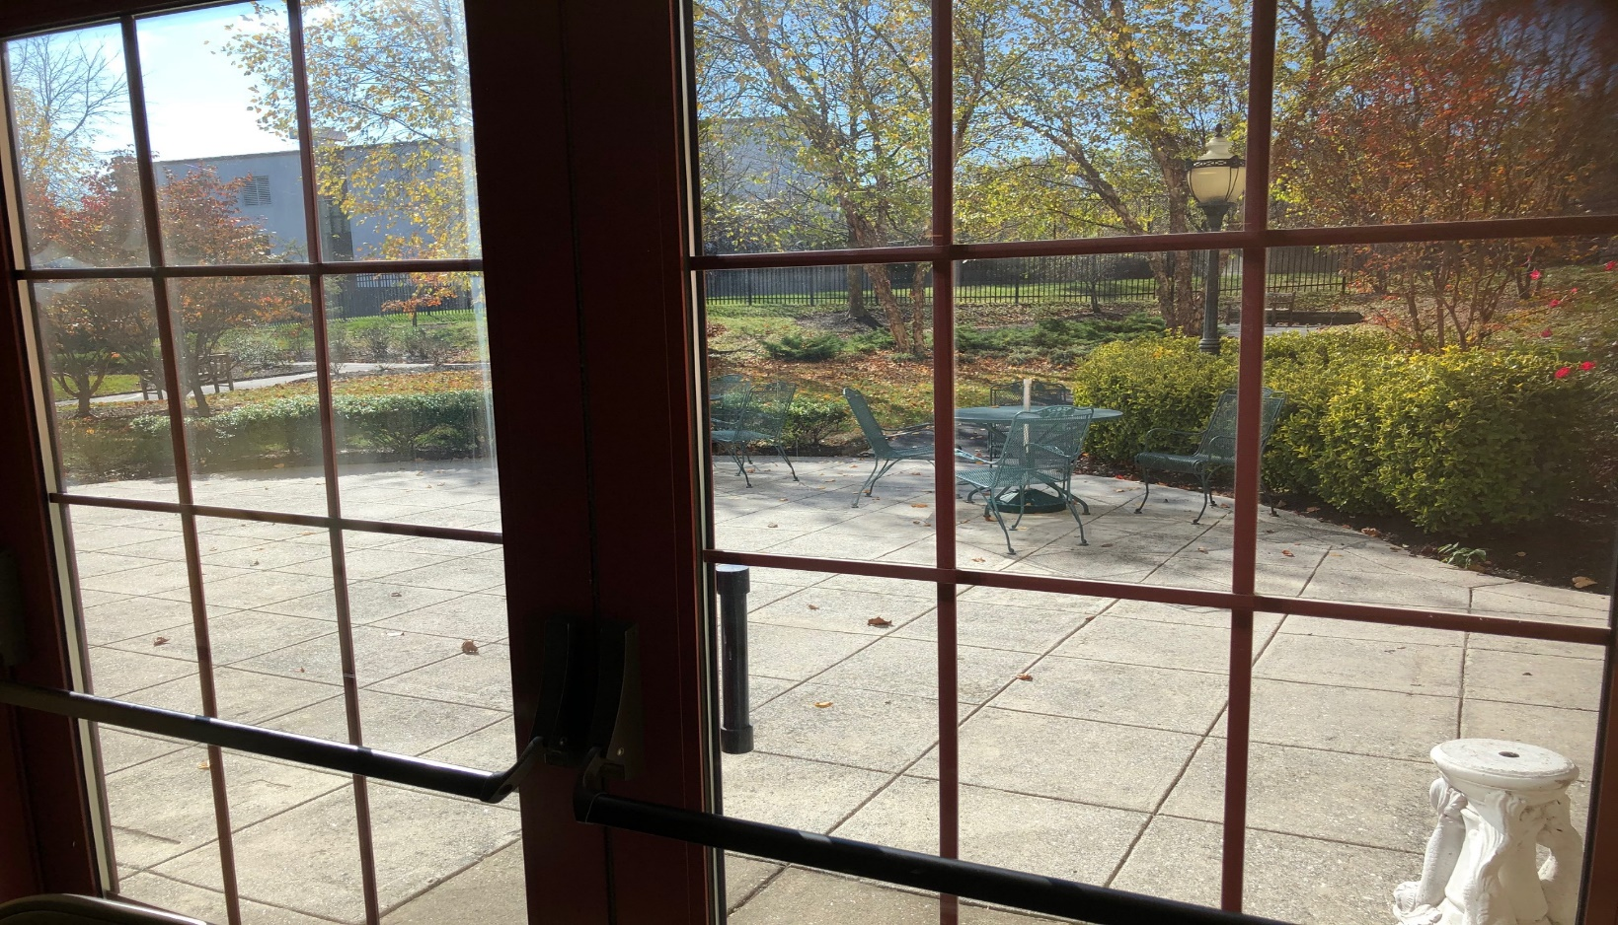
COVID19 :: LESSONS FROM THE FIELD
EMERGING ISSUES THAT CONFRONT:
O C C U P I E D
R E N O V A T I O N S
www.ceag2.com

Slide 2
COVID19 :: LESSONS FROM THE FIELD
AGENDA:
- Quick introductions
- Real issues from a specific client
- Client overview
- Event tracking in real time
- Material sourcing
- Training
- Compliance
- Wrap-up Q&A
www.ceag2.com

Slide 3
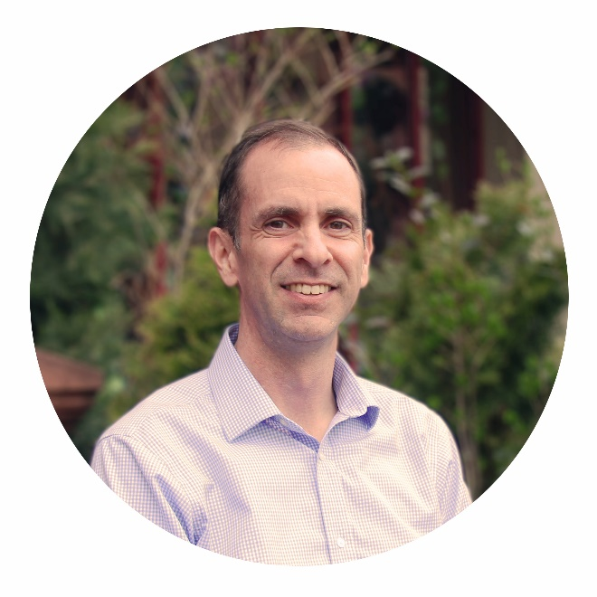

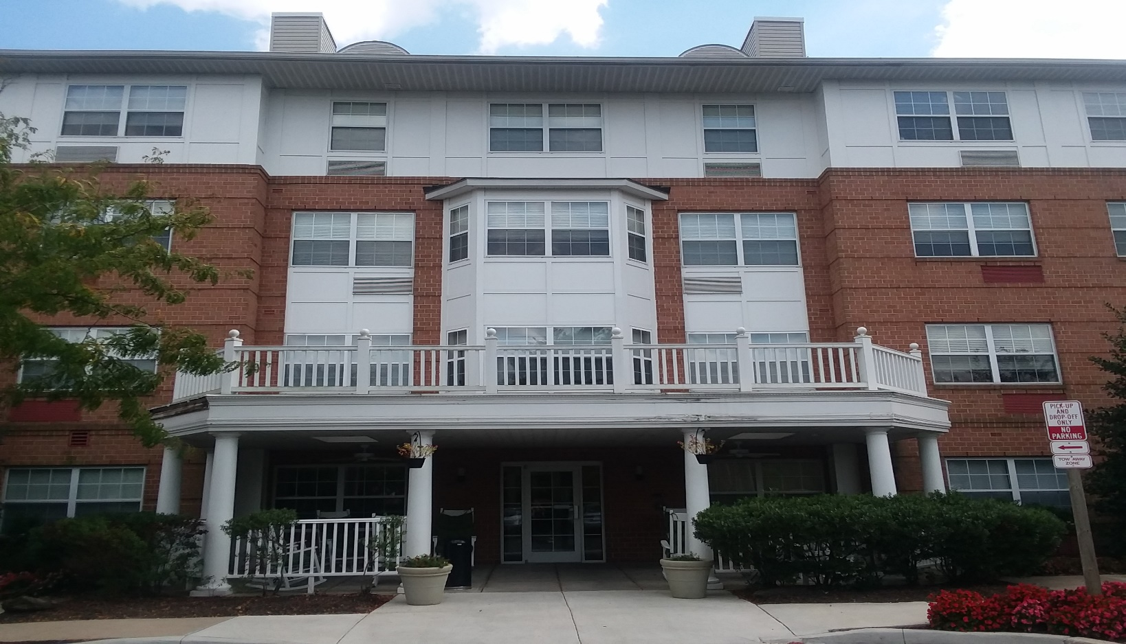
COVID19 :: LESSONS FROM THE FIELD
Russ Robertson is a former practicing architect with a business degree from The Wharton School.
r u s s @ c e a g 2 . c o m 4 4 3 . 8 5 0 . 5 9 5 6
Cailin McGough is a former non-profit developer with a degree in public policy from Johns Hopkins.
c a i l i n @ c e a g 2 . c o m 2 4 0 . 7 0 7 . 1 5 1 5
www.ceag2.com

Slide 4
COVID19 :: LESSONS FROM THE FIELD
AGENDA:
- Quick introductions
- Real issues from a specific client
- Client overview
- Event tracking in real time
- Material sourcing
- Training
- Compliance
- Wrap-up Q&A
www.ceag2.com

Slide 5
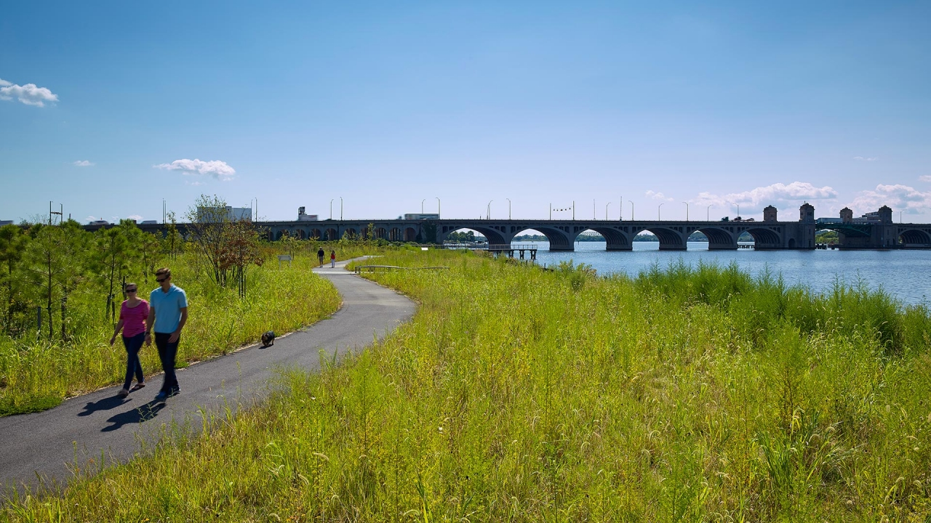
CLIENT NAME: “ABC CORPORATION”
C L I E N T O V E R V I E W :
1
Developer of age/income-restricted communities
Significant regional presence
(150+communities, several thousand units)
Funded by LIHTC, tax-exempt bonds, etc.
Occupied renovations for each site every 15 years
2
3
4
www.ceag2.com

Slide 6
CLIENT NAME: “ABC CORPORATION”
C O V I D 1 9 R I S K S :
1
Workers and elderly residents in proximity
PPE available, but on a limited basis
(PR: Should construction compete for resources?)
Necessary delay v. funding timing
Is “assumed” diagnosis a form of discrimination?
2
3
4
www.ceag2.com

Slide 7
COVID19 :: LESSONS FROM THE FIELD
AGENDA:
- Quick introductions
- Real issues from a specific client
- Client overview
- Event tracking in real time
- Material sourcing
- Training
- Compliance
- Wrap-up Q&A
www.ceag2.com

Slide 8
E V E N T T R A C K I N G :
ABC seeks real time information from 9 active jobsites.
Reports to be filed daily by G.C.’s project management team. (Administrative burden? Cost?)
Reports allow ABC to adjust, reallocate resources among jobs, proactively negotiate political solution(s) to permit/inspection impacts, etc.
TRACKED COVID19 ITEMS:
- Pricing complications (gouging)
- Procurement problems (supply chain)
- Labor disruptions (call outs)
- Moratoriums on construction
- Inability to obtain inspections
- Permit review issues
- Fed/State financing inspections
www.ceag2.com

Slide 9
COVID19 :: LESSONS FROM THE FIELD
AGENDA:
- Quick introductions
- Real issues from a specific client
- Client overview
- Event tracking in real time
- Material sourcing
- Training
- Compliance
- Wrap-up Q&A
www.ceag2.com

Slide 10
M A T E R I A L S O U R C I N G :
ABC seeks early procurement of materials & supplies.
Complications:
- Conditioned storage
- Financing limits
- Potential out-of-pocket purchase
- Implications for Builder’s Risk
- The “two-path” problem
- Nervous contractor (payment)
- Impropriety
TRACKED COVID19 ITEMS:
- Approved? (outstanding submittals?)
- Released? (contractor release subs to buy?)
- Date needed? (what about ordinary long leads?)
- Is material/supply already onsite?
- Onsite v. offsite? (onsite typ allowed by lenders)
- Conditioned v. unconditioned (mold, humidity)
- Insurance cert, bill of sale, affidavit, etc.
www.ceag2.com

Slide 11
COVID19 :: LESSONS FROM THE FIELD
AGENDA:
- Quick introductions
- Real issues from a specific client
- Client overview
- Event tracking in real time
- Material sourcing
- Training
- Compliance
- Wrap-up Q&A
www.ceag2.com

Slide 12
T R A I N I N G :
ABC seeks a training system for workers and site visitors.
Complications:
- Logistics
- Frequency
- Speed
Opportunity:
- Integrate with GC’s typ training
WHAT ARE THE “REAL” QUESTIONS?
www.ceag2.com

Slide 13
T R A I N I N G :
ABC seeks a training system for workers and site visitors.
Complications:
- Logistics
- Frequency
- Speed
Opportunity:
- Integrate with GC’s typ training
WHAT ARE THE “REAL” QUESTIONS?
A training system based on what standard(s)?
www.ceag2.com

Slide 14
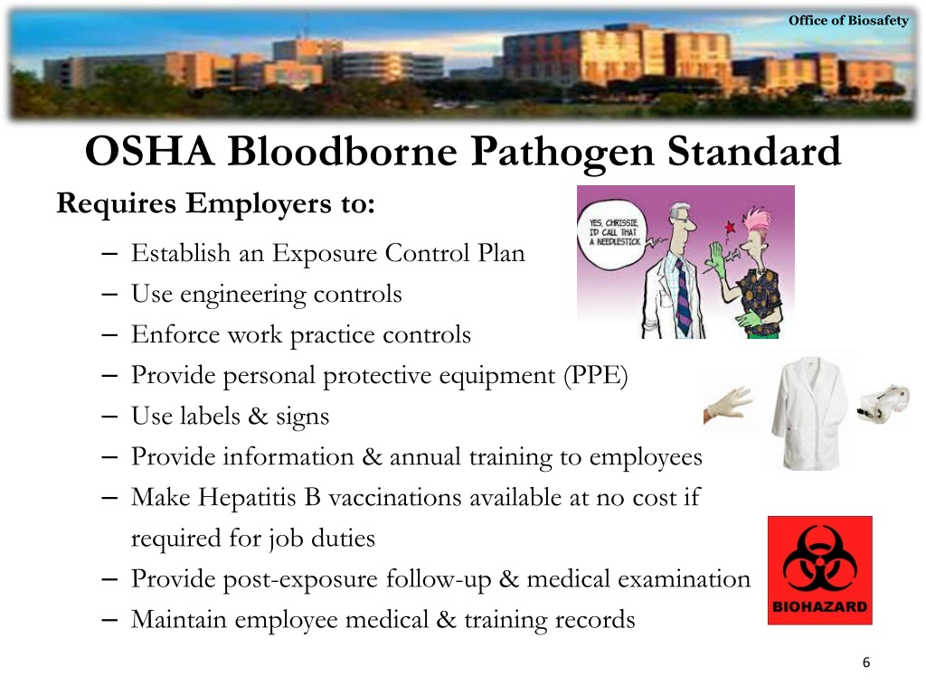
T R A I N I N G :
ABC seeks a training system for workers and site visitors.
Complications:
- Logistics
- Frequency
- Speed
Opportunity:
- Integrate with GC’s typ training
www.ceag2.com

Slide 15
T R A I N I N G :
ABC seeks a training system for workers and site visitors.
Complications:
- Logistics
- Frequency
- Speed
Opportunity:
- Integrate with GC’s typ training
WHAT ARE THE “REAL” QUESTIONS?
Exactly who are these workers? What are their roles?
What does their daily routine look like?
www.ceag2.com

Slide 16
T R A I N I N G :
ABC seeks a training system for workers and site visitors.
Complications:
- Logistics
- Frequency
- Speed
Opportunity:
- Integrate with GC’s typ training
Typical daily routine:
Arrive on site.
Enter building. (same entry as residents?)
Visit field office. (vacant unit? onsite trailer?)
Gather tools/materials.
Proceed to vacant units where work will occur.
Back-n-forth between units and staging area(s).
Use common corridors/stairs? No elevator.
Lunch/restroom breaks. Designated area(s).
Trash removal or clean-up. (personal v debris)
Return tools/materials.
Leave the site.
www.ceag2.com

Slide 17
T R A I N I N G :
ABC seeks a training system for workers and site visitors.
Complications:
- Logistics
- Frequency
- Speed
Opportunity:
- Integrate with GC’s typ training
WHAT ARE THE “REAL” QUESTIONS?
Can/should ABC limit access to non-essential site visitors? Who are these groups? Architects, inspectors, property management, ABC personnel, etc.
Do these groups need training?
www.ceag2.com

Slide 18
T R A I N I N G :
ABC seeks a training system for workers and site visitors.
Complications:
- Logistics
- Frequency
- Speed
Opportunity:
- Integrate with GC’s typ training
WHAT ARE THE “REAL” QUESTIONS?
Should ABC hire a specialist to handle logistics of designing and implementing a training program?
What logistics?
www.ceag2.com

Slide 19
T R A I N I N G :
ABC seeks a training system for workers and site visitors.
Complications:
- Logistics
- Frequency
- Speed
Opportunity:
- Integrate with GC’s typ training
Should training be in writing or video? BOTH?
?
WHAT ARE THE “REAL” QUESTIONS?
+
Does the trainer train the GC and all subs?
Does the GC train its subs?
?
?
+
+
?
Should ABC hire a specialist to handle logistics of designing and implementing a training program?
What logistics?
?
How do you prove training was received?
Stickers on hard hats? Badges?
?
+
Is training different for contractors and site visitors? SAME?
?
+
?
?
?
?
+
Is the training bi-lingual?
Is the training different for vacant v. occupied space(s)?
www.ceag2.com

Slide 20
T R A I N I N G :
ABC seeks a training system for workers and site visitors.
Complications:
- Logistics
- Frequency
- Speed
Opportunity:
- Integrate with GC’s typ training
How does ABC strike the balance between implementing “serious” protocols while making the protocols seem “easy” for anyone to follow?
WHAT ARE THE “REAL” QUESTIONS?
+
+
Should ABC hire a specialist to handle logistics of designing and implementing a training program?
What logistics?
?
?
?
+
www.ceag2.com

Slide 21



T R A I N I N G :
ABC seeks a training system for workers and site visitors.
Complications:
- Logistics
- Frequency
- Speed
Opportunity:
- Integrate with GC’s typ training
How does ABC strike the balance between implementing “serious” protocols while making the protocols seem “easy” for anyone to follow?
WHAT ARE THE “REAL” QUESTIONS?
+
+
Should ABC hire a specialist to handle logistics of designing and implementing a training program?
What logistics?
?
?
?
+
www.ceag2.com

Slide 22
T R A I N I N G :
ABC seeks a training system for workers and site visitors.
Complications:
- Logistics
- Frequency
- Speed
Opportunity:
- Integrate with GC’s typ training
WHAT ARE THE “REAL” QUESTIONS?
What is the right frequency for training?
One-n-done? Repeated on a regular basis? Updated only as conditions change?
www.ceag2.com

Slide 23
T R A I N I N G :
ABC seeks a training system for workers and site visitors.
Complications:
- Logistics
- Frequency
- Speed
Opportunity:
- Integrate with GC’s typ training
WHAT ARE THE “REAL” QUESTIONS?
What is the tradeoff between speed and comprehensiveness?
Is it better to roll something out quickly or slow things to consider every angle?
www.ceag2.com

Slide 24
T R A I N I N G :
ABC seeks a training system for workers and site visitors.
Complications:
- Logistics
- Frequency
- Speed
Opportunity:
- Integrate with GC’s typ training
WHAT ARE THE “REAL” QUESTIONS?
Is there an opportunity to integrate a COVID training into the GC’s ordinary training for staff and sub-contractors?
Or to mimic standard jobsite safety training delivery methods?
www.ceag2.com

Slide 25
COVID19 :: LESSONS FROM THE FIELD
AGENDA:
- Quick introductions
- Real issues from a specific client
- Client overview
- Event tracking in real time
- Material sourcing
- Training
- Compliance
- Wrap-up Q&A
www.ceag2.com

Slide 26
COVID19 :: LESSONS FROM THE FIELD
AGENDA:
- Quick introductions
- Real issues from a specific client
- Client overview
- Event tracking in real time
- Material sourcing
- Training
- Compliance
- Wrap-up Q&A
www.ceag2.com

