Slide 1




Pitfalls of Risk Management for Owners, Developer and General Contractors in Construction Projects

Slide 2





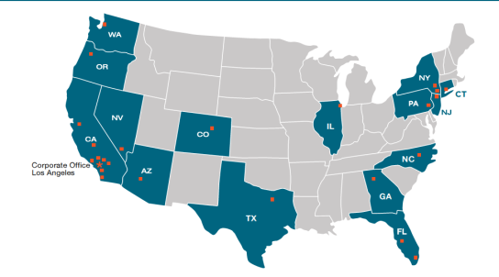
Title
Who We Are
Founded in 1997 specializing in construction law
Over 300 lawyers supported by
280 support staff and management
26 offices
Licensed in 24 states

Slide 3



Types of Risks in Construction Projects
Personal Injury
Worker’s
Third Parties
Construction Defect
Property Damage
Contract Disputes (Delays, Changes, etc.)

Slide 4

Basics of Personal Injury Claims

Slide 5


Slide Title Goes Here
Brief Review of the Duty of Care
Title
Invitee
Keep premises reasonably safe and warn of known or should have been known latent or concealed defects.
Licensee
Refrain from wanton negligence or willful misconduct, avoid intentionally exposing person to danger, and warn of known latent or concealed dangerous or defective conditions.
Known Trespasser
Avoid willful and wanton injury, and warn of known dangerous conditions not readily apparent to ordinary observation
Unknown Trespasser
Avoid willful and wanton injury

Slide 6

Slide Title Goes Here
Worker Injuries
Title
Owners and Developers
Worker’s Compensation Immunity does not apply to owners or developers!
As a general rule, one who hires an independent contractor is not liable for injuries sustained by that contractor's employees in performing their work.
Unless the owner/developer actively participating in the construction to the extent that he directly influences the manner in which the work is performed.
General Contractors
Florida’s Workers’ Compensation Law generally prohibits an employee from bringing a negligence suit against the employer.
Intentional Tort Exception

Slide 7

Slide Title Goes Here
Minimizing Worker Injury Risks
Title
Owners and Developers
Contractual Risk Transfer
Safety Program
Leave the work to the professionals
Documentation!

Slide 8

Slide Title Goes Here
Third-Party Injuries
Title
Owners and Developers
General rule is that owners are not liable for the torts of an independent contractors.
A rule that is full of holes: Non-delegable duties
General Contractors
Contractors are not liable for the torts of subcontractors

Slide 9

Slide Title Goes Here
Minimizing Third-Party Injury Risks
Title
Owners and Developers
Pre-Contract Vetting
Contractual Risk Transfers
WRAP Insurance Programs (OCIP/CCIP)
Additional Insured Strategies
General Contractors
Safety Program
Daily Inspections and Documentations
Additional Strategies
Access Control
Documentation
Comprehensive Safety Review

Slide 10

Slide Title Goes Here
First of all: What is a “Construction Defect" in Florida?
Title
By written statute, (broadly) it’s a deficiency in the design and construction of real property caused by:
Defective material
Violation of the building codes
Failure of design
Failure to properly construct according to the standard of care in the industry

Slide 11

Slide Title Goes Here
Typical Construction Defect Claims in Florida
Title
Florida’s Unique Environment
Water, Water, Water!
Typical Defects Alleged
Stucco
Roofs
Windows
Sliding Glass Doors and Other Doors
Soils

Slide 12

Slide Title Goes Here
Minimizing Risk of Construction Defect Claims
Title
Everyone
Contractual Risk Transfers
WRAP Insurance Programs (OCIP/CCIP)
Additional Insured Strategies
GAP INSURANCE!
General Contractors
Quality Control!
Get Involved Early

Slide 13

Questions?
Slide Title Goes Here
Title

Slide 14


Pitfalls of Risk Management for Owners, Developer and General Contractors in Construction Projects
Anthony S. Wong
D: (786) 358-6433
E: awong@wshblaw.com

