Slide 1

Florida Bar- RPPTL Section Construction Law Committee
November 11, 2019
Peter Quinter, Esq.

Slide 2

Peter Quinter, Attorney
Customs & International Trade Law Group
GrayRobinson, P.A.
Mobile (954) 270-1864
Office (305) 416-6960
Miami, Florida
Peter.Quinter@Gray-Robinson.com
Skype: Peter.Quinter1

Slide 3
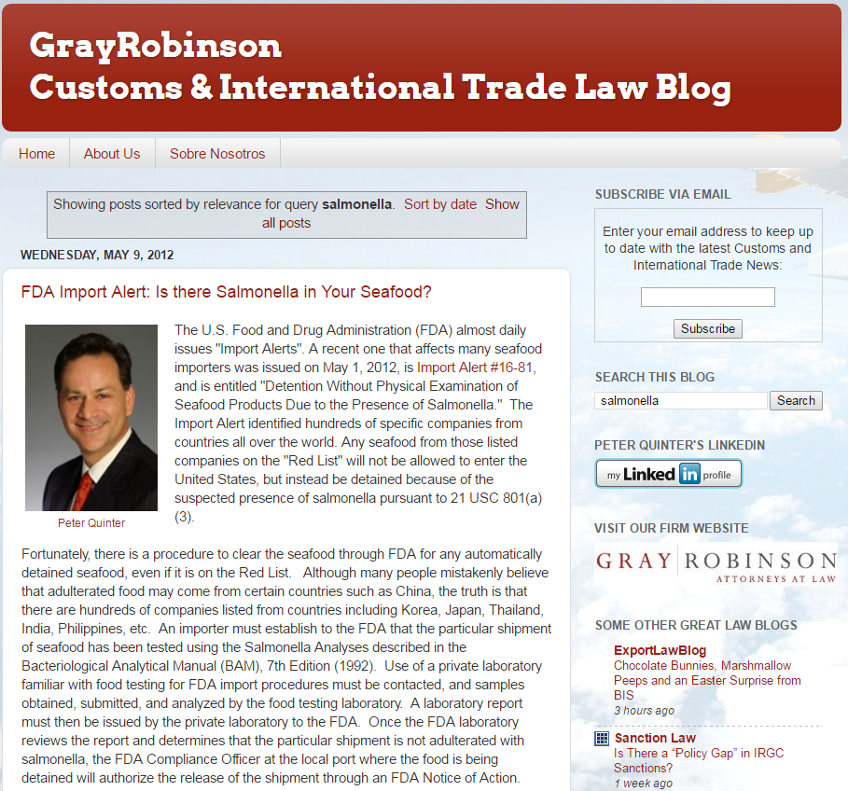
Do you have questions about importing/exporting? www.GRCustomsLaw.com

Slide 4

Recognized as one of the “Best Lawyers in America” from 2009 to 2019

Slide 5
An anti-dumping duty is a protectionist tariff that a domestic government imposes on foreign imports that it believes are priced below fair market value. Dumping is a process where a company exports a product at a price lower than the price it normally charges in its own home market.
Countervailing duty (CVD) cases are established when a foreign government provides assistance and subsidies, such as tax breaks, to manufacturers that export goods to the U.S., enabling the manufacturers to sell the goods cheaper than domestic manufacturers.

Slide 6
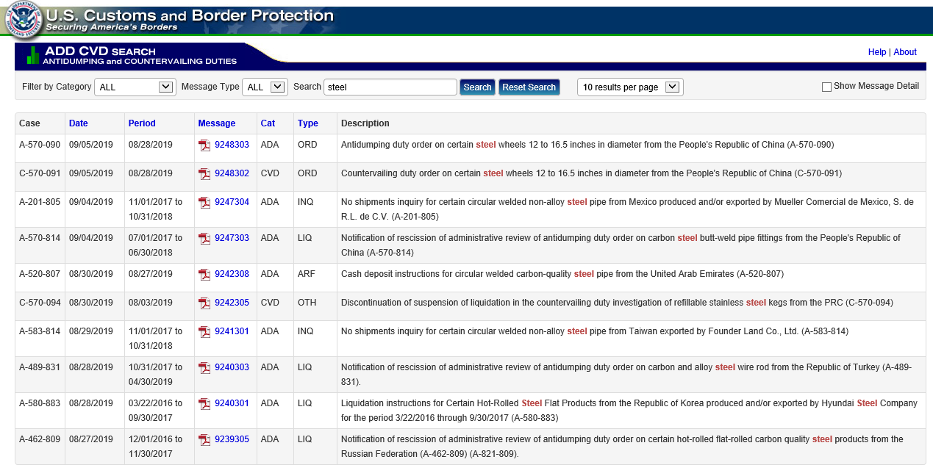

Slide 7
Presidential Proclamation on Adjusting Imports of Steel into the United States
Economy & Jobs
Issued on: March 8, 2018
1. On January 11, 2018, the Secretary of Commerce (Secretary) transmitted to me a report on his investigation into the effect of imports of steel mill articles (steel articles) and the circumstances of global excess capacity for producing steel are “weakening our internal economy,” resulting on the national security of the United States under section 232 of the Trade Expansion Act of 1962, as amended (19 U.S.C. 1862).
2. The Secretary found and advised me of his opinion that steel articles are being imported into the United States in such quantities and under such circumstances as to threaten to impair the national security of the United States. The Secretary found that the present quantities of steel articles imports in the persistent threat of further closures of domestic steel production facilities and the “shrinking [of our] ability to meet national security production requirements in a national emergency.” Because of these risks and the risk that the United States may be unable to “meet [steel] demands for national defense and critical industries in a national emergency,” and taking into account the close relation of the economic welfare of the Nation to our national security, see 19 U.S.C. 1862(d), the Secretary concluded that the present quantities and circumstances of steel articles imports threaten to impair the national security as defined in section 232 of the Trade Expansion Act of 1962, as amended.
8. In the exercise of these authorities, I have decided to adjust the imports of steel articles by imposing a 25 percent ad valorem tariff on steel articles, as defined below, imported from all countries except Canada and Mexico.
(1) For the purposes of this proclamation, “steel articles” are defined at the Harmonized Tariff Schedule (HTS) 6‑digit level as: 7206.10 through 7216.50, 7216.99 through 7301.10, 7302.10, 7302.40 through 7302.90, and 7304.10 through 7306.90, including any subsequent revisions to these HTS classifications.
(2) In order to establish increases in the duty rate on imports of steel articles, subchapter III of chapter 99 of the HTSUS is modified as provided in the Annex to this proclamation.
DONALD J. TRUMP

Slide 8
Equipment Finance Advisor
February 4, 2019
The Impact of Steel and Aluminum Tariffs on the Construction Industry
In the weeks leading up to the tariffs’ imposition, many construction industry observers predicted significant cost increases for critical inputs. Everything from rebar to steel beam, steel pipe and tube, and aluminum mill products, were predicted to go up in price, potentially causing an industry slowdown. Further speculation was that the cost of new and used construction equipment would rise, pushing purchase and rental prices for contractors higher.
Indeed, most predictions turned out right.

Slide 9
According to Stephen E. Sandherr, CEO of the Associated General Contractors of America, as reported in Buildings: Smarter Facility Management on May 20, 2019,
“Higher steel and aluminum prices will make the kind of infrastructure work President Trump supports more expensive, forcing federal, state and local officials to cut back on projects they can fund. And the likely trade war these new tariffs prompt will diminish demand for private investment in infrastructure as well as construction demand for manufacturing, shipping and distribution facilities.”

Slide 10
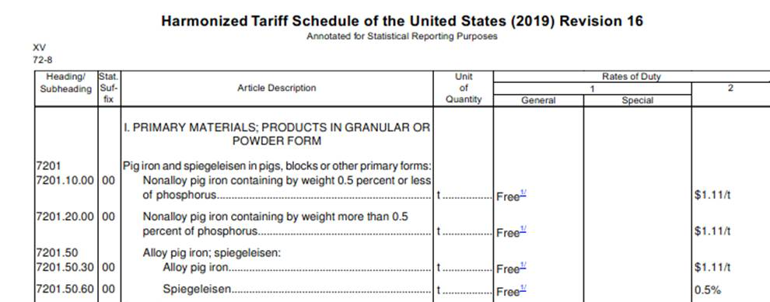
Effects of Trade War on U.S. Construction Industry

Slide 11
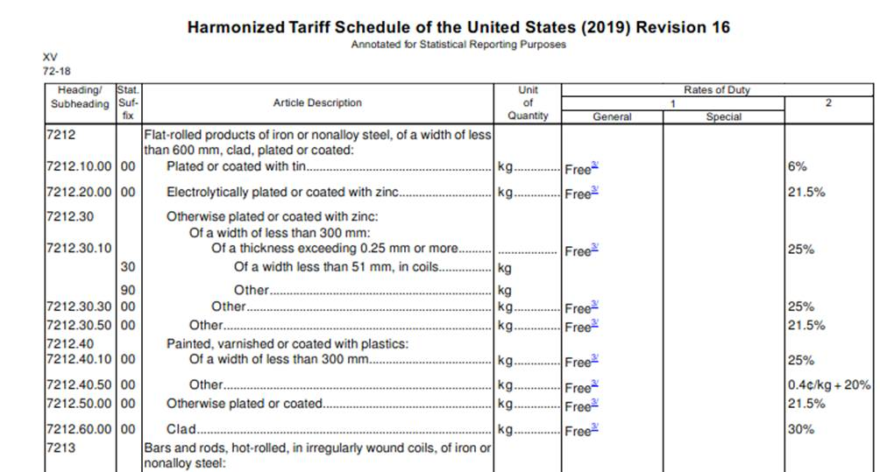
Effects of Trade War on U.S. Construction Industry

Slide 12
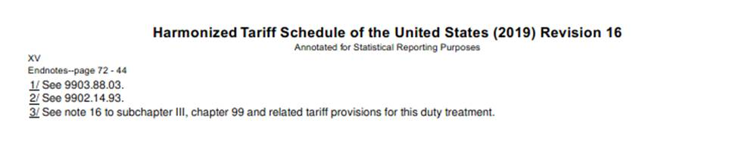
Effects of Trade War on U.S. Construction Industry

Slide 13
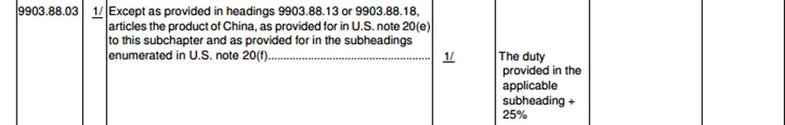
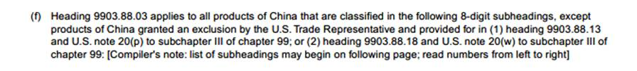

Slide 14
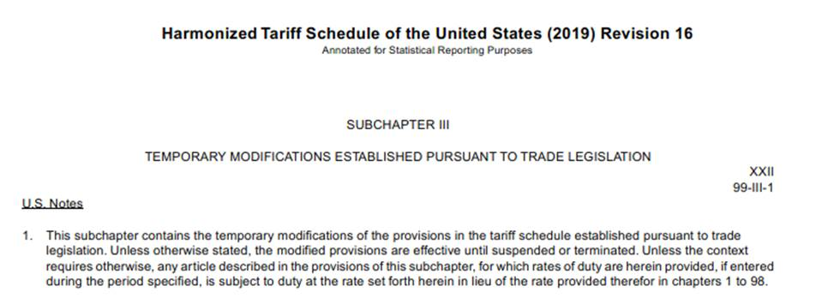

Slide 15
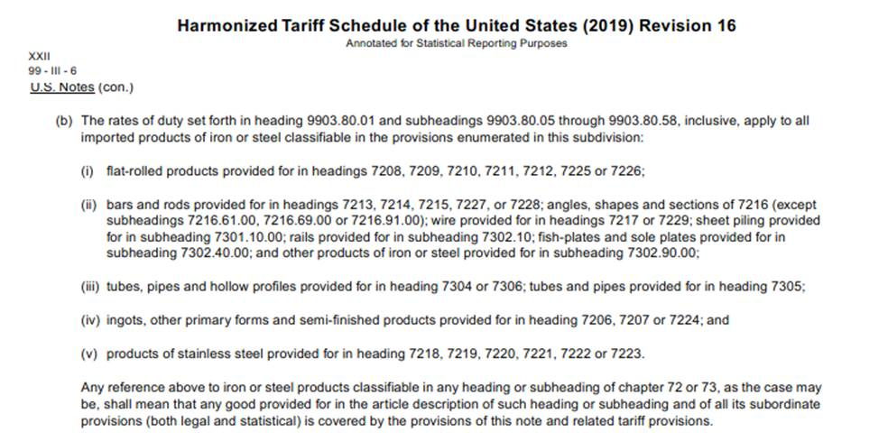

Slide 16
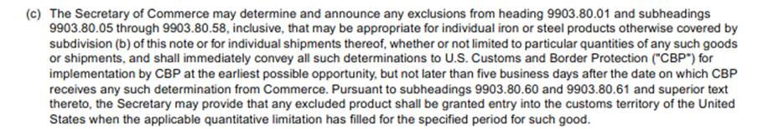
HTSUS Chapter 99, Subchapter III, U.S. Note 16(c)

Slide 17
Peter Quinter, Attorney
Customs & International Trade Law Group
GrayRobinson, P.A.
Mobile (954) 270-1864
Office (305) 416-6960
Miami, Florida
Peter.Quinter@Gray-Robinson.com
Skype: Peter.Quinter1

