Slide 1

Cybersecurity Issues in Today’s Workplace October 14, 2019
Michael Hooker & Jason Pill
Phelps Dunbar LLP
813-472-7550

Slide 2
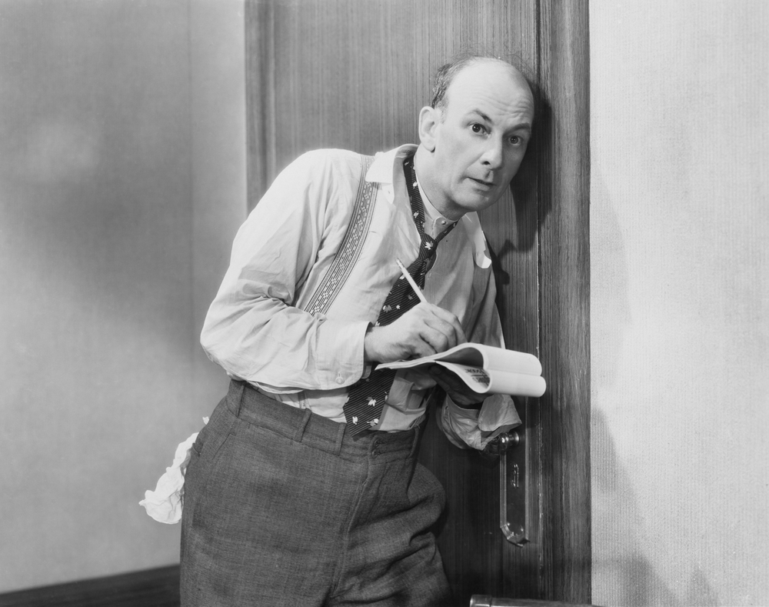
Where we started . . .

Slide 3

Where we ended up . . .

Slide 4
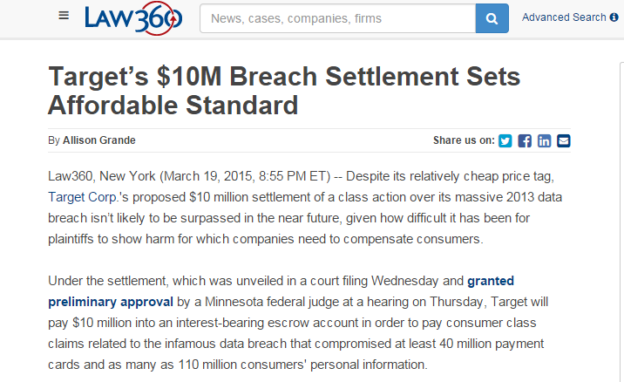
The Fallout

Slide 5
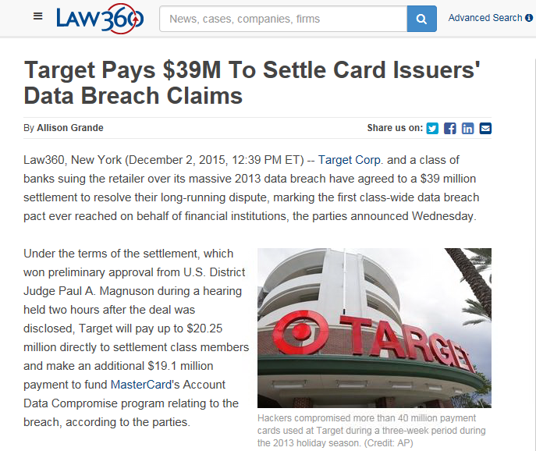
The Fallout

Slide 6
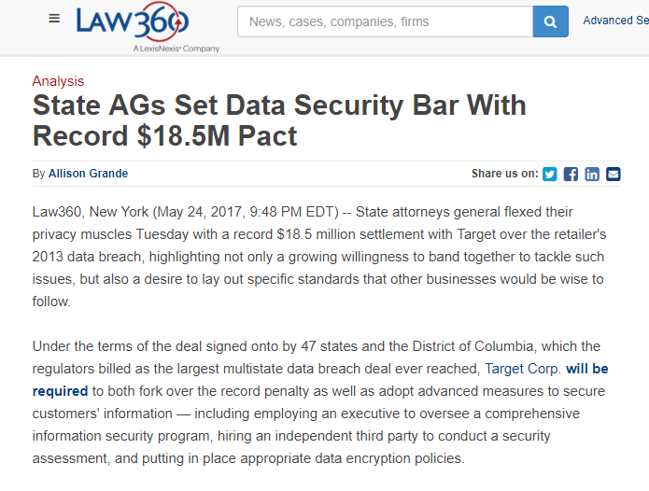
The Fallout

Slide 7
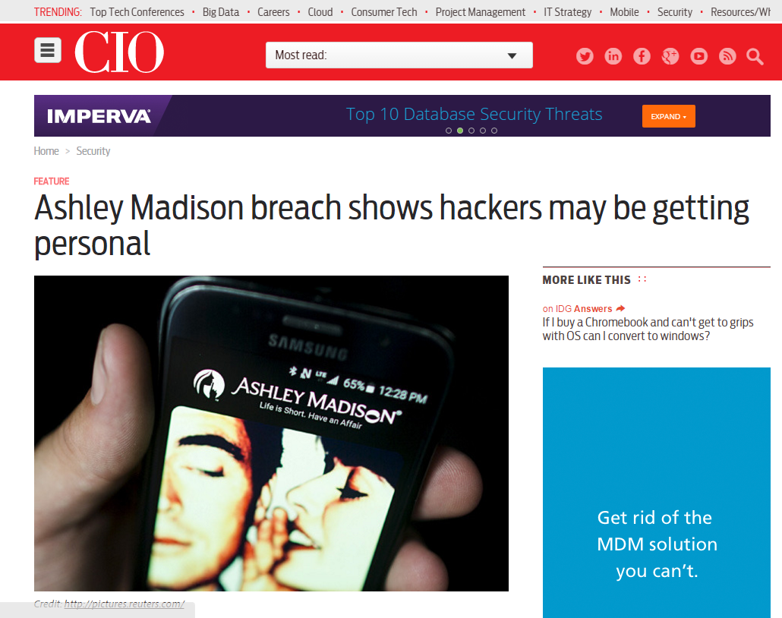
“Bank Hackers Steal Millions via Malware”

Slide 8
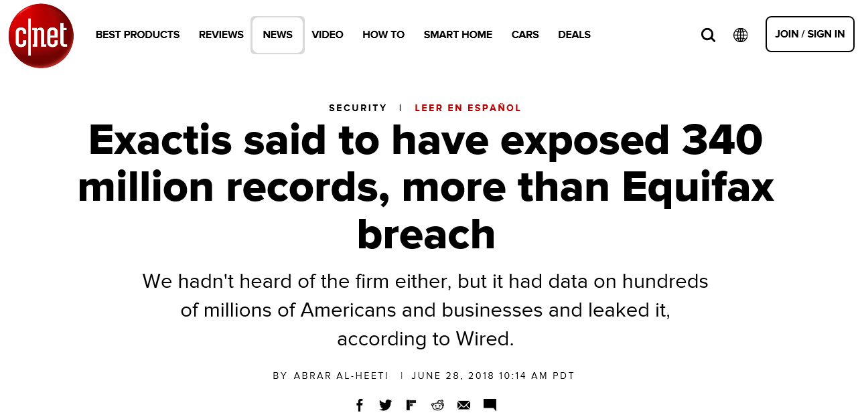
Terrible Way to Get Your Company’s Name in the News . . .

Slide 9
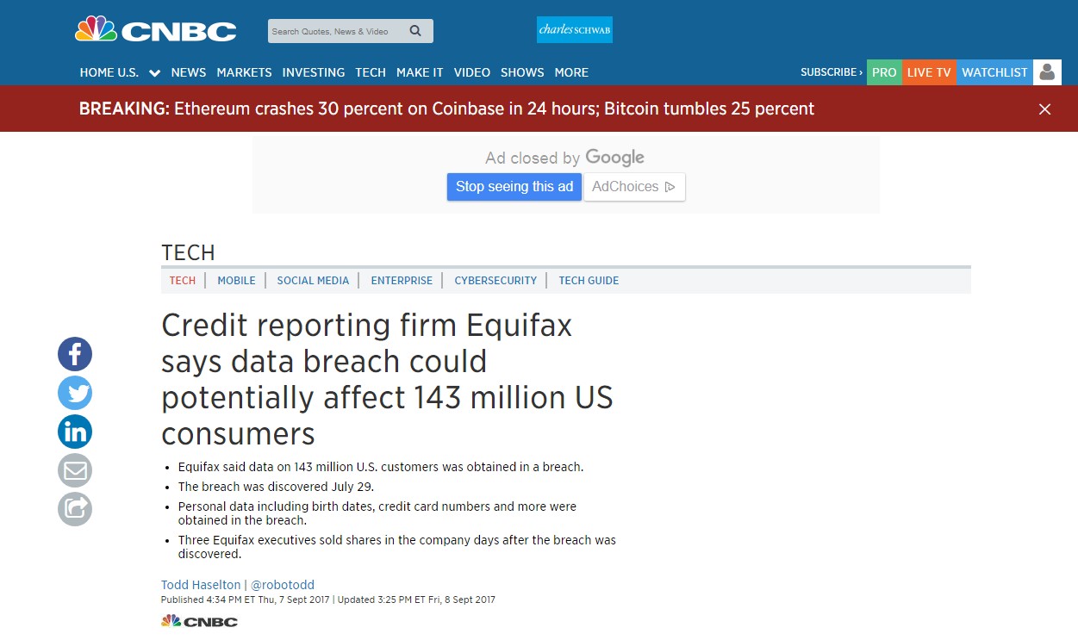
Impact felt in all business sectors…

Slide 10
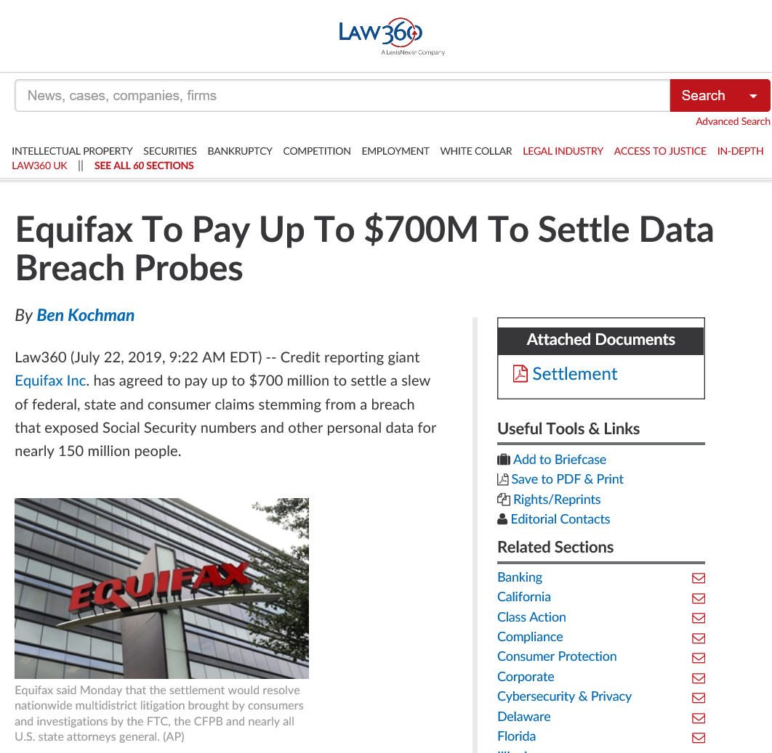
Settlement Numbers are Rising…

Slide 11
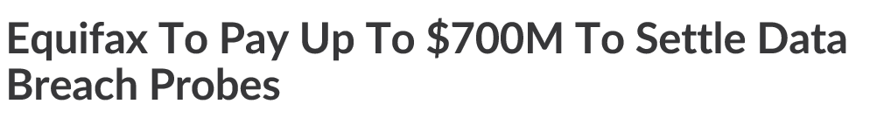
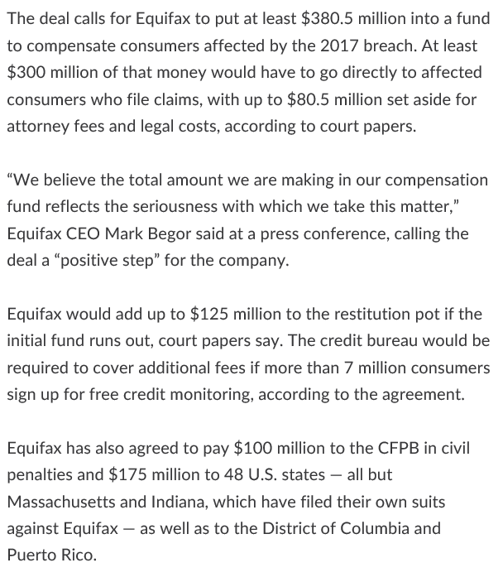
Settlement Numbers are Rising…

Slide 12
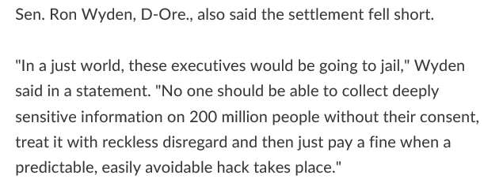

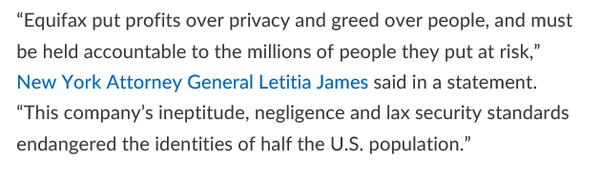
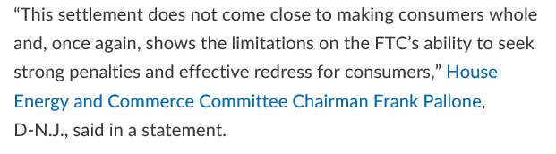
The Breached Company Will Not Be Perceived as a “Victim”

Slide 13











Impact Felt in All Business Sectors…

Slide 14
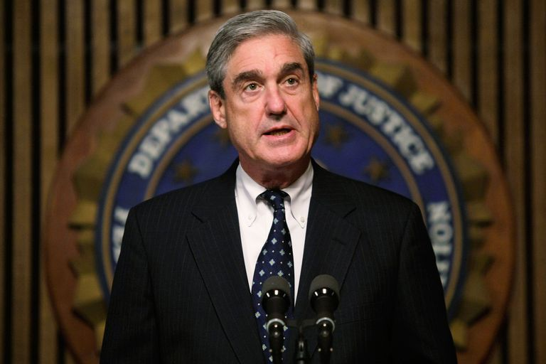
Cybersecurity – A new business priority
“I am convinced that there are only two types of companies: those that have been hacked and those that will be. And even they are converging into one category: companies that have been hacked and will be hacked again.”
- Robert Mueller
(2012, then-FBI Director)

Slide 15
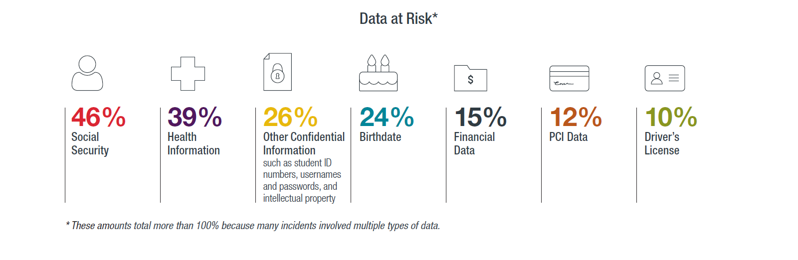
What data is typically at risk?

Slide 16
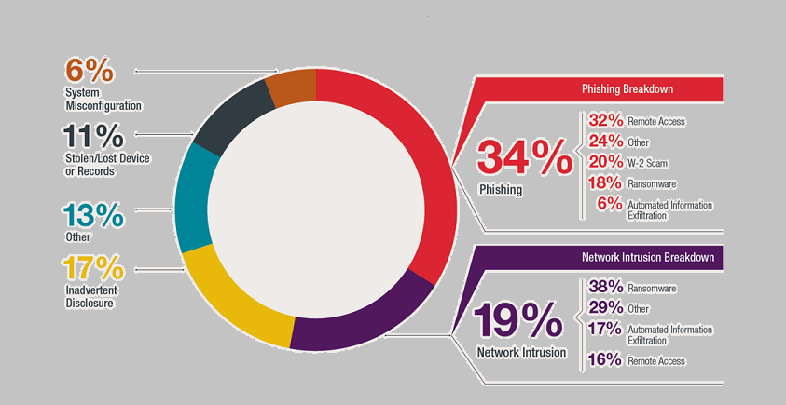
Incident Causes

Slide 17
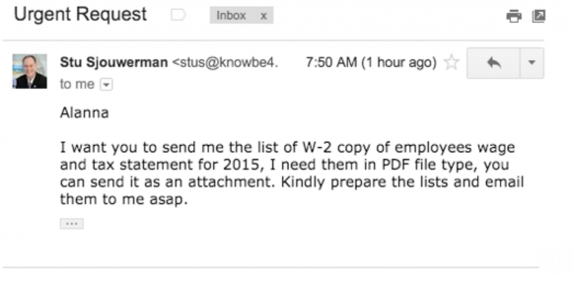

Phishing
Common Phishing Technique:
Hackers use emails from a target organizations CEO, asking human resources and accounting departments for employee W-2 information:

Slide 18
Ransomware
How it Happens:
Best Practices:
Hackers gain access to your computer’s file system by installing a program via phishing link or attachment
The ransomware encrypts all the data stored on the computer
The user asks the victim to pay a fixed amount of money before decrypting
Maintain off-site backup of data

Slide 19
Ransomware Average Payment
$40,000
Ransomware Is Here To Stay
Low entry cost for cybercriminals
Ransomware models are:
Developing new strains
Data mining

Slide 20

Construction Industry is Not Immune
Unique risks associated with
Use of automation on the job site (e.g., remotely operated construction equipment that can be hacked)
A mobile workforce
High Personnel turnover
Valuable digital information often is stored with limited protections

Slide 21
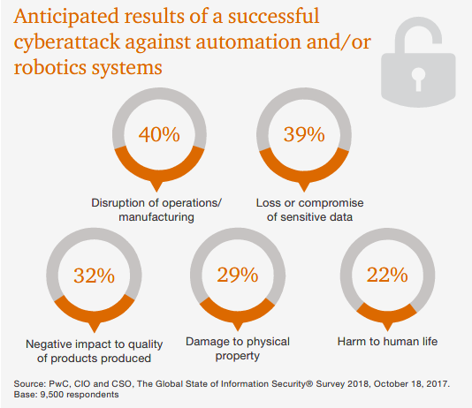
Increased Fears with the Rise of Automation

Slide 22

GET IN FRONT OF THE PROBLEM

Slide 23

An ounce of prevention . . .
The best plan is to have a plan. Insurers and certain compliance standards already require plans and systems in place.

Slide 24

All Too Common Approach
“We have a vendor that protects our data”
“We have an IT department”
“We don’t have anything hackers want”

Slide 25
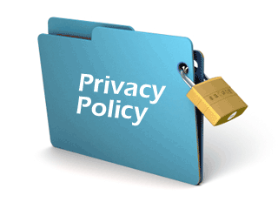
Preventative Measures
Incident response policies
Privacy policies and notices
Information security policies
Document retention policies

Slide 26

Preventative Measures
BYOD policies
Non-party agreements
Confidentiality Agreements
HOWEVER, policies are bad if not enforced, not practical, and unknown to the employees who need to follow them

Slide 27

Be Proactive
Establish a risk committee
Review risk assessments
Evaluate whether appropriate privacy and security roles exist (e.g., CISO, CPO)
Evaluate security budgets
Discuss with board how they will be notified and what their role will be
Address risk shifting through insurance

Slide 28
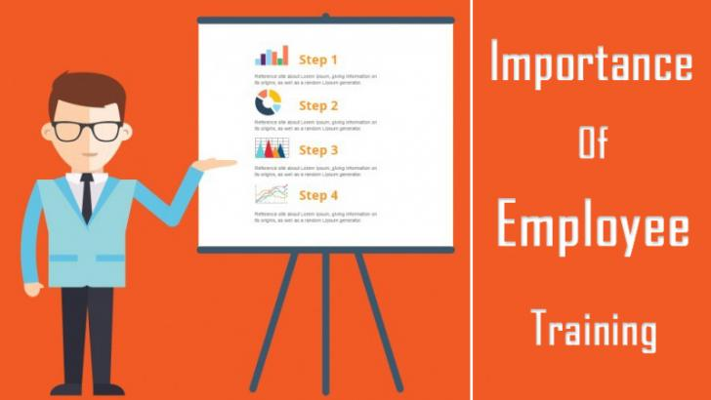
Train Employees
Train employees at the time of hiring:
How do employee’s spot security problems?
What is the reporting procedure?
Are leaders trained to handle reports?
Continue training employees regularly:
Formal online training course
Monthly staff meetings

Slide 29

Incident Response Team
Team Manager
Cybersecurity Law Firm
Computer Forensics Firm
Notification Vendor
Public Relations Firm

Slide 30
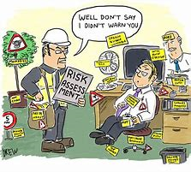
Conduct Periodic Risk Assessments
Review Administrative Safeguards
Review Physical Safeguards
Review Technical Safeguards
Review Data Flow – has the quantity/nature/sensitivity of the data changed?

Slide 31
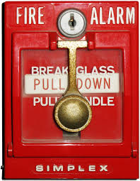
Perform Data Breach Fire Drill
Determine weaknesses in Response Plan
Test lines of communications
Consider what documents are being created and which documents could become evidence in litigation
Test again to look for improvements

Slide 32
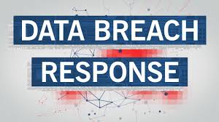
You’ve Been Hacked!
Despite your best efforts, you’ve been hacked. . .
How do you respond and who is on your response team?

Slide 33

Data Breach Checklist
Consider Insurance
Validate the Breach
Engage Incident Response Team
Establish a “privileged” reporting and communication channel
Use independent cyber security and forensic experts
Stop additional data loss
Secure evidence
Prevent physical access to the affected systems (e.g., work stations, servers, etc.)
Preserve all security access devices, logs, surveillance tapes, and computer logs

Slide 34
Data Breach Checklist
Document the data breach
E.g., date and time of the breach (or when learned about), the personnel who discovered the breach, the nature of the breach, the types of compromised data, when the response efforts began, etc.
Collect names for all employees terminated within the last 180 days and confirm whether their security access was terminated
Consider possibly involving law enforcement
Determine your legal, contractual, and insurance notification obligations
Interview personnel involved
Change security access and passwords

Slide 35
Communication Don’ts
Don’t speak too early and/or “on the fly.”
Don’t use a misleading initial holding statement.
Don’t fall victim to saying too much or being too reassuring.
Don’t make logistical mistakes (e.g., call center).
Don’t assume you have to answer all media inquiries.
Don’t over-apologize.
Don’t leave out helpful evidence.
Don’t call yourself a victim.
Don’t overstate the security measures you had in place.
Don’t overstate new security measures.
Don’t ignore regulators.

Slide 36
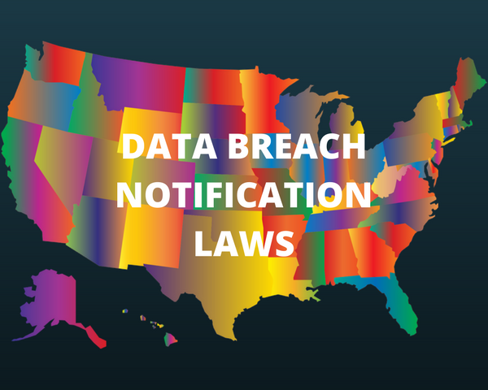
What To Do When You’ve Been Hit

Slide 37
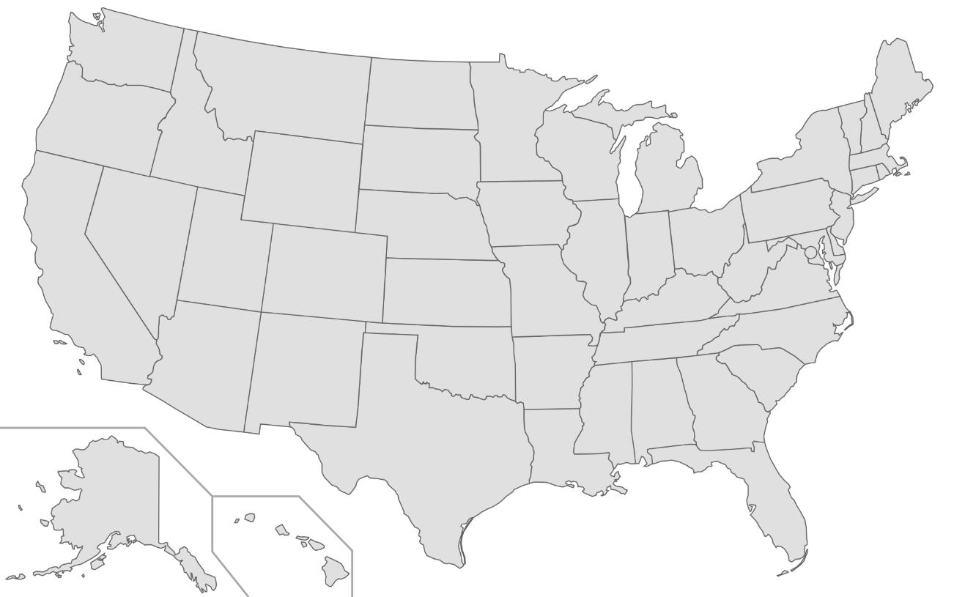
State Laws
50 States, D.C., & U.S. territories
Laws vary between jurisdictions
Varying levels of enforcement by state attorneys general

Slide 38

Proposed Federal Privacy Legislation
Several proposals recently introduced in Congress
Bipartisan desire to provide more extensive and uniform protection for individuals
Landscape likely to change . . .

Slide 39
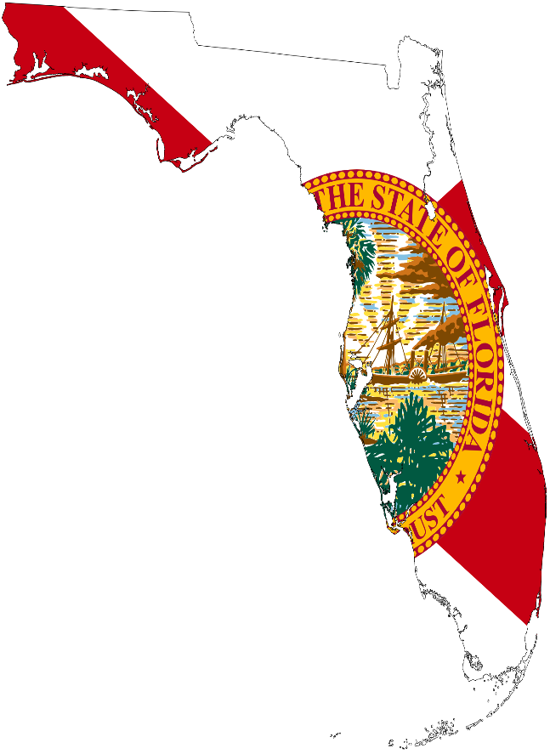
FLORIDA LAWS

Slide 40
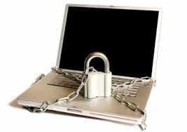
Section 501.171 Florida Statutes
The “Florida Information Protection Act of 2014” was passed by Florida House of Representatives on April 30, 2014, and became effective July 1, 2014
The Act repealed and replaced§817.5681, “Breach of security concerning confidential personal information in third-party possession; administrative penalties”

Slide 41

Section 501.171 – Duty to Provide Notice of Breach
“A covered entity shall provide notice to the [Department of Legal Affairs] of any breach of security affecting 500 or more individuals in this state.”§501.171(3)(a)
“A covered entity shall give notice to each individual in this state whose personal information was, or the covered entity reasonably believes to have been, accessed as a result of the breach.” §501.171(4)(a)
Notice must be provided as “no later than 30 days after the determination of the breach or reason to believe a breach occurred” §501.171(3)(a); (4)(a)

Slide 42
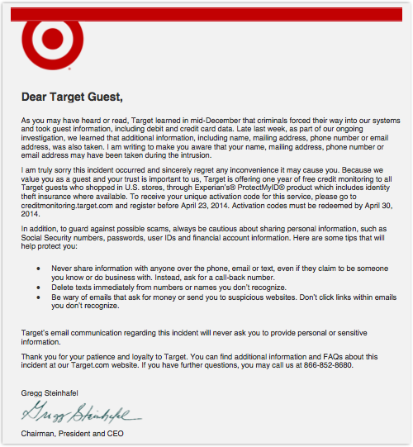
A Notable Example

Slide 43
Who is Covered?
“Covered Entity” means a “sole proprietorship, partnership, corporation, trust, estate, cooperative, association, or other commercial entity that acquires, maintains, stores, or uses personal information.”
§ 501.171(1)(b)

Slide 44
What is Covered?
“Personal Information” means:
An individual’s first name or first initial and last name in combination with any one or more of the following:
A social security number;
A driver’s license number;
A financial account number or credit/debit card number, in combination with any required security code;
Any information regarding an individual’s medical history;
An individual’s health insurance policy number
A user name or email address, along with the password

Slide 45
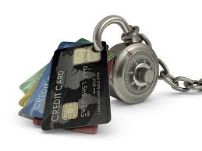
Section 501.171(4)(B),(C) – Two Exceptions to Individual Notice
No written notice to individuals is required if the notice would interfere with a state or federal investigation
No written notice to individuals is required if, after an appropriate investigation and consultation with relevant law enforcement agencies, the covered entity reasonably determines that the breach has not and will not likely result in identity theft or any other financial harm to the individuals whose personal information has been accessed

Slide 46

Section 501.171(9) – Enforcement
Covered entities shall be liable for a civil penalty not to exceed $500,000, as follows:
$1,000 for each day for each day notice is not provided to the Department of Legal Affairs or the affected individuals during the first 30-day period of noncompliance and, thereafter, $50,000 for each subsequent 30-day period of noncompliance
Penalty applies per breach, not per individual

Slide 47

Section 501.171(10) – Enforcement
No private cause of action for violations
Plaintiffs’ attorneys have looked to the statute to identify a putative class
Unclear how the statute may be used by Courts to establish negligence per se or evidence of negligence in civil actions
Plaintiffs’ attorneys, however, have begun citing it as a basis for negligence and negligence per se in data breach litigation

Slide 48
OTHER PERTINENT LAWS

Slide 49
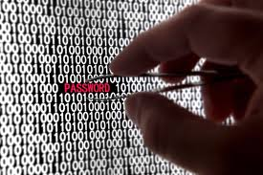
Florida’s Computer Abuse and Data Recovery Act (if you find the culprit)
Effective October 1, 2015, Fla. Stat.§668.801-805
Creates a new cause of action for businesses victimized by unauthorized computer access
Triggered when an individual “knowingly and with intent to cause harm or loss” obtains information from or improperly accesses a protected computer
A party can recover lost profits, economic damages, and attorneys’ fees, and obtain injunctive relief

Slide 50

Florida’s Proposed Biometric Information Privacy Act
Introduced on February 21, 2019 – “Died in Innovation, Industry, and Technology” and indefinitely postponed on May 3, 2019
Purpose is to establish requirements and restrictions on the collection, use and maintenance of biometric identities and information
Will it be resurrected?

Slide 51

International Breach Notification Laws
Several Non-U.S. jurisdictions have security breach notification requirements
Some are specific to certain industries
Some only require notification to a regulator
In certain countries, authorities have issued “guidance” for providing breach notification
GDPR imposes a 72-hour notification requirement
The Information Commissioner’s Office (the “ICO”) enforces the GDPR and has the ability to issue fines
Civil penalties up to €20M or 4% of global “turnover”, whichever is higher

Slide 52
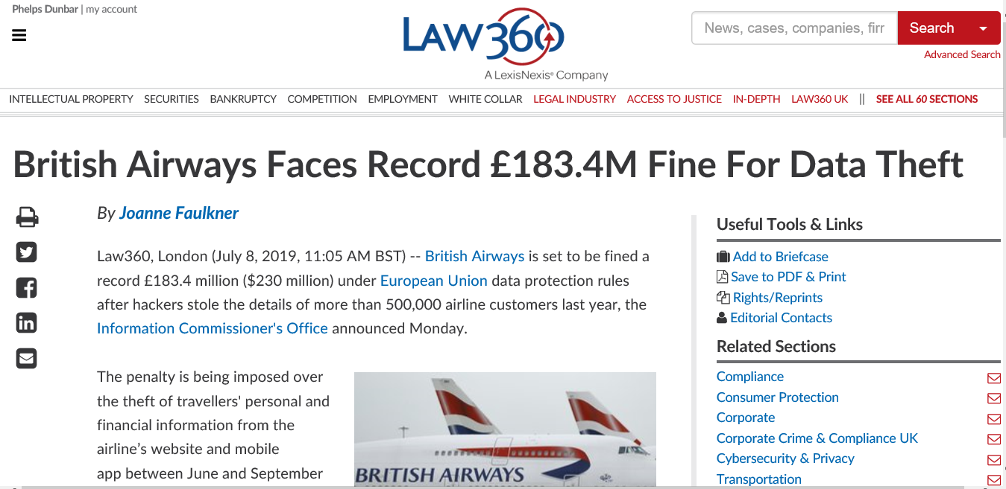
Massive Penalties from the EU

Slide 53
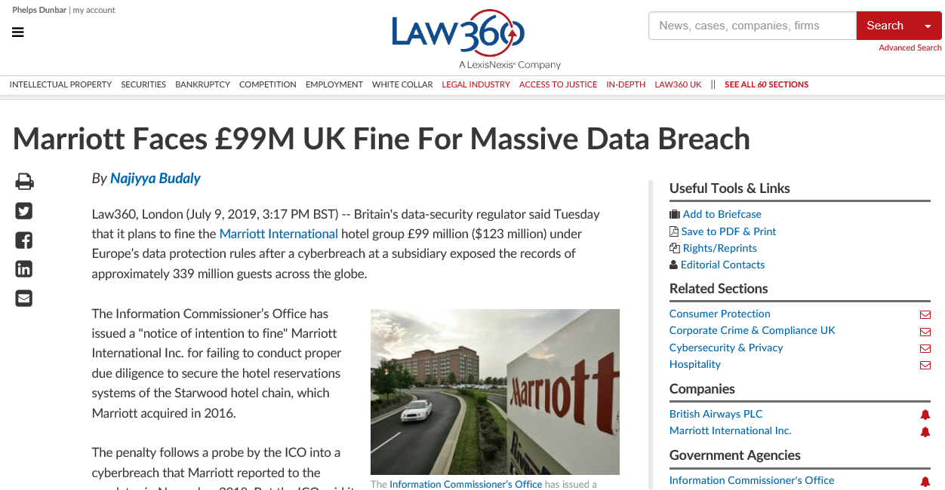
Massive Penalties from the EU

Slide 54

CYBERSECURITY LITIGATION

Slide 55
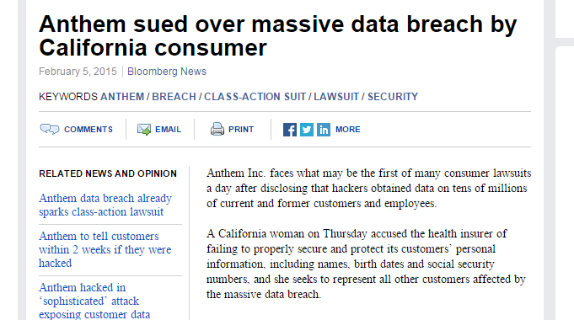
Immediate Consumer Litigation

Slide 56
What’s in the Complaint?
You had unreasonable information security controls
You took too long to notify me (even if you complied with state law)
You breached your promise to provide reasonable security
I would not have paid the stated price (or done business with you) had I known you had bad data security

Slide 57
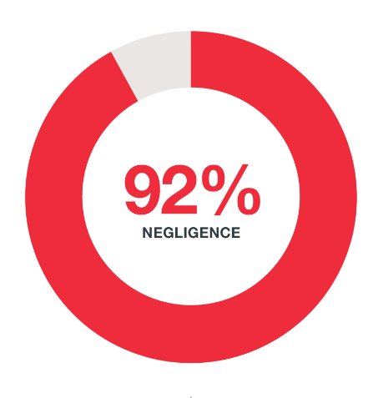
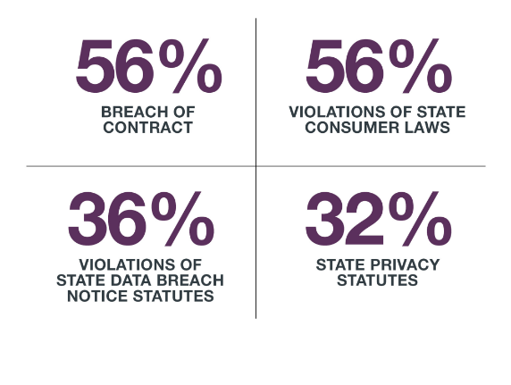
Causes of Action

Slide 58

Rising Costs
Potential Damages Sought in Litigation:
Out-of-Pocket losses by individuals as result of the breach
Compensatory Damages for Compromised Data
Lost Time
Costs to the Breached Company
Remediation and investigation
Civil Penalties to State and Federal Agencies
Attorneys’ Fees (Plaintiffs’ Fees and Defense Costs)
Class costs
Business Interruption

Slide 59

Why Are Companies Settling?
To end costly and time-consuming litigation
Lack of reasonable controls
Evidence that the controls were not followed
Uncertain legal precedent and increasing exposure
Bad documents
Bad witnesses
Bad facts

Slide 60

How Do You Know My Company Caused You Any Harm?
With so many data breaches, how do you know which one caused the plaintiff’s alleged losses?
PEW Research survey released on January 26, 2017 revealed that over half of U.S. Citizens have experienced a data breach

Slide 61
Have We Reached the Tipping Point?
If over half of U.S. Citizens experienced a data breach as of January 26, 2017, that number is no doubt higher now as a result of the many data breaches that have occurred since then.
How can a plaintiff who has been involved in multiple data breaches prove which breach caused damages?
If data breaches have not reached a tipping point yet, it seems they will be there soon.

Slide 62

Cyber Insurance

Slide 63
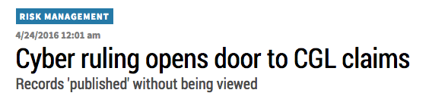
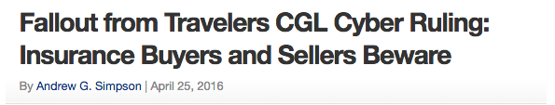
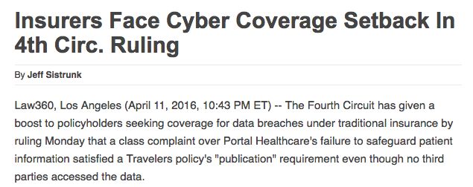
Fourth Circuit’s 2016 Ruling

Slide 64
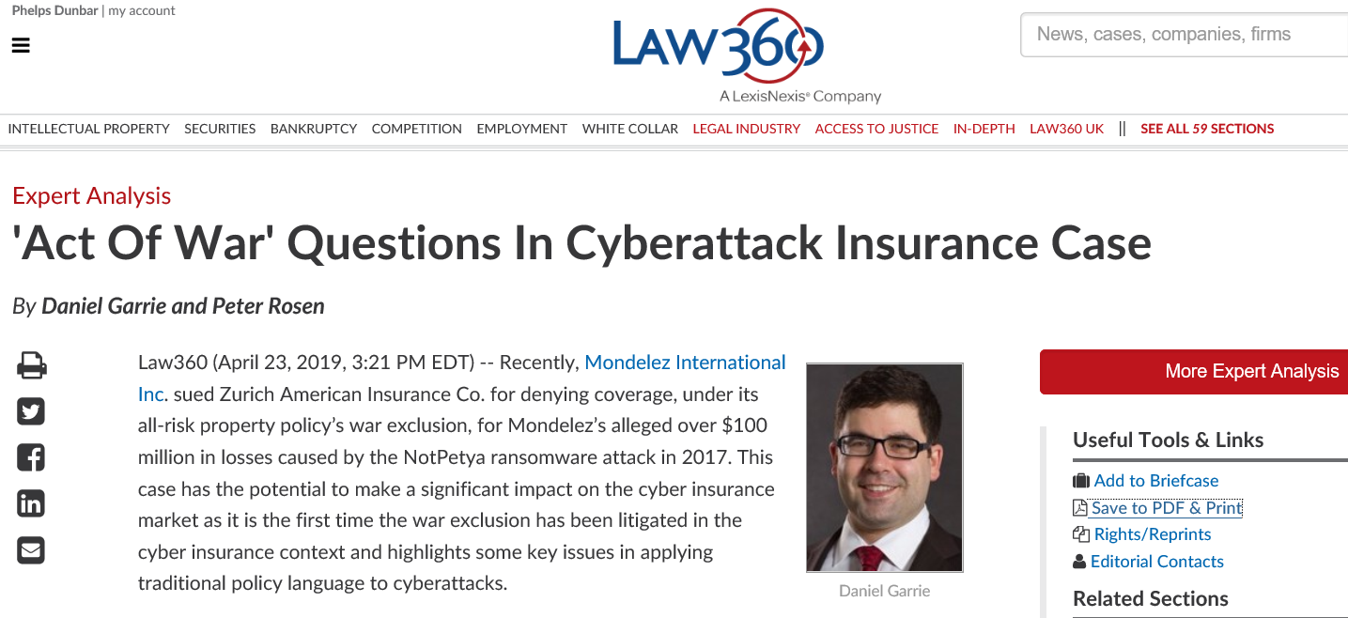
Coverage Issues are Evolving . . .

Slide 65
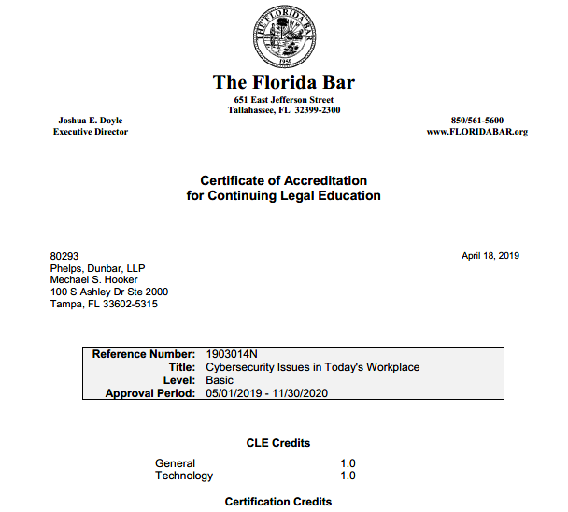

Slide 66
Cybersecurity Issues in Today’s Workplace October 14, 2019
Michael Hooker & Jason Pill
Phelps Dunbar LLP
813-472-7550

