Slide 1
Drafting Settlement Agreements
(That Stay Out of Court)
Presented by James W. Martin, Esq.
Florida Bar Board Certified Real Estate Lawyer
St. Petersburg, Florida
January 8, 2018
Construction Law Committee
The Florida Bar RPPTL Section

Slide 2

Are you ready to defend
your settlement agreement in court?
Here are tips to avoid that.

Slide 3
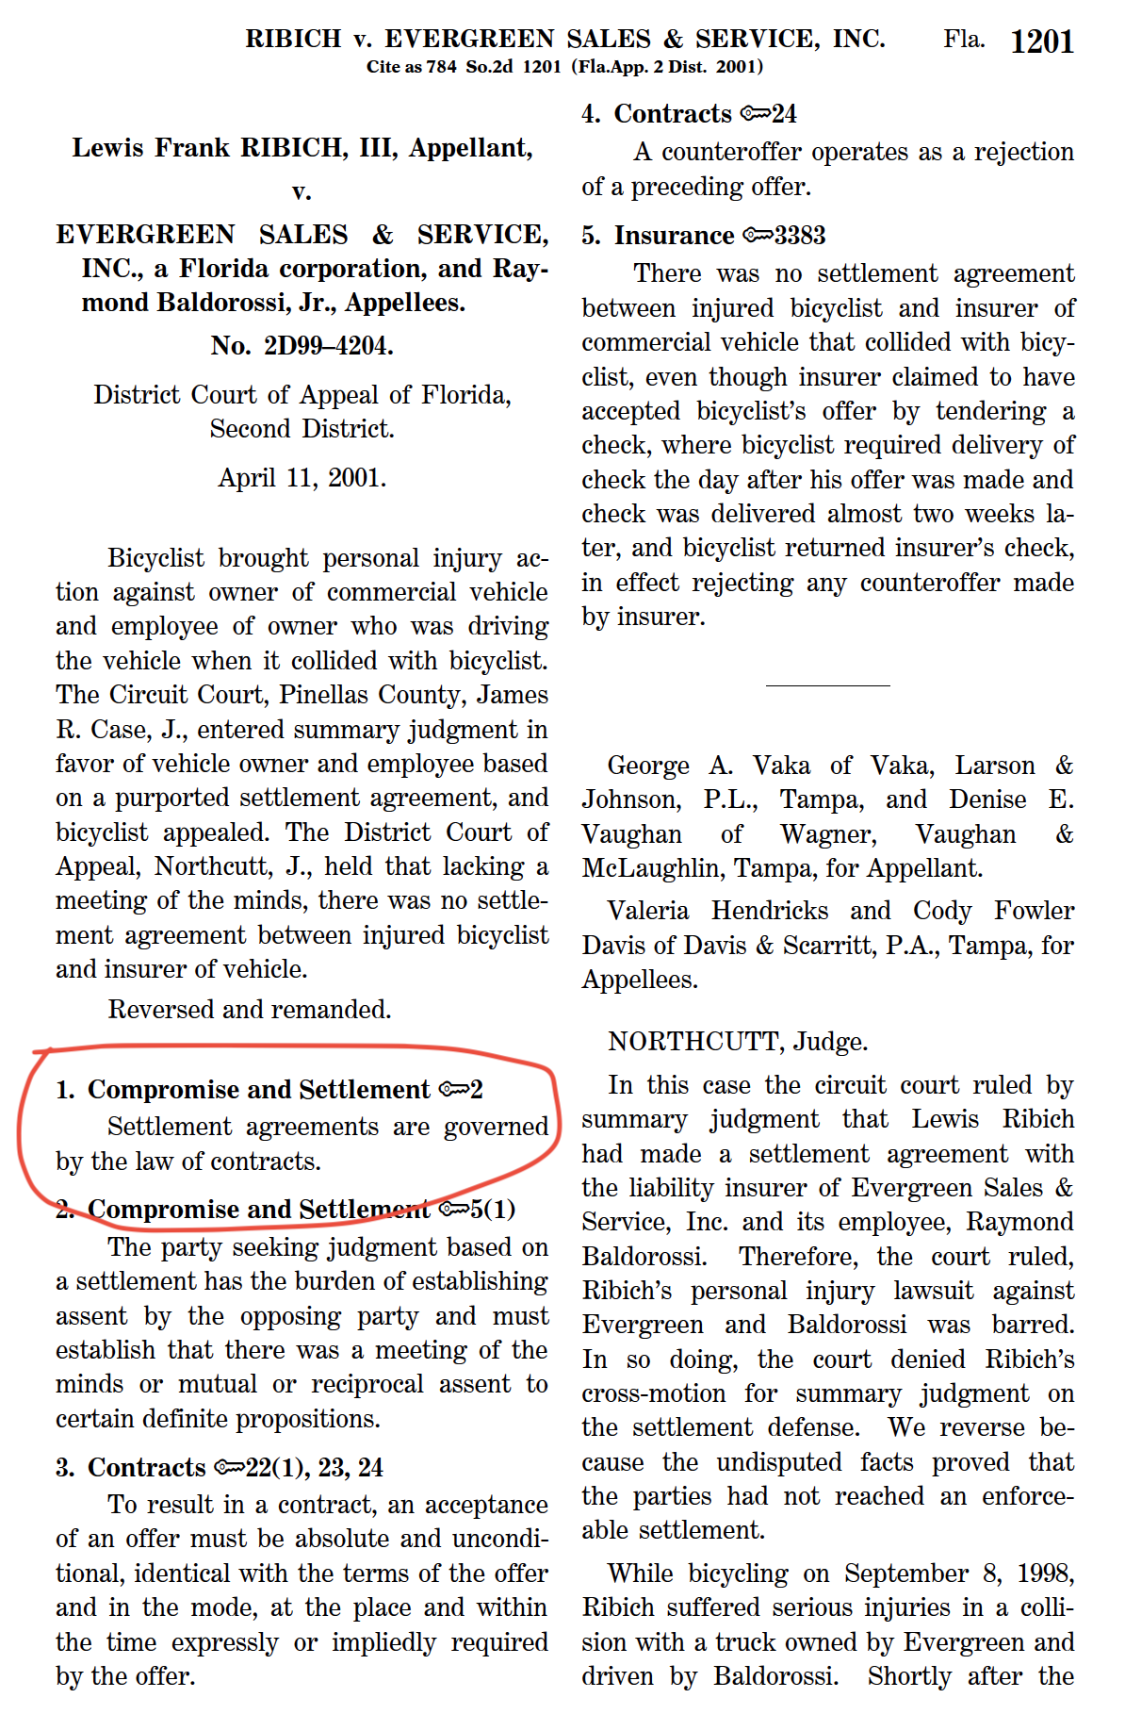
Settlement agreements
are contracts
Ribich v Evergreen, 784 So.2d 1201 (Fla. 2nd DCA 2001)

Slide 4
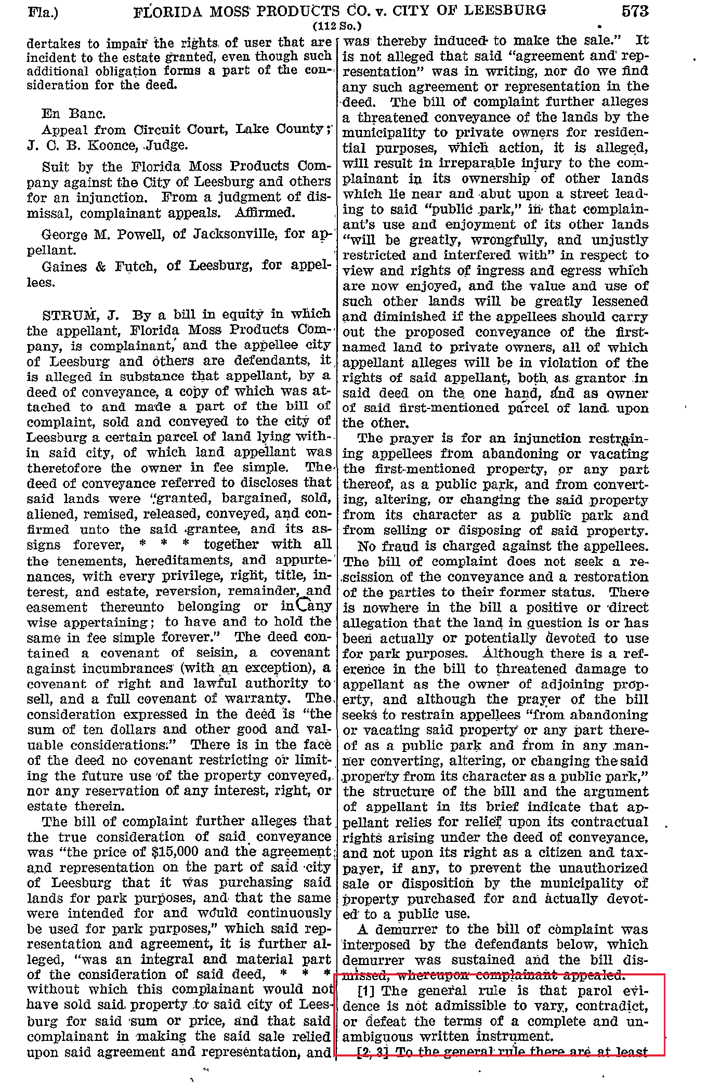
Parol evidence is not admissible to vary, contradict or defeat terms of a complete and unambiguous written instrument.
Florida Moss v Leesburg, 112 So. 572 (Fla. 1927)

Slide 5
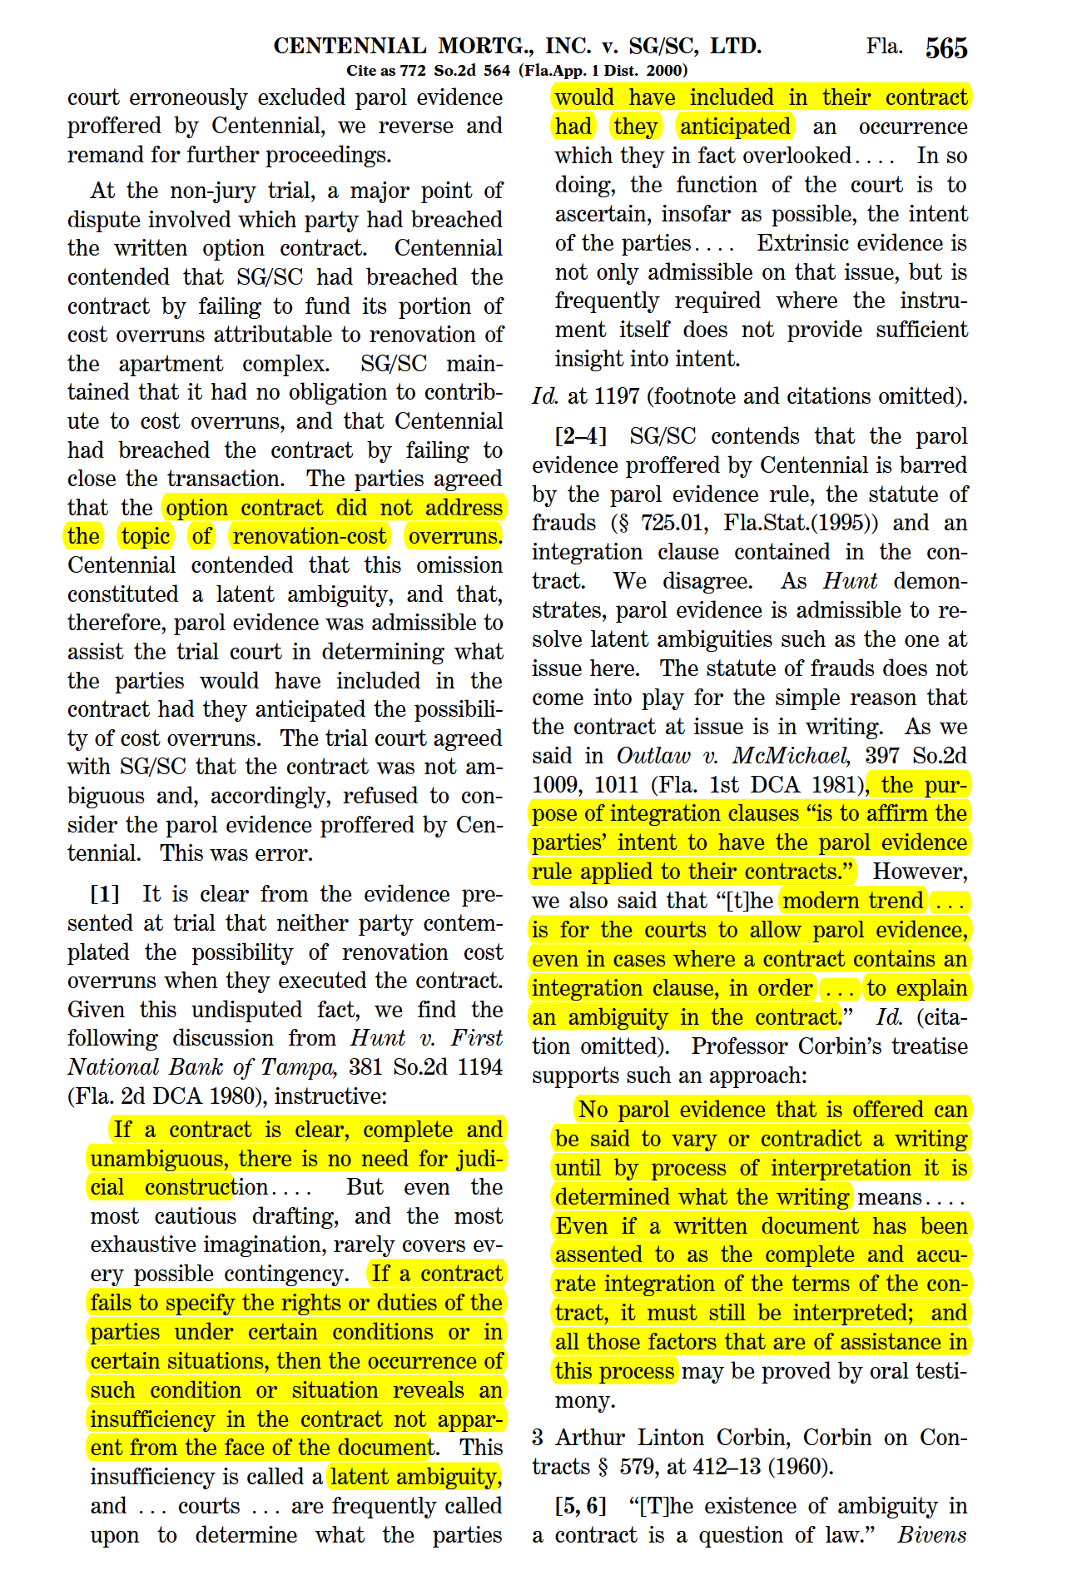
Latent ambiguities may require
court interpretation
Centennial Mortgage v SG/SC, 772 So.2d 564 (Fla. 1st DCA 2000)

Slide 6
What do you do before you write
the first word?
With your client, list the settlement points
Engage your client in “what if” scenarios
Find settlement points from other cases
Search your computer for prior settlement forms
Obtain forms in books, library databases, online

Slide 7
How do you determine the client’s objectives?
WWWWWHHMHL (whowhatwhenwherewhyhowhowmuchhowlong)

Slide 8
Who is the audience for the settlement agreement?
Client
Other parties
Opposing counsel
Court
Public

Slide 9
How do you make
non-binding lists of deal points?
“This is a non-binding outline of points that are being discussed for a possible settlement. This is not a settlement agreement or contract. No one is legally bound by this document.”

Slide 10
How do you write
that first word?
Start with a simple, generic form of settlement agreement:

Slide 11
SETTLEMENT AGREEMENT
AGREEMENT made this _____ day of _________, 20__, between _________, hereinafter called "_________", and _________, hereinafter called "_________".
WHEREAS, _________;
NOW THEREFORE, in consideration of their mutual promises made herein, and for other good and valuable consideration, receipt of which is hereby acknowledged, the parties, intending to be legally bound, hereby agree as follows:
1. Recitals. The parties agree that the foregoing recitals are true and correct and are incorporated herein by reference.
2. __________________ [Insert settlement details here]
3. Miscellaneous. Time is of the essence of this agreement. This agreement is made in the State of Florida and shall be governed by Florida law. This is the entire agreement between the parties, supersedes all prior discussions, and may not be modified or amended except by a written document signed by the party against whom enforcement is sought. This agreement may be signed in more than one counterpart, in which case each counterpart shall constitute an original of this agreement. Paragraph headings are for convenience only and are not intended to expand or restrict the scope or substance of the provisions of this agreement. Wherever used herein, the singular shall include the plural, the plural shall include the singular, and pronouns shall be read as masculine, feminine or neuter as the context requires. The prevailing party in any litigation or arbitration relating to this agreement shall be entitled to recover its reasonable attorneys fees from the other party for all matters, including but not limited to appeals. Pinellas County, Florida, shall be proper venue for any litigation involving this agreement. This agreement may not be assigned or delegated by either party without the prior written consent of the other party.
IN WITNESS WHEREOF, the parties have signed this agreement as of the day and year first above written.
______________________________ __________________________(Seal)

Slide 12
Where do I find the correct legal names of the parties?
See driver license
Search sunbiz.org for FL entities
Search governmentfilesonline.com for other states
If construction contract varies, use both names and say “also known as” or “a/k/a”

Slide 13
Why put the date on page 1?
To later identify the settlement agreement by date
To make it easy to find
Because parties sign on different dates

Slide 14
Can I abbreviate names?
Identify the parties by nicknames, such as
“Plaintiff” and “Defendant”
“ABC” and “XYZ”
But be careful when using legal terms for nicknames:
“Owner”, “Contractor”, “Consultant”, “Engineer”, “Architect”, “Agent”

Slide 15
What are recitals
and why use them?
“Whereas” clauses
Provide background information to place the settlement agreement in context
State facts for future use in court without leaving the four corners of the document
Provide a place to define “Property”, “Project”, etc.
Not a place to create rights or duties

Slide 16
What comes after recitals?
“NOW THEREFORE, in consideration of their mutual promises made herein, and for other good and valuable consideration, receipt of which is hereby acknowledged, the parties, intending to be legally bound, hereby agree as follows:”

Slide 17
How can I make
the settlement clear?
Outline the settlement agreement
List paragraph headings in their logical order
1. Recitals.
2. Settlement.
3. No Admission.
4. Releases.
5. Confidentiality.
6. Breach.
7. Miscellaneous.

Slide 18
How do I actually draft the body of the settlement agreement?
Write each paragraph by writing the terms that apply to it
Start out by writing the settlement points, heading by heading, as if you were speaking them
Writing need not be difficult; it’s just thinking on paper…or computer screen
Keep a legal pad at hand to write down other points you think of while drafting

Slide 19
Divide the settlement terms into categories
No overlapping (mutually exclusive)
Nothing missing (categories equal the whole)
Division is based on just one consistent principle

Slide 20
What should I watch out for when drafting?
Title must include “Contract” or “Agreement”
Write in short sentences
Repeat yourself only to improve clarity
Write in active tense, rather than passive

Slide 21
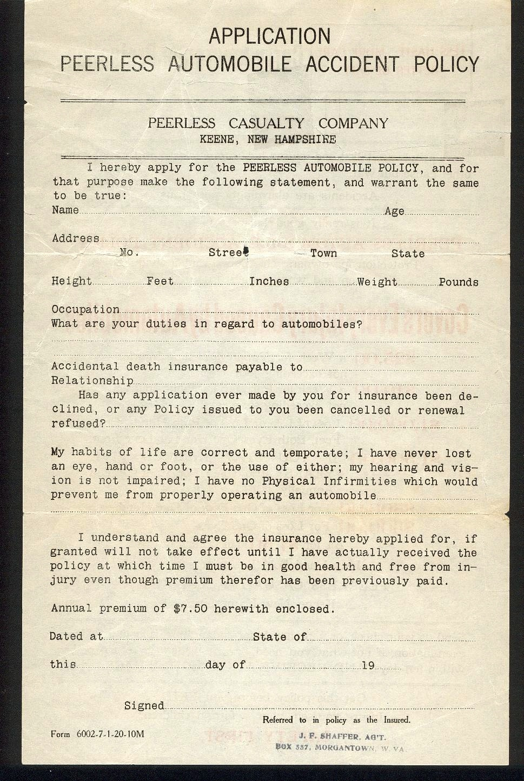

Slide 22
Don’t say things like “active termites and organisms” Say “active termites and active organisms”
Don’t say “Lessor” and “Lessee” Say “Landlord” and “Tenant”
Watch out when using “herein”
Write numbers as both words and numerals: ten (10)
Don’t use ambiguous words “biweekly” and “bimonthly”

Slide 23
When you write “including” consider adding “but not limited to”
Don’t rely on rules of grammar to resolve ambiguous writing; we all learned different rules

Slide 24
Don’t be creative
Be consistent
It’s ok to use the same word over and over for the same meaning
Dates (January 1, 2018 or 1/1/18 or 1/1/2018)
Numbers (ten or 10)

Slide 25
How do I define terms?
Define words when first used
Define a word with capitals and quotes:
Wherever used herein, the word “Project” means the construction of an office building on the Property as more particularly set forth in the Plans.

Slide 26
Consider strategy
before using these clauses
Choice of law
Venue selection
Attorneys fees to prevailing party
Arbitration and mediation

Slide 27
Consider a merger clause
“This settlement agreement is the final expression of the settlement between the parties and is the complete and exclusive statement of the settlement terms. There is no other agreement between the parties regarding this settlement.”

Slide 28
Consider a
time of essence clause
“Time is of the essence of the payment provisions of this settlement agreement. Plaintiff is relying upon the timely payment of the Settlement Amount in entering into this settlement, and Plaintiff would not have entered into this settlement agreement otherwise.”

Slide 29
Write as if the reader were
a knowledgeable layman
Explain technical terms and concepts
Let your secretary, assistant, paralegal, partner, or someone else read it
But maintain the attorney-client privilege, work product doctrine, and ethics confidentiality
Let your client read it

Slide 30
Attorney David Boies said to Ken Auletta, author of World War 3.0: Microsoft and Its Enemies, in re his closing argument in the federal antitrust trial:
“Obviously, the judge looked at me as a partisan. But I wanted to perform, as much as possible, a law clerk's role."
(page 287)

Slide 31
Keep your client informed while you write
Settlement agreements should come with a cover letter
Tell your client the ideas that come as you write
Inform your client of the risks

Slide 32
What to check after
the first draft is written
Spelling
Defined terms
Cross references
Paragraph numbering
Page numbering
Use both computer and manual proofing

Slide 33
Save drafts as multiple files on your computer
Name drafts:
Settlement agreement d2 by Smith 2018.01.08
Compare the current draft to prior drafts using Compare Documents command in Word and name it:
Comparison settlement agreement d2 to d1 2018.01.08

Slide 34
How to print & sign
the settlement agreement
Print on pages using the same paper (watermarks)
If pages change, reprint the entire document
Initial every page
Sign in blue ink, not black
Sign enough that each party gets an original

Slide 35
To avoid personal liability, be sure entity signers include their titles, the entity name and the words “by” and “as its”:
ABC Corporation, a Florida corporation
By:________________________________
As its:____________________________

Slide 36
Add a notary clause that complies with the notary law where the settlement agreement is signed
STATE OF FLORIDA COUNTY OF PINELLAS The foregoing instrument was acknowledged before me this _____ day __________________, ______, by __________________, as _____ of ___________________________________, a Florida corporation.
Notary Public-State of Florida: sign_________________________________ print________________________________
Personally Known _____; OR Produced Identification ______
Type of Identification Produced: ____________________________
Affix Seal Below:

Slide 37
Simple Things
Make a Big Difference
Number every page
Number every paragraph
Proofread every document
Use your skills for your client’s good
Be respectful of opposing counsel

Slide 38
Download article:
Drafting the Contract or Settlement Agreement That Stays Out of Court, The Brief (ABA Tort Trial & Insurance Practice Section, Winter 2003)
Other articles:
http://www.jamesmartinpa.com/published-articles/
For more information:
www.jamesmartinpa.com

Slide 39
James W. Martin, Esq.
540 4th Street North
St. Petersburg, FL 33701
Tel (727) 821-0904
Fax (727) 823-3479
Email jim@jamesmartinpa.com
Web www.jamesmartinpa.com
Florida Bar Board Certified Real Estate Lawyer

