Slide 1
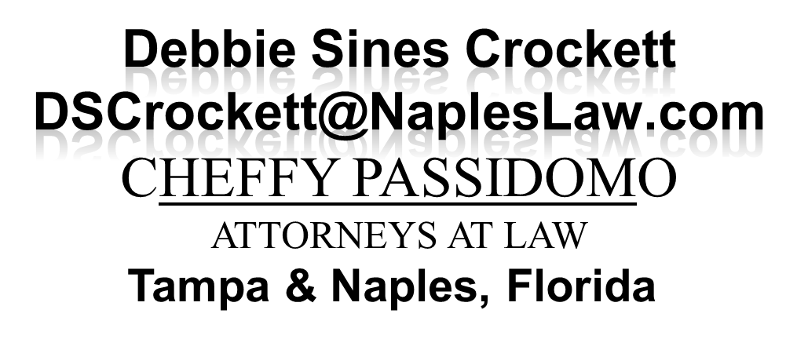
Examination of Sebo v. American Assur. Home Co., Inc., 208 So. 3d 694 (Fla. December 1, 2016): Is There Insurance Coverage for Construction Defects under a Homeowner’s Insurance Policy?
Fla Bar RPPTL Construction Law Committee
August 4, 2017
David A. Zulian, Esq.
Debbie Sines Crockett, Esq.

Slide 2
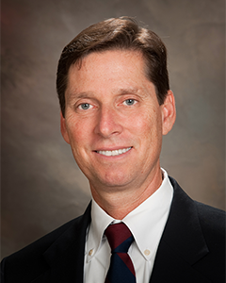
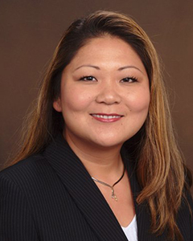
DAVID A. ZULIAN is a graduate of Emory university (B.A., 1983) and received his law degree from the University of Miami School of Law (J.D., 1987). He was formerly associated with and a partner in the law firm of Ruden, McClosky, Smith, Schuster & Russell, P.A. in 2001, David joined Cheffy Passidomo as a shareholder and principal. David is a certified by the Florida Bar as a specialist in construction law, and is an experienced trial lawyer who concentrates his practice in the areas of construction, real estate and commercial litigation. His client base is diverse and includes the representation of manufacturers, suppliers, distributors, subcontractors, general contractors, developers, design professionals, owners, lenders, mortgage brokers, real estate brokers, condominium associations, mobile home associations and homeowners associations. David an has extensive experience in dealing with cases involving insurance for construction defects in first party settings, construction defects, Florida’s construction lien law (chapter 713) and Florida’s public bond law (chapter 255). In 1995, he was the first attorney in the state of Florida to successfully try and appeal a case involving Florida’s Prompt Payment law in connection with a public project. In addition, David has lectured in the areas of construction, insurance coverage, and commercial law. In 1989, he became certified as a court arbitrator by the Florida dispute resolution center. Formerly, David was the president of the American Concrete Institute, Florida Gulf Chapter (ACI), and was the co- chairman of the Jim Dent Naples Golf Classic To Benefit Cystic Fibrosis Foundation. David was also formerly the chairman of the Major Emphasis Committee Of The Wilton Manors Kiwanis Club, and was a member of the Board of Adjustments of the City of Wilton Manors.

Slide 3

DEBBIE SINES CROCKETT is a trial lawyer with Cheffy Passidomo, P.A. located in Tampa, Florida, where she concentrates in the areas of insurance coverage, construction litigation, and commercial disputes. Debbie is experienced in representing policyholders of all types of insurance policies in litigation against carriers from the trial level through appeal, in both state and federal courts. She has an emphasis in complex insurance recovery issues such as additional insured status and contractual indemnity, and her practice includes all aspects and types of insurance recovery, including insurance denials, claim representation, risk transfer mechanisms, and both first and third party bad faith/extra-contractual claims. just prior to joining Cheffy Passidomo, P.A., Debbie was an equity partner in the law firm of Boyle, Gentile, Leonard And Crockett, P.A. in Fort Myers, Florida. Debbie is licensed in Florida and Maryland. Among her many bar activities, notably, she is a current co-chair of the National Asian American Bar Association (NAPABA) Insurance Law Committee and an active member of the Florida Bar Real Estate Property, Probate, And Trust Law Section including committees on Insurance & Surety Law and Construction Law, Hillsborough County Bar Association Construction Law Section, NAPABA Solo Small Firm Network, ABA Tort Trial & Insurance Practice Section, ABA Forum On Construction Law. Debbie has been appointed to serve on the Florida Bar Standing Committee on the Florida Civil Procedure Rules. Over the years, Debbie has presented on numerous CLEs on insurance law topics, to both local and national audiences, and has written several articles on insurance law related topics.

Slide 4
Quick Facts
April 2005 Sebo purchased home (4 years old)
Rainstorms in May 2005
Leaks throughout the home
“It became clear that the house suffered from major design and construction defect”
August 2005 rain – “paint along with windows just fell off the wall”
October 2005 – Hurricane Wilma and “further damaged the Sebo residence”
“Residence could not be repaired and was eventually demolished.”

Slide 5
Trial Court
February 2011
Grants SJ to Sebo against his HO carrier
Applying Concurrent Cause Doctrine
April-Mar 2011
Jury Trial b/w Sebo & his HO carrier

Slide 6
2nd DCA Appeal
Am. Home Assur. Co., Inc. v. Sebo,
141 So. 3d 195 (Fla. 2d DCA 2013)
2nd DCA Reverses Trial Court
Follows CA Case Law
Based Upon CA Insurance Code §
Adopts The
Efficient Proximate Cause Rule

Slide 7
Efficient Proximate Causation (EPC)
2 or More Identifiable Causes
At Least 1 Is Covered
& At Least 1 Is Excluded
Dependent on Each Other
Contribute to a Single Loss

Slide 8
EPC
“Causes are dependent on each other when one peril instigates or sets in motion the other, such as an earthquake which breaks a gas line that starts a fire.”
Empire Indem. Ins. v. Winsett, 2008 U.S. Dist. Lexis 27695 (N.D. Fla. Apr. 3, 2008)
Paulucci v. Liberty Mutual, 190 F. Supp. 2d 1312 (M.D. Fla. 2002)
Hartford Accident & Indem. Co. v. Phelps, 294 So. 2d 362, 364 (Fla. 1st DCA 1974)
If the cause that sets the chain of events in motion, the efficient proximate cause, is covered under the terms of the policy, the loss will likewise be covered.
7 Couch On Insurance § 101:45 (Steven Plitt, Et. Al., Eds., 2008).
The EPC is “The One That Sets Others In Motion … if the EPC is covered, then the Claim for damages will be covered even if the other causes are not covered.”
Hartford Accident & Indem. Co. v. Phelps, 294 So. 2d 362, 364 (Fla. 1st DCA 1974)

Slide 9
Dependent Causes
Earthquake
causes
Broken
Gas Line
causes
Fire
causes
=
DAMAGE

Slide 10
FL SC Appeal
Sebo v. Am. Home Assur. Co., Inc.,
208 So. 3d 694 (Fla. December 1, 2016)
Quashes 2nd DCA Opinion
Follows Wallach v. Rosenberg, 527 So. 2d 1386 (Fla. 3d DCA 1988)
Applies the
Concurrent Causation Doctrine
Current Case Status:
2/6/17: Mandate issued - remanded to the 2nd DCA
7/19/17: 2nd DCA remanded to the Trial Court

Slide 11
Concurrent Cause Doctrine (CCD)
2 or More Identifiable Causes
At Least 1 Is Covered
& At Least 1 Is Excluded
Independent of Each Other
Contribute to a Single Loss

Slide 12
Hurricane Sandy, Rita & Katrina
DAMAGE
Flood
(Flood Policy)
Wind
(HO Policy)

Slide 13
State Farm v. Rigsby, 137 S. Ct. 436 (Dec. 6, 2016)
Hurricane Katrina
Claims handlers filed suit against State Farm under False Claims Act.
$3.6M Jury verdict against State Farm, included treble damages award, plus fees.
Clams handlers allegedly instructed by State Farm to misclassify wind damage as flood damage in order to shift State Farm’s liability onto the federal government – flood policies.
SCOTUS ruled district court did not abuse its discretion in not dismissing the action even though claimants violated the FCA by revealing the complaint against state farm to media while still under seal.

Slide 14
CCD in Florida
“Causes are independent when they are unrelated such as an earthquake and a lighting strike or a windstorm and wood rot.”
Where a policy expressly insures against direct loss and damage by one element, but excludes loss or damages caused by another element, coverage extends to the entire loss even though the excluded element is a contributory cause.
Paulucci v. Liberty, 190 F. Supp. 2d 1312 (M.D. Fla. 2002)

Slide 15
CCD in Florida
FL’s recognition of the CCD in all-risk first party policies was uninterrupted from the time of Wallach v. Rosenberg, 527 So. 2d 1386 (Fla. 3d DCA 1988) decision in 1988, until American Home Assur. Co., Inc. v. Sebo, 141 So. 3d 195 (Fla. 2d DCA 2014)
See Empire Indem. Ins. Co. v. Winsett, 325 Fed. Appx. 849 (11th Cir. 2009); Swire Pac v. Zurich Ins. Co., 845 So. 2d 161 (Fla. 2003); Fayad v. Clarendon Nat’l Ins. Co., 899 So. 2d 1082 (Fla. 2005); Sun Ins. Office, Ltd. v. Clay, 133 So. 2d 735 (Fla. 1961); Hudson v. Prudential Prop. & Cas. Ins. Co., 450 So. 2d 565 (Fla. 2d DCA 1984); General Am. Trans. Corp. v. Sun Ins. Office, Ltd., 239 F. Supp. 844 (E.D. Tenn. 1965); Essex House v. St. Paul Fire & Marine Ins. Co., 404 F. Supp. 978 (S.D. Ohio 1975); N-ren Corp. v. Am. Home Assur. Co., 619 F. 2d 784 (11th Cir. 1980); Avis v. Hartford Fire Ins. Co., 195 S.E. 2d 545 (Tenn. 1973); Kramer Bros., Inc. v. U.S. Fire Ins. Co., 278 N.W. 2d 857 (Wis. 1979).

Slide 16
Independent Causes
DAMAGE
Construction Defects
cause
Hurricane, Wind & Rain
cause

Slide 17
RFP

Slide 18
All Risk Insurance Policies The purpose of all-risk policies … is to cover, unless specifically excluded by the policy's terms, losses from “fortuitous events” that are dependent upon chance. 10 Couch on Insurance 3d, §148:50

Slide 19
Interpretation of All Risk Policies
State Farm v. Pridgen, 498 So. 2d 1245 (Fla. 1986); Demshar v. Aaacon, 337 So. 2d 963 (Fla. 1976); Fayad v. Clarendon, 899 So. 2d 1082 (Fla. 2005); Sun v. Clay, 133 So. 2d 735 (Fla. 1961); Phoenix v. Branch, 234 So. 2d 396,398 (Fla. 4th DCA 1970); Wallach v. Rosenberg, 527 So. 2d 1386; Hudson v. Prudential, 450 So. 2d 565 (Fla. 2d DCA 1984); Stonewall v. Emerald, 388 So. 2d 1089 (Fla. 3d DCA 1980).
Broad coverage grant provides “a special type of coverage extending to risks not usually covered under other insurance”
Coverage is available for all fortuitous loss or damage not resulting from the insured’s willful misconduct or fraud, unless the policy contains “a specific provision expressly excluding the loss from coverage.”

Slide 20
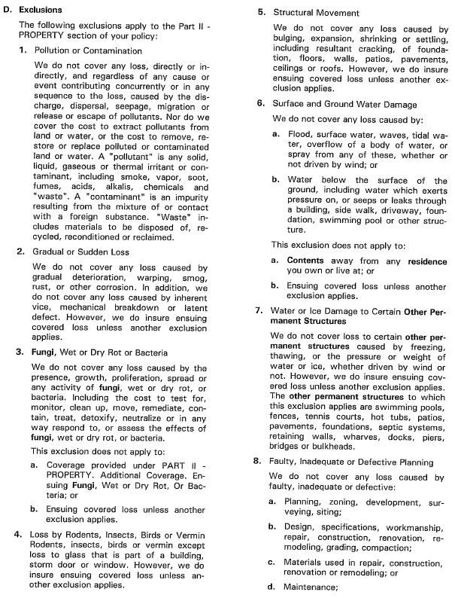
8. FIDP Exclusion
8. Faulty, Inadequate or Defective Planning
“We do not cover any loss caused by faulty, inadequate or defective … design, specifications, workmanship, repair, construction, renovation, remodeling…”

Slide 21
“Caused By” ≠ “Arising Out Of”
“Arising Out Of”
Is broader in meaning than “caused by” or “resulted from”
Means “originating from”, “having its origin in”, “growing out of”, “flowing from”, “incident to” or “having a connection with”
Means causally connected with, not proximately caused by
Taurus Holdings, Inc. v. United States Fid. & Guar. Co., 913 So. 2d 528, 532-533 (Fla. 2005)

Slide 22
“Caused By”
A single cause
“Caused By” in a policy, limits the applicability of a policy provision to conditions solely occasioned by the event referenced.
See Garcia v. Fed. Ins. Co., 969 So. 2d 288 (Fla. 2007).
Thus, FIDP Exclusion, by its own terms, only applies to the construction defects themselves but not resulting water damage.
See Buscher v. Economy Premier Ins. Co., 2006 WL 268781 (D. Minn. Feb. 1, 2006); McGrath v. American Family Mut. Ins. Co., 2008 WL 4531373 (N.D. Ill. April 29, 2008)

Slide 23
Wallach v. Rosenberg, 527 So. 2d 1386 (Fla. 3d 1988)
Where concurrent causes join to produce a loss and one of the causes of risk is excluded under the policy, coverage was available even if “the insured risk [is] not … the prime or efficient cause of the accident.”
“Where weather perils combine with human negligence to cause a loss, it seems logical and reasonable to find the loss covered by an all-risk policy even if one of the causes is excluded from coverage,” (citing Safeco v. Guyton, 692 F.2d 551 (9th Cir. 1982)(coverage was available where a covered risk, negligent maintenance of flood control structures, combined with an excluded risk, a flood, to cause a loss); Mattis v. State Farm, 454 N.E.2d 1156, 1160 (Ill. App. Ct. 1983)(“where a policy expressly insures against loss caused by one risk but excludes loss covered by another risk, coverage is extended to a loss caused by the insured risk even though the excluded risk is a contributory cause.”))

Slide 24
Independent Causes
DAMAGE
EXCLUDED
Construction Defect
causes
COVERED Hurricane, Wind & Rain
causes

Slide 25
Sebo v. Am. Home Assur. Co., Inc., 208 So. 3d 694 (Fla . 2016)
CCD not EPC applied when determining causation of insured’s loss regarding home, which sustained damage allegedly due to wind, rain and defective construction, and thus loss would be covered under all-risk homeowners insurance policy, even though policy contained defective-work exclusion, where there was no reasonable way to distinguish proximate cause of insured’s property loss and insurer did not explicitly avoid applying the CCD in language of the policy.
When two or more perils converge to cause a loss and at least one of the perils is excluded from an insurance policy, when independent perils converge and no single cause can be considered the sole or proximate cause, it is appropriate to apply the CCD, rather than the EPC.

Slide 26
Anti-Concurrent Causation (ACC) Provisions

Slide 27
S A M P L E
SECTION I – EXCLUSIONS
We do not insure for loss caused directly or indirectly by any of the following. Such loss is excluded regardless of any other cause, event, material or product contributed concurrently or in any sequence to such injury, damage or loss.

Slide 28
RFP

Slide 30
HO 00 03
Very Common
HO Form

Slide 31
Section I – EXCLUSIONS
1. We do not insure for loss caused directly or indirectly by any of the following. Such loss is excluded regardless of any other cause or event contributing concurrently or in any sequence to the loss.
a.
b.
c.
…
h.

Slide 32
Section I – EXCLUSIONS
2. We do not insure for loss to property described in Coverages A and B caused by any of the following. However, any ensuing loss to property described in Coverages A and B not excluded or excepted in this policy is covered.
a. Weather Conditions
b. Acts of Decisions
c. Faulty, inadequate or
Defective …

Slide 33

Do I have construction defects plus another cause that combined to cause the loss/property damage? Were they independent causes or dependent causes that combined to cause the loss/property damage? RFP! Review the HO or Commercial Property Policy. Is the other cause a covered cause/peril? Are there applicable ACC provisions?

Slide 34
David A. Zulian, Esq.
DAZulian@NaplesLaw.com
Debbie Sines Crockett, Esq.
DSCrockett@NaplesLaw.com
813-225-2684

