Slide 1

ROADWAY CONSTRUCTION CLAIMS The Complex and Potentially Costly Intersection of Construction and Auto Liability.
Presented by: Randy R. Dow, Boyd & Jenerette, P.A. Partner & Practice Group Leader

Slide 2
What are we going to discuss today?
Introduction to Roadway Construction Claims
Damages and Exposure
MOT and MOT Related Claims
Roadway Hazards and Related Claims
Human Factors
Additional Liability Considerations
Defenses
Evidence Collection and Preservation

Slide 3
What are roadway construction cases?
Liability claims
Involving automobiles and/or pedestrians
In a construction work zone
What is a construction work zone?
What are project limits?

Slide 4
What are roadway construction cases?
Examples:
Pedestrian walking in roadway construction zone and falls in vicinity of sidewalk/crosswalk work
Vehicle traveling in roadway construction zone strikes/is struck by another vehicle
Vehicle traveling in roadway construction zone strikes/is struck by equipment
Vehicle traveling in roadway construction zone has single vehicle accident
Rolling Roadblocks/Back Ups

Slide 5
Potential Parties
Drivers
Phantom Drivers
Contractor
Subcontractors
Striper
Concrete Sub
Asphalt Sub
MOT Installer/Maintainer
FDOT
Roadway Design Engineer & their Consultants
Roadway Construction Engineer
MOT Designer and/or Materials Supplier(s)
Construction Engineer & Inspector (“CEI”)

Slide 6
Types of Claims
MOT Design and Maintenance
Roadway Defects and Hazards
Human Factors
Additional Considerations

Slide 7

Damages - Special Considerations
Damages often aggravated or inflated
Large machinery = significant injuries
Multiple parties
Corporate Defendants
Public Dislike of Roadway Construction
Reptile Theory = “that could have been me”
Recipe for very large verdicts

Slide 8
Potential Damages, cont.
Jenkins v. Ranger, Palm Beach County and Riviera Beach, 2001 WL 1839497 (July 7, 2001 Fla. Cir. Ct.)
$256 million verdict, Palm Beach County, 2001
Off Duty Riviera Police broadsides Jenkins family car at intersection under construction.
Allegations that MOT plan was defective and out of place barricades caused line of sight of obstruction such that oncoming traffic could not see plaintiff’s car turning left.
Settled with Ranger and County for $57 million pre-trial.
Liability: Jury found off duty officer 7% at fault - $256 million verdict.
Injuries: 6 year old killed, 3 year old rendered quadriplegic, another 3 year old with brain injury.

Slide 9
Potential Damages, cont.
McKinnley v. Bob’s Barricades and FDOT, 2005 WL 4169194 (July 5, 2005 Fla. Cir. Ct.)
$164 million verdict, Miami-Dade County, 2005
16 year old struck on bridge under construction while walking bike.
Allegations MOT failed to provide pedestrian access, missing signs/barricades led to injuries.
Injuries: Permanent brain damage.
Liability: Bob’s found 30% liable, Driver that struck Plaintiff found 25% liable, FDOT found 20% liable and Contractor found 25 % liable

Slide 10
Potential Damages, cont.
Brashear v. Zep Construction, Traffic Control, 2010 WL 1452739 (Feb. 26, 2010 Fla. Cir. Ct.)
$4.5 million verdict, Sarasota County, 2010
Allegations of rolling roadblock without sufficient signage and warnings in order to save money.
Tractor trailer slammed into line of stopped traffic.
Liability: GC found to 65% liable, MOT Installer 30% liable, and Driver that slammed into line of cars found only 5% liable

Slide 11
MOT, What is it?
Literally the Maintenance Of Traffic:
Vehicular
Pedestrian

Slide 12
MOT, What is “Duration”?
Two types:
Permanent
Temporary

Slide 13
MOT Design and Maintenance
Permanent
Raised Pavement Parkers (“RPMs”)
Skip Striping
Signs
Lights
Medians

Slide 14
MOT Design and Maintenance
Temporary
Duration could be years – ask Atlanta
Used during construction (active construction and “inactive” construction)
Examples:
RPMs
Temporary Skip Striping
Signs
Lights
Variable Message Boards (“VMBs”)
Cones
Drums
Flagger controls

Slide 15
Design Standards - MUTCD
Manual on Uniform Traffic Control Devices (“MUTCD”)
862 page Federal Manual - Adopted by Rule 14-15.010, Florida Administrative Code
Focuses on Traffic Control Devices (“TCDs”)
Purpose
Principles
Design
Placement
Maintenance
Responsibility for
Temporary TCD
Pedestrian/Worker Safety
TCDs include:
Signs, Barricades, Markers, Variable Message Boards (VMBs), Markings, Signals
Chapter 6: 150 pages specifically addressing temporary traffic control and work zones

Slide 16
Design Standards – The Green Book
Manual of Uniform Minimum Standards for Design, Construction and Maintenance for Streets and Highways (the “Florida Green Book”)
Developed by FDOT
Adopted by Rule 14-15.002, Florida Administrative Code
§20.23, Florida Statutes
§334.044(10)(a), Florida Statutes
§334.048(3), Florida Statutes
§336.045, Florida Statutes
Provides minimum standards and criteria for design, construction and maintenance of public roads
Relates more to original roadway design
Does have chapters discussing general principles for resurfacing, work zone safety and roadway construction
More big picture concepts of goals/guidelines

Slide 17
Design Standards – The Green Book
Focuses on:
Geometric Design
Roadside Design
Pavement Design/Construction
Roadway Lighting
Maintenance
Work Zone Safety
Bridges and Other Structures
Line of Sight
Chapter 3

Slide 18
Design Standards – The Green Book
Penske v. Moore, 702 So. 2d 1295 (Fla. 4th DCA 1997)
Courts have held the Florida Green Book is a part of the building code and courts can take judicial notice of it.
Gibbs v. Hernandez, 810 So.2d 1034 (Fla. 4th DCA 2002)
Motorcyclist injured attempting to make left had turn in construction zone.
Allegations that the line of sight was obstructed by construction materials (concrete pipes).
Expert for Plaintiff testified placement of the pipes violated line of sight requirements in the Florida Green Book.
Trial court entered summary judgment in favor of the General Contractor and it was reversed on appeal.

Slide 19
Design Standards – Standard Specs
FDOT Standards Specifications for Road & Bridge Construction (“Standard Specs”)
Provides standard specifications that are used on all FDOT roadway construction projects.
That way each FDOT project uses the same specs.
Often incorporated into contracts for non-FDOT projects.
Adopted by many counties in Florida.

Slide 20
Design Standards – Standard Specs
Covers everything from material quantities to MOT
Defines scopes of work
Signage
Pavement Markings
Lighting
TCDs
Construction – Asphalt, bridges, concrete, etc.

Slide 21
Design Standards – Index 600
FDOT Index 600, et seq.
Provides standard plans for various MOT installations
Also known as a Traffic Control Plan (“TCP”)
Lays out exactly how the other standards are to be implemented
Where each sign/cone/barricade/marking is to be located for various circumstances
Single lane closure
Double lane closure
Intersection work
Two-lane road work
Shoulder work
FDOT utilizes on all of their projects
Is also incorporated by Designers in non-FDOT projects

Slide 22
Liability – MOT Design
Design does not meet standards
Incomplete design
Examples:
Insufficient MOT
Improper placement of MOT
Line of Sight Issues
Jenkins v. Ranger, 2001 WL 1839497 (July 7, 2001 Fla. Cir. Ct.)
Previously discussed above
Plaintiff argued that could not see car making left turn due to MOT line of site obstructions
Chris Searcy called it at trial, a construction “Death Trap”

Slide 23
Liability – MOT Installation/Pick Up
Contractors can incorporate the MOT design in the plans (Index 600, et seq.) as their own, or submit their own for approval.
Once Contractor incorporates MOT design, they own it.
Must be installed exactly per plans
Lesson learned: Take pictures as installed

Slide 24
Liability – MOT Installation/Pick Up, cont.
Examples:
Insufficient MOT
Cones/drums/signs/tapers not installed per plans/specs
Improperly installed
Not enough devices used
Improper placement of MOT
Cones/drums/signs/tapers not installed per plans/specs
Not placed with correct spacing
Not placed in correct locations
Conflicting MOT/Signage
Line of Sight Obstructions

Slide 25
Liability – MOT Installation/Pick Up, cont.
Confusing/Conflicting Standards
Improper Preparation
Failure to fully remove old/conflicting stipes and pavement markings
Lighting
Inadequate
Blinding
Moth to Flame theory
Failure to pick up on time

Slide 26
Liability – MOT Installation/Pick Up, cont.
Jones v. Triple R Paving, 1991 WL 712567 (June 5, 1991 Fla. Cir. Ct.)
$150,000.00 verdict, Broward County, 1991
Contractor found liable for damages caused by leaving MOT in place 3 hours after determined could not work due to rain
Determined unnecessary lane closure contributed to the accident

Slide 27
Liability – MOT Maintenance
Maintenance
Failure to maintain MOT per plans/specs/standards
Cones/drums/signs/tapers not kept installed per plans/specs due to:
Traffic
Workers
Pedestrians
Who is responsible?
Maintenance contractors
Workers who moved MOT
Lights out on signs/drums/cones
Improper VMB messages

Slide 28
Liability – MOT Inspection
CEI Services
Definition of Role
Direct contract with FDOT
Contractor reports to CEI
Designer reports to CEI
Acts as conduit
Sub-Consultant CEIs
Obligations per
Standards
Contract
Project Plans/Specs

Slide 29
Liability – MOT Inspection, cont.
Scope of Work
Contract Administration
Inspection
Materials Sampling and Testing
Inspection of MOT Installation and Maintenance
Worksite Traffic Safety Supervisor (”WTS”)
Reporting
By who?
To whom?
How often?
What format?

Slide 30
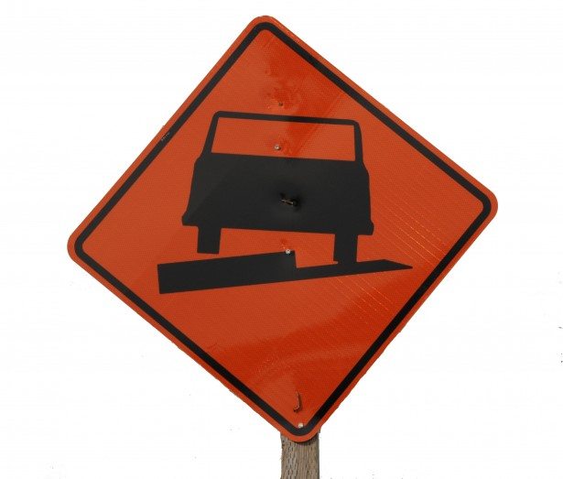

Roadway Defects and Hazards
Unavoidable vs. Unacceptable
Unavoidable require sufficient notice and warnings
Difference between the two is often a mater of degree

Slide 31
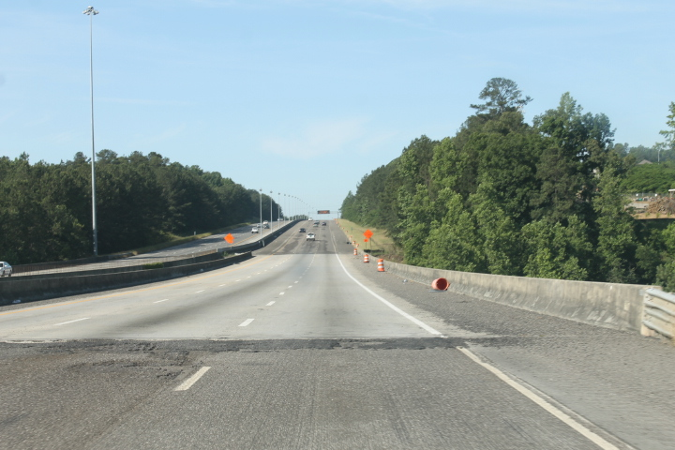
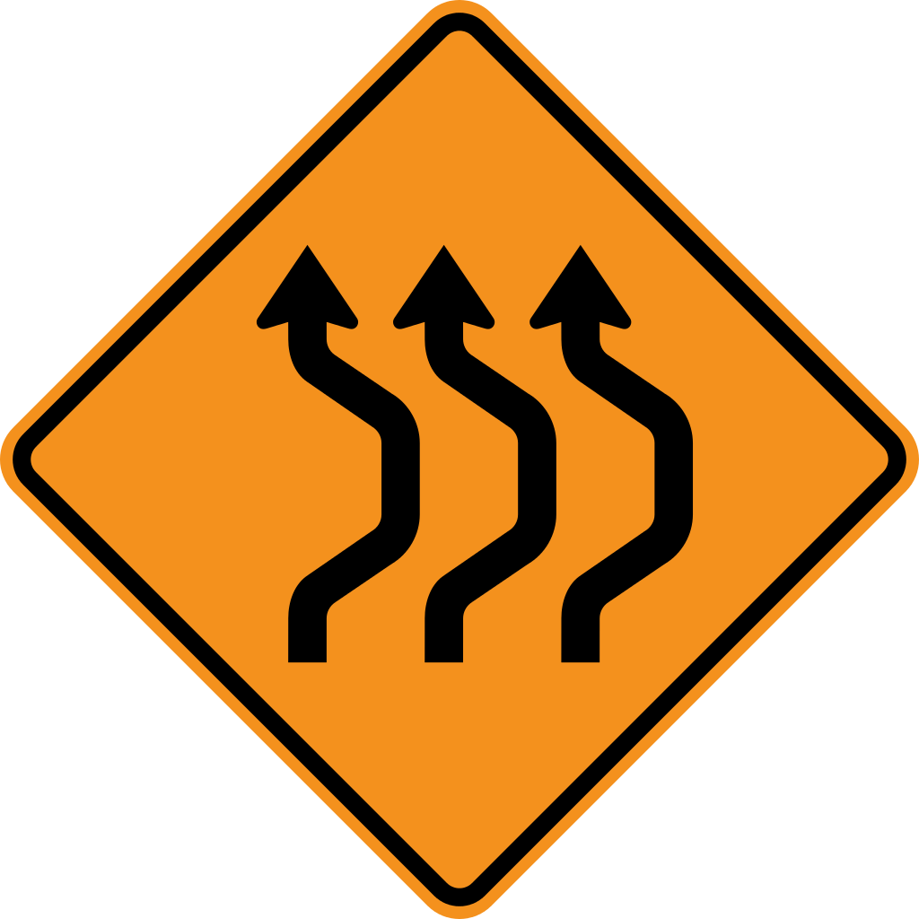
Roadway Defects and Hazards - Unavoidable
Double Reverse Curves and other lane shifts
Minimal drop-offs and height differentials
Rough Surfaces
Grooved Pavement
Exposed Manhole Covers

Slide 32
Roadway Defects and Hazards - Unacceptable
Debris in the roadway
Depressions allowing for the pooling of water
Excessive drop-offs and height differentials
Excessive divots or ridges caused by removal or stripes
Excessive gravel and oil
Excessively high manhole covers
Index 600 requires temporary pavement “apron” for heights over 1” above roadway

Slide 33
Roadway Defects and Hazards, cont.
Did an unacceptable hazard cause or contribute to the accident?
Did a permissible hazard without sufficient notice/warning cause or contribute to the accident?
Does the hazard or failure to warn trace back to one or more of the following:
Design
Installation
Maintenance
Inspection
How can I collect evidence of these hazards before they are gone?

Slide 34
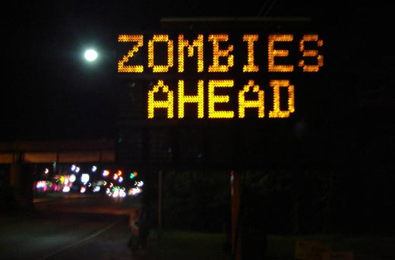
Human Factors
Night time work
Reaction time and response to MOT
Training and lack of due care

Slide 35
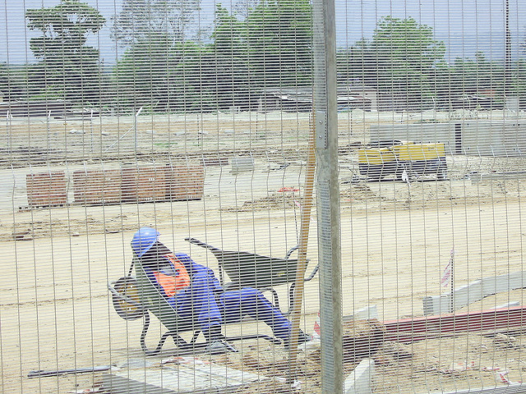


Human Factors - Night Work
Sleepy Drivers
Even sleepier workers
Long and irregular shits
Overtime
School
Day jobs
Family responsibilities

Slide 36
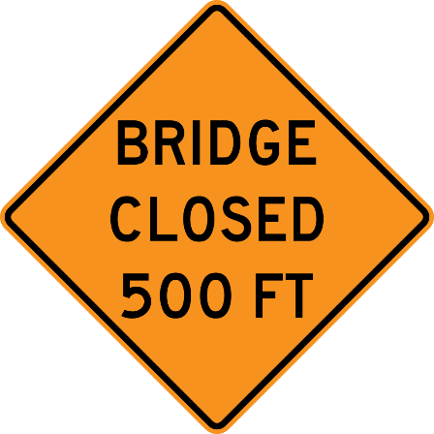

Human Factors – Human Error
Construction and construction MOT require drivers to analyze and react to “new” and possibly “unexpected” conditions
MOT is should provide advanced notice and time to respond
Deficient or obstructed MOT steals that time from drivers
Chain reaction accidents – trace back to simple negligence by one driver OR… did bad MOT start the chain of events?
Moth to the Flame
Alcohol

Slide 37
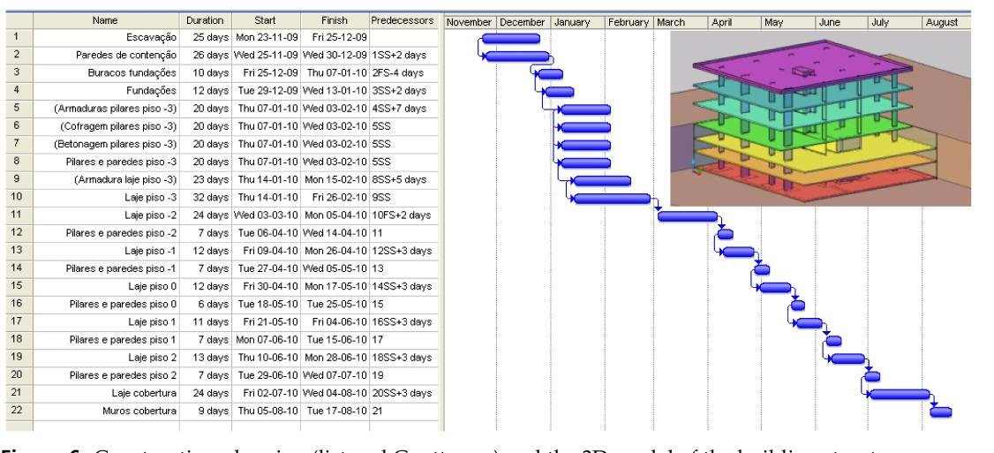
Additional Considerations – Economics
Construction Contract
Schedule requirements
Liquidated Damages for delay(the stick)
Bonuses for early completion (the carrot)
MOT costs money and takes time
Just because the MOT is on the plans and discussed at site does not mean it was actually used
Attorneys must get the documents, ask the questions and KNOW HOW TO READ AND UNDERSTAND A CONSTRUCTION SCHEDLE!!!

Slide 38
Additional Considerations - Accident Clusters, cont.
Delp v. TBE Group, 2001 WL 379477 (Fla Cir. Ct. Feb. 12, 2001)
Reported settlement of $1 million
Pooling water on construction site
A week after the first accident, an ambulance crashed in the same place due to same pooling water
Ambulance settlement was unreported
Multiple accidents = Something is not right

Slide 39
Defenses – Sovereign Immunity
§768.28(9), Florida Statutes
No agent of state or its subdivisions can be held personally liable or named as Defendant
FDOT
Waived Sovereign Immunity per Section 13, Article X of the Florida Constitution
Pursuant to waiver, damages against FDOT limited
§768.28(5), Florida Statutes
No punitive damages
No pre-judgment interest
$200,000.00

Slide 40
Defenses – Sovereign Immunity, cont.
Condition Precedent
§768.28(6)(a), Florida Statutes
Claimant must present claim in writing to the agency and the Department of Financial Services
Claim must be submitted within 3 years of accrual
Wrongful death claims must be submitted within 2 years of accrual
Commercial Carrier Corp. v. Indian River County, 371 So. 2d 1010, 1022-23 (Fla. 1979)
Held strict compliance with pre-suit notice requirements of §768.28(6) must be alleged in the complaint, in accordance with 1.120(c), Florida Rules of Civil Procedure.

Slide 41
Defenses – Sovereign Immunity, cont.
CEI
§768.28(9), Florida Statutes:
No officer, employee or agent of the state or of any of its subdivisions shall be held personally liable in tort or named as a party defendant in any action for any injury or damage suffered as a result of any act, event or omission of action in the scope of his employment or function . . .The exclusive remedy for injury or damage suffered . . . shall be by action against the governmental entity . . .

Slide 42
Defenses – Sovereign Immunity, cont.
CEI
§768.28(10)(e), Florida Statutes:
For purposes of this section, a professional firm that provides monitoring and inspection services of the work required for state roadway, bridge, or other transportation facility construction projects, or any of the firm’s employees performing such services, shall be considered agents of the Department of Transportation while acting within the scope of the firm’s contract with the Department of Transportation to ensure that the project is constructed in conformity with the project’s plans, specifications, and contract provisions. Any contract between the professional firm and the state, to the extent permitted by law, shall provide for the indemnification of the department for any liability, including reasonable attorney’s fees, incurred up to the limits set out in this chapter to the extent caused by the negligence of the firm or its employees . . . This paragraph is not applicable to a firm engaged by the Department of Transportation for the design or construction of a state roadway, bridge, or other transportation facility construction project or to its employees, agents, or subcontractors.

Slide 43
Defenses – Sovereign Immunity, cont.
Senate Staff Analysis and Economic Impact Statement, S. CS/SB 1138, 2003 Sess. at 6, 8, 9, (2003)
Intent of §10(e) was to codify common law principal that CEIs were agents of the FDOT.
Legislative analysis revealed FDOT’s standard practice with CEIs is to retain right to review CEI’s work, define CEI’s personnel at will, and require CEIs to follow FDOT standards/procedures.

Slide 44
Defenses – Lack of Duty
Florida Power & Light Co. v. Periera, 705 So. 2d 1359 (Fla. 1998)
Whether a defendant owes a duty to plaintiff is a question of law.
Moransais v. Heathman, 744 So. 2d 973 (Fla. 1999))
Florida law recognizes that negligence actions may be brought against professional engineers, but duty in many of these cases presupposes a contractual obligation or duty owed to the claimant.
Where no express or implied obligation to claimant exists, there is no duty owed.
Where a duty does exist, but is owed to another party, a third party cannot state a claim based on the underlying relationship unless the third party is an intended beneficiary of the relationship (similar to a contractual third party beneficiary analysis).

Slide 45
Defenses – Other Defenses
Seat Belt
Failure to Mitigate
Collateral Source
Slavin v. Kay, 108 So.2d 462 (Fla. 1959)
Open and obvious defects
No duty to warn
Fabre v. Martin, 623 So.2d 1182 (Fla. 1993)
Comparative Fault
768.81, Florida Statutes
Unforeseeable Damages
Performance According to Design

Slide 46

Evidence Collection/Preservation –
First Response
Document Conditions immediately
Photographs, including MOT
Video of driving through scene
If accident at night, photos should be taken at night
Diagram of scene reflecting all MOT to scale
Measurements - Distances, station numbers, pavement drop-offs
There could be 100 of these lighted barricades … but only half of them might be working properly!

Slide 47

Evidence Collection/Preservation –
Documents, documents and more documents!
Project Plans/Specifications
Project Photographs
Daily/Weekly Reports
FDOT
Contractors
Subcontractors
CEI
MOT Reports
Meeting Minutes
Project Correspondence

Slide 48
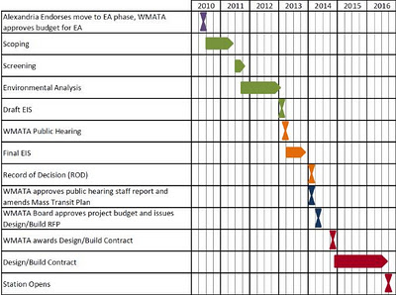
Evidence Collection/Preservation - Construction Timeline
Schedules
As Planned
As built
Contracts/Subcontracts
Liquidated Damages
Bonus for Early Completion
Indemnity
Additional Insured
Delay Notice – Change Orders

Slide 49
Evidence Collection – The Crash
Engineer’s MOT Evaluation at Crash Site
Witness names and contact info
Drivers
Workers
Eye Witnesses
First Responders
Surveillance Video
FHP Report
Electronic Control Module “Black Box”
Weather Conditions

Slide 50

(904) 353-6241
www.boydjen.com

